Slide 1
4
Economic Activity & Performance
Macroeconomics
Curtis, Irvine © 2013

Slide 2
This chapter explains:
1. Indicators of macroeconomic activity & performance
2. Recent Canadian economic performance
3. National Accounts & Economic Structure
4. Nominal GDP, Real GDP and the GDP deflator
5. Per capita real GDP, Productivity & Standards of Living

Slide 3
Macroeconomics studies
The national economy as a system in terms of:
  The economy’s total output of goods & services
  Expenditures on current output
  Employment & incomes
  Money & financial markets
  Prices and inflation
  Macroeconomic performance.
  Monetary and fiscal policies
Notes:
See the introduction to chapter 19 in the main text.

Slide 4
Macroeconomic Performance
Three main indicators of performance:
a) Output of goods and services
  Rate of growth of output
  b) The price level
  Rate of inflation
  c) Employment
  Unemployment rate
Notes:
See Section 19-1 in the main text.

Slide 5

  Rate of growth of real GDP
  In 2010, real GDP was $1,325billion
  In 2011, real GDP was $1,360 billion

Slide 6
Economic Performance
The Price Level
  Weighted average price of a basket of goods & services
  Consumer Price Index (CPI)
The Inflation Rate:
    Annual % change in the Price Level
Notes:
See Section 19-1 in the main text.

Slide 7
Economic Performance
Inflation in Canada
  In 2010, CPI at 117.5
  In 2011, CPI at 120.9

Slide 8
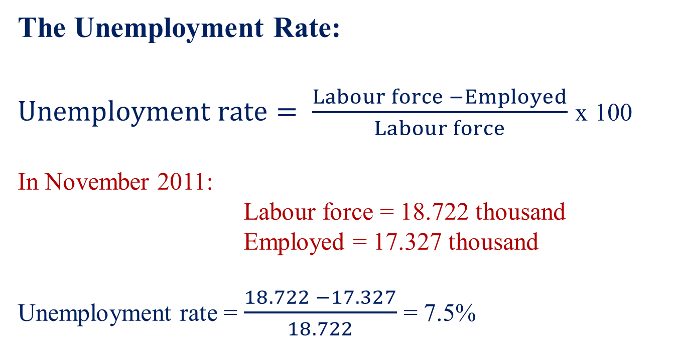
Economic Performance
The Unemployment Rate:
$Unemployment rate= \frac{Labour force −Employed}{Labour force}$ x 100
In November 2011:
Labour force = 18.722 thousand
Employed = 17.327 thousand
Unemployment rate = $\frac{18.722 −17.327}{18.722}$ = 7.5%

Slide 9
Macroeconomic Performance
Labour Force, Employment & Unemployment
  Canada, November 2011 (000 persons):
    1. Non-Institutional pop 15+ yrs. 28,111
    2. Labour force 18,772
    3. Employment 17,327
    4. Unemployment [(2 – 3)] 1,395
    5. Participation rate [(2)/(1)]x100 66.7%
    6. Employment rate [(3)/(1)]x100 61.6%
    7. Unemployment rate [(4)/(2)]x100 7.5%
Notes:
See Section 19-1 in the main text.

Slide 10
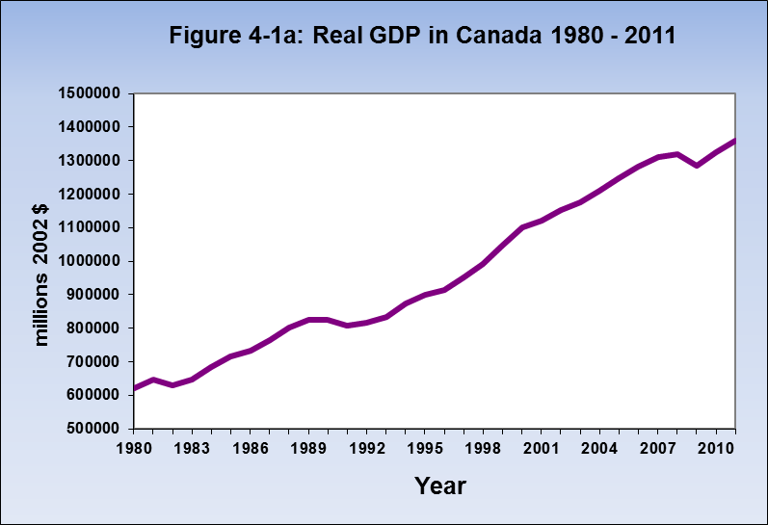
Canadian Economic Performance
Strong trend in real GDP growth
based on growth in labour force and
productivity but interrupted by recessions
Recessions

Slide 11
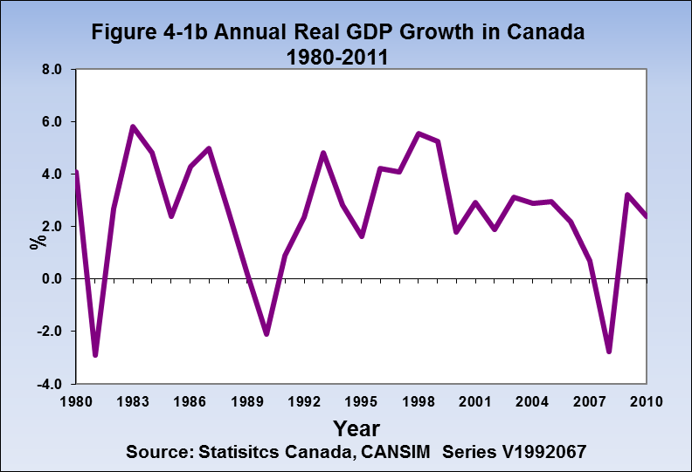
Canadian Economic Performance
Growth trend disguises important
business cycle fluctuations in
annual growth rates including the
negative growth in recessions
Recessions

Slide 12
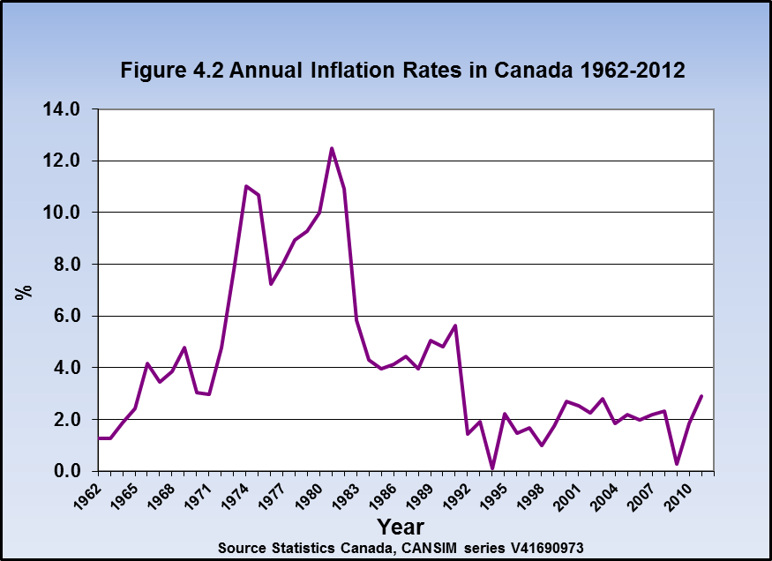
Canadian Economic Performance
Since 1991 the Bank of Canada
has conducted monetary policy
based on an inflation rate
target
Low, stable inflation rates
Volatile inflation rates

Slide 13
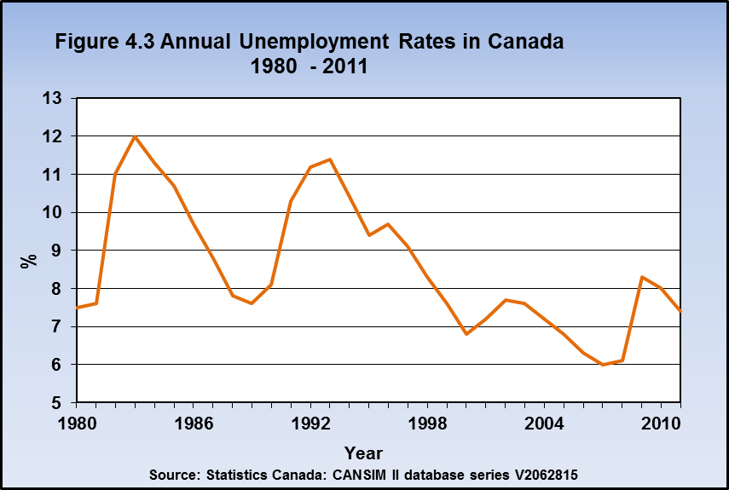
Canadian Economic Performance
Recessions
Unemployment rates vary inversely to GDP growth rates.
Recessions cause high unemployment.

Slide 14
National Accounts
National Accounts provide:
Definitions and concepts for measuring GDP
A framework for aggregate demand (AD) and supply (AS) models of the economy

Slide 15
National Accounts
The Circular Flow Diagram
Expenditure on goods & services
Money receipts $$
Money payments $$
Output of goods & services
Households
Businesses
Factor inputs
to business
Money incomes $$
Factor incomes paid households
Production costs $$

Slide 16
Measuring GDP
Three measures of nominal GDP
Output-based GDP ≡ sum of value added by all industries
Income-based GDP ≡ sum of payments to factors of production
Expenditure-based GDP ≡ sum of expenditures on final goods
and services

Slide 17
Output – Based GDP
Output based GDP = the sum of all net outputs by industries
as measured by value added
Value added ≡ market value of output minus cost of inputs
purchased from other businesses
Inputs purchased from other businesses are intermediate inputs
- Net outputs by industry describe the industrial structure of
the economy

Slide 18
Income-Based GDP
  Income based GDP = Domestic Income + CCA + T_{IN}
  Domestic Income: DI = W + BI
W = employment Income : the sum of all wages, salaries & benefits paid to labour
BI =business and investment income: the sum of corporate profit, other business income , and interest & investment,

Slide 19
Income-Based GDP
Income based GDP = DI + CCA + T_{IN}
DI = W + BI
CCA = Capital consumption allowance to cover the depreciation of capital stock
GDP at basic price = DI + CCA
T_{IN} = Net indirect Tax = sales + excise taxes – subsidies
GDP at market price = W + BI + CCA + T_{in}

Slide 20
Expenditure-Based GDP
Expenditure based GDP = C + I + G + X – IM
C = consumption expenditure by households
I = investment expenditure by business on buildings, machinery, & inventories,
G = government expenditure on currently produced final goods & services,
X = exports of goods and services
IM = imports of goods and services
GDP at market price = C + I + G + X – IM

Slide 21
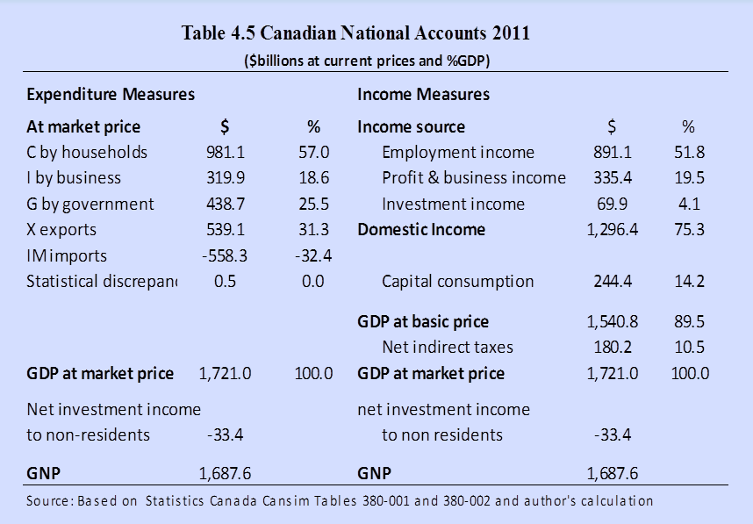
Canadian National Accounts
The National Accounts identity means GDP by the Income approach must equal GDP by the expenditure approach

Slide 22
Nominal GDP, Real GDP & the GDP Deflator
Nominal GDP ≡ output & incomes of a given year measured with current market prices of goods & services.
Real GDP, or GDP in constant dollars ≡ output & incomes of given year measured with base year prices of goods & services .
Changes in nominal GDP = Changes in prices & quantities
Real GDP = Nominal GDP is adjusted by GDP deflator.
Changes in real GDP = Changes in quantities
Notes:
See Section 19-4 of the main text.
Income from abroad tends to be relatively small for the UK, but may be substantial for countries such as Egypt or the Philippines where there are large flows of repatriated income from workers abroad.

Slide 23
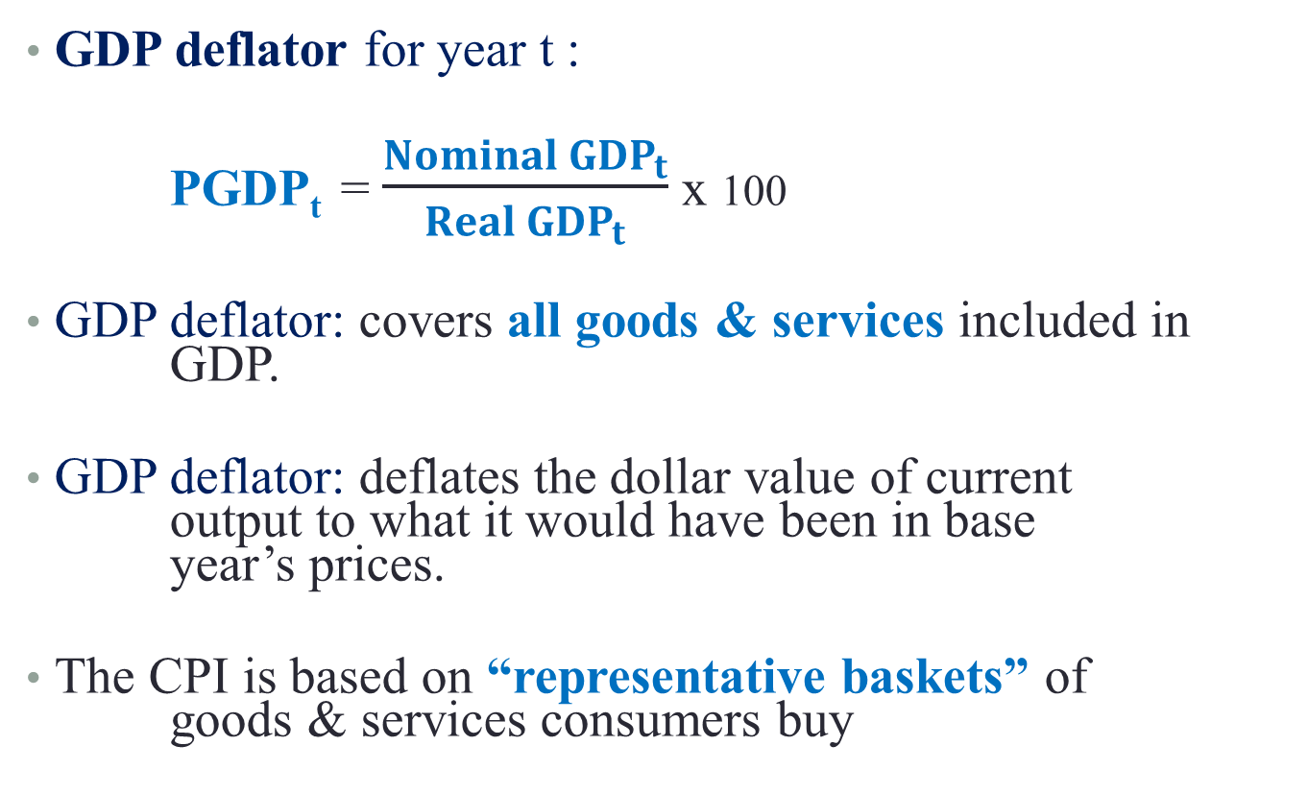
Nominal & Real GDP & the GDP Deflator
GDP deflator for year t :
PGDP_{t} = $\frac{{Nominal GDP}_{t}}{{Real GDP}_{t}}$ x 100
GDP deflator: covers all goods & services included in GDP.
GDP deflator: deflates the dollar value of current output to what it would have been in base year’s prices.
The CPI is based on “representative baskets” of goods & services consumers buy

Slide 24
Nominal & Real GDP & the GDP Deflator
∆ nominal GDP 2000 – 2011
= 115%
∆ real GDP 2000 – 2011
= 56.9%
∆ Prices 2000-2011
= 37.4%

Slide 25
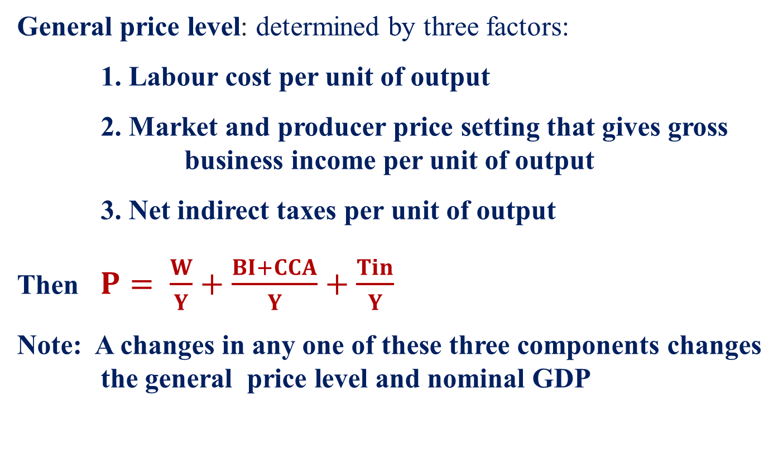
The General Price Level (P)
General price level: determined by three factors:
1. Labour cost per unit of output
2. Market and producer price setting that gives gross business income per unit of output
3. Net indirect taxes per unit of output
Then $P= \frac{W}{Y}+\frac{BI+CCA}{Y}+\frac{Tin}{Y}$
Note: A changes in any one of these three components changes the general price level and nominal GDP

Slide 26
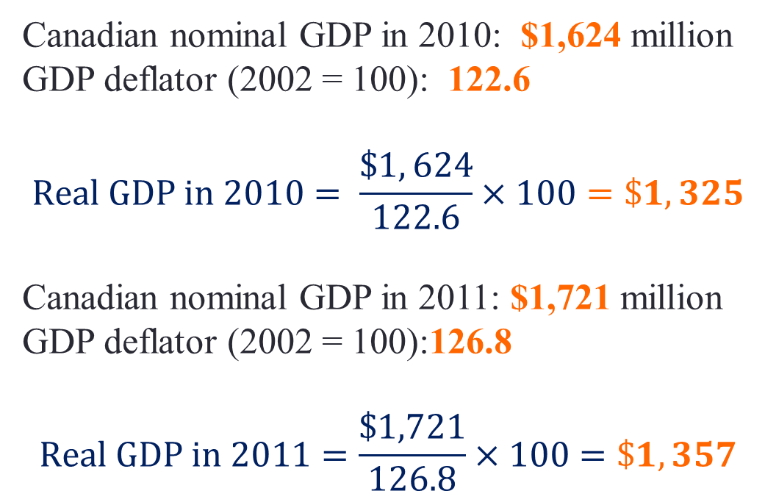
Using the GDP Deflator
From 2010 to 2011 Nominal GDP grew by about 6%
Over the same period the price level increased by 3.45%
Therefore real GDP grew by 2.4%
Canadian nominal GDP in 2010: $1,624 million
GDP deflator (2002 = 100): 122.6
$$Real GDP in 2010= \frac{\$1, 624}{122.6}×100=\$1,325$$
Canadian nominal GDP in 2011: $1,721 million
GDP deflator (2002 = 100):126.8
$$Real GDP in 2011=\frac{\$1,721}{126.8}×100=\$1,357$$

Slide 27
Per Capita GDP
Per Capita real GDP : an indicator of standard of living.

Slide 28
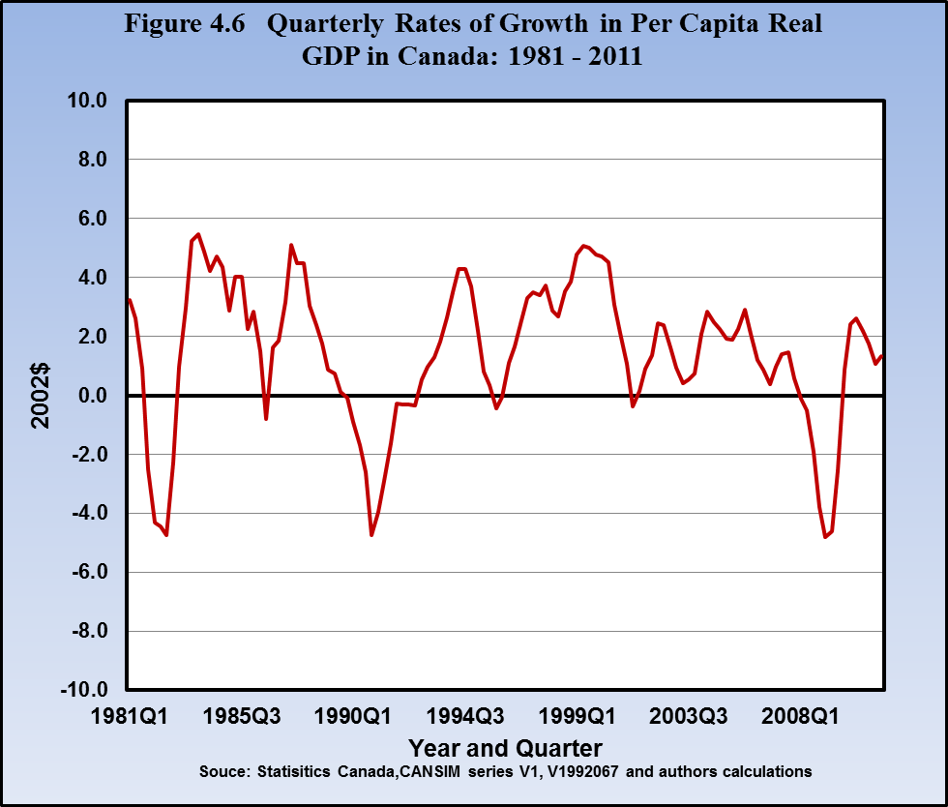
Quarterly Growth rates in Canadian Per Capita Real GDP
The reductions in
per capita real GDP
during recessions
motivate stabilization
policy

Slide 29
Limitations of GDP
Pollution & other externalities caused by production and consumption
Unreported income & output
Non-marketed goods & services
Composition of output affects standard of living
  (military production vs health care)
Income distribution

Slide 30
Top Ten Countries by UN HDI 2011
Human Development Index (HDI) provides a broader measure of a country’s wellbeing and standard of living than per capita GDP.

Slide 31
Chapter Summary
Macroeconomics studies the whole national economy as a system
Real GDP growth rates, inflation rates & unemployment rates are indicators of macroeconomic performance
Business cycles cause fluctuations in real GDP growth, in inflation, and in unemployment
Circular flow shows macroeconomic linkages
The national accounts provide a framework for the measurements of national output & income

Slide 32
Chapter Summary
Nominal GDP measures the output of final goods & services at market prices in the economy
Real GDP measures the country’s output of final goods & services
The GDP deflator is a measure of the price level relative to a base year
Real GDP and per capita real GDP are crude measures of national and individual welfare

