Slide 1

INNOVATION: THE CREATIVE PURSUIT OF IDEAS
Course Pack: Section 3
Comm 320 / Summer 2013
Lidia Varbanova, PhD

Slide 2
Learning points
Innovation: definitions
To understand categories/types of innovation
To define and illustrate the sources of innovative ideas
To examine the role of creativity and the components in the creative process
To present ways of developing personal creativity and “thinking beyond the box” techniques
To introduce the four major types of innovation

Slide 3
I. Entrepreneurship-innovation-invention-business
Benjamin Franklin (1706-1790) invented the lightning rod, the iron furnace stove or 'Franklin Stove', bifocal glasses, and the odometer.
Alexander Graham Bell (1847-1869) – at the age of 29 invented his telephone. Among one of his first innovations after the telephone was the "photophone," a device that enabled sound to be transmitted on a beam of light.
Henry Ford (1863-1947) - invention of the moving assembly line. This division of labor allowed cars to be produced both more quickly and efficiently. With the addition of the world's first automatic conveyor belt, Henry Ford's factory in Michigan was soon producing a car every 93 minutes.
Think beyond the box concept: an important start

Slide 4
More inventors
Canadians
Canada dry ginger ale: invented in 1907 by John A. McLaughlin
James Naismith was the Canadian physical education instructor who invented basketball in 1891
Joseph-Armand Bombardier: In 1922 developed the type of sport machine that we know today as the snowmobile.
Harry Wasylyk: invented the disposable green polyethylene garbage bag.
Women as inventors
Dr Guliana Tesoro , Venice, Italy: obtained more than one hundred and twenty-five patents. Made advances in textile processing and organic compounds that have improved textile performance
Temple Grandin: improve animal-handling devices, designed a number of inventions that use behavioral principles rather than excess force to control animals. Aaccomplished all this while living with autism.

Slide 5
New Technologies
Rapid development of new technologies in the past 15 years.
This has changed the way we think, work, collaborate and learn.
Most obvious is the computer and its ever increasing power as the most significant change since the printed book was introduced.
What does the future hold for ever increasing technology-based entrepreneurship?

Slide 6

Example
Silicon Valley: high-tech business area; home to world’s largest technology companies; most famous in recent years for innovations in software and Internet services.
Canada’s “tech triangle”: Cambridge, Kitchener and Waterloo
  Mike Lazaridis – Research in Motion: http://www.rim.com/
- created and manufactures the BlackBerry
- former chancellor of of the University of Waterloo
- Premiere Institute for Theoretical Physics (2000): http://www.perimeterinstitute.ca/

Slide 7


Example
Daniel Langlois
  Ex-Centris laboratory for digital media production as well as a state-of-the-art screening venue
  Daniel Langlois Foundation: www.fondation-langlois.org
  Also: DigiScreen, Media Principia, Digimart and the Softimage.
  Bachelor’s degree in design from the Université du Québec à Montréal.
Gained recognition worldwide for his work on the first stereoscopic 3-D computer animation in IMAX format.
  Unique approach: focusing on artists, not on technology!
  Innovation: shifting digital animation from object to character.

Slide 8

Example
Helen and Rene Leger – St.Hubert restaurants
Established 1951 in Montreal
Uniqueness:
  Sauce (first manufactured in 1965): guarded secret
  Delivery: The first chain offering free delivery at home.
  Special short song when opening the door of delivery: http://www.st-hubert.com/entreprise/historique/annees-1960.en.html
Now:
100 restaurants throughout Quebec, Ontario and New Brunswick
9,000 employees
1 Best Brands distribution centre in Anjou (84,000 sq. ft.) that delivers to more than 1,400 destinations
A food production plant (Produits Alimentaires St-Hubert) in Blainville
More than 600 products available through grocery stores
A state-of-the-art customer service centre
Home delivery service
Transactional website for online orders: www.commandezsthubert.com

Slide 9
II. Innovation: definitions
Innovation is the process by which entrepreneurs convert ideas to opportunities and marketable solutions.
First step: identification of a “good idea” and transforming it into opportunity. Opportunity recognition is central
P. Drucker (1919-2005): considered by many to be the most insightful management thinker of all time
“Innovation is the specific instrument/ function of entrepreneurship…the act that endows resources with a new capacity to create wealth.”
“Innovation is an economic or social rather than a technical term”.
“Innovation can be systematically managed if one knows where and how to look”. “Innovation is organised, systematic, rational work”
p. 55

Slide 10
Innovation: definitions
Implies “newness”, a new:
  product
  service
  process, or
  a more efficient way of doing
  something;
Implies change in the environment.
Not just improve what already exist, by create new and different values & satisfactions.
Innovation results from a conscious purposeful search for new opportunities (p.98)
“Destroys” the established order, the “old way” of doing things: “creative destruction”.
Is innovation a result of a “flash of genius” or is motivated by a sense of opportunity?

Slide 11
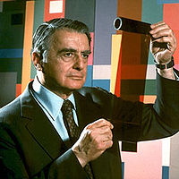
III. Categories/types of Innovation
Breakthrough Innovation:
  Radical change leading to a completely new product, service, or process
  Large initial investment in R&D
  Can lead to an “all-or-nothing” outcome
  May sustain heavy losses
  May have many failures before achieving anything
Edwin Land (1909-1991): Polaroid instant camera (1948)
Performed "an experiment each day“
Made technical and management decisions based
on what he felt was right as both a scientist and a humanist
Hired women and trained them to be research scientists
Had an artistic vision and was a photo collector

Slide 12
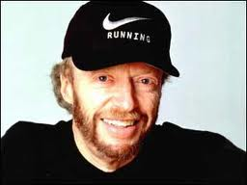
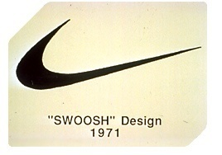
Categories/types of Innovation
2. Incremental Innovation:)
Gradual improvement and enhancement of an existing product, service, or process
Use of past experiences applied to something new
Moderate and gradual investment
Known and usually developed markets
Phill Knight (1938_ _) – Nike
Graduate of the University of Oregon and Stanford
Graduate School of Business
"Can Japanese Sports Shoes Do to German Sports Shoes
What Japanese Cameras Did to German Cameras?“
Discovered Tiger brand running shoes (Kobe): impressed
by the quality and low costs
Nike: named after a Greek Goddess of Victory
Philanthropist: donation to schools, incl. Stanford’s
business school (2006)

Slide 13
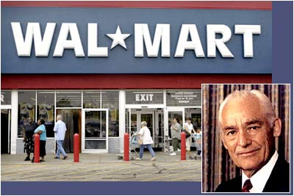
Types of innovation: Service Innovation
Developing and introducing a new
service concept or improving on
an existing process.
Sam Walton-Wal-Mart (1918-1992)
Lived with his parents on their farm by 1923
Major in Economics: University of Missouri
In 1945, after leaving the military, Walton took over management of his first variety store. With the help of a $20,000 loan from his father-in-law, plus $5,000 he had saved from his time in the Army, he purchased a store.
Pioneered the practice of discount merchandising by buying wholesale goods from the lowest priced supplier
First Wall-Mart: 1962 in Arkansas: Wall-Mart Discount City
1998: In Time’s list of 100 most influential people of 20th century

Slide 14
Another typology of innovation
Invention: Creation of a new product, service, pro process (“revolutionary”, breakthrough)
Expansion of a product, service of process.
Duplication: replication of an already existing product, service or process.
Synthesis: Combination of existing concepts and factors into a new formation.
P. 98

Slide 15
IV. Principles of Innovation
Be action oriented
Make the product, process or service simple and understandable
Custom-based: consumer needs-go out, look, ask, listen
Start small
Must be simple and focused
Aim high: aims leadership, focus on being a pioneer
Learn from failures
Follow a milestone schedule
Mind rewards
p. 99
2

Slide 16
Critical factors
The success of an innovation depends on critical factors:
Uniqueness
Timing
Customer needs and wants
---
Objectives of innovation:
  To make a change
  To achieve growth and profitability
  To motivate R&D

Slide 17
V. Sources of innovative ideas
1. Trends – social , technological, economic, government.
2. The unexpected occurences: unexpected success or failures: beyond the “normal”:
  - What would it mean if we exploited it?
  - What would we have to do to convert it into an opportunity?
  - How do we get about it? How do we analyse it?
  Thomas J. Watson (1854-1956): Developed IBM's renowned management style and corporate culture, and turned the company into one of the most effective selling organizations yet seen
  Steve Jobbs: NeXT Computers (failure)
  Ford: Edsel (failure)
  p.91

Slide 18
Sources of innovation
3. Incongruities: a discrepancy between what is and what should be:
Between the economic realities of an industry
Internal incongruity within the rhythm of the logic of a process.
How to find incongruities? Listen for customer complaints. These indicate that what the supplier or producer values is different from what the consumer values. They indicate an opportunity for an innovation that is specific and has a good chance of success.

Slide 19
Sources of Innovation
4. Process needs:
- Starts with the job to be done;
- Task-focused rather than situation-focused
- Process is perfected or redesigned or a weak link replaced
- The solution must fit the way people do the work.
Examples: creation of new medical devices, health food, pharmaceuticals, time saving innovations

Slide 20
Sources of innovation
4. Industry and market changes:
Industries go through the “life-cycle” model of growth maturity and decline
They can also change due to political, regulatory, and/or legislative changes (more in Section 3)
Established companies tend to “defend” what they already have while neglecting the growth areas
Industry and market changes are a source of emerging opportunities

Slide 21
Sources of innovation
The second set of sources for innovative opportunity involve changes outside the enterprise or industry:
5. Demographic changes: changes in population,age, education, occupation, geographic locations, educational status and income.
- Example: Increasing of number of educated youth
6. Perceptual changes: changes that occur in people’s interpretation of facts and concepts. Cost major shift in ideas to take place.
- Health concerns
- Desire of people to better use their free time
- Acceptance of new technology: resistance, traditions
7. Knowledge-based concepts, both scientific and non-scientific:
- Knowledge-based innovation is the “super-star” or entrepreneurship.
- Require the longest time period between initiation and market implementation because of the need for testing and modification.

Slide 22
Example: consumer needs as a source of innovation
Max Braun
- Established a small engineering shop in Frankfurt in 1921.
- In 1923 he began producing components for radio sets.
- 1950s marked the beginning of the product that Braun is most known for today: the electrical shaver.
- By the 1970s, Braun had begun to focus on home consumer appliances, including shavers, coffee makers, razors, clocks, and radios.
- 1982, Gillette Group moved to integrate Braun with the parent company by taking full control over its operations.
- Many of his designs - coffee makers, calculators, radios and razors - have found a permanent home at the Museum of Modern Art.

Slide 23
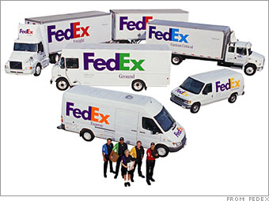
Example: sources of innovation
Fred Smith (1944_ _ )
Federal Express (FedEx)
The first overnight express delivery
company in the world.
The largest in the US.
While attending Yale, Fred wrote a paper for an economics class, outlining overnight delivery service.
Federal Express founded with his $4 million inheritance (about $21 million in 2008 dollars) and raised $91 million (about $484 million in 2008 dollars) in venture capital.
Awarded "CEO of the Year 2004" by Chief Executive Magazine.

Slide 24
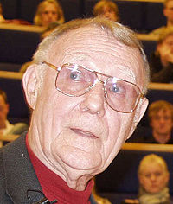
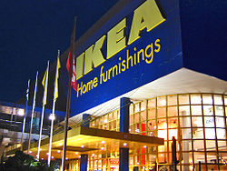
Sources of new ideas: example
IKEA ((Ingvar Kamprad Elmtaryd Agunnaryd)
- stylish, functional and cost effective
- packed flat: creates savings for everyone involved, reducing manufacturing costs, and shipping and storage costs, resulting in lower prices for the consumer.

Slide 25
VI. The creative process
Creativity is fundamental to innovation: important element of business management not only to arts
Creativity refers to capacity of doing things differently, creating a completely new value
Creativity is a distinct way of looking at the world that is often illogical.
Theodore Levitt: ““Creativity is thinking up new things. Innovation is doing new things”.

Slide 26
The creative thinking process
Creative process
Incubation
Ideas
Evaluation and implementation
Knowledge accumulation

Slide 27
Developing creativity
Use and develop both parts of your brains: think of a problem and solution both from the rational and irrational angle
Look at the things and people in non-conventional way
Make exercises putting “nonsensical” things together, e.g. “imagine a restaurant with no waiters” (fast-food restaurants concept), “imagine moving tracks with no movers” (U-Hall concept)
Be curious and open
Accumulate knowledge and analyze it
Use your imagination
Brainstorm p. 96

Slide 28
Areas of creativity
Idea creativity (new concept)
Material creativity (inventing and building tangible objects)
Organization creativity (new organizational forms or approaches)
Relationship creativity (innovative approach to achieving collaboration, cooperation, networking)
Event creativity (changing ways in which an event is organized and people are involved)
Inner creativity (inner openness to new approaches, thinking in different ways)
Spontaneous creativity (“witty brains”)

Slide 29
Sources of new ideas: online tools
Mindmaps:
Mapul - www.mapul.com
Webspiration - http://mywebspiration.com/
Grifitty - http://www.gliffy.com/
Mindomo - http://www.mindomo.com/
Text2mindmap- http://www.text2mindmap.com/
Bubbl.us - http://www.bubbl.us/
Keywords: visual dictionaries:
Visuwords: online graphical dictionary for generating ideas: http://www.visuwords.com/
Lexipedia: http://www.lexipedia.com/english/learning
Eye Pooler: http://eyeplorer.com/show

Slide 30
Summary
Being innovative and creative is seen as a primary “trait” of most entrepreneurs. It is a key activity that most successful entrepreneurs perform.
Innovation implies newness, a new product, service, process, or a new (more efficient) way of doing something. Innovation brings efficiency and effectiveness as a result.
Innovation is motivated by a sense of opportunity and occurs from the deliberate effort to satisfy a customer need and want.
There is a match or “fit” between the internal passion of the entrepreneur, and the external opportunity.
Creativity is having a new idea. Innovation means actually doing something with that idea

Slide 31
REMINDER!!
Form working groups for interviewing the entrepreneur ((first assignment) and for working on the business plans Choose entrepreneurial profile/business to work on Buy or borrow Comm320 course pack

