Slide 1
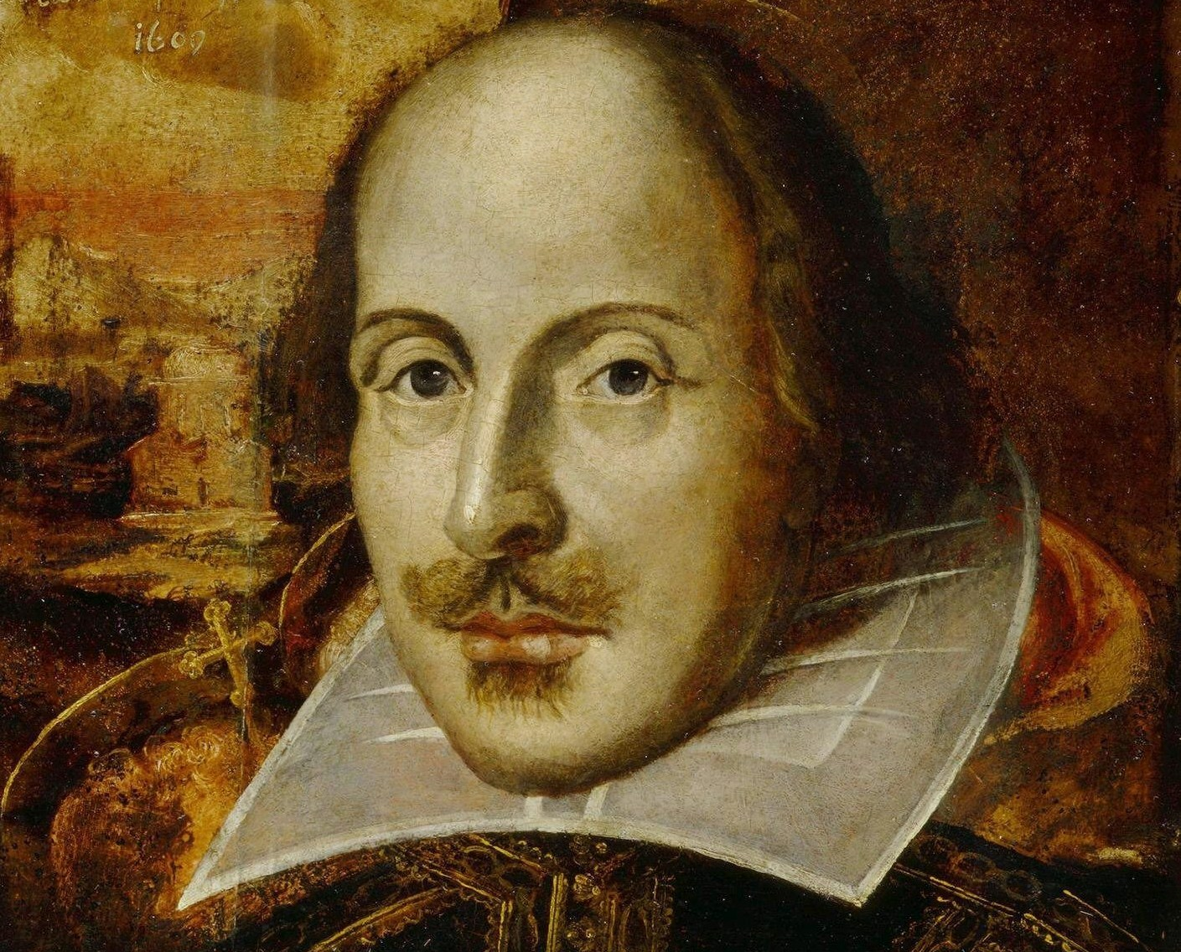
Class Five
-William Shakespeare
-The Elizabethan Theatre
-Close Reading of Othello
a) Irony
b) Sight/Blindness and Deception
c) Representation of Women
d) Jealousy and Poison
e) Petrarchan Lover and Rodrigo
f) Key Characters: Iago, Othello (tragic hero), Desdomona

Slide 2
William Shakespeare . . .
-grew up in Stratford, England
-was christened on 26 April 1564
-married Anne Hathaway
-had children
-disappeared from history for a seven year period
-surfaced in London around 1592
-worked as an actor and playwright
-was a part owner of a acting troupe and theatre
-sent money back to his family in Stratford
-considered a master of the English language
-has been accused of being a fraud
(not the author of his plays)
-remains a mystery

Slide 3
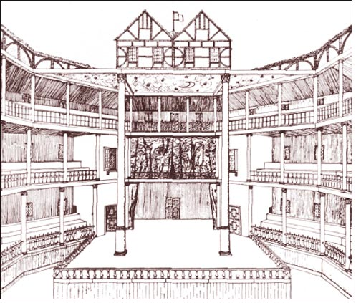
The Elizabethan Theatre

Slide 4
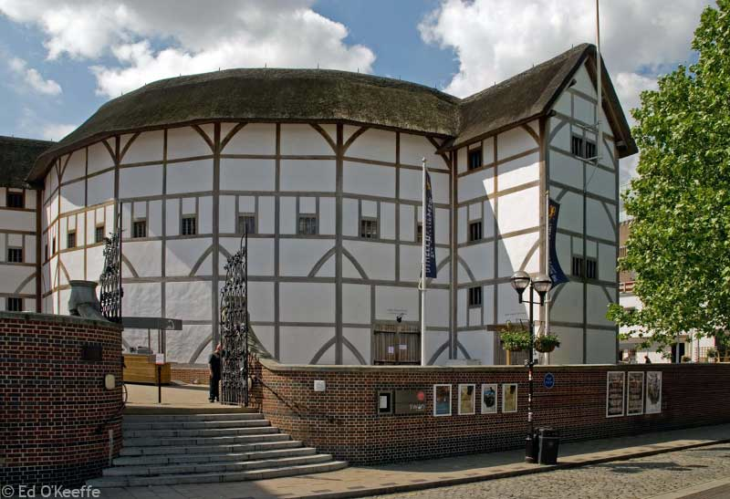
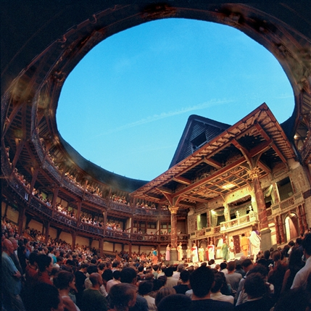
The Elizabethan Theatre
Acting
-only men
-company actors
-not always considered an
honorable job
-realistic style of performance
-often elaborate costumes
-involved props
Theatre Space
-often outside city walls
-featured levels of tickets
groundlings stood in the pit
spectators sat in the galleries
-natural lighting

Slide 5
Act 1
Scene 1
-The play begins in medias res (in the middle of things).
-Iago has been passed up for promotion.
-Michael Cassio has been promoted despite the fact that Iago was Othello’s trusted, honest friend and served under him in numerous battles.
-Iago hates “him [Othello]” (6).
-Iago notes that he does not serve Othello—though it appears he does.
-See his monologue “O sir, content you” (p. 1180)
-Iago summarizes a key idea and his personal character: “I am not what I am” (65).
-Iago puts a plan of revenge into motion.
-Iago encourages Rodrigo to, “[r]ouse [Brabantio], make after him, poison his delight” (68).
-Iago and Rodrigo rouse Brabantio from sleep.

Slide 6
Act 1
Scene 1
-Iago and Rodrigo utilize robbery images to alarm Brabantio.
“thieves, thieves, thieves! . . . . Thieves, thieves! (79,80)
“‘Swounds sir, you’re robbed” (86)
-The implication is that Othello stole Desdomona (Brabantio’s property).
-The implication is that Desdomona deceived her father and committed treason through her relationship with Othello.
“I say again hath made gross revolt, / Tying her duty, beauty, wit , and fortunes / In an extravagant and wheeling stranger” (135-137)
“O heaven, how got she out? O, treason of the blood! / Fathers from hence trust not your daughters’ minds / By what you see them act” (170-172)
-Brabanzio applies Iago’s line “I am not what I am” to Desdomona.

Slide 7
Act 1
Scene 2
-The scene begins with irony: “Tis better as it is” (6)
-Iago deceives Othello.
-Othello does not fear being imprisoned for marrying Desdomona.
-He has a distinguished military reputation and state value.
-Othello is summoned to the Senate.
-Othello is surrounded by Brabantio’s following.
“Down with him, thief!” (59)
“O thou foul thief!” (63)
-Brabantio accuses Othello of “enchant[ing] her” (64).
-Desdomona was “opposite to marriage” and “shunned the curled darlings of our nation” (68-69).
-Brabantio’s monologue, along with Rodrigo and Iago’s earlier crude phrases about Othello, illustrate the racist stereotypes surrounding Othello.
-He encounters prejudice despite being a war hero.
-He is treated as an ambiguous figure in the nation.

Slide 8
Act 1
Scene 3
-There is a war threat: “A Turkish fleet, and bearing up to Cyprus” (8).
-Othello is needed for war.
-Othello is greeted as “Valiant Moor” (48) then “Valiant Othello” (49).
How is this a problematic greeting?
-The play includes a comedic moment (see lines 50-65).
-Brabanzio repeats words such as “stol’n” and “spells.”
-Note Othello’s defense and how it reveals his character (76-94 and p.1189).

Slide 9
Act 1
Scene 3
-The monologue’s reveal that Othello is…
blunt and forward
not comfortable in discourse or speech
a career soldier
able to deal with conflict
confident in self and able to ignore racial slurs
respectful of Desdomona
-Desdomona is comfortable speaking for herself.
-She pledges her alliance and duty to her husband first
(though she continues to honor her father).
-This establishes Desdomona as independent in spirit and non-conventional.
-Othello and Desdomona request that Desdomona follow Othello to war.

Slide 10
Act 1
Scene 3
-Lines 283 to 299 (page 1192) explore ideas of sight/blindness and wisdom/deception.
Othello notes that his ensign (“[h]onest Iago”) and Iago’s wife Emilia will travel to Cyprus (294).
Othello’s repetition of “honest Iago” creates dramatic irony and illustrates that he should not rely so heavily of sight.
The Duke praises Othello, saying, “Your son-in-law is far more fair than black” (286).
A Senator states, “Adieu, brave Moor” (290).
Brabanzio warns Othello, “Look to her, Moor, if thou hast eyes to see / She has deceived her father, and may thee” (291-292).
Note rhythm and rhyme here.

Slide 11
Act 1
Ending of Scene 3
-Rodrigo plays the Petrachan lover.
“I will incontinently drown myself” (304)
“It is silliness to live when to live is torment” (307)
-Note the repetition of “put money in thy purse” (page 1193).
-Iago is confident his plan will work.
-Iago’s hatred and motivation is further made evident.
“I hate the Moor. My cause is hearted, thine hath no less reason. Let us be conjunctive in our revenge against him. If thou canst cuckold him, thou dost thyself a pleasure, me a sport. There are many events in the womb of time, which will be delivered” (355-359).
“I hate the Moor, and it is thought abroad that ‘twist my sheets that he has done my office. I know not if’t be true, but I, for mere suspicion in that kind, will do as if for surety” (368-372).
-Iago does not trust Othello.

Slide 12
Act 1
Ending of Scene 3
-See film clip http://www.youtube.com/watch?v=UeU6jpmiF4I.
-Look at the monologue at the end of 1:3 or pay close attention to the film.
-Discussion:
How will Iago’s plan work?
What is he relying on?
Think about Othello as a military person. Why does this make him weak to Othello’s plan?
What does the monologue reveal about Iago’s character?
What is the importance of the chess pieces in the film?

Slide 13
Act 2
Scene 1
-A storm has defeated the Turkish fleets.
-The war is over.
-Othello is momentarily lost at sea (others have landed): “O, let the heavens give him defence against the elements, for I have lost him on the dangerous sea” (45-47).
-This line is ironic, for the enemy is on the shore.
-Iago observes Cassio’s affection for Desdemona: “divine Desdomona” (73); “The riches of the ship is come on shore!” (84); and “Hail to thee, lady, and the grace of heaven” (86).
-He uses their affection for one another and his keen observations to “spin his web”: “He [Cassio] takes her [Desdomona] by the palm. Ay, well said—a whisper. With as little a web as this will I ensnare as great fly as Cassio” (168-169).
-Consider how his plot is like a spider web. Link this spider images to ideas on sight/blindness and deception.
-Note also the music metaphor: “O, you [Othello] are well tuned [happy] now, but I’ll set down the pegs that make this music, as honest as I am” (197-198)

Slide 14
Act 2
Scene 1
-The scene ends with Iago “ensnaring” Roderigo: “First, I must tell thee this: Desdomona is directly in love with [Cassio]?” (214-215).
-Why does Roderigo first express disbelief?
Why does he eventually fall for the “trap”?
Consider the following lines:
“Her eyes must be fed, and what delight shall she have to look upon the devil? . . . . her delicate tenderness will find itself abused, begin to heave the gorge [feel nausea], disrelish and abhor the Moor. Very nature will instruct her in it and compel her to some second choice” (220-229)
“the knave is handsome, young, and hath all those requisites in him that folly and green minds look after” (238-239)
Why does Iago have such a negative impression of women?
Why are these lines offensive to modern sensibilities?

Slide 15
Act 2
Scene 1
-Iago has Roderigo agree to provoke Cassio.
-Why is Iago’s plan strong?
“That Cassio love her, I do well believe it,
That she loves him, ‘tis apt and of great credit” (273-274).
-Iago restates why he is engaged in an act of revenge: “I do suspect the lusty Moor hath lept into my seat, the thought whereof doth, like a poisonous mineral, gnaw my inwards and nothing can or shall content my soul till I am evened with him, wife for wife—or failing so, yet that I put the Moor at least into a jealousy so strong that judgment cannot cure” (282-288.)
-The play thus demonstrates the effects of jealousy.

Slide 16
Act 2
Scene 2 (transition scene)
-There will be a celebration.
Scene 3
-Othello asks Cassio to stand guard.
-There is a repetition of the association of Iago with honesty.
-Iago lies, saying Othello has dismissed them early.
-Iago encourages Cassio, who has “very poor and unhappy brains for drinking” (29-30), to drink and celebrate.
-Note how Iago ensures Cassio continues to drink. He repeats “drink, ho!” and “Some wine, ho!” (p. 1203).
-Roderigo picks a fight with Cassio, and Cassio engages in disorderly conduct.
-Othello asks “honest Iago” to explain and Iago plays innocent (p. 1205).
-His lines are deeply ironic: “Touch me not so near. I had rather ha’ this tongue cut from my mouth than it should do offence to Michael Cassio” (203-205).

Slide 17
Act 2
Scene 3
-Othello dismisses Cassio: “Cassio I love thee, but never more be office of mine” (231).
-Cassio’s lament offers Iago a chance to further his plan of deception.
-Shakespeare suggests Iago’s evil nature: “Divinity of hell: when the devils will the blackest sins put on, they do suggest at first with heavenly shows, as I do now” (324-327).
-To consider: Is he inherently evil? What is Shakespeare saying about sight? About deception?
-Shakespeare associates jealousy with poison, for Iago says, “I’ll pour this pestilence into his [Othello’s] ear” (330)
-Iago identifies as a fisherman: “And out of [Desdomona’s] goodness make the net that shall enmesh them all” (335-336).
-So, we have three images—a spider, a tuner/musician, and a fisherman—in order to highlight Iago’s deceptive nature.

Slide 18
Discussion and Activity
-Consider the first two acts of the play.
-What aspects of the play are outdated?
-What aspects are relevant? How did the play resonate with you?
-How would you stage a contemporary adaptation of this play? How would you change the characters? What type of costumes would you use? Where would you set the play?
-Your vision of the play should capture Shakespeare’s key ideas (on deception, jealousy, human character, passion, the effects of the military, friendship, the representation and role of women in society, racism, marriage, etc.) while also making Othello accessible to modern audiences.
-Bring yourself and your knowledge of the world to your adaptation. Make it your own.

