Slide 1

ADM1301 - Social Context of Business
Professor: Pierre Martel
Lecture 6
Corporate Social responsibility (CSR)

Slide 2
What exactly is Corporate Social Responsibility”?
The degree of moral obligation that may be ascribed to corporations beyond simple obedience to the laws of state (Kilcullen & Kooistra, 1999).
An organization’s obligation to maximize its positive impact and minimize its negative effects in being a contributing member to society, with concerns for society’s long-run needs and wants. CSR means being a good steward of society’s economic and human resources (Journal of Consumer Marketing, 2001)
The intelligent and objective concern for the welfare of society that restrains individual and corporate behaviour from ultimately destructive activities, no matter how immediately profitable, and leads in the direction of positive contributions to human betterment, variously as the latter may be defined (Andrews, quoted in Hartman, 1998, Perspectives in Business Ethics)

Slide 3
CSR: Examples of Proposed Definitions
UK Minister of CSR
Maximizing benefits and minimizing the downsides of economic, social and environmental impacts of business.
UK Department of Trade and Industry
Investment in communities
Integrity with which a company
  Governs itself
  Engages with stakeholders
  Measures its impacts
  Reports its activities
International Chamber of Commerce
Voluntary commitment of business to manage its activities in a responsible way
World Business Council for Sustainable Development
Ethical Behaviour of business
Contribution of business to economic development while improving quality of life of
  workforce and their families
  local community
  society at large

Slide 4
CSR: Examples of Proposed Definitions
European Union (EU)
Companies integrate social and environmental concerns in their business operations on a voluntary basis
International Labour Organization (ILO)
Voluntary initiatives enterprises undertake over and above their legal obligations
Sir Geoffrey Chandler
Director Shell International
Founder: Amnesty International UK Business Group
Companies should follow international values set out in:
  UDHR: Universal Declaration of Human Rights
  Convention on the Rights of the Child
  Core ILO Conventions
Notes:
No children involved in the production in any material, or any part of the shoes that Nike produces or sells.

Slide 5
CSR: Examples of Proposed Definitions
Amnesty International
  CSR is a philosophy of ethical business whereby all corporate decisions are made with the utmost respect and concern for human rights.
Institute for Corporate Culture Affairs
  Ongoing commitment to behave ethically and contribute to economic development, while improving the quality of life of its employees and the community in which it operates, as well as society at large
International Finance Corporation
  CSR is the commitment of businesses to contribute to sustainable economic development by working with employees, their families, the local community and society at large.
Christian Aid
  CSR: Voluntary codes, principles and initiatives companies adopt in their general desire to self regulation.

Slide 6
CSR as portrayed by Industry Canada
Corporate social responsibility is a concept with a growing currency within Canada and around the globe.
CSR is a concept that frequently overlaps with similar approaches such as:
  corporate sustainability,
  corporate sustainable development,
  corporate responsibility, and
  corporate citizenship.
Source: Industry Canada 2011 http://www.ic.gc.ca/eic/site/csr-rse.nsf/eng/home

Slide 7
CSR as portrayed by Industry Canada
While CSR does not have a universal definition, many see it as the private sector’s way of integrating the economic, social, and environmental imperatives of their activities.
In addition to integration into corporate structures and processes, CSR also frequently involves creating innovative and proactive solutions to societal and environmental challenges, as well as collaborating with both internal and external stakeholders to improve CSR performance.
Source: Industry Canada 2011 http://www.ic.gc.ca/eic/site/csr-rse.nsf/eng/home
Notes:
-Paying attention to the economic, social, and civil aspects of your corporation
-Engage in a proactive manner towards stakeholders
-Build processes and gov’t structure to support your CSR objectives

Slide 8

Corporate Social Responsibility: Definition
The way a corporation achieves a balance among it economic, social, and environmental responsibilities in its operations so as to address shareholder and other stakeholder expectations.
Notes:
On P. 139

Slide 9
Key Elements of CSR
Corporations have responsibilities beyond the production of goods and services.
These responsibilities involve helping to solve social problems.
Corporations have a broader constituency than just stockholders.
Corporations have impacts beyond simple marketplace transactions.
Corporations serve a wider range of human values than just economic values.
Notes:
General Mgnt concept processes that it is important in all aspects of the business operation
Impose CSR through all aspects of the business

Slide 10

Case for Involvement
Business must satisfy society’s needs.
CSR prevents public criticism and government regulation.
Business and society are interdependent.
CSR is good for the bottom line.
Investors and consumers support CSR.
Addressing social problems can become financial opportunities (e.g., pollution abatement).
Notes:
CSR=legitimacy in the eyes of stakeholders

Slide 11
Case for Involvement
Business should take long-term CSR approach.
Social actions improve public image and goodwill.
Business can solve problems as well as government.
Proactive approach is better than reactive.
Business people are also concerned citizens.
Notes:
In the strategic interest of the Corporation to pay attention to CSR and to incorporate it into its decision making processes and business operations
Good for business

Slide 12

Support for CSR
Social and environmental sustainability will be the defining business drivers for multi-national enterprises in the first part of the 21st century.
Source: Sustainable Value: by Chris Laszlo, Greenleaf Publishing 2008
Patrick Cescau, Group CEO, Unilever
Notes:
Peter Monk, CSR in the way he wants to see his company represented
CSR main drivers of corporate world in the 21rst century

Slide 13

Counterarguments
Profit maximization is the primary purpose of business.
Business is responsible to shareholders.
Social policy is role of government.
Business lacks training in social issues.
CSR would give too much power to business.
Notes:
Maximize profits, and comply with existing laws
Could cause corporate domination of the social/economical sphere

Slide 14
Counterarguments
Business involvement in social matters increases costs.
No reliable guidance for business in CSR matters.
Business cannot be held accountable unlike social institutions.
There is divided support in business community for social involvement.

Slide 15
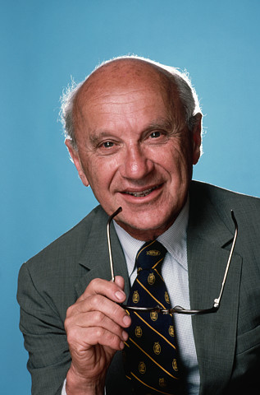
Milton Friedman’s Critique
Humans have a moral responsibility for their actions but corporations do not.
Managers are responsible to shareholders. Acting otherwise is theft of shareholders money.
Social issues should be dealt with by governments, not by corporations.
Corporations are responsible to comply with the law, nothing more.
Milton
Friedman (1912 – 2006)
Text on this slide paraphrases
Friedman’s views and is not
verbatim quotations.
CSR is fine, but its just another way of making profits for shareholders.

Slide 16

Social Responsibility Theories
Amoral view
  Traditional view of business as merely profit-making entity
Source: Klonoski, 1991
Notes:
IMPORTANT

Slide 17
Social Responsibility Theories
Personal view
  Corporations are like people and can therefore be held accountable for their actions
Source: Klonoski, 1991
Notes:
IMPORTANT

Slide 18
Social Responsibility Theories
Social view
  Corporations are social institutions with social responsibilities
Source: Klonoski, 1991
Notes:
IMPORTANT

Slide 19
CSR:
Summary of perspectives
Why CSR?
  CSR has moved from a public relations, window dressing fuzzy issue to being vital for the long term sustainability of the organization.
CSR Critique
  “The business of business is business”
  CSR is not proven to improve profits
  CSR-washing
Strategic CSR
  Need to integrate company and society needs.
Notes:
Not proven that CSR contributes to profits

Slide 20
Pyramid of Corporate Social Responsibility
“Be a good
corporate citizen”
Desired
Philan-
thropic
“Be ethical”
Ethical
Expected
“Obey the law”
Legal
Required
“Be profitable”
Economic
Required
Source: Archie Carroll, 1991
Notes:
CSR mostly in top segment(Environment, Stakeholder management)

Slide 21
Corporate Social Responsibility
Carroll’s Four Part Definition
CSR encompasses the economic, legal, ethical, and discretionary (philanthropic) expectations that society has of organizations at a given point in time

Slide 22
Corporate Social Responsibility (CSR)
CARROLL’S FOUR PART DEFINITION
Understanding the Four Components
Responsibility | Societal Expectation | Examples
Economic | Required | Maximize sales, minimize costs, increase profits
Legal | Required | Obey laws and regulations.
Ethical | Expected | Do what is right, fair and just.
Discretionary (Philanthropic) | Desired/ Expected | Be a good corporate citizen.
Notes:
IMPORTANT

Slide 23
Corporate Social Responsibility
Economic Responsibilities (Make a profit)
+Legal Responsibilities (Obey the law)
+Ethical Responsibilities (Be ethical)
+Philanthropic Responsibilities (Good corporate citizen)
Corporate Social Responsibility

Slide 24
CSR Summary Definition
Social
Environmental
Economic
CSR
Legal Responsibilities
Economic Responsibilities
Going beyond
Society
Environment
Employees
Shareholders
Employees
Shareholders
Social
Stakeholder
Corporate
Responsibility
Notes:
CSR=Going beyond economic and legal responsibility

Slide 25

A CSR Example
Starbucks Coffee Company
Video
2010 CSR Report
  check it out at http://www.starbucks.com/responsibility/learn-more/goals-and-progress

Slide 26
Contemporary CSR Concepts
Corporate Sustainability
Reputational Management
Social Impact Management
Triple-E Bottom Line

Slide 27
Corporate Sustainability (CS)
Compliance-driven CS: follow regulations
Profit-driven CS: focus on bottom line
Caring CS: go beyond legal compliance
Synergistic CS: well balanced solutions
Holistic CS: fully integrated CS

Slide 28
Reputation Management
Reputation management is an effort to enhance a corporation’s image
Previous focus on media and public relations as well as crisis management
Today, focus is on relationships with all stakeholders
Reputations take a long time to be established, but can be destroyed quickly

Slide 29
Social Impact Management
Field of inquiry at the intersection of business needs and wider societal concerns that reflects and respects the complex interdependency between the two.
Evaluates 3 aspects of business:
  Purpose of business
  Social context of business
  Metrics: how performance is measured

Slide 30

Triple-E Bottom Line (TBL)
Evaluates a corporation’s performance according to a summary of the economic, social, (ethical) and environmental value the corporation adds or destroys.
Now forms the basis for corporate reporting of economic, ethical, and environmental responsibilities.

Slide 31

Corporate Social Responsibility
Corporate Citizenship Concepts
Corporate social responsibility – emphasizes obligation and accountability
Corporate social responsiveness – emphasizes action and responsibility
Corporate social performance – emphasizes outcomes and results

Slide 32
Good Corporate Citizenship: Benefits
Reputation management
Risk profile and risk management
Employee recruitment, motivation, and retention
Investor relations and access to capital
Learning and innovation
Competitiveness and market positioning
Operational efficiency
License to operate
Source: World Economic Forum

Slide 33
New Approach to
Corporate Citizenship
Limited
  Focus on corporate giving
Equivalent
  Emphasis on sustainability
Extended
  Defined as a set of individual, social, civil, and political rights
Source: Matten and Crane, 2005

Slide 34

Responses to
Corporate Social Responsibility
Corporate giving
Voluntarism
Corporate sponsorship
Social venture philanthropy
Social enterprise

Slide 35
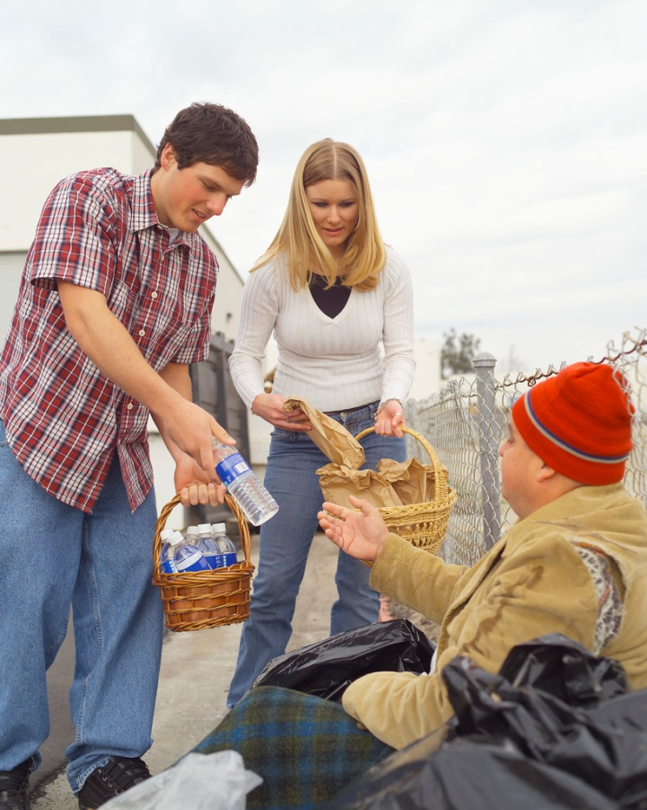
Corporate Philanthropy: Definition
The effort of business to contribute to society socially, manifested by donations of money or goods and services in kind, voluntarism (where corporate employees work for social causes), and sponsorship of events that contribute to society.

Slide 36
Arguments For
Corporate Philanthropy
Means to express CSR to community
Promotes image of good citizenship
Business benefits from volunteer sector
Benefits from corporate community investment program
Company’s success linked to community’s health

Slide 37
Arguments Against
Corporate Philanthropy
Funds given belong to shareholders
Social welfare is the job of government
Corporation might become accountable for actions of charity
No guidelines or standards to measure, evaluate, or monitor corporate giving

Slide 38

Trends and Concerns in
Corporate Giving
Cause-related marketing: The purchase of a particular product results in a donation being made by a corporation to a non-profit organization’s program.
Charitable Foundations
  (see p.163 text)

Slide 39
Trends and Concerns in
Corporate Giving
Strategic giving: An attempt to rationalize the shareholder interests with corporate philanthropy whereby the corporation benefits directly from the funds given.

Slide 40

Other Concepts:
Corporate Voluntarism
Forms of support
  Providing facilities, allowing time off, assisting with personal expenses incurred while undertaking voluntary activities, special recognition to employees
Corporate policies regarding voluntarism
  encouraging; enabling; and promoting

Slide 41

Other Concepts:
Corporate Sponsorship
A partnership which has been established for mutual benefit between a business sponsor and an event or a non-profit.
Examples: sports, cultural, and educational events, literacy, race relations, drug abuse, environmental issues, etc.
  Example:

Slide 42
Other Concepts:
Social Venture Philanthropy
The investment of human and financial resources by corporations in non-profit community development agencies to generate a social return instead of only a financial one.
Also known as social venturing, the new philanthropy, and high-engagement philanthropy.

Slide 43
Social Enterprise
A model of business operation where some or all profits are deliberately used to further social aims.
Two types:
  (1) non-profit enterprises that contribute all profits to social initiatives (e.g., Value Village thrift stores);
  (2) for-profit enterprises that divide profits between social initiatives and shareholders (e.g., The Body Shop)

Slide 44
Social Entrepreneurship
An innovative, visionary leader of a non-profit with real-world problem-solving creativity and a high awareness of ethical considerations.
Also referred to as philanthrocapitalism.

Slide 45
Borderless
Recall the definition of CSR:
  The way a corporation achieves a balance among it economic, social, and environmental responsibilities in its operations so as to address shareholder and other stakeholder expectations.
In your view, are the construction companies operating in a socially responsible way?

Slide 46

Fish & Chips
What is the most socially responsible thing to do??

Slide 47
NSI
If you were Mike, what would you do?
How does this case demonstrate the complexities around CSR issues? What ARE the CSR issues in this case?

Slide 48
Lecture 6
Text Book – Key Points
Chapter 7
  7.1 – The Rationale for Corporate Social Responsibility (CSR)
  7.2 – Describing CSR
  7.3 – The CSR Debate
  7.4 – CSR Theories
  7.5 – Carroll’s Pyramid of Social Responsibility
  7.6 – Contemporary CSR Concepts
Chapter 8
  8.3 – Corporate Philanthropy
  8.4 – Corporate Voluntarism
  8.5 – Corporate Sponsorship

