Slide 1
Concepts Review
A multitude of internal and external factors influence workplace safety
  Social norms, utility, economics, politics, etc, etc
  SDH (soc determinants of health) provide a holistic view of health
    Employment and workplace conditions are key
A safety culture is required to ensure a safe workplace
  Corporate culture may support or impede a safety culture
IRS is needed for a Systems approach
  Contributory groups play important role in IRS and are key to Systems approach
A Systems Approach is required for continuous improvement
  As business changes, culture remains constant but practices change. Risk assessment is key to maintaining acceptable risk levels
  What gets measure and rewarded get done
    Motivation plays a key role in workplace H&S
Notes:
40-45 mc
6-8 short answer
1 long answer
Choose 1 to 3 to answer
“There really are no accidents”
State whether u agree disagree or partially agree with this statement. Provide clearly worded arguments supported by specific workplace examples or research to support ur position.
25 years ago workers commonly smoked in the workplace. It was considered an acceptable workplace risk, this act of tobacco and its waste products have not changed, current social norms do not support smoking in the workplace as acceptable. What has changed? ( need 15 things to get full marks, can use personal experience not just whats from class).
1. Legislation 2. IRS 3. social norms 4. workers rights 5. SDH 6. safety culture –corporate culture 7. A systems approach 8. recognition of hazards 9. new scientific knowledge and health findings, statistics, research studies etc..
-focus on unit 1 sec d – unit 3
May be a question on green book like ‘how would u look up something’ … go to index look it up… go to page…

Slide 2
Concepts Review
Injury free workplace does not equal Safe workplace
  Weakness of stats
Legislation represents a minimum standard
  It is “written in blood”
Hazards are the potential to cause harm
  inherent
Risk is the likelihood of harm
  based on circumstances, scenarios
  Elements/factors to consider: hazard, exposure, consequences, likelihood of scenario
Risk Assessment is based on available resources and pre-set corporate values
  May change over time (technology, research, experience, utility)
Risk perception is based on individual traits, skills, etc

Slide 3
Concepts Review
Risk reduction
  Hierarchy and placement of controls
  Choosing personal protective equipment
Basic rights and duties of workplace parties
Basic knowledge of how to use the OHSA book
Precautionary Principle
  Reasonable precautions in absence of scientific proof

Slide 4
Prevention Strategies
Success at Workplace Level Depends on
  Goal setting
  Collaboration (IRS)
  Management systems
  Safety Culture
  Effective communication
    Between ALL parties
    Feedback from stakeholders
  Worker Empowerment
  Access to health care services
    Primary, secondary and tertiary
  Celebrating and sharing success
Notes:
EXAMPLES OF SYSTEMATIC APPROACHES
Lead exposure in 1970’s geometric mean was 16 microgram/decilitre of blood
bans on lead in gas, lead in food containers (cans), water carrying pipes and paint
Now only 2 % of children aged 1-5 have BLL over 10 ug/dL of blood
The level of 10 ug/dL is the CDC concern level.
Professional collarboration
A dentist sees a patient regularly and observes grey discolouration developing along the gumline
could be from workplace or home exposure to lead

Slide 5
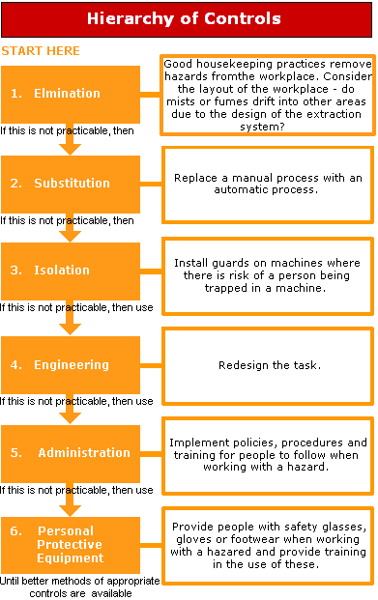

Slide 6
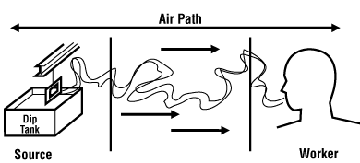
Location of Controls
At the source
Along path between hazard and worker
At the worker
Notes:
At the source
best to attack the hazard at its source
substitute chemical for one that is less toxic, flammable, corrosive, etc
substitute spray process for a wipe process
isolate the process or chemical
use self feeding process instead of worker pouring product into equipment
Along path between hazard and worker
erect a barricade or guard between the worker and the source of hazard
install local exhaust to remove hazard from workplace
At the worker
install automatic feeders on equipment
rotate workers on task to reduce overall daily exposure
PPE

Slide 7
PPE Selection Criterion
Hazard
  properties, concentration, warning signs of overexposure
Anticipated routes of entry
  Inhale, ingest, contact, inject
Intended use
  procedure, tools, environment
Duration of use
  minutes, hours, days
Type of application
  spray, brush, roll, etc
Other available controls
  ventilation, etc
Personal factors
  fit, medical conditions, training
Hazards created by PPE
Regulation requirements
Notes:
Questions to ask when selecting personal protective equipment
What is the hazard of the product
abrasion, cut, hot, cold, radiation, corrosive, toxic, flammable, etc
What additional hazard is created by the method of use
increase exposure or contact, incompatibilities,
What are the expected routes of entry or contact
skin contact, eyes, respiratory system, ingestion, skin absorption
What is the expected duration and concentration of exposure
less than legal exposure values, greater than warning property threshold
Are there medical or personal factors effecting the choice
clostrophobia, heart condition, lung condition, facial hair, allergies
What training is required and has it been provided

Slide 8
Evaluation of Risk Reduction Options
Effectiveness at reducing risk
Cost to implement and maintain
Impact of control measures on workers
New associated risks to stakeholders
Beneficial side effects of new controls
Decisions are impacted by assumptions and perceptions
  Be sure to document assumptions, perceptions and anticipated benefits

Slide 9
Hazard Recognition
Reactive
  Event investigations
    Injury
    Equipment failure
  Enforcement action
    MOL, MOE, MOH, etc
    Internal system audit
Proactive
  Workplace Inspections
  Planned review
    Preventative maintenance
    Procedure review
    New equipment/process review
  Job Hazard Analysis
    Preliminary Hazard Analysis
    Detailed Hazard Analysis

Slide 10
Precautionary Principle
Reasonable efforts to reduce risk need not await scientific proof
  Testing protocols may not be developed
  Science cannot always prove cause and effect
Treat unknowns as a hazard until information is available to “clear them”
“Better safe than sorry”
Notes:
Science cannot always prove cause and effect
In a timely manner
Given current resources
Technology, money, data, etc
Within scientific certainty

Slide 11
Risk Elements
The hazard
  Corrosive, toxic, poisonous, sharp, hot, cold, blunt force…
The range of exposures
  Routes of entry
    Inhalation, Ingestion, Skin and mucous membrane contact, Injection
  Concentration, duration, frequency, synergies, work tasks during exposure….
The range of consequences
  Irritant, acute toxin, chronic toxin, sensitizer, carcinogen, asphyxiates, fatal…..
The probability
  Intended life of equipment, facility or structure, control reliability, ……

