Slide 1
Practice Questions

Slide 2

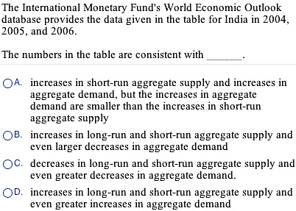

Slide 3
D

Slide 4
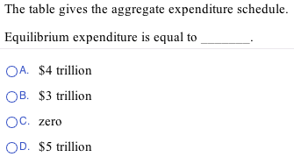
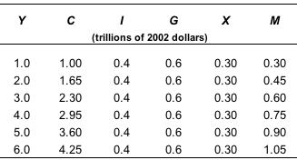

Slide 5
B

Slide 6
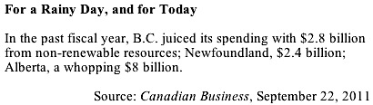


2.8
B. 3.55
C. 7
D. 11.2

Slide 7
D

Slide 8
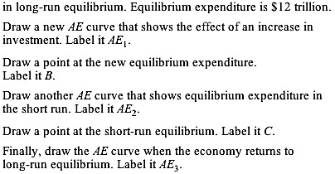
Draw an AE curve to show that the economy is

Slide 9
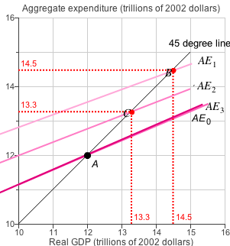

Slide 10
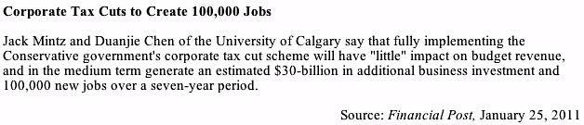
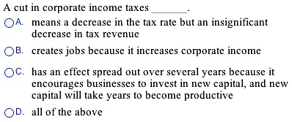
Answer - D

Slide 11


Slide 12
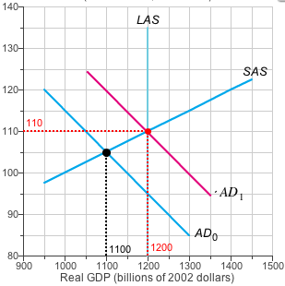

Slide 13
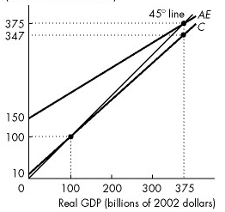

Calculate the multiplier

Slide 14
E

Slide 15
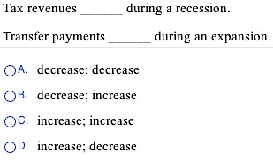

Slide 16
A

Slide 17
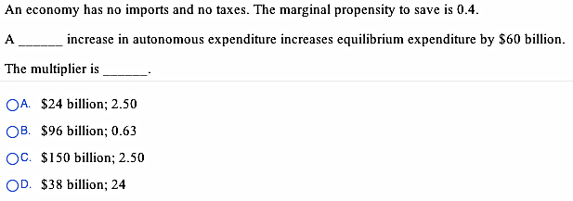

Slide 18
A

