Slide 1
ADM1300~W2
Chapter 1
.I.B.M.~.T.S.M.
JFA
Thanks to the much appreciate collaboration of
Prof. Matt Archibald and Prof. David Delcorde
F’2011

Slide 2
Managers and Managing
Managing the Business Enterprise
Idea of the management process:
  Management is the process of P______, O_______, L_______ and C_______ an enterprise’s financial, physical, human and information R_______ to achieve the organization’s G_______ of supplying various P_______ and S_______.

Slide 3
Part II
Managers and Managing
Managing the Business Enterprise
Idea of the management process:
  Management E___________ means achieving the greatest level of output with a given amount of input (doing things right);
  Management E____________ means achieving the organizational goals that have been set (doing the right things);

Slide 4
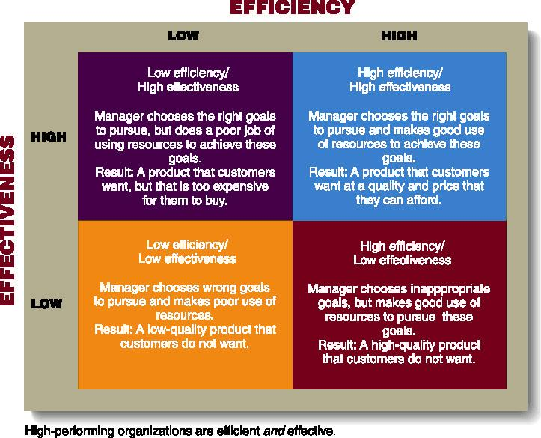
Efficiency, Effectiveness, and Performance in Organizations

Slide 5
Part II
Managers and Managing
Managing the Business Enterprise
The functions that are necessary in the management process:
  All managers plan, organize, direct and control day-to-day operations;
  PODC are interrelated;
  P____________ is the process of determining the firm’s goal and developing a strategy for achieving them;
  See the five basic steps on page 17 (Textbook).

Slide 6
Part II
Managers and Managing
Managing the Business Enterprise
Planning:
  Step 1: _____________________________________________________________________________________________________________________
  Step 2: _____________________________________________________________________________________________________________________
  Step 3: _____________________________________________________________________________________________________________________

Slide 7
Part II
Managers and Managing
Managing the Business Enterprise
Planning:
  Step 4: ____________________________________________________________________________________________________________________________________
  Step 5: ____________________________________________________________________________________________________________________________________
    ____________________________________________________________________________________
    ____________________________________________________________________________________

Slide 8
Part II
Managers and Managing
Managing the Business Enterprise
Planning (A Hierarchy of Plans):
  Strategic plans: Set by top management
    __________________________________________________________________________________________
  Tactical plans: Set by middle management
    __________________________________________________________________________________________
    __________________________________________________________________________________________.
  Operational plans: Developed by middle management and lower-level managers that set short-term targets for daily, weekly, or monthly performances.

Slide 9
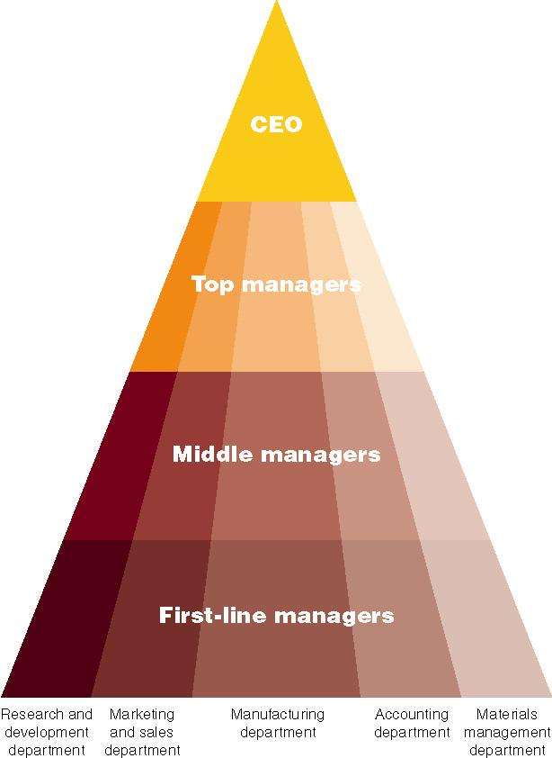
Management Hierarchy

Slide 10
Part II
Managers and Managing
Managing the Business Enterprise
The functions that are necessary in the management process:
  O________________ involves mobilizing the resources that are required to complete a particular task;
  In organizing, managers create the structure of working relationships between organizational members that best allows them to work together and achieve goals
  Managers will also lay out lines of authority and responsibility for members.

Slide 11
Part II
Managers and Managing
Managing the Business Enterprise
The functions that are necessary in the management process:
  L____________ involves the interactions between managers and their subordinates as they both work to meet the firm’s objectives.
    _____________________________________________
    _______________________________________________________________________________________________________________________________________
  The outcome of the leading function is a high level of M________________ and C_________________ from employees to the organization;

Slide 12
Part II
Managers and Managing
Managing the Business Enterprise
The functions that are necessary in the management process:
  C___________ is the process of monitoring a firm’s performance to make sure that it is meeting its goals.
    Control can also show where performance is better than expected and thus can serve as a basis for providing rewards or reducing cost.
    Managers will monitor individuals, departments, and the organization to determine if desired performance has been reached.
    Managers will also take action to increase performance as required.
    The outcome of the controlling function is the accurate measurement of performance and regulation of efficiency and effectiveness.

Slide 13
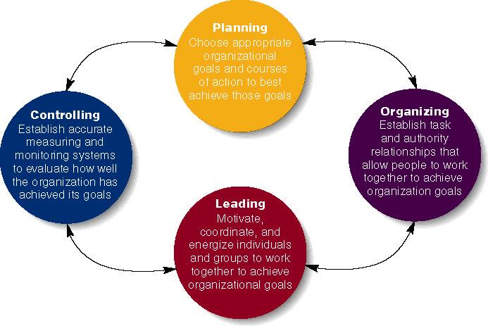
Four Functions of Management

Slide 14
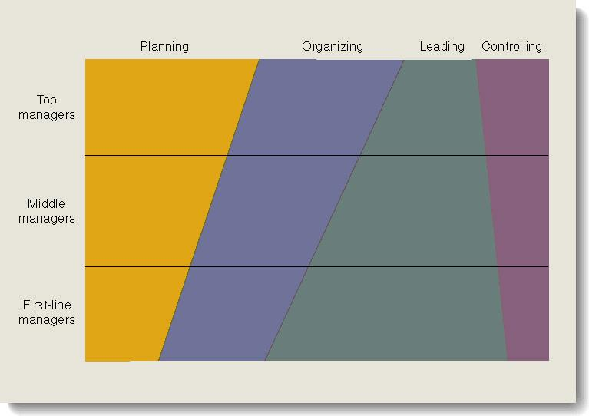
Relative Amount of Time That Managers Spend on the Four Managerial Functions

Slide 15
Part II
Managers and Managing
Managing the Business Enterprise
Types of Managers:
  Top Managers: Those managers responsible for a firm’s overall performance and effectiveness and for developing long-range plans for the company.
  Middle Managers: Those managers responsible for implementing the decision made by top managers.
  First-line Managers: Those managers responsible for supervising the work of employees.

Slide 16
Part II
Managers and Managing
Managing the Business Enterprise
Areas on Management:
  ___________ ______________ Managers: Provide assistance to other managers when they are hiring employees, training them, evaluating their performance, and determining their compensation level.
  O______________ Managers: They are responsible for the production systems that create goods and services.
  I___________________ Managers: They are responsible for designing and implementing systems that gather, process, and disseminate information.
    __________________________________________________________________________________________________E______________________ of this important function.

Slide 17
Part II
Managers and Managing
Managing the Business Enterprise
Areas on Management:
  M______________ Managers: They are responsible for getting products and services to buyers.
  F_______________ Managers: Management of a firm’s finances, including its investments and accounting functions, is extremely important to its survival.

Slide 18
Part II
Managers and Managing
Managing the Business Enterprise
The Basic Management Skills:
  T_____________: People develop their technical skills through E________________ and E_______________. Those skills are associated with performing specialized task within a company.
  H____________ _____________: Those skills are very important at all levels, but they are probably most important for middle managers, who must often act as bridges between top managers, first-line managers, and managers from other areas of the organization.
    ________________________________________________________________________________________________________________________________________________________________________________________________________
    Thus, they are skills that enable managers to understand and get along with other people.

Slide 19
Part II
Managers and Managing
Managing the Business Enterprise
The Basic Management Skills:
  C_________________: A person’s ability to think in the abstract, to diagnose and analyze different situations, and to see beyond the present situation.
    __________________________________________________________________________________________
  T______ M_________________: The productive use that managers make of their time.
    Paperwork, Telephone, Meetings and Email
  D____________-M__________: Choosing one alternative from among several options.
    Decision-making skills are the skills in defining problems* and selecting the best courses* of action…

Slide 20
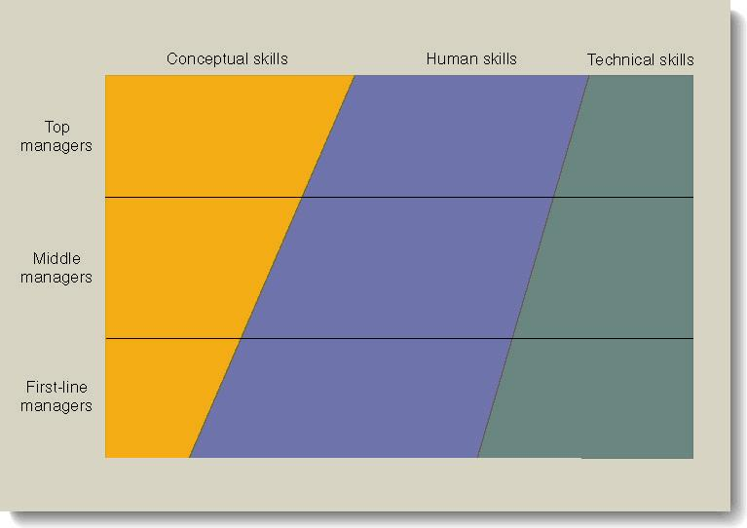
Conceptual Human and Technical Skills Needed by Three Levels of Management

Slide 21
The Rational Decision Making Process
The sparkle : ________________________________________________________________________________
The stimulus for a decision maybe either a ___________ or an ___________________.
______________ ____________: A decision that is necessary when actual results do not conform to those expected.
________________ ___________: Taking new initiatives or doing a current activity more efficiently even no problem exists.

Slide 22
The Rational Decision Making Process
Step 1 : ___________________________________
__________________________________________
Stimulus +/-
Step 2 : ___________________________________
Obvious and creative
The more important the decision, the more alternatives should be generated.
Factors such as legal restrictions, moral and ethical norms and available technology can limit alternatives.

Slide 23
The Rational Decision Making Process
Step 3 : ___________________________________
Feasibility, satisfactoriness and consequences
Step 4 : ___________________________________
Choose the alternative that best fits the managers solution
It is the real crux of decision making
Decision makers should also remember that finding multiple acceptable alternatives maybe possible, so selecting just one alternative and rejecting all others might not be a good decision.

Slide 24
The Rational Decision Making Process
Step 5 : ___________________________________
__________________________________________
The chosen alternative is implemented into the organizational system
One of the key things that managers must deal with during implementation is employee resistance to change
The reason for such resistance include insecurity, inconvenience and fear of the unknown
Unanticipated consequences are still possible

Slide 25
The Rational Decision Making Process
Step 6 : ___________________________________
__________________________________________
The decision making process requires managers to :
1- ______________________________________________
______________________________________________
2- ____________________________________________
______________________________________________
3- Adopt an alternative that had previously been discarded
4- Recognize that the situation was not correctly defined to begin with and start the process all over again

Slide 26
The Rational Decision Making Process
Step 6 : ___________________________________
__________________________________________
The decision making process requires managers to :
3- ______________________________________________
______________________________________________
4- ____________________________________________
______________________________________________
______________________________________________

Slide 27
The Behavioural Aspects of Decision Making
_________________ and _________________ factors often influence managerial decision making.
1. Organisational politics: _________________________
_____________________________________________
_____________________________________________ (O__________________ power and P__________ power)
2. Intuition: ___________________________________
__________________________________________________________________________________________

Slide 28
The Behavioural Aspects of Decision Making
3. ___________________________: When a manager makes a decision and then remains committed to its implementation in spite of clear evidence that it was a bad decision.
4. ___________________________: How much a manager is willing to gamble when making decisions. (Take risk?)

Slide 29
Chapter 1 ~ PART II

