Slide 1
Chapter 11
Decision Making

Slide 2
Learning Objectives
Define decision making and differentiate well-structured and ill-structured problems.
Compare and contrast perfectly rational decision making with decision making under bounded rationality.
Discuss the impact of framing and cognitive biases on the decision process.

Slide 3
Learning Objectives
4. Explain the process of escalation of commitment to an apparently failing course of action.
5. Consider how emotions and mood affect decision making.
Summarize the pros and cons of using groups to make decisions, with attention to the groupthink phenomenon and risk assessment.

Slide 4
What Is Decision Making?
Decision making is the process of developing a commitment to some course of action.
Three things are noteworthy about decision making:
  It involves making a choice among several action alternatives.
  It is a process.
  It involves a commitment of resources.(time money, skills, staff, raw materials)

Slide 5
What Is Decision Making? (continued)
Decision making can also be described as a process of problem solving.
A problem exists when a gap is perceived between some existing state and some desired state.

Slide 6
Well Structured Problems
Programmed decisions
Clear, easy to define, easy to define, know how to solve them (had them before)
More efficient to rely on programmed solutions
Ill-Structured Problems
Non-programmed decisions
Unique, difficult to define, haven’t occurred before

Slide 7
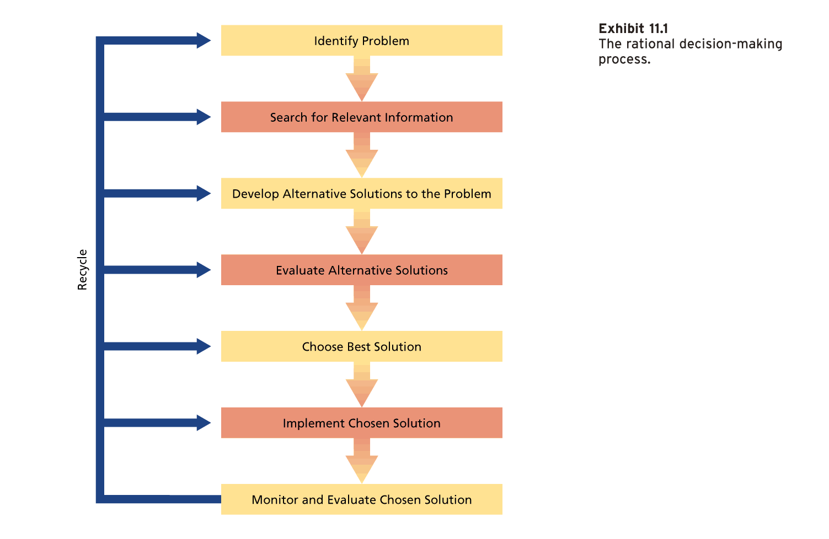
The Rational Decision Making Process

Slide 8
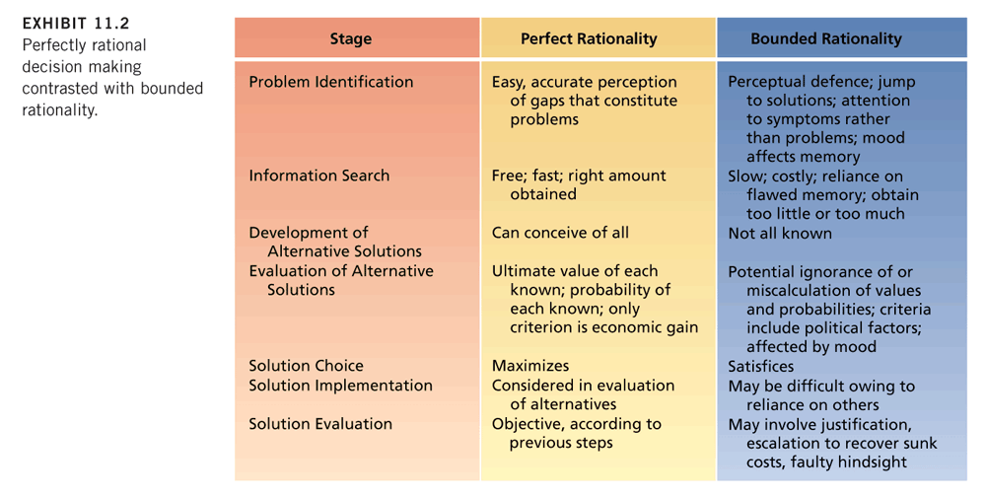
Perfectly Rational Decision Making Contrasted with Bounded Rationality

Slide 9
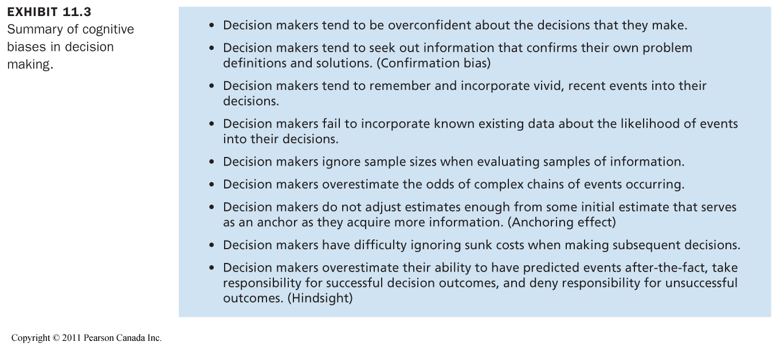
Summary of Cognitive Biases in Decision Making

Slide 10
Group Decision Making
Many organizational decisions are made by groups, especially when problems are ill structured.
Why use groups for decision-making?

Slide 11
Why Use Groups?
Decision Quality
  Groups or teams should make higher-quality decisions than individuals.
Decision Acceptance and Commitment
  A group decision will be more acceptable to those involved.
  This is especially important in getting a decision implemented.

Slide 12
Why Use Groups? (continued)
Diffusion of Responsibility
  The ability of group members to share the burden of the negative consequences of a poor decision.

Slide 13
Do Groups Actually Make Higher-Quality Decisions?
Is the frequent use of groups to make decisions warranted by evidence?
Groups should perform better than individuals when:
  the group members differ in relevant skills and abilities, as long as they do not differ so much that conflict occurs;
  some division of labour can occur;
  memory for facts is an important issue; and
  individual judgments can be combined by weighting them to reflect the expertise of the various members.

Slide 14
Disadvantages of Group Decision Making
Time
  The time it takes to make a decision increases with group size.
Conflict
  Decision quality can take a back seat to political wrangling and infighting.
  Groups will make better decisions when members feel psychologically safe.

Slide 15
Disadvantages of Group Decision Making (continued)
Domination
  When meetings are dominated by a single individual or a small coalition.
  Domination is not likely to lead to group acceptance and commitment.
  If the dominant person is misinformed, the group decision is likely to be ineffective.

Slide 16
Groupthink
The capacity for group pressure to damage the mental efficiency, reality testing, and moral judgment of decision-making groups.
Unanimous acceptance of decisions is stressed over quality of decisions.
Victims of groupthink operate in an atmosphere of unreality that should lead to low-quality decisions.
Power is in numbers (more ppl, more power). Group members make a coalition and pressure other members for the sake of consensus and norms

Slide 17
Groupthink (continued)
Factors that can cause groupthink include:
  High group cohesiveness.
  Strong identification with the group.
  Concern for approval from the group.
  Isolation of the group from other sources of information.
  Promotion of a particular decision by the group leader (this appears to be the strongest cause).

Slide 18
What Can Prevent Groupthink?
Leaders must avoid exerting undue pressure for a particular decision outcome and concentrate on good decision processes.
Leaders should establish norms that encourage and reward responsible dissent.
Outside experts should be brought in from time to time to challenge the group’s views.

