Slide 1
Somatosensory System
Chapter 11

Slide 2
How Does the Nervous System Respond to Stimulation and Produce Movement?
Hierarchical Control of Movement
Organization of the Motor System
The Motor Cortex and Skilled Movements
The Basal Ganglia and the Cerebellum
Organization of the Somatosensory System
Exploring the Somatosensory Cortex

Slide 3
The Somatosensory System
What does it process?
  Touch
  Pain
  Proprioception
Somatosensation and Movement

Slide 4
Somatosensory Receptors and Perception
Sensitivity and receptor numbers
Sensitivity to different somatosensory stimuli is a function of the kinds of receptors
Humans have two kinds of skin
  Hairy skin
  Glabrous skin

Slide 5
Somatosensory Perception
Nocioception
  Perception of pain and temperature
Hapsis
  Perception of fine touch and pressure
Proprioception
  Perception of the location and movement of the body

Slide 6
Somatosensory Receptor Types
Mechanoreceptors
  Hapsis and proprioception
Nociceptors
  Pain (chemical, mechanical)
Thermoceptors
  pain

Slide 7
Somatosensory Receptors
Rapidly Adapting (phasic) Receptor
  Body sensory receptor that responds briefly to the beginning and end of a stimulus on the body
Slowly Adapting (tonic) Receptor
  Body sensory receptor that responds as long as a sensory stimulus is on the body

Slide 8
Stimulus
Slowly Adapting
Rapidly Adapting

Slide 9
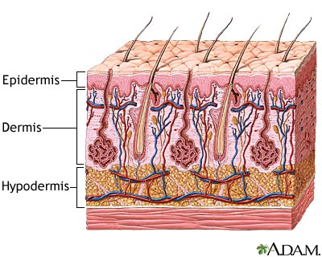

Slide 10
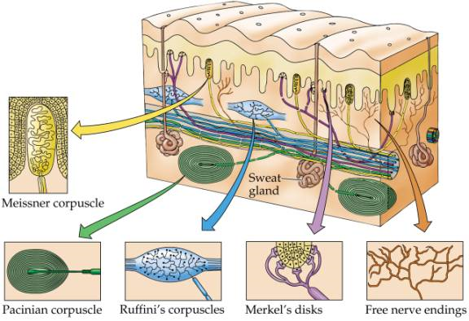

Slide 11
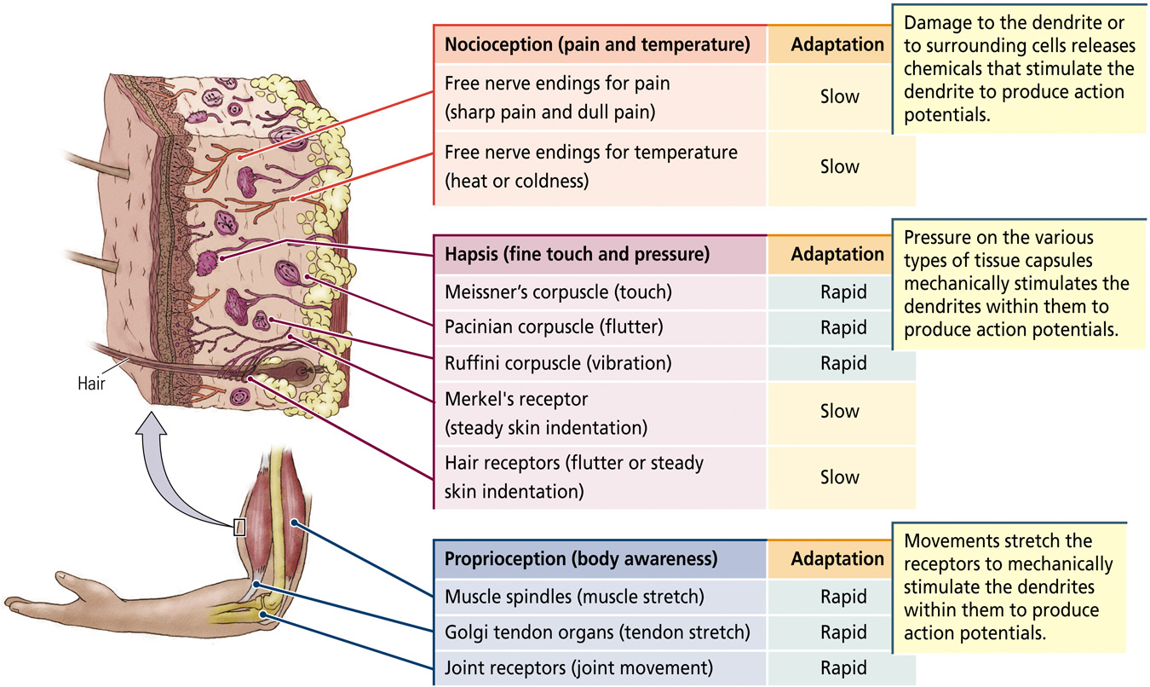
Slow

Slide 12
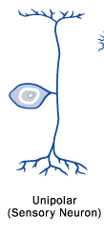
Dorsal-Root Ganglion Neurons
The dendrite and axon are contiguous and carry sensory information from the skin to the central nervous system
The tip of the dendrite is responsive to sensory stimulation
The cell bodies of the sensory neurons are located just outside the spinal cord in dorsal-root ganglia

Slide 13
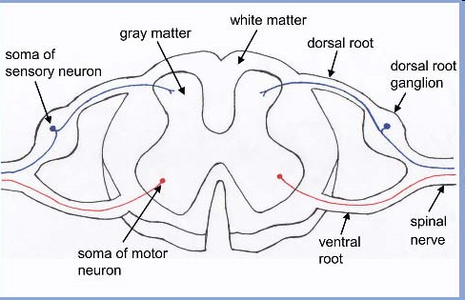
Dorsal-Root Ganglion Neurons
Each spinal cord segment has one dorsal-root ganglion on each side that contains many dorsal-root ganglion neurons
In the spinal cord, the axons of these neurons may synapse onto other neurons or continue up to the brain

Slide 14
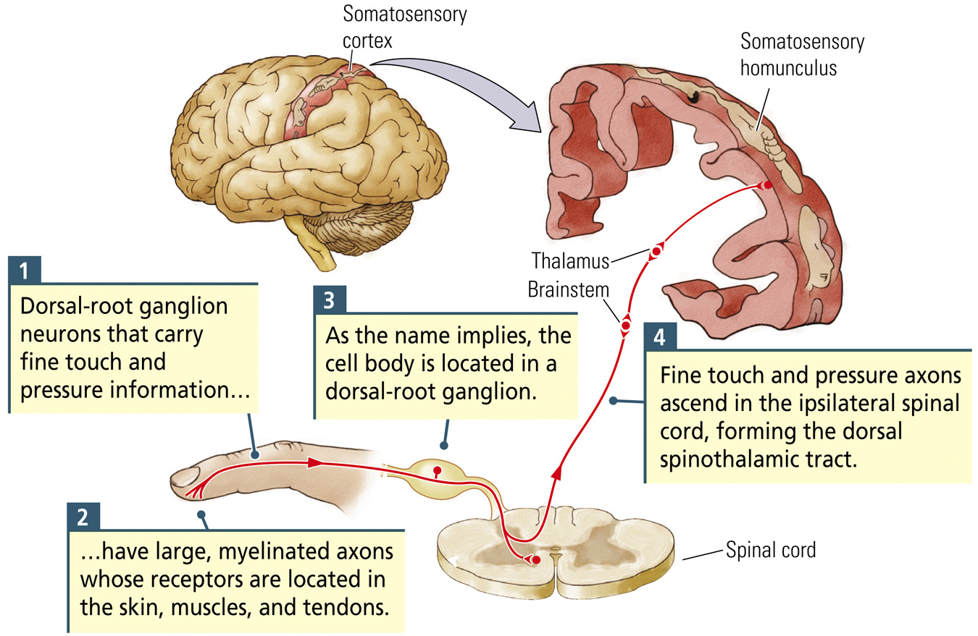

Slide 15
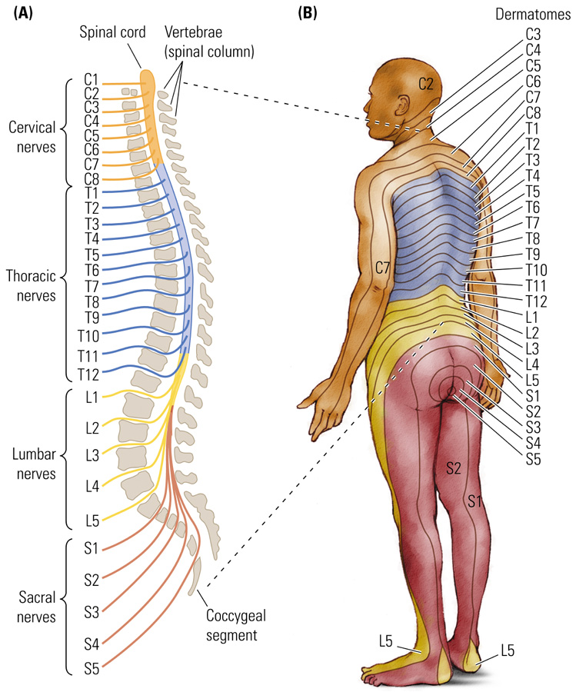
Reminder
Dermatome-Area of skin supplied with afferent nerve fibers by a single spinal cord dorsal root

Slide 16
Dorsal-Root Ganglion Neurons
Proprioceptive and Haptic Neurons
  Large, well-myelinated axons (fast)
Nocioceptive Neurons
  Small axons with little or no myelination (slow)
Deafferentation
  Loss of incoming sensory input usually due to damage to sensory fibers; also loss of any afferent input to a structure

Slide 17
Dorsal Spinothalamic Tract
(Dorsal column medial lemniscus pathway)
Carries haptic and proprioceptive information
  dorsal-root ganglion neurons
  ascend ipsilaterally in the dorsal spinal cord
  dorsal column nuclei (medulla) (cross over)
  medial lemniscus
  Ventrolateral thalamus
  somatosensory cortex and motor cortex

Slide 18
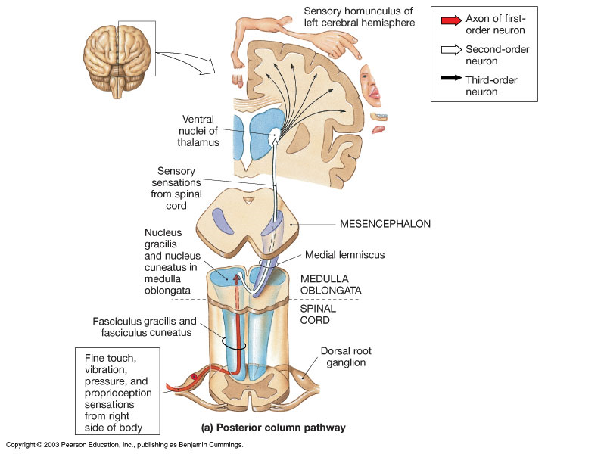

Slide 19
Ventral Spinothalamic Tract
Carries nocioceptive information
  dorsal-root ganglion neurons
  Ventral spinal cord (cross over)
  Ventrolateral thalamus
  somatosensory cortex

Slide 20
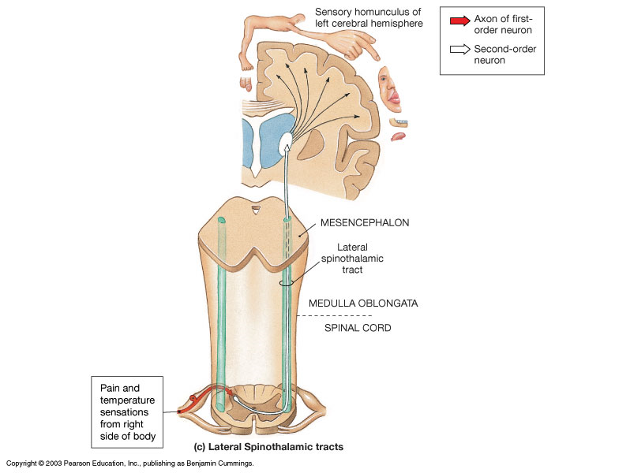



Slide 21
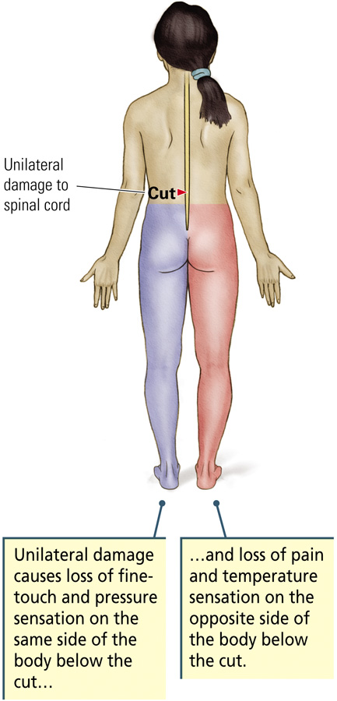
Haptic and proprioception information stays on same side until it crosses over in the brainstem
Pain information crosses over on the other side at point of entry

Slide 22
Pain Receptors
Free nerve endings:
  Intense pressure (striking, stretching or pinching)
  Extreme heat
  Chemicals: acids and capsaicin

Slide 23
Pain’s behavioral and perceptual effects
Sensory component
  Somatosensory pathway
Emotional Consequence of pain
  Hypothalamus, amygdala,
  periaqueductal grey
  Anterior Cingulate Cortex
Long-term emotional implications of chronic pain
  Prefrontal cortex

Slide 24
Pain
Periaqueductal Gray Matter (PAG)
  Nuclei in the midbrain that surround the cerebral aqueduct joining the third and fourth ventricles
  Receive projections from amygdala, and hypothalamus
  play an important role in the modulation of pain

Slide 25
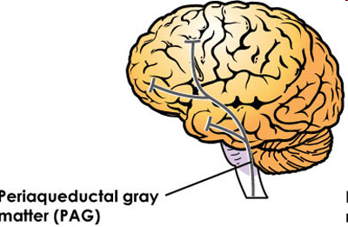
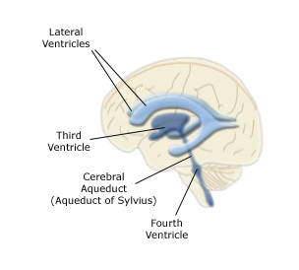
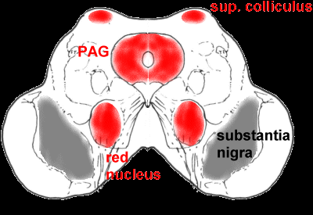

Slide 26
Gate Theory of pain
Melzack & Wall, 1965
  Hypothetical neural circuit in which activity in haptic (fine-touch and pressure) pathways diminishes the activity in nocioceptive (pain and temperature) pathways

Slide 27
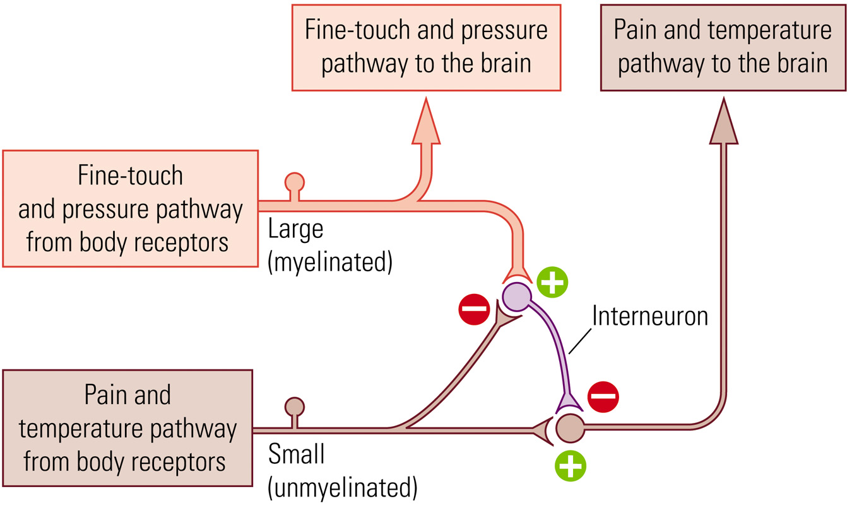

Slide 28
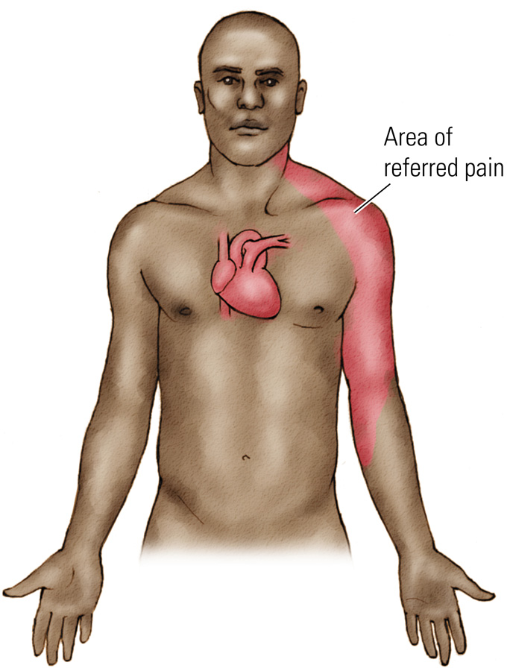
Referred Pain: Pain felt on the surface of the body that is actually due to pain in one of the internal organs

Slide 29
Exploring the Somatosensory Cortex
Two main somatosensory areas in the cortex
Primary Somatosensory Cortex
  Receives projections from the thalamus
  Brodmann’s areas 3-1-2
  Located within the postcentral gyrus, right behind the central fissure
Secondary Somatosensory Cortex
  Located behind the primary somatosensory cortex
  Brodmann’s areas 5 and 7

Slide 30
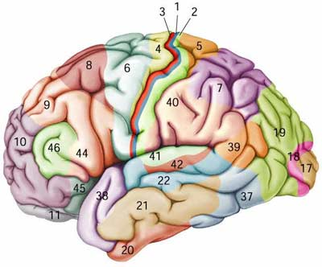
Notes:
5,7 association somatosensory cortex
1,2,3 primary sensory system

Slide 31
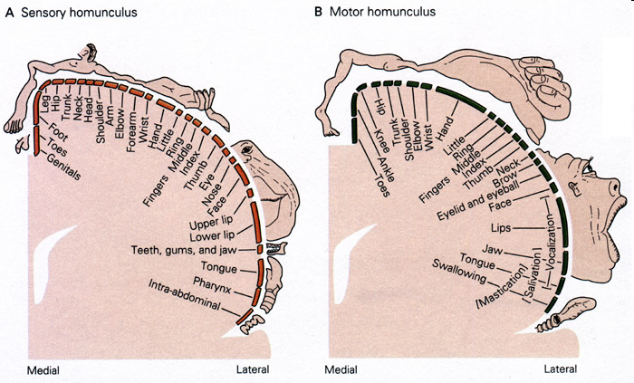
The Somatosensory Homunculus

Slide 32
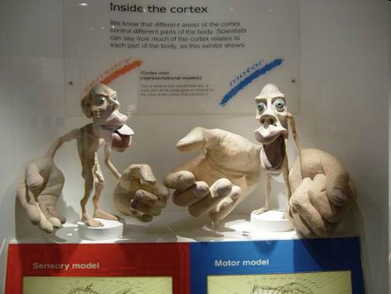

Slide 33
The Somatosensory Homunculus
More recent work suggests that there are four separate somatosensory homunculi
  Area 3a: Muscles
  Area 3b: Skin (slow)
  Area 1: Skin (fast)
  Area 2: Joints, pressure
Notes:
Described in book.

Slide 34
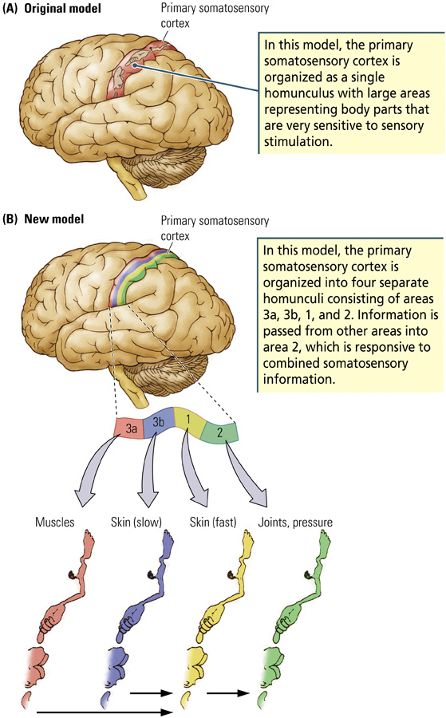

Slide 35
Damage to the Somatosensory Cortex
Damage to the primary somatosensory cortex
Reorganization following damage
Notes:
Unable to sense things (cortical sensory loss).

Slide 36
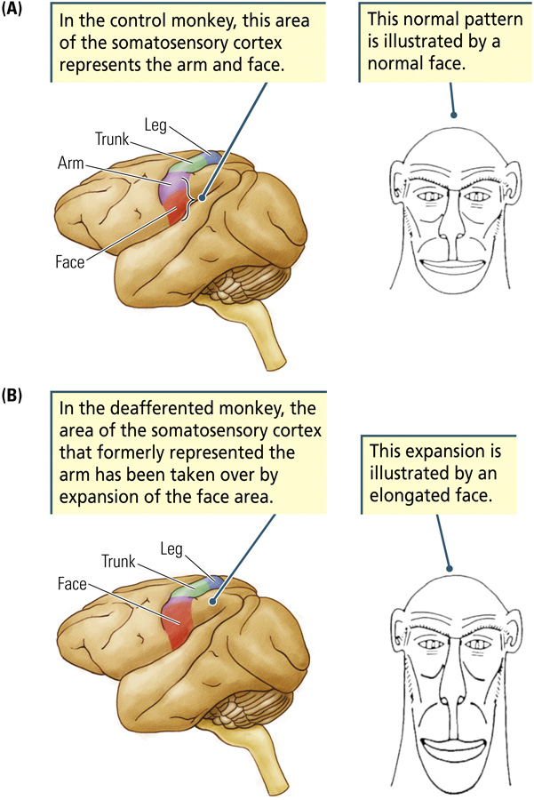

Slide 37
The Secondary Somatosensory Cortex
Secondary Somatosensory Cortex
  Involved in integrating information from the sensory and motor systems
  Participates in both the dorsal and ventral visual streams
Notes:
No the different pathways for each system and where they cross over

Slide 38
The Vestibular System and Balance
Vestibular System has two functions
  Tells us the position of the body in relation to gravity
  Signals changes in the direction and speed of movements of the head
Within each ear, there is a vestibular organ (the labyrinth) that contains:
  Three semicircular canals
  Two otolith organs (utricle and saccule)

Slide 39
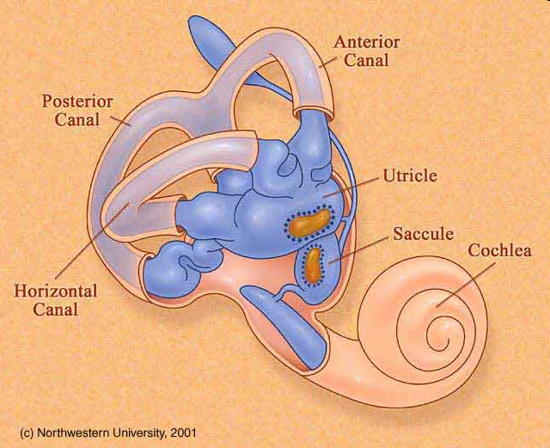

Slide 40
The Labyrinth
Three semicircular canals
  Rotational accelerations of the head
Two otolith organs (utricle and saccule)
  Linear accelerations of the head
  Static head position relative to the gravitational axis

Slide 41
The Vestibular System and Balance
When the head moves, fluid (endolymph) located within the semicircular canals pushes against hair cells, which causes bending of the cilia located on top of the hair cells
Bending of cilia leads to receptor potentials in the hair cells and action potentials in the cells forming the vestibular nerve
The direction in which the cilia are bent determines whether the hair cell becomes depolarized or hyperpolarized

Slide 42
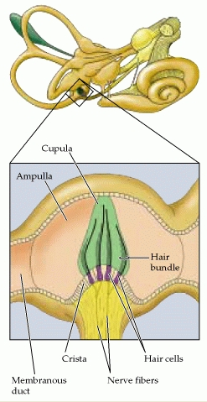
Detect rotational accelerations of the head
ampulla

Slide 43
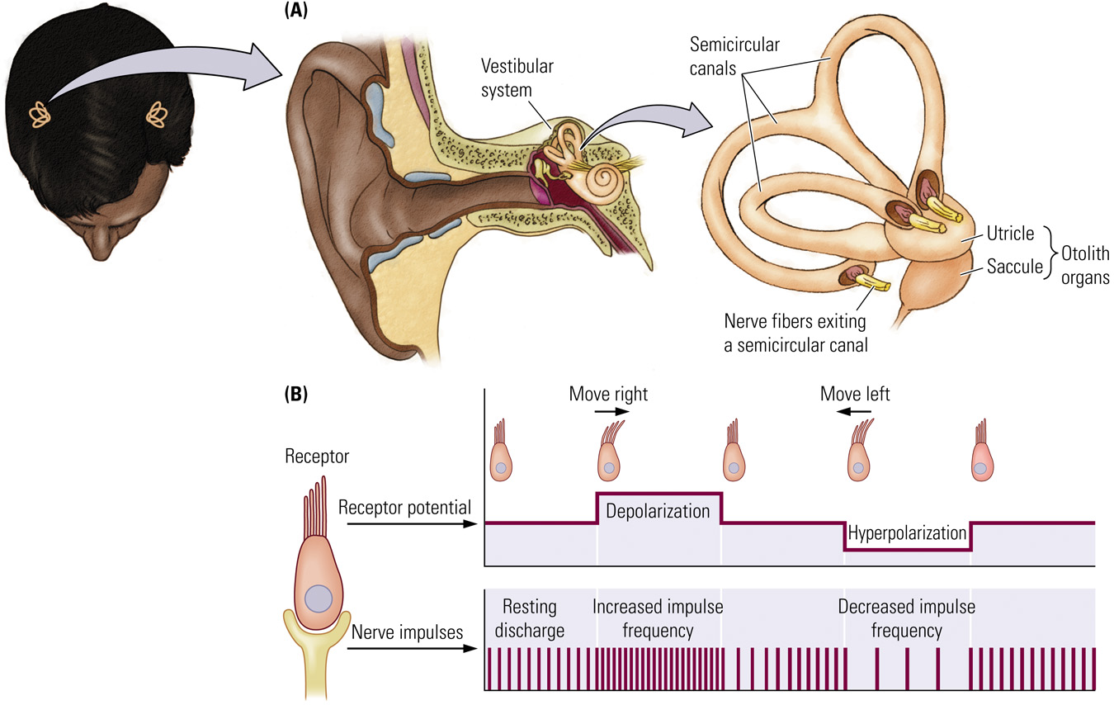
Notes:
Sensory receptors constantly fire

Slide 44
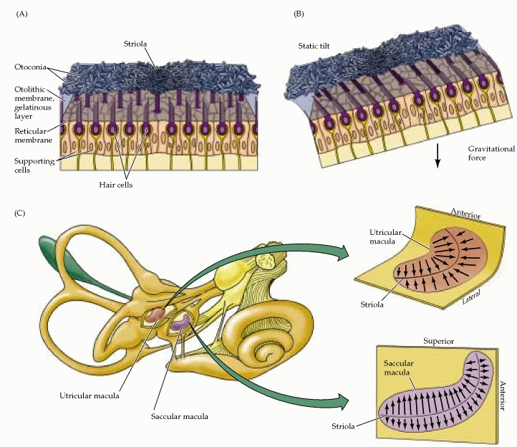
  Linear accelerations of the head
  Static head position relative to the gravitational axis

Slide 45
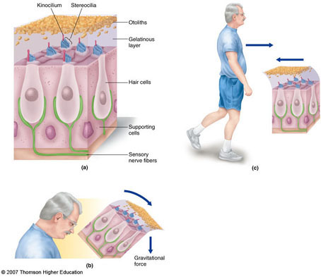

Slide 46
The Vestibular System and Balance
The utricle and saccule also contain hair cells, which are embedded within a gelatin-like substance that contains small crystals of calcium carbonate called otoconia
When the head is tilted, the gelatin and otoconia push against the hair cells, which alters the rate of action potentials in cells that form the vestibular nerve

