Slide 1
The Auditory System
Chapter 10

Slide 2
How Do We Hear, Speak, and Make Music?
Sound Waves: The Stimulus for Audition
Anatomy of the Anatomy System
Neural Activity and Hearing
Anatomy of Language and Music
Auditory Communication in Nonhuman Species

Slide 3
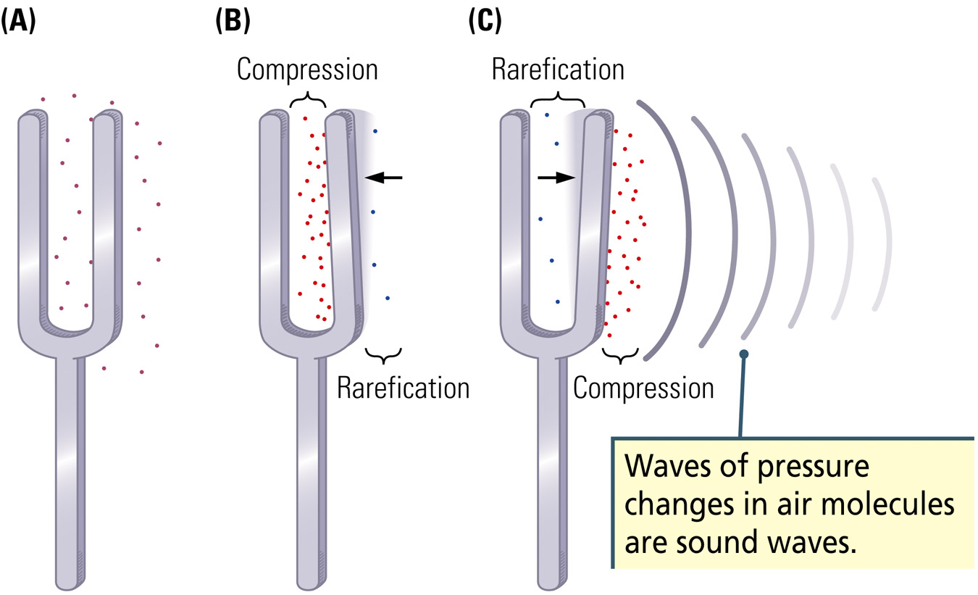
Sound Waves
Pressure waves generated by vibrating air molecules

Slide 4
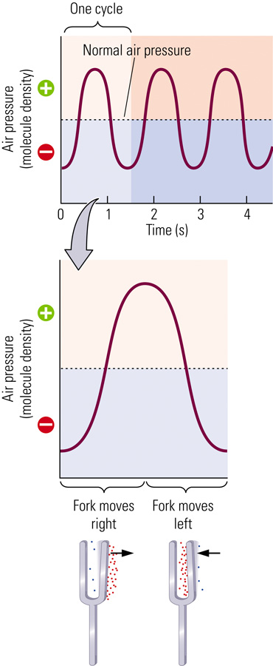

Slide 5

Three Properties of Sound
1) Frequency
Number of cycles that a wave completes in a given amount of time
  Measured in Hertz: Cycles per second
Corresponds to our perception of pitch
  Low pitch: low frequency
  High pitch: high frequency
  Examples

Slide 6
Three Properties of Sound
2) Amplitude
The intensity of a sound stimulus, usually measured in decibels (dB)
The magnitude of change in air-molecule density
Corresponds to our perception of loudness
  Soft sound: Low amplitude
  Loud sound: High amplitude

Slide 7
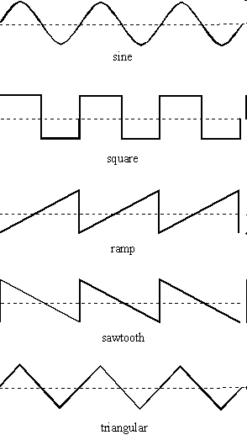
Three Properties of Sound
3) Complexity
A. Waveform
-video examples
http://www.youtube.com/watch?v=fiSeKzhBuFY

Slide 8
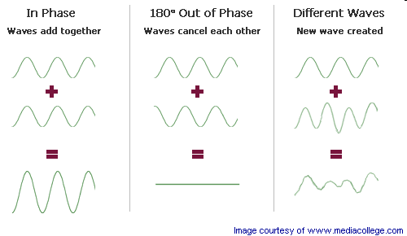
Three Properties of Sound
3) Complexity
B. Phase
http://www.umanitoba.ca/faculties/arts/linguistics/russell/138/sec4/acoust1.htm

Slide 9
Complexity of Sound Waves
Pure tones
  Sounds with a single frequency
Complex tones
  Sounds with a mixture of frequencies
  Corresponds to our perception of timbre or uniqueness
  The combination of qualities of a sound that distinguishes it from other sounds of the same pitch and volume.

Slide 10
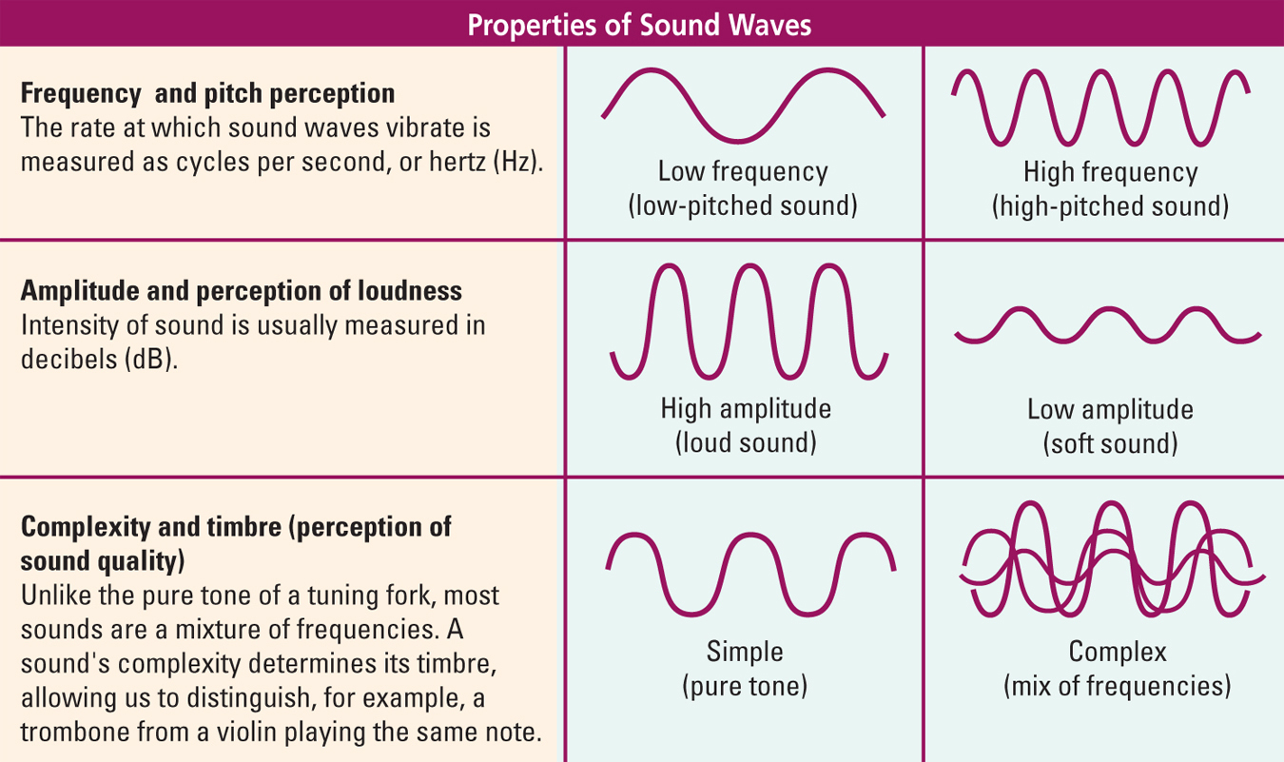
Notes:
Know this

Slide 11
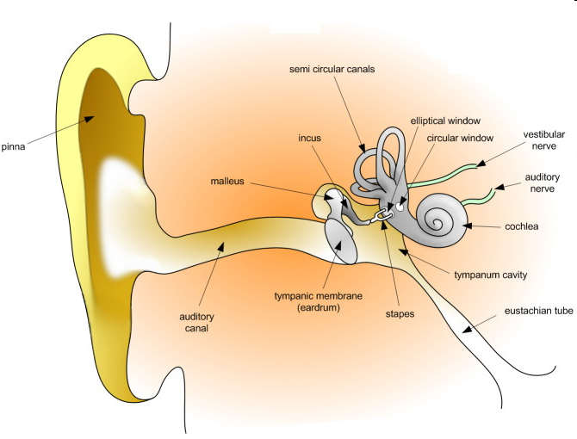

Slide 12
Structure of the Ear
Outer Ear
Pinna
  Funnel-like external structure designed to catch sound waves in the surrounding environment and deflect them into the ear canal
External Ear Canal
  Amplifies sound waves somewhat and directs them to the eardrum, which vibrates in accordance with the frequency of the sound wave

Slide 13
Structure of the Ear
Middle Ear
Air-filled chamber that comprises the ossicles
Ossicles
  Bones in the middle ear:
    Hammer (Malleus)
    Anvil (Incus)
    Stirrup (Stapes)
  Connects the eardrum to the oval window of the cochlea, located in the inner ear
  Video: http://www.youtube.com/watch?v=fm7t5S09iUg
Notes:
Know the three ossicles bones

Slide 14
Structure of the Ear
Inner Ear
Cochlea
  Fluid-filled inner-ear structure that contains the auditory receptor cells
  Organ of Corti: receptor cells and the cells that support them
Basilar membrane
  Receptor surface in the cochlea that transduces sound waves into neural activity

Slide 15
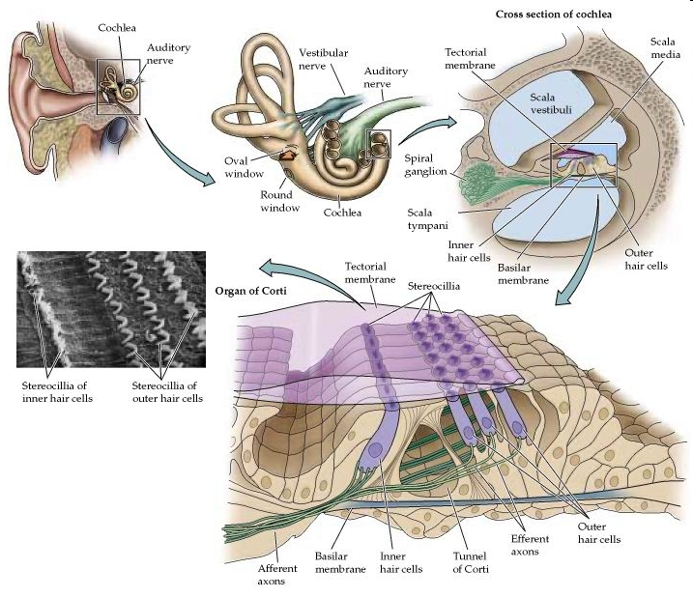

Slide 16
Structure of the Ear
Inner Ear
Hair Cells
  Sensory neurons in the cochlea tipped by cilia
  When stimulated by waves in the cochlear fluid, outer hair cells generate graded potentials in inner hair cells, which act as the auditory receptor cells
Tectorial Membrane
  Membrane overlying hair cells

Slide 17
Structure of the Ear
George von Békésy (1960s)
Sound waves produced a traveling wave that moved all along the basilar membrane
Mapped the responsiveness of the basilar membrane to different frequencies
  Fast wave frequencies: caused maximum displacement near the base of the membrane
  Slower wave frequencies: caused maximum displacement near the membrane’s apex

Slide 18
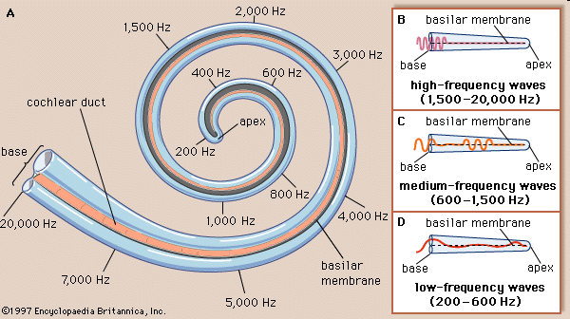

Slide 19
Auditory Receptors
Transduction of sound waves into neural activity takes place in the hair cells
  inner hair cells
    3500
    auditory receptors
  outer hair cells
    12,000
    alters stiffness of tectorial membrane
Movement of the basilar membrane stimulates the hair cells via bending and shearing action

Slide 20
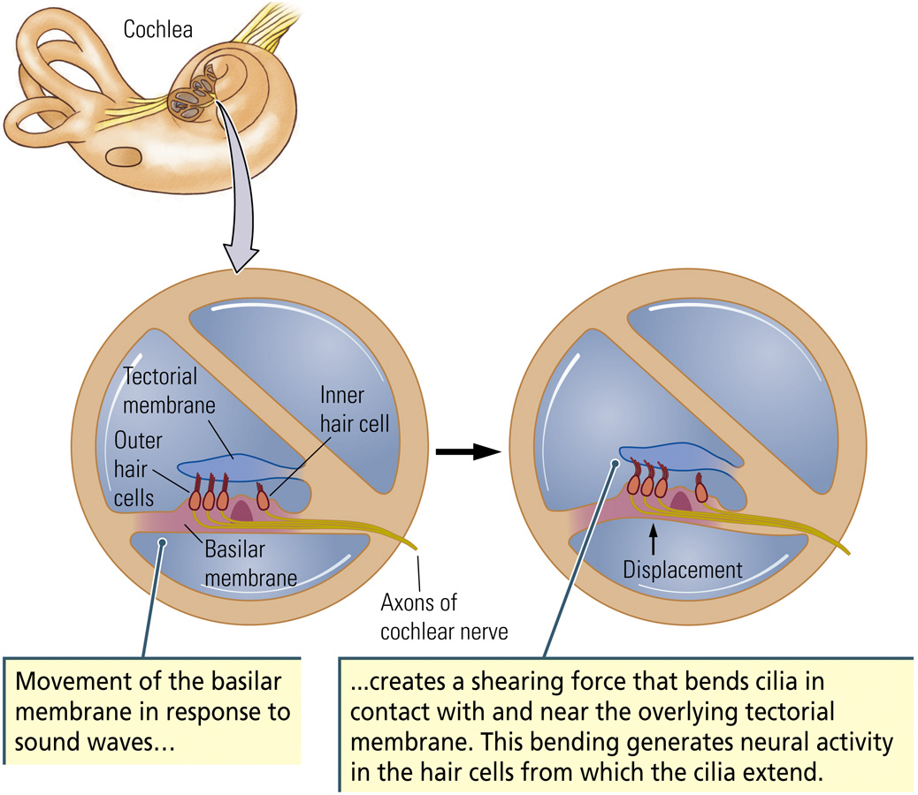

Slide 21
Auditory Receptors
Movement of cilia toward the tallest one depolarizes the cell, causing calcium influx and release of neurotransmitter, which stimulates cells that form the auditory nerve
Movement of cilia toward the shortest one hyperpolarizes the cell, resulting in less neurotransmitter release

Slide 22
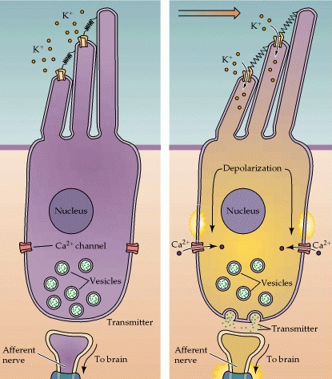
Tip link

Slide 23
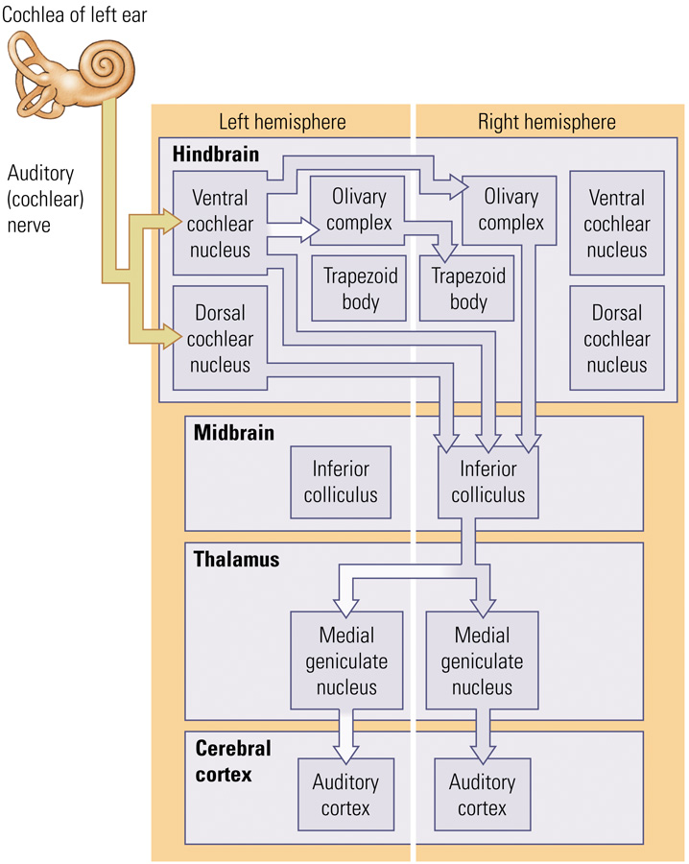
Lateral lemniscus
Notes:
Know the type of nuclei that information travels through

Slide 24
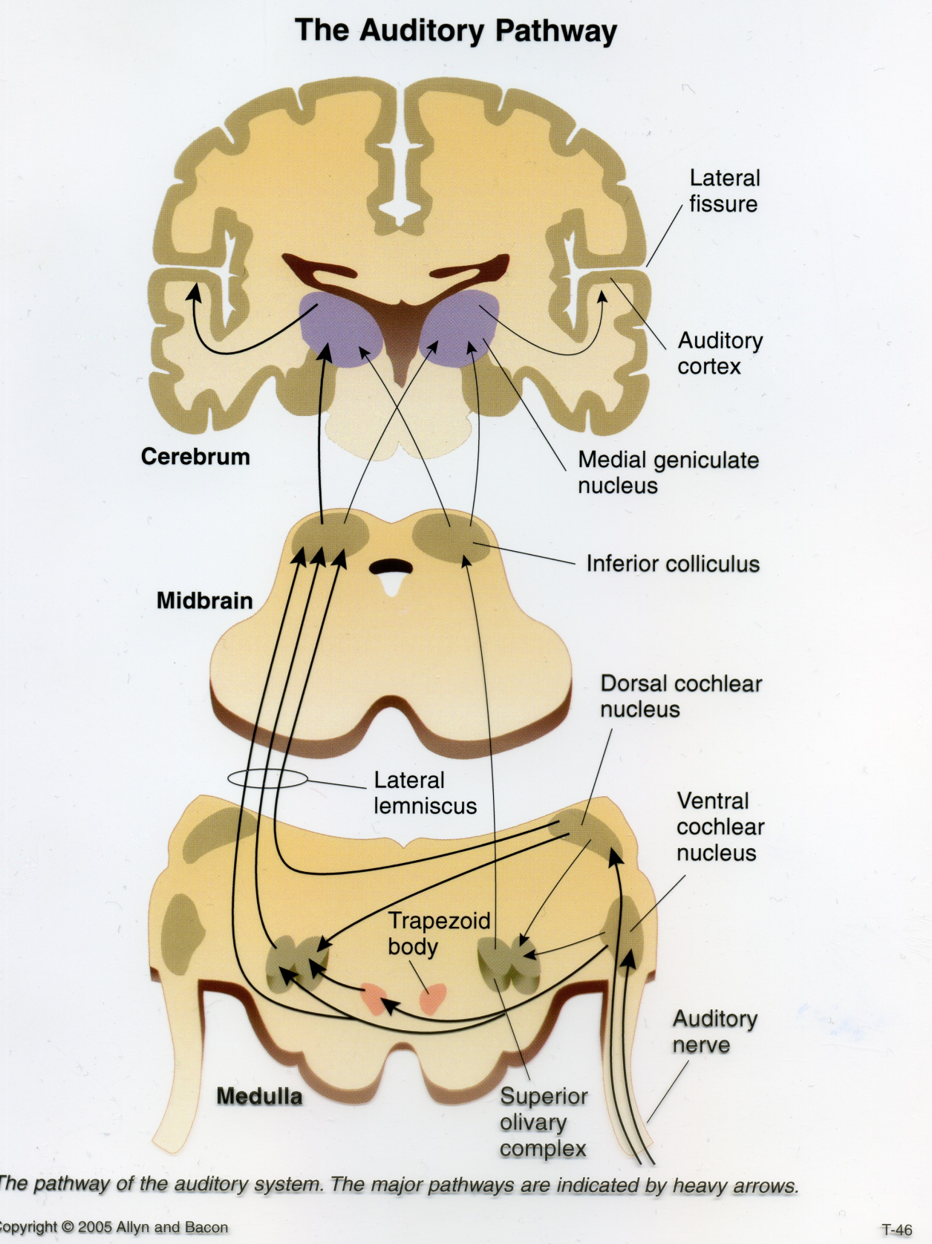
Medial Geniculate Nucleus (MGN)
  Ventral region projects to Primary Auditory Cortex (A1)
  Dorsal regions project to cortical regions adjacent to A1
Primary Auditory Cortex (A1)
  Asymmetrical structures, found within Heschl’s gyrus in the temporal lobes

Slide 25
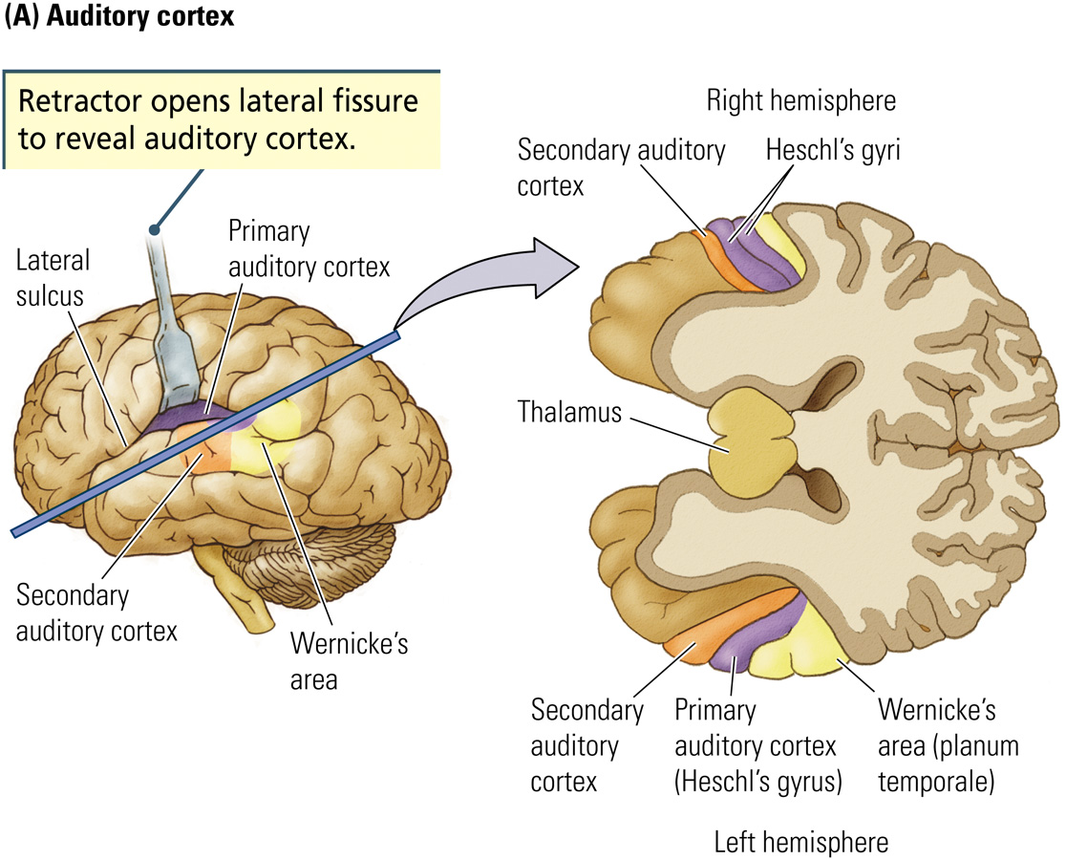

Slide 26
Auditory Cortex
Heschl’s gyrus (A1)
Wernicke’s area
  Secondary auditory cortex (planum temporale) lying behind Heschl’s gyrus (A1) at the rear of the left temporal lobe

Slide 27
Auditory Cortex
Asymmetries in Right-Handed People
Lateralization
What about Left-Handed People?

Slide 28
Detecting Pitch:
Very Low Frequencies of Sound Tonotopic Representation
Property of audition in which sound waves are processed in a systematic fashion from lower to higher frequencies
Low frequencies
  the apex of the basilar membrane
  the anterior portion of A1
High frequencies
  the base of the basilar membrane
  posterior portion of A1

Slide 29
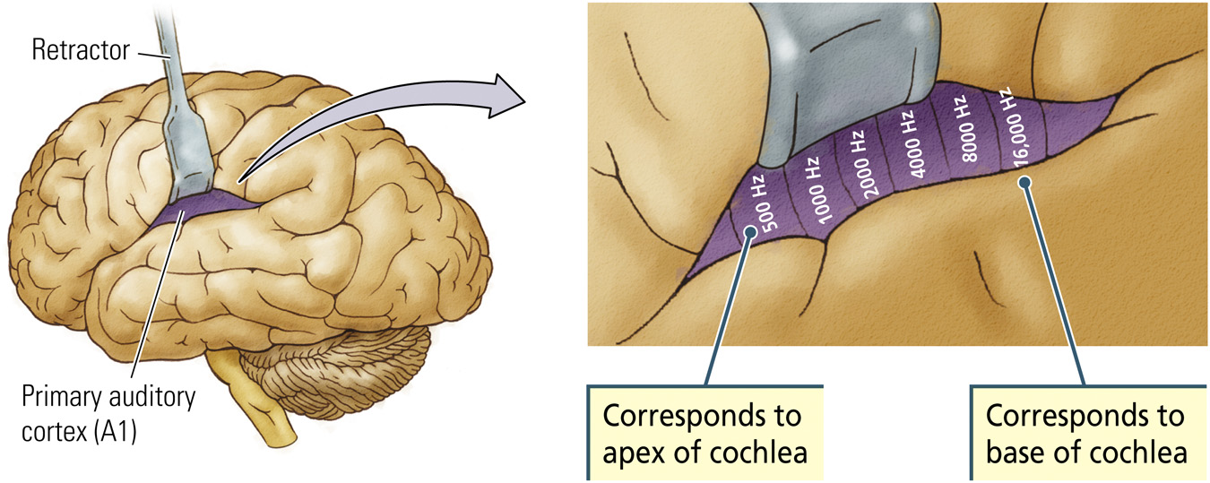

Slide 30
Detecting Pitch:
Very Low Frequencies of Sound
What about very low frequencies?
  Tonotopic theory does not explain how sounds below 200 Hz are coded
  Sounds in this range stimulate all cells on the very apex of the basilar membrane
  Rate of firing is proportional to frequency

Slide 31
Detecting Loudness
greater shearing action of the hair cells leading to more neurotransmitter release onto bipolar cells
greater firing rate of bipolar cells in the cochlea

Slide 32
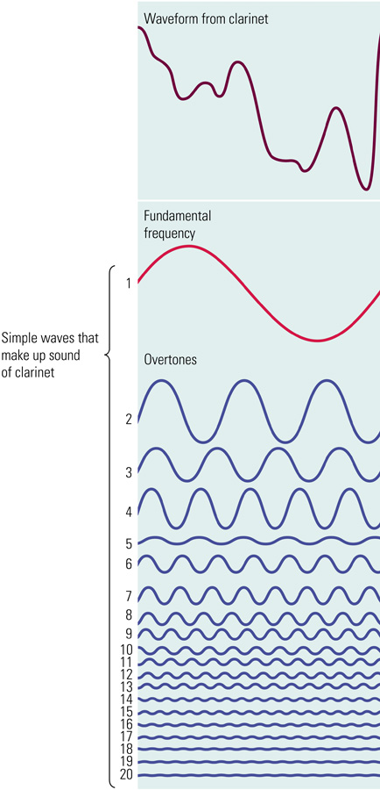
Detecting Timbre
Fundamental Frequency: The rate at which the complex waveform pattern repeats
Overtones: Set of higher frequency sound waves that vibrate at whole-number (integer) multiples of the fundamental frequency

Slide 33
Detecting Location
Medial Part of the Superior Olivary Complex
  Cells in each hemisphere receive inputs from both ears and calculate the difference in arrival times between the two ears

Slide 34
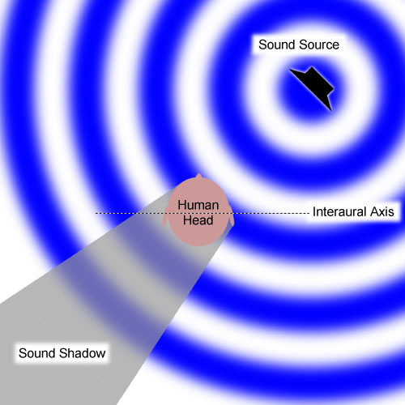

Slide 35
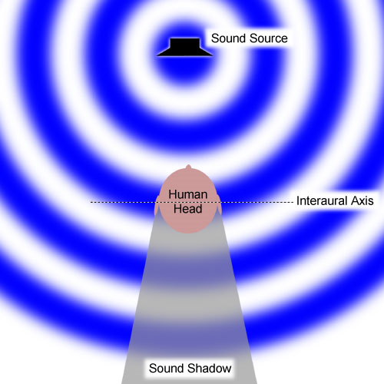

Slide 36
Detecting Location
Lateral Part of the Superior Olivary Complex and Trapezoid Body
  Source of sound is detected by the relative loudness on the left or on the right side of the head
  the head absorbs high frequency and acts as a “sonic shadow”

