Slide 1
Managerial Economics
Class 5 -- Production
Remember Assignment
Clicker Questions (Review of Consumer Theory)
Introduction to Production
Short Run Production
Long Run Production
Returns to Scale
Summary and Next Class

Slide 2

Clicker Question 1
Linda likes dancing, T, and shoes, S. Her utility function is U(S,D) = SD² . The prices are 10 for dancing and 50 for shoes. Linda has an annual budget of $550 and maximizes utility.
Shoes and dancing are perfect complements for Linda.
Shoes and dancing are perfect substitutes for Linda.
The marginal utilities are MU_{S} = 2SD and MU_{D} = D² .
Linda will certainly consume positive amounts of shoes and dancing.
c. and d.

Slide 3


Clicker Question 2
As with Q1, Linda has utility function is U(S,D) = SD² , the price of going dancing is 10, the price of a pair of shoes is 50, and Linda has an annual budget of $600 for shoes and dancing. She maximizes utility subject to her budget constraint.
For every 10 times Linda goes dancing she will get one new pair of shoes.
Linda will go dancing 40 times during the year.
Dancing and shoes are both normal goods.
All of the above.
Linda will have sore feet.

Slide 4
Is the Theory of Consumer Choice accurate?
Do real choices match the “bang for the buck” principle?
(Are people good consumers?)
Are real choices transitive?
What explains failures to make good choices?
Is consumption utility closely related to happiness?
Does more income make people happier?

Slide 5
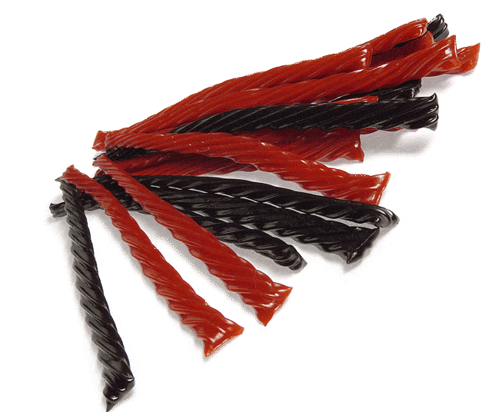
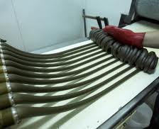
2. Introduction to Production
One important managerial decision is how to carry out production. The manager asks “What is the best way to produce our output?”
Ch. 5 of the textbook starts with a discussion of licorice production. The owner, Mr. Nelson, recently installed an automated drying system – reducing his workforce from 450 to 240 workers. What are the implications for him and his workers?

Slide 6
Inputs
Output is produced using inputs such as capital, labour, land and energy. We will focus on just two inputs – capital and labour – so as to make it possible use diagrams for our analysis.
The average product, AP of labour is total output divided the labour input.
The marginal product, MP of labour shows the extra output arising from using more unit of labour, holding other factors (capital) constant. Using calculus the marginal product is the derivative of output with respect to labour – a rate of change.

Slide 7
The Production Function
The production function shows the maximum output (q) that a firm can produce for every specified combination of inputs.
The production function shows what is technically feasible when the firm operates efficiently with current technology.
The production function for two inputs: q = F(L,K). Output (q) is a function of capital (K) and labour (L).

Slide 8
Short and Long Run Production
Short Run
Period of time in which quantities of one or more productive inputs cannot be varied. These inputs are called fixed inputs.
Long Run
Amount of time needed to make all production inputs variable,
When we work with labour and capital and inputs, we normally assume that capital is fixed in the short run but flexible in the long run. Labour is flexible in both the long run and the short run.

Slide 9
3. Production in the Short Run
K | L | Output, Q | MP of Labour | AP of Labour
8 | 0 | 0
8 | 1 | 5 | 5 | 5
8 | 2 | 18 | 13 | 9
8 | 3 | 36 | 18 | 12
8 | 4 | 56 | 20 | 14
8 | 5 | 75 | 19 | 15
8 | 6 | 90 | 15 | 15
8 | 7 | 98 | 8 | 14
8 | 8 | 104 | 6 | 13
8 | 9 | 108 | 4 | 12
8 | 10 | 110 | 2 | 11
8 | 11 | 110 | 0 | 10
8 | 12 | 108 | –2 | 9
This table shows short run production for a firm.
Capital is fixed at 8.
Output, Q varies as labour varies.
MP = ΔQ/ΔL
AP = Q/L

Slide 10
Clicker Question 3:
Marginal and Average Product
Marginal product (MP) and average product (AP) are related. Which of the following statements is true?
If MP > AP then AP must be increasing.
When marginal product is zero, total product (output) is at its maximum.
If MP = AP, then AP is at its maximum.
All of the above.
None of the above.

Slide 11
The Law of Diminishing Marginal Returns
If a firm keeps increasing an input, holding all other inputs and technology constant, the corresponding increases in output will eventually become smaller (diminish).
The law of diminishing marginal returns (LDMR) is reflected in the shape of the marginal product curve. After some point it declines.
Based on the LDMR Thomas Malthus raised concerns about hunger and starvation in the late 18th century. If land is fixed and labour grows, MP should decline, leading to less food per person.
The primary question concerns whether the effects of diminishing returns can be offset by technological progress.

Slide 12
Agricultural Yield Growth Rates (Technological Progress)
Yield growth exceeded population growth until the last decade. (Land is approximately fixed.)

Slide 13
Clicker Question 4
Assume that agricultural land is approximately fixed. Which of following statements about agricultural production is true?
Technological progress in agriculture has pretty much stopped.
If population growth exceeds yield growth the per capita food availability will fall.
The theory of supply and demand suggests that food prices will rise if population growth exceeds yield growth.
all of the above.
b and c.

Slide 14
Real Food Prices 1961-2011

Slide 15
Clicker Question 5:
Which of the following statements is true.
In the short run all factors of production are flexible.
If capital is fixed we normally expect marginal returns to labour to first rise and then fall as we increase labour.
When we refer to “capital” as a factor of production we mean “money” (financial capital).
All of the above.
None of the above.

Slide 16
4. Long Run Production
In the long run, both labour and capital can be varied. The following table the output produced by various amounts of labour and capital.
 | Labor, L
Capital, K | 1 | 2 | 3 | 4 | 5 | 6
1 | 10 | 14 | 17 | 20 | 22 | 24
2 | 14 | 20 | 24 | 28 | 32 | 35
3 | 17 | 24 | 30 | 35 | 39 | 42
4 | 20 | 28 | 35 | 40 | 45 | 49
5 | 22 | 32 | 39 | 45 | 50 | 55
6 | 24 | 35 | 42 | 49 | 55 | 60
Note the various different ways of producing 24 units of output.

Slide 17
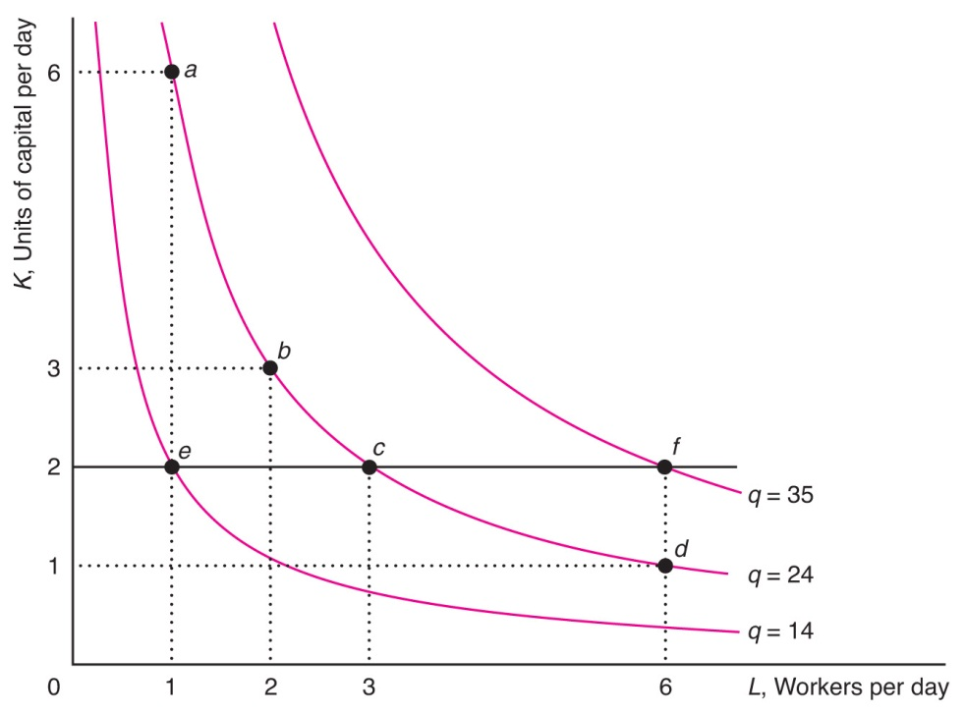
Isoquants
An isoquant shows all efficient combinations of labour and capital that can produce the same output.
The various combinations of labour and capital that can produce 24 units of output are shown on the middle isoquant.

Slide 18
Properties of Isoquants
Isoquants are similar to indifference curves. An indifference curve shows different combinations of goods that yield the same utility.
An isoquant shows different input combinations that yield the same output.
Isoquants that are further from the origin represent higher levels of output. Isoquants slope downward, do not cross, and are usually convex.
Selecting an output level determines the isoquant to be reached. The position on the isoquant determines the capital output ratio.

Slide 19
Marginal Rate of Technical Substitution (MRTS)
The slope of an isoquant is the marginal rate of technical substitution (MRTS).
It shows how much of the good on the vertical axis (capital) is needed to replace one unit of the good on the horizontal axis (labour) to keep output constant.
The MRTS is the slope of an isoquant.
If the isoquant is convex, then the MRTS is diminishing.
The next two slides show two extreme examples: perfect substitutes and perfect complements.

Slide 20
Perfect Substitutes
Capital
per
month
A
The same output can be reached with mostly capital or mostly labor (A or C) or with equal amount of both (B)
B
C
Q₁
Q₂
Q₃
Labor
per month
The MRTS is constant for this case.
Notes:
64

Slide 21
Perfect Complements
In this case, no substitution between inputs is possible.
Capital
Q₃
C
Q₂
B
K₁
Q₁
A
Labor
L₁
Notes:
66

Slide 22
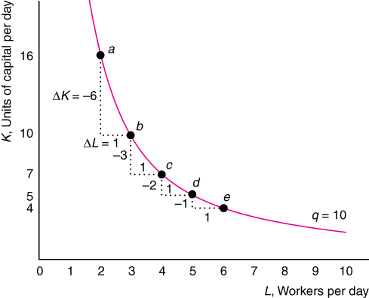
A Diminishing MRTS
In the standard case, it becomes more difficult to replace capital as the amount of capital falls. The MRTS falls – the slope of the isoquant gets flatter. See Ford Video.

Slide 23
Clicker Question 6
See Ford Video
The Ford plant in Brazil exhibits
a high capital labour ratio relative to US plants.
the benefits of collective bargaining between unions and management.
diminishing marginal returns to labour.
perfect complementarity in production between capital and labour.
None of the above.

Slide 24
5. Returns to Scale
  Increasing returns to scale (IRS): When all inputs increase by the same proportion, output increases by a greater proportion.
  Constant returns to scale (CRS): When all inputs increase by some proportion, output increases by the same proportion.
  Decreasing returns to scale (DRS): When all inputs increase by the same proportion, output increases by a smaller proportion.
  For example, if we double all inputs and output triples, then we have increasing returns to scale.

Slide 25
Clicker Question 7
Suppose that the production function is given by Q = 10K + 5L.
This production function has increasing returns to scale everywhere.
This production function has constant returns to scale everywhere.
The production function has decreasing returns to scale everywhere.
The returns to scale vary depending on the amount of capital and labour used.
None of the above.

Slide 26
Summary
1. One important managerial decision concerns how to produce output
2. Diminishing Marginal Returns arise in the short run.
3. The key long run production question concerns choosing factor proportions. (Licorice plant?)
4. The concept of returns to scale is a long run concept.
5. Technological progress and the resulting growth of productivity is the main source of improvements in standard of living.
Next class: Clicker questions related to Q. 2.3 and Q. 4.8
Then: Ch. 6, Sections 6.1-6.3.

