Slide 1
Managerial Economics
Class 4 –Monday, Sept. 19
Assignment 1 is posted and is due in two weeks (Oct. 1)
1. Clicker Questions on Elasticity and Regression
2. Introduction to Consumer Choice
3. Indifference Curves
4. Utility and Marginal Utility
5. The Budget Line
6. Maximizing Utility
7. Summary
Reading: Sections 4.1-4.4 (up to p. 103).

Slide 2
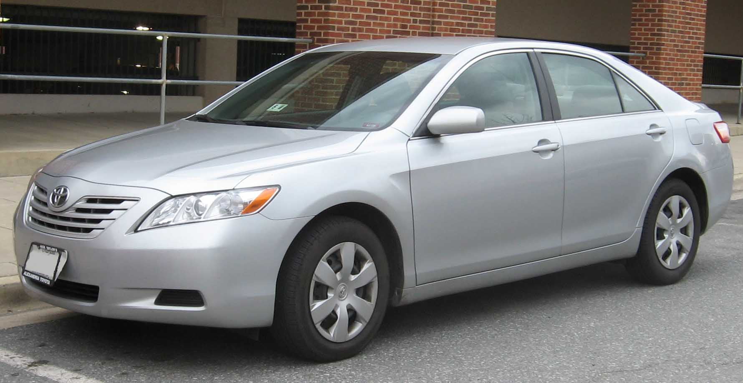
Clicker Question 1:
Camry Regression
Based on a particular focus group with 50 people in it, demand for the Camry was estimated as Q = 53.857 – 1.438p where p is price in $ ‘000s.
At a price of $20 (thousand) demand is elastic.
If this focus group is representative of a large population of about 50,000 potential buyers in BC, then expected sales at a price of $10 (thousand) would be over 38,000 vehicles.
Price is the dependent variable in this regression.
a. and b.
All of the above.

Slide 3
Clicker Question 2
Which of the following statements about the Camry regression is correct.
Price and quantity are negatively correlated but not causally related.
We can be confident that no potential explanatory variables other than price are important.
The textbook shows that the linear form is the best functional form for Camry demand.
The standard errors reported by the LINEST function can be used in assessing the statistical significance of the results.
None of the above.

Slide 4
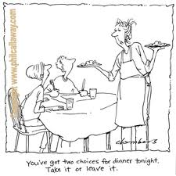
2. Introduction to Consumer Choice
It is important for managers to have some understanding of consumer behaviour –what lies behind the demand curve.
It is also important for consumers and for managers to understand how to make good purchasing decisions.

Slide 5
Preferences
Consumer choice is based on consumer preferences. Consumers prefer some consumption bundles to others.
A consumption bundle consists of specific amounts of particular goods.
We make three assumptions about preferences over consumption bundles:
Completeness (Any two consumption bundles can be compared.)
Transitivity (If a is preferred to b and b is preferred to c, then a must be preferred to c. Also if a consumer is indifferent between a and b and between b and c, then a and c must be equally preferred.)
Non-satiation (More is preferred to less).

Slide 6
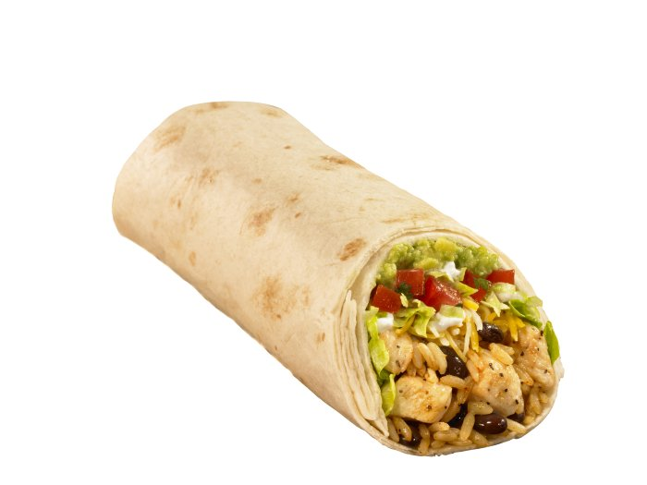
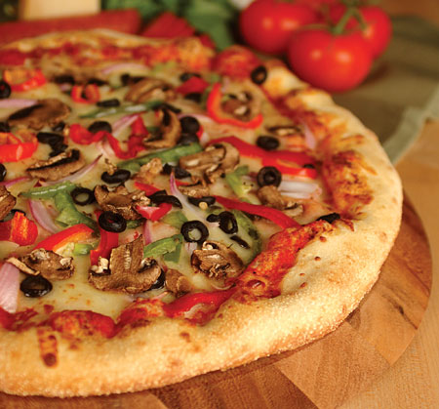
3. Indifference Curves
We can represent consumer preferences using indifference curves.
To keep things as simple as possible we will focus on just two goods.
Consider a consumer who is choosing between two goods, burritos and pizza – trying to determine how much of each good to consume over a week.

Slide 7
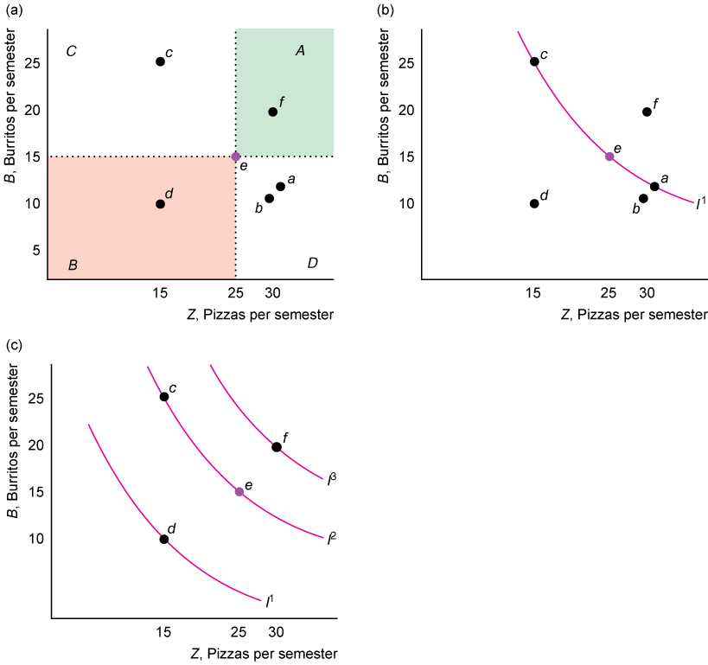
Indifference Curves cont’d.
Several possible consumption bundles are illustrated. For example, point e represents 15 burritos and 25 pizzas. This bundle can be compared with any other bundle. Point e might be preferred, the other bundle might be preferred, or the consumer might like the two bundles equally.
All the bundles that the consumer likes equally to bundle e are on the scarlet line – the indifference curve.

Slide 8
Indifference Curves cont’d
Higher indifference curves represent bundles that the consumer likes better.

Slide 9
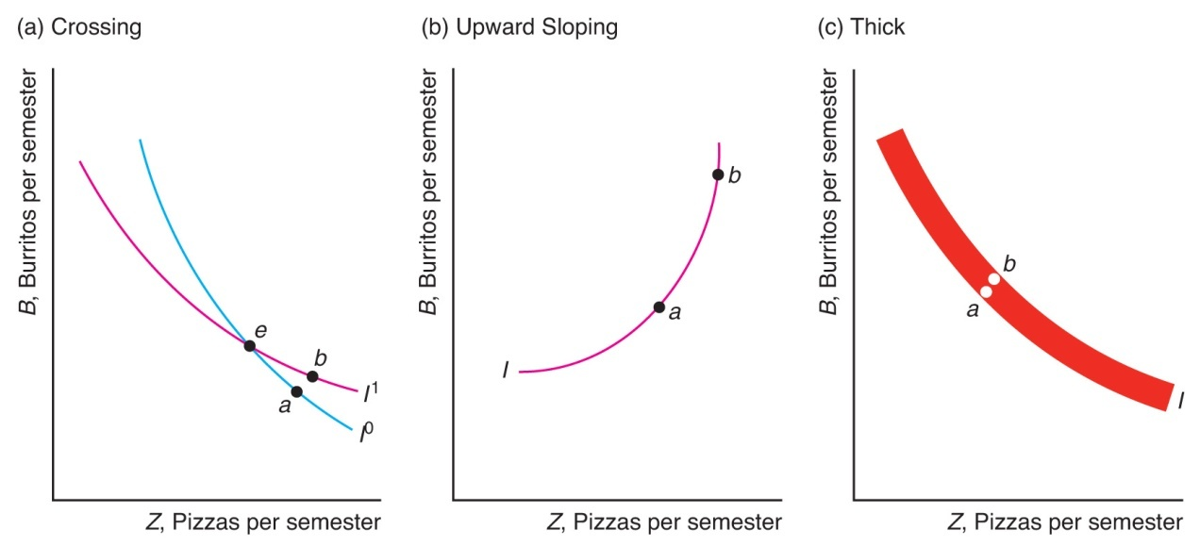
Impossible Indifference Curves
Indifference curves cannot cross.
Indifference curves for goods do not slope upwards.
Indifference curves cannot be thick.

Slide 10

Clicker Question 3
To prove that indifference curves cannot cross we assume they can and show this is impossible (i.e. is inconsistent with our assumptions). In the diagram bundle b must be preferred to bundle a due to the assumption of _______. However, a and e must give equal utility because they are on the same indifference curve and b and e must also give the same utility as they are on the same indifference curve. If follow a and b must give the same utility because of _______. The missing are, in order:
Transitivity and transitivity.
Transitivity and non-satiation.
Non-satiation and transitivity.
Non-satiation and something else.
None of the above.

Slide 11
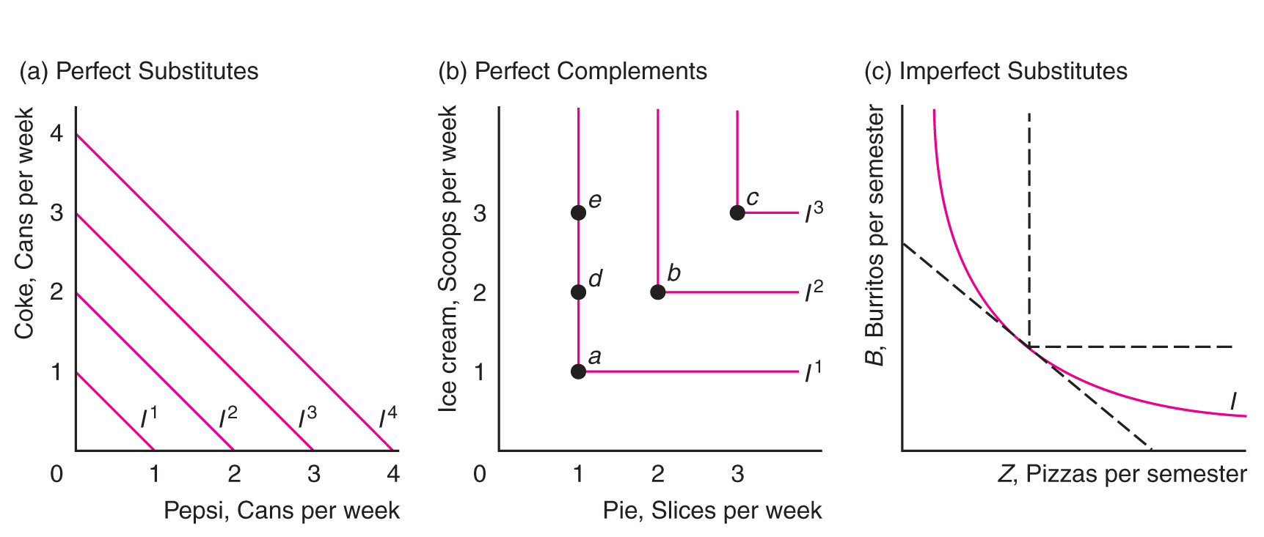
Examples of Indifference Curves
Panel b shows indifference curves for someone who only eats ice cream with pie and only eats pie if ice cream is available.

Slide 12
Clicker Question 4
A consumer has a budget for two perfect complements. If the budget for these goods shifts out, the consumer would
Consume more of only one of the two goods.
Consume more of the two goods but keep their proportion constant.
Consume more of the two goods but change their proportion.
Consume the same amount of both goods and spend the extra money on other goods.
None of the above.

Slide 13
4. Utility and Marginal Utility
Utility is the consumer’s well-being or satisfaction from consuming a bundle of goods.
We can represent this utility using a function. If there are two goods, like burritos, B, and pizza, Z, then the utility function is U(B,Z).
Sometimes we think of this function as having only ordinal properties, like a critic’s movie ratings.
Sometimes we think of the utility function as having cardinal properties
Marginal utility is, in rough terms, the extra utility from an additional unit of a good. Using calculus, it is the derivative of utility with respect to the quantity of the good.
We expect diminishing marginal utility: the more of a good we have, the less we value additional units of that good.

Slide 14
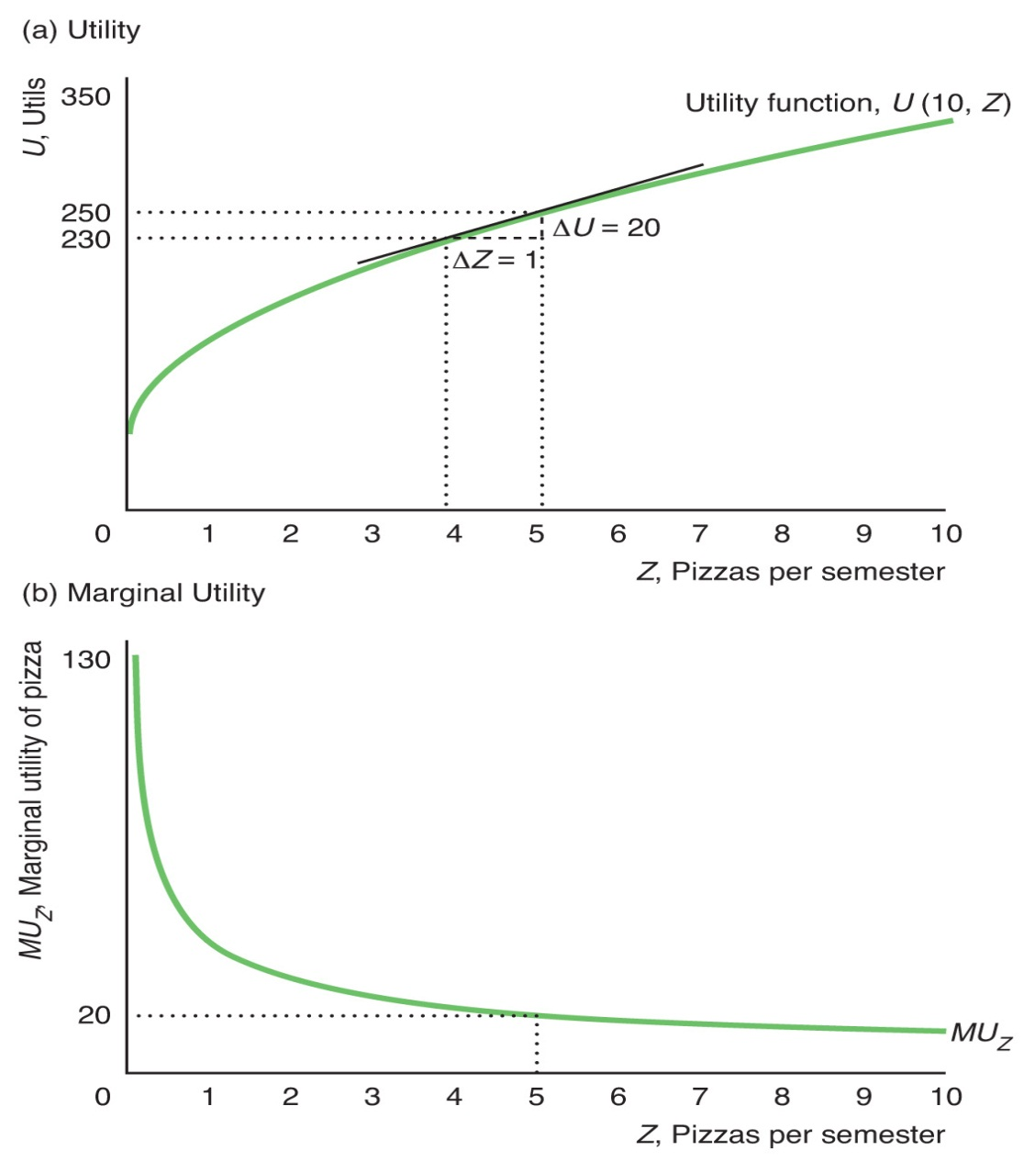
Diminishing Marginal Utility for Pizza
In this case we hold burrito consumption fixed at 10 and graph utility as a function of pizza.
The slope of utility function decreases as Z increases. We can plot this slope, showing the marginal utility.
Pizza has diminishing marginal utility in this case.

Slide 15
Clicker Question 5
Consider the following two possible utility functions.
(1) U = BZ; (2) U = ln(B) + ln(Z). Recall that the derivative of ln(x) is 1/x.
Utility function 1 exhibits decreasing marginal utility for both goods.
Utility function 2 exhibits decreasing marginal utility for both goods.
Using marginal utility assumes that utility has cardinal properties.
All of the above.
b and c.

Slide 16
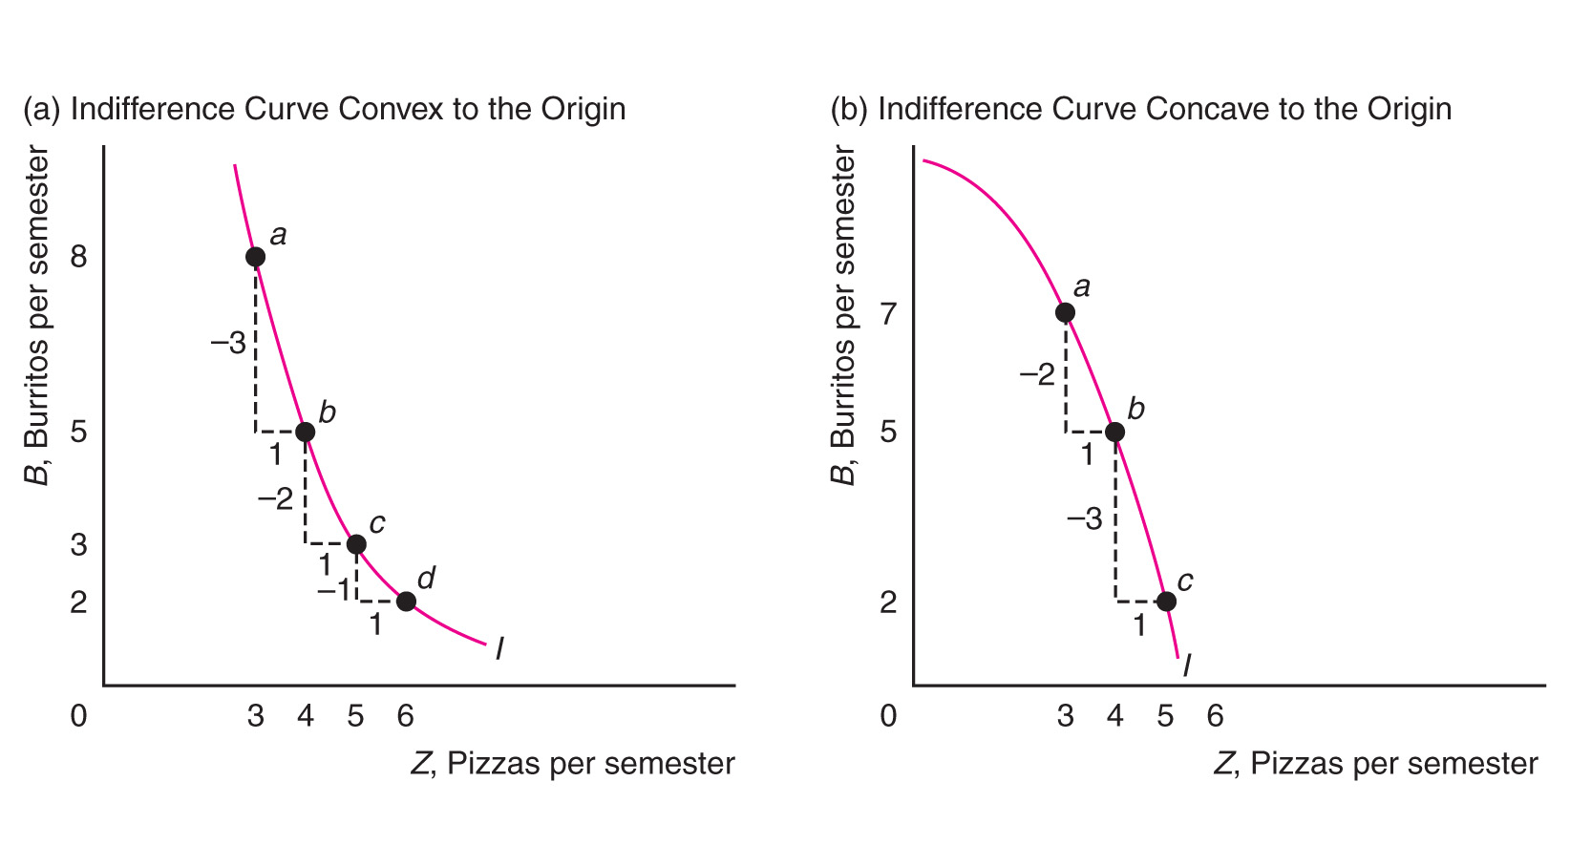
The Marginal Rate of Substitution
The MRS is the slope of an indifference curve (IC). It shows the rate at which the consumer can exchange one good for another and stay on the same indifference curve.
If B is on the vertical axis, then MRS is ΔB/ΔZ. It tells us how many units B are needed to replace one unit of Z in order to keep the consumer on the same indifference curve (i.e. at the same utility level).
Using calculus, the MRS at a point is the derivative of the indifference curve: dB/dZ along the IC.

Slide 17
5. The Budget Line
We assume that consumers seek to get to the highest indifference curves they can – to achieve the highest level of utility possible – given their limited income (or budget) and any other constraints they face. Let Y = income.
We represent limit income using a budget constraint: the amount spent on the consumption bundle cannot exceed the available budget.
p_{B}B + p_{Z}Z = Y,
or
This is the budget line. The slope of the budget line is the price ratio. We sometimes call this slope the marginal rate of transformation (MRT) as it shows the rate at which we can transform one good into another.

Slide 18
Clicker Question 6
Suppose a consumer has a budget, Y, of $40 to spend on guacamole (G) and salsa (S) for the month. G costs $6.00 per container and salsa costs $4.00 per container. It follows that the budget line can be written as:
40 = 6S + 4G.
G = 10 – 1.5S
S = 10 – G
S = 40 – 6G
None of the above.

Slide 19
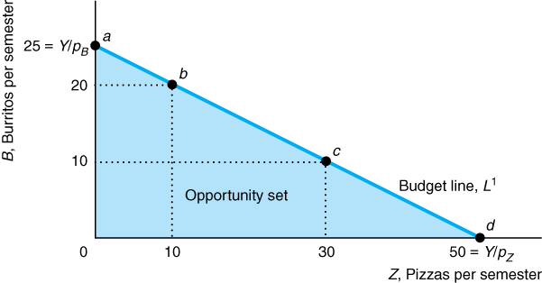
The Budget Line cont’d
Here is an example of a budget line.
Suppose p_{Z} = $10, p_{B} = $20, and Y = $500.
Then the budget line is B = 25 – Z/2.

Slide 20
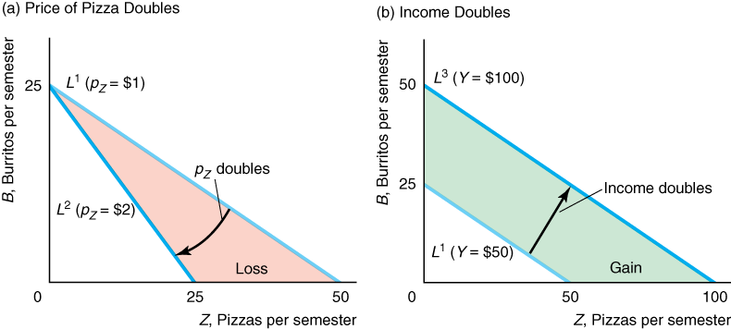
Changes in Price and Income
What happens to the budget line if the price of pizza doubles?
What happens if income doubles?

Slide 21
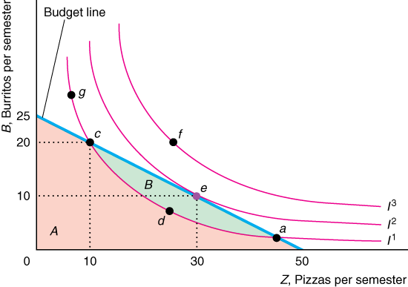
6. Maximizing Utility
Maximizing utility requires getting to the higher possible indifference curve. This occurs where an indifference curve is tangent to the budget line – they have the same slope. Thus MRS = MRT.

Slide 22
Equal Marginal Utility Per Dollar for Each Good
The MRS the ratio of marginal utilities. We sometime call the slope of the budget line (the price ratio) the marginal rate of transformation or MRT.
Rearranging terms, this condition is equivalent to
This condition says that to maximize utility the consumer should arrange spending so as to get the same marginal utility per dollar for each good consumed.

Slide 23
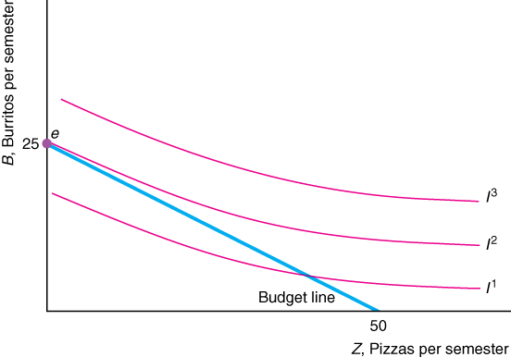
A Corner Solution
Some goods are not consumed at all – corner solutions – because the marginal utility of even the very first unit is too low.

Slide 24
Equal “Bang for the Buck”
This is an important rule of thumb for buying anything – in private life or in business. For any goods we buy we want to equalize the marginal utility (or marginal value) per dollar.

Slide 25
Q&A 4.3
Nate has utility function U = JN where J is jelly and N is peanut butter.
The price of J is $5 per jar and the price of N is $10 per jar. Nate has $100 to spend on peanut butter and jelly. If Nate maximizes utility how much of each good will he consumer?
MU_{J} = dU/dJ = N. MU_{N} = dU/dN = J.
Set MU_{J} /p_{J} = MU_{N} /p_{N} => N/5 = J/10 => 10N = 5J or N = J/2.
Use budget line: Y = p_{J}J + p_{N} N
100 = 5J + 10N = 5J + 10J/2 = 10J.
Therefore J = 10 and N = 5.

Slide 26
Clicker Question 7
Suppose that prices and Joseph’s marginal utilities are as follows:
p_{x} = 4, p_{y} = 1, MU_{x} = 12, MU_{y} = 4,
It follows that
Joseph is maximizing utility
Joseph can increase utility by consuming more x and less y.
Joseph can increase utility by consumer more y and less x.
There is insufficient information to assess whether Joseph is maximizing utility.
Goods x and y are perfect substitutes.

Slide 27
Is the Theory of Consumer Choice accurate?
Do real choices match the “bang for the buck” principle?
(Are people good consumers?)
Are real choices transitive?
What explains failures to make good choices?
Is consumption utility closely related to happiness?
Does more income make people happier?

Slide 28
7. Summary and Next Class
The theory of consumer choice lies behind demand curves. The theory of consumer choice is directly relevant for various managerial decisions – pricing, promotions, compensation, etc.
The theory of consumer choice is based on utility, indifference curves and budget lines.
The theory of consumer choice as presented here is a reasonably good approximation for many purposes but there are some systematic violations that arise in practice.
People can learn to be better consumers
For next class review Q. 4.1 in Ch. 4. Then Ch. 5, sections 5.1-5.4

