Slide 1
Managerial Economics
Class 3
Review Questions – Elasticity and Regression
Multivariate Regression
Goodness of Fit
Statistical Significance
Sources of Data
iTunes Regression Using LINEST
Revenue and Elasticity
Functional Form
Summary and Next Class

Slide 2
Clicker Question 1: Elasticity
Demand is given by Q = 1500 – p².
At a price of 30 demand is inelastic.
At a price of 30 demand has unitary elasticity.
At a price of 30 demand is elastic.
As this demand curve is not linear, the elasticity does not vary along the demand curve.
c. and d.
(Hint: dQ/dp = -2p.)
Note: Any function of the form Q = ap^{b} is called a polynomial and the derivative is dQ/dp = bap^{b-1} . What happens if b = 1, if b = 2, if b = 3?

Slide 3
Clicker Question 2: Regression
Which of the following statements about the Portland Cod regression is true?
The demand curve we estimated was obtained by minimizing the sum of squared residuals from the regression line.
We estimated a linear demand curve, but could have used Excel to estimate a nonlinear form.
Some observed points do not lie on the estimated demand curve.
a. and b.
All of the above.

Slide 4
2. Multivariate Regression
If we estimate a demand curve of the form Q = a + bp, then Q is the dependent variable and there is only one explanatory variable (price, p). Therefore we call this a univariate regression.
Estimating such a regression equation makes sense if other important variables, such as income, are held constant.
However, if both price and income vary in our data, we might wish to estimate a demand function with two explanatory variables – price and income:
Q = a + bp + cY, where Y represents income.
This is a multivariate regression – there is more than one explanatory variable.
See the mini-case on CEO compensation for another multivariate example.

Slide 5
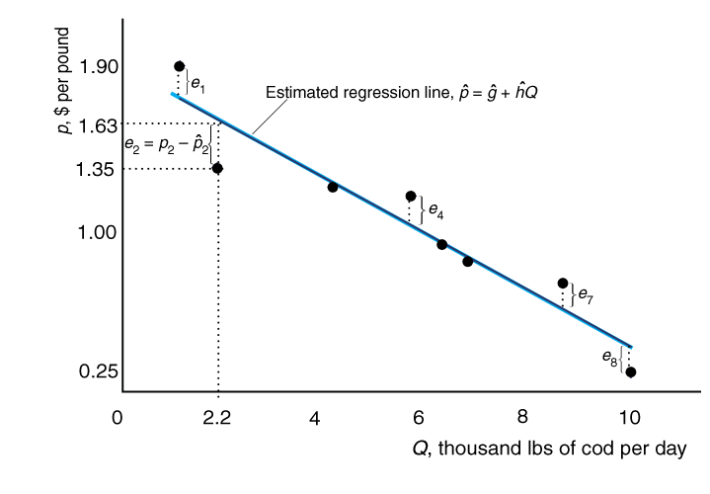
3. Goodness of Fit: Assessing a Regression Using R-squared
When we do a regression we have to be concerned about whether the estimated regression line is a “good fit” for the data.
This demand curve fits the data quite well.

Slide 6
Mai’s pies – a pricing experiment.
Mai varies pie prices in two bakeries in different towns. The estimated demand curve on the left fits the data better than the one on the right. We use the R² (or R squared) to measure how much of the variation is explained by the regression. It can vary from 0 (explains nothing) to 1 (explains everything). The R² on the left is 0.98 and the R² on the right is 0.54

Slide 7
Clicker Question 3. R-squared
Look at the cod regression again (two slides back).
Suppose you discover that the second data point was incorrectly written down. The actual price was 1.60. If this change is made
The R-squared will remain the same.
The R-squared will fall.
The data will not fit the estimated line as well.
The estimated demand curve will changes its position.
None of the above.
Note: Having a high R-squared indicates that the regression line provides good estimates.

Slide 8
4. Statistical Significance
When we gather some data – as with Mai’s pie data – we can always run a regression. But is it capturing anything meaningful? Or is the result just an accident or coincidence? We assess this, if we can, by repetition. If we do the same experiment many times and get the same answer, that gives us more confidence.
We cannot always repeat experiments, but we can use statistical techniques to assess whether the results are significant: We can assess the statistical significance of our results.
We regard our results as meaningful if they have statistical significance. We will not study this in detail here, but regression software (including Excel) provides some tools to assess statistical significance.

Slide 9
5. Sources of Data
Data can come from
observing actual markets (Portland Cod, CEO compensation)
running experiments (Mai’s pies)
focus groups (Camry, iTunes)
polls or other surveys (usually done using questionnaires, interviews)
Much data is collected by commercial vendors, who sell it, and by government statistical agencies (such as Statistics Canada).
We will consider some focus group data collected on i-Tunes.

Slide 10
6. i-Tunes Regression in Excel using LINEST on focus group data
Quantity | Price
441 | 1.49
493 | 1.29
502 | 1.19
536 | 1.09
615 | 0.99
643 | 0.89
740 | 0.79
757 | 0.69
810 | 0.49
Put this data in an Excel spreadsheet with quantity in col. A and price in B.
In Cell A12 put =LINEST(A2:A10,B2:B10,, TRUE).
Select cells A12 to B14.
WINDOWS: Press F2. Then press CTRL, SHIFT, ENTER at the same time.
or MAC: Press CRTL-U then COMMAND and Enter at the same time.
This estimates a demand curve with price as the explanatory variable. The equation is Q = 1024 – 413p. The intercept is in cell B12 and the slope coefficient is in cell A12. The R² is in A14. You can ignore the other numbers.

Slide 11
iTunes Regression Results: Is 99¢ or 1.29 a better price?
The estimated regression line is: Q = 1024 – 413p
We can use this estimated demand curve to estimate the revenue for any price:
R(p) = pQ(p) = p(1024 – 413p) = 1024p – 413 p² .
(This is a quadratic function because it has squared term in it. )
For example, if p = .99 then the estimated R is 609.
If p = 1.29 then the estimated R is 634.
Therefore, raising p from .99 to 1.29 would increase R from 609 to 634.

Slide 12
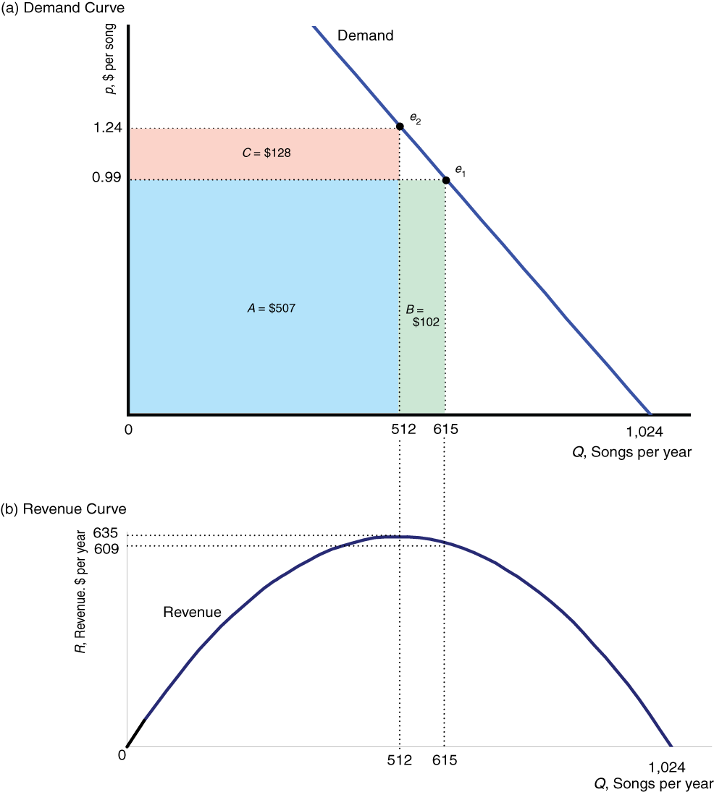
Did it make sense for iTunes to Raise Price?
We can use the estimated demand curve to calculate revenue at different prices, such as .99 and 1.24.
Revenue is pQ. In this case $1.24 gives the highest possible revenue, more than at 99 cents (or $1.29).

Slide 13
Clicker Question 4. Demand Estimation and Elasticity.
The estimated i-Tunes demand curve is Q = 1024 – 413p.
At p = 0.99 the price elasticity is less than 0.7 in absolute value.
At p = 0.99 the price elasticity is greater than 0.7 in absolute value.
At p = 0.99 demand is elastic.
There is not enough information to determine the elasticity at p =0.99.
In this case we can calculate an arc elasticity but not a point elasticity.

Slide 14
7. Revenue and Elasticity
We can use elasticity as a short-cut to tell us whether raising price will lower or raise revenue, R.
Claim:
i) If demand is inelastic, then raising price will raise revenue.
ii) If demand is elastic, then raising price will lower revenue.
iii) If the elasticity = -1 then revenue is maximized and changing price in either direction will lower revenue.
Proof of i): (Using calculus)
R = p Q(p). Therefore, dR/dp = pdQ/dp + Q = Q(ε + 1).
If ε is less than 1 in absolute value (like -0.5) then dR/dp >0.
Therefore R rises if p rises.

Slide 15
Revenue and Elasticity cont’d
When price rises the price effect in itself tends to raise revenue, holding quantity constant. But quantity falls, which tends to reduce revenue for any given price. If demand is inelastic, then the percentage increase in price exceeds the percentage decline in quantity so revenue rises.
If demand is elastic then the percentage decline in quantity is bigger than the percentage increase in price, and revenue falls.

Slide 16
Clicker Question 5
Using our focus group data, the revenue maximizing price was 1.24, but Apple actually chose a price of 1.29. Which of the following reasons is a plausible explanation for this apparent difference.
Our focus group (sample) is different from the sample used by Apple to do its calculations – giving rise to slightly different results.
Apple is trying to maximize profits, not revenues.
Apple is expecting to keep this price in place for several years and is considering likely future changes in demand as well as the present.
All of the above.
None of the above.

Slide 17
Functional Form
Demand curves do not have to be linear and we do not have to estimate linear functions. It is possible to estimate other functional forms. The following figures show regressions of demand on advertising expenditure. Is a linear function or a quadratic function a better fit for the data?

Slide 18
6. Clicker Question – Functional Form
Consider demand function Q = 100 - 5p + 0.5p² + 3Y
where Y is income.
This demand function is linear.
This demand function is univariate.
This demand function satisfies the Law of Demand at all price levels.
All of the above.
None of the above.

Slide 19
Summary of Elasticity and Regression
Elasticities are useful because they indicate to a firm how price changes will affect revenue (among other reasons).
If we have two data points we can obtain an arc elasticity. If we estimate a demand curve we can calculate point elasticities
We obtain estimates of demand curves (and other relationships) using regression. A univariate regression is like drawing a line through some points.
We can use Excel to run regressions. There are also more sophisticated regression programs.
In later courses you will consider issues such as statistical significance, functional form, and other issues in more detail.
Next Class: Clicker Questions on Camry case in textbook. Then Ch. 4 – sections 4.1-4.4.

