Slide 1
Managerial Economics
Class 2
Administrative Issues: Class Liaison
Review of Supply and Demand (Clicker Questions)
Introduction to Elasticity
Arc and Point Elasticity
Where Do Demand Curves Come From
Using Regression Analysis to Estimate Demand
Summary and Next Class
Reading: 3.1-3.2.

Slide 2
Clicker Question 1
The demand curve is given by Q = 100 – 2p and the supply curve is Q = 40 + p.
The equilibrium price is 10.
The equilibrium price is 20.
The equilibrium quantity is 60.
b and c.
None of the above.

Slide 3
Clicker Question 2
Suppose a late winter frost destroys much of the Florida orange crop. Application of the supply demand model suggests that:
The income of BC apple producers will rise.
The income of BC apple producers will fall.
The price of apple juice will fall.
The U.S. will export more orange juice.
None of the above.
(Hint: Keep in mind that most oranges are used to produce orange juice, which is a substitute for apple juice.)

Slide 4
Does the Supply-Demand Model Always Apply?
The model of supply and demand is a theory about how markets work. Is it a good theory?
The basic logic is that price will tend toward the level where supply and demand are equal – the equilibrium price, where the supply curve and the demand curve cross.
If price exceeds the equilibrium price then excess supply will occur and the price will be bid down. If the price is below this price then there will be excess demand and price will be bid up.
This model is very good in many cases, but does not always apply. It works well when markets are highly competitive.

Slide 5
iTunes Prices: Using Elasticity
Question: A couple of years ago Apple’s iTunes raised the price of new songs from 99 cents to 1.29. How could Apple predict whether this change would raise or lower revenue (and profit)?
We will answer this question in the next class using the concept of elasticity and using regression analysis.

Slide 6
3. Introduction to Elasticity
The price elasticity of demand measures how sensitive quantity demanded is to changes in price – how much demand increases or stretches when price fall.
The price elasticity of demand, ε is a measure of the change in quantity demanded resulting from a change in price. It is the percentage change in quantity divided by the percentage change in price.
ε = %ΔQ/%Δp
If demand slopes downward, the elasticity of demand is negative.

Slide 7
Clicker Question 3:
Elasticity Calculations
Here is a table showing percentage changes in price and quantity.
Change in Quant. Change in Price Elasticity
-5% 10% -20% 20%
10% -5%
The correct answers are -2, -1, and -0.5.
The correct answers are -0.5, -1, and -2.
The correct answers are 0.5, 1, and 2.
The Law of Demand holds only for the first two changes.
None of the above.

Slide 8
4. Arc and Point Elasticity
An elasticity is a ratio of percentage changes. How do we calculate those percentages? There are two approaches
Approach 1: The Arc Price Elasticity of Demand – for a discrete interval
Price goes from p₁ to p₂ so Δp = p₂ – p₁ ;
Q goes from Q₁ to Q₂ so ΔQ = Q₂ – Q₁.
We use average values of p and Q as the base to calculate a percentage.
The average values for p and Q are p* = (p₁ + p₂)/2 and Q* = (Q₁ + Q₂)/2.
The arc elasticity is then given by ε = (ΔQ/Q*)/(Δp/p*)
= (ΔQ/Δp)(p*/Q*)

Slide 9
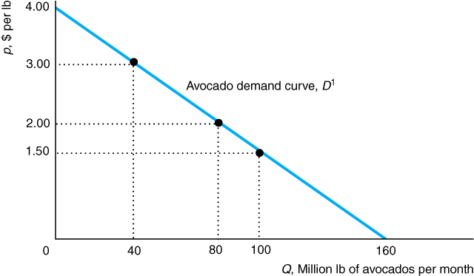
Arc Elasticity for Avocados
For avocados if p = $3.00 then Q = 40. If p falls to $2.00 then Q rises to 80. What is the arc price elasticity of demand for this change in price?
ε = (ΔQ/Δp)(p*/Q*) = [(80-40)/(2.00 – 3.00) ][2.50/60] = - 1.67

Slide 10

iTunes – What was the effect of the 2009 Price Increase?
In 2009 Apple raised the price for downloads of popular new releases from 99 cents to 1.29 for the U.S. market. What was the effect on quantity sold?

Slide 11
iTunes Elasticity
A top-selling download the week before the increase was “Beautiful”. After the price increase sales fell from 57,941 for the week to 52,760. What was the price elasticity of demand for this song?
Elasticity = (ΔQ/Δp)(p*/Q*) = (-5181/.30)(1.14/55,350.5) = -0.36 (approx.)

Slide 12
Clicker Question 4: Arc Elasticity
Suppose that the price of avocados falls from $2.10 to $1.90 and the quantity demanded rises from 90 to 110. What is the arc price elasticity of demand for this change in price?
-1
-1.5
-2
It varies from -1.5 to -2.5
none of the above

Slide 13
Point Elasticity
The point elasticity is the elasticity at a point – a single combination of p and Q on the demand curve.
Recall that elasticity
This can be rewritten as
As Δp gets very small, ΔQ also gets very small and ΔQ /Δp approaches the derivative dQ/dp. A derivative is a slope.
Therefore, it makes sense to define the elasticity at a point as
If Q = a + bp, then dQ/dp = b. For a demand curve, b is negative.

Slide 14
Clicker Question 5.
Suppose demand is given by Q^{D} = 160 – 40p. The point elasticity is given by
This demand curve is nonlinear.
At a price of 2 the elasticity of demand is -2.
The elasticity of demand varies along the demand curve.
All of the above
None of the above.

Slide 15
Elastic and Inelastic Demand
If the price elasticity of demand is more than 1 in absolute value (like -1.5) we say demand is elastic.
If the price elasticity of demand is less than 1 in absolute value (like -0.5) we say is inelastic.
If the elasticity = -1 we say demand has unitary elasticity. It is neither elastic nor inelastic.
The elasticity equation is ε = %ΔQ/%Δp.
This equation can be rewritten as %ΔQ = ε%Δp.
Thus the percentage change in quantity is larger in absolute value than the percentage change in price if demand is elastic (if ε is bigger than 1 in absolute value).

Slide 16
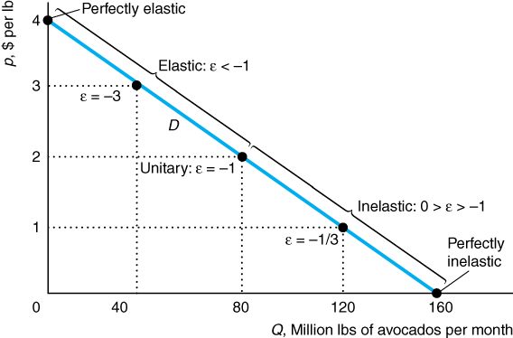
Elasticity Along a Linear Demand Curve
Q^{D} = 160 – 40p.
= -40p/Q
The Elasticity Varies Along the Linear Demand Curve.
The higher the price, the more elastic the demand curve (ε is larger in absolute value). Demand is perfectly inelastic (ε = 0) where the demand curve hits the horizontal axis and is perfectly elastic where the demand curve hits the vertical axis.

Slide 17
Other Elasticities
So far we have focused on the price elasticity of demand . We can determine an elasticity between any two related variables, such as the elasticity between quantity demanded and income.
The income elasticity of demand, η, is the percentage change in quantity demanded divided by the associated percentage change in income.
Is this elasticity positive or negative for avocados?
We can also define the cross-price elasticity of demand – showing how responsive the quantity of one good is to the price of another good, or supply elasticities.

Slide 18
5. Where do Demand Curves Come From?
We estimate demand curves (and elasticities) from data using regression analysis.
Table 3.1 Data Used to Estimate Cod Demand at the Portland Fish Exchange
Price in $ per lb. | Thousands of lbs
1.90 | 1.5
1.35 | 2.2
1.25 | 4.4
1.20 | 5.9
0.95 | 6.5
0.85 | 7.0
0.73 | 8.8
0.25 | 10.1

Slide 19
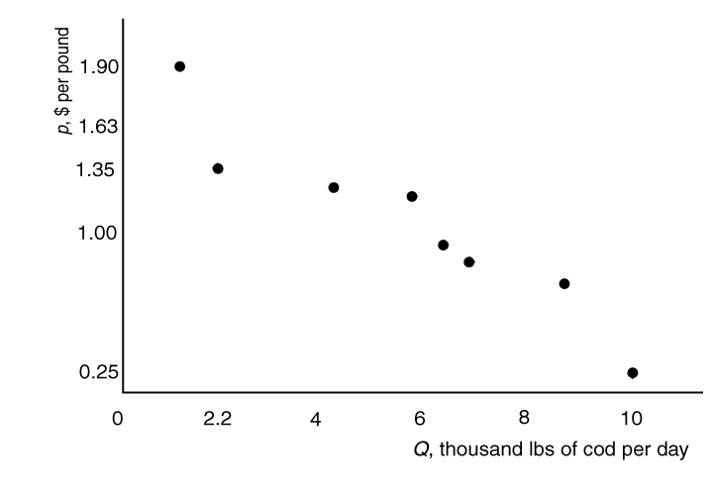
Cod Data in a Diagram
We can estimate a demand curve by drawing a line or curve through these points.

Slide 20
6. Using Regression to Estimate Demand
We want to find the “best possible” line or curve that represents this data. The best possible curve might be a straight line or it might be something else.
In this case we think of price as the dependent variable and quantity as the explanatory variable. Fishing boats catch as much as they can and bring that to market. Price adjusts to clear the market.
We therefore put price on the left hand side of the demand relationship. When we do this, we sometimes say we have the “inverse demand curve”.

Slide 21
Inverse Demand
If we start with a standard demand curve of the form Q = a + bp (where a is positive and b is negatiave).
We can rearrange this expression to obtain p = -a/b + Q/b.
(Note that –a/b is a positive number as b is negative.)
We can rewrite this as p = g + hQ where g = -a/b > 0 and h = 1/b < 0.
This is the inverse demand curve. It expresses the same information as the standard demand curve but is rearranged to put price on the left hand side.

Slide 22
Random error
When we observe actual data it would not normally lie on straight line. However, we can write
p = g + hQ + e
where e is an “error”.
The “error” shows the difference between the proposed linear relationship and the actual observation.
The error might be due to non-price factors that we cannot hold fixed.

Slide 23
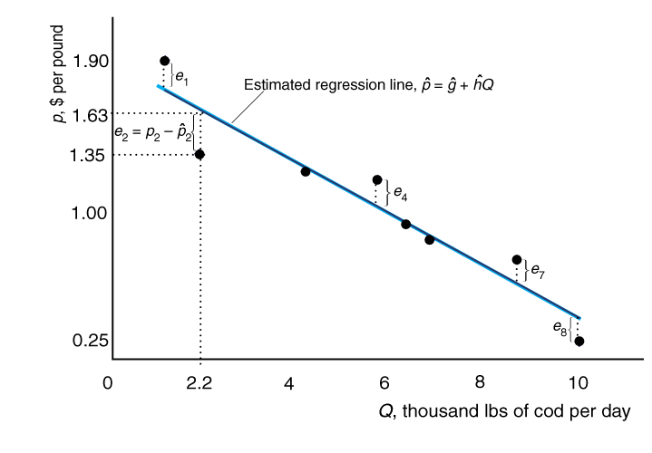
An Estimated Demand Curve

Slide 24
Ordinary Least Squares
When we estimate a demand curve, the points do not lie on the line precisely, because of the random error. The “residual” is the vertical distance between the actual price and the “predicted” price obtained from the regression line. It is an estimate of the random error, e.
We can choose where to draw the line (i.e. we can get our estimate of the demand curve) by drawing the line so that the residuals are small.
One specific way of drawing such a line is the method of “ordinary least squares”, which makes the sum of squared residuals as small as possible. This is normally done using computer programs and can be done in spreadsheets, such as Excel.

Slide 25
Cod Data
Thousands of lbs
1.5
2.2
4.4
5.9
6.5
7.0
8.8
10.1
Price in $ per lb.
1.90
1.35
1.25
1.20
0.95
0.85
0.73
0.25
Put this data in an Excel spreadsheet.
Put Quantity in the A column and Price in the B column.

Slide 26
Regression using Excel
Carry out the following steps.
Put the Cod data in an Excel spreadsheet. Put Quantity in column A and Price in Column B.
Select the two columns of data.
Click on <Insert>, <Scatter>, and select the first type of scatterplot. You should see a scatterplot like Figure 3.3.
Click on Layout, then Trendline and select Linear Trendline. The estimated demand curve will appear.
Right Click on the line and then Format Trendline. Select Display Equation, and Display R-squared.
Click on and then delete the legend that appears at the right.
Excel uses Ordinary Least Squares Regression to get this line.

Slide 27
Regression Output
1.5 | 1.9
2.2 | 1.35
4.4 | 1.25
5.9 | 1.2
6.5 | 0.95
7 | 0.85
8.8 | 0.73
10.1 | 0.25
The variable y stands for price and the variable x stands for quantity. Rounding off and rewriting the estimated equation yields
p = 1.96 – 0.15Q, as shown in the textbook.

Slide 28
Clicker Question 6.
The estimated (inverse) demand curve p = 1.96 – 0.15Q . Therefore,
We can be confident that a quantity of 10 will yield a price of 46 cents.
We would estimate that a quantity of 10 would yield a price of 46 cents.
As a quantity of 10.1 actually generated a price of 25 cents we can see that this demand curve over-estimates prices.
b. and c.
None of the above.

Slide 29
Summary
Review of Supply-Demand Model
Elasticity
Arc and Point Elasticity
Using Regression to Estimate Demand Curves
Next Class: Clicker questions similar to 1.5, 1.11, and Portland Fish example in Chapter 3.

