Slide 1
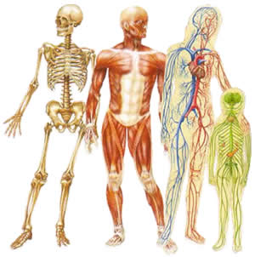
Topic #1
Structural Organization of the Human Body
Part 2

Slide 2
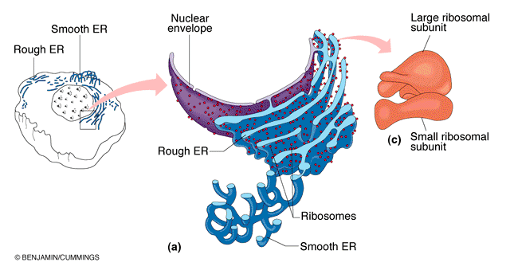
1.2 Cell and its organelles:
Non-membraneous organelles - Ribosomes
Structure: Small, dark-staining granules of protein
+ rRNA;
large + small subunits
Function: Site of protein synthesis
Two flexible distributions of ribosomes:
 free ribosomes  make soluble proteins
 membrane-bound ribosomes (ER) 
produce proteins primarily for membrane or export

Slide 3
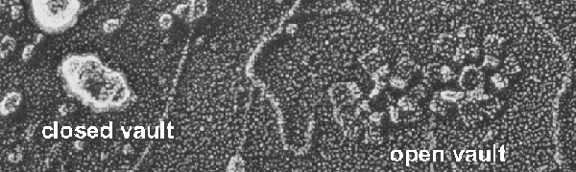
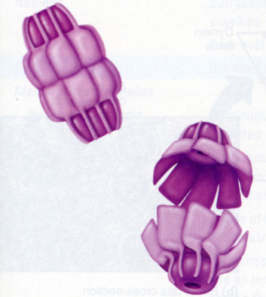
1.2 Cell and its organelles:
Non-membraneous organelles - Vaults
First described in 1986
Present in all cells, abundant in macrophages and epithelial cells
Their precise function is still unknown
Their size, shape and location at nuclear pores suggests that they may be a plug of the pore complex
They may be carriers of molecules such as mRNA (from nucleus to cytoplasm) and play a role in assembly, transport or regulation of ribonucleoprotein particles
Elevated number of vaults in cancer patients resistant to chemotherapy
Stanfield and Germann,
Principles of Human Physiology,
2009

Slide 4
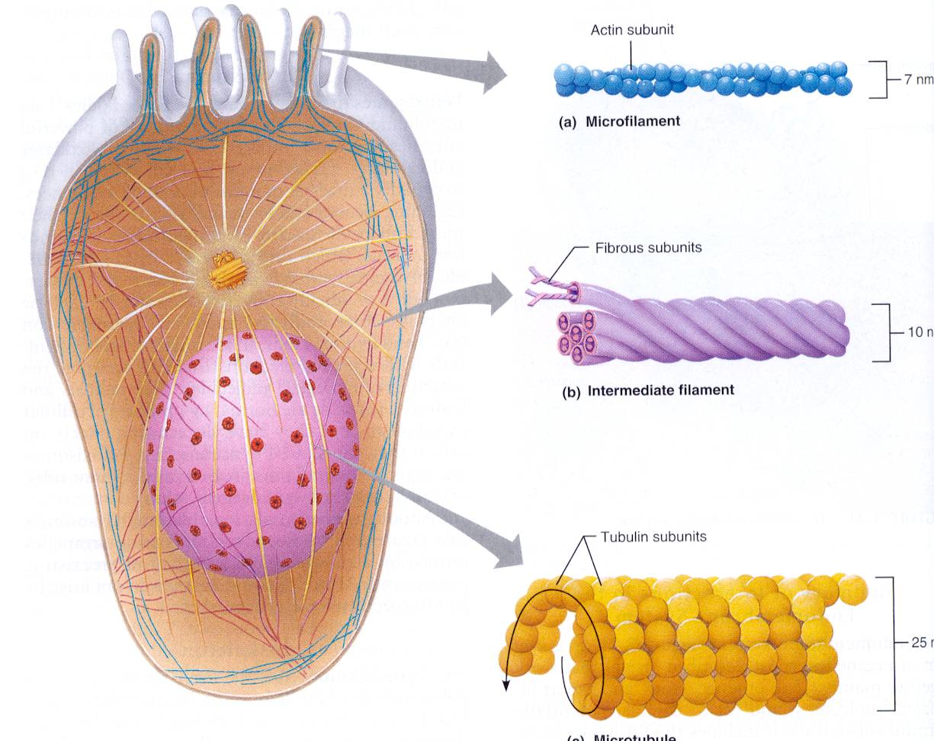
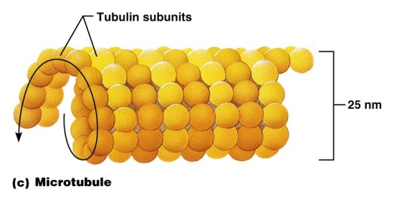
1.2 Cell and its organelles:
Cytoskeleton
Cell skeleton - provides the cell with support and
enable some degree of motility and contractility
Microfilaments - thin strands of contractile protein: actin –
dynamic protein; cell shape & cell motility, separation of
cytoplasm during cell division, structural
support (microvilli)
Intermediate filaments - tough, rope-like
protein fibers, more stable than microfilaments
Examples: keratin (skin, hair), myosin (muscle)
Microtubules: hollow, tubular cylinders made
of tubulin; implicated in a variety of phenomena

Slide 5

1.2 Cell and its organelles:
Cytoskeleton - microtubules
Microtubules functions
- Provide shape and strength to the cytoskeleton
- Form spindle fibres during cell division
- Assist with directional movement of vesicles with large biomolecules within the cytosol
- Are components of cilia and flagella

Slide 6
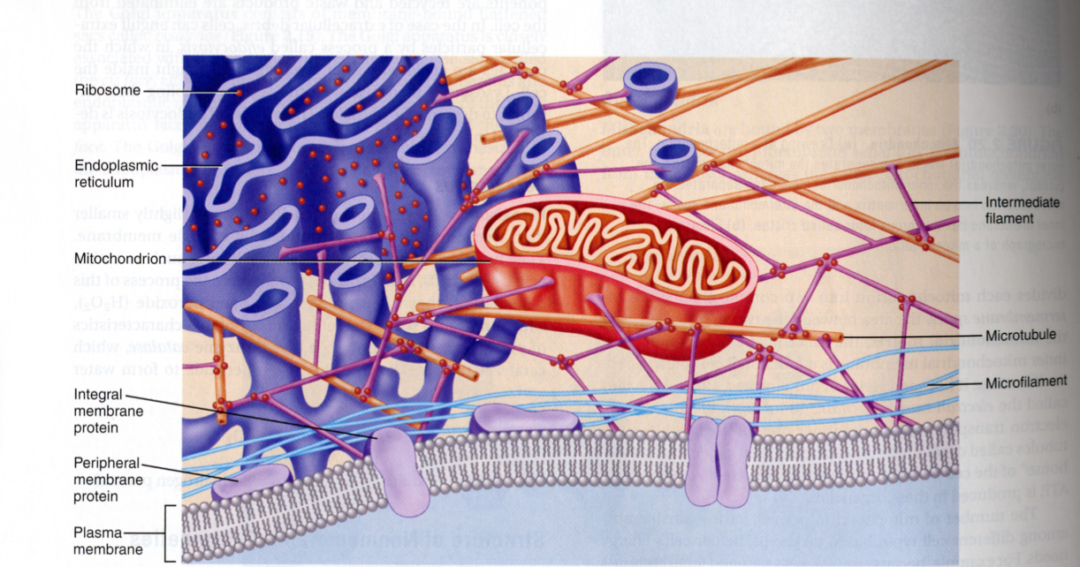
1.2 Cell and its organelles:
Cytoskeleton
Organelles are suspended in the cytosol by filaments
Stanfield and Germann,
Principles of Human Physiology, 2009

Slide 7
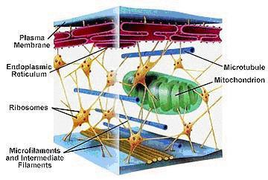
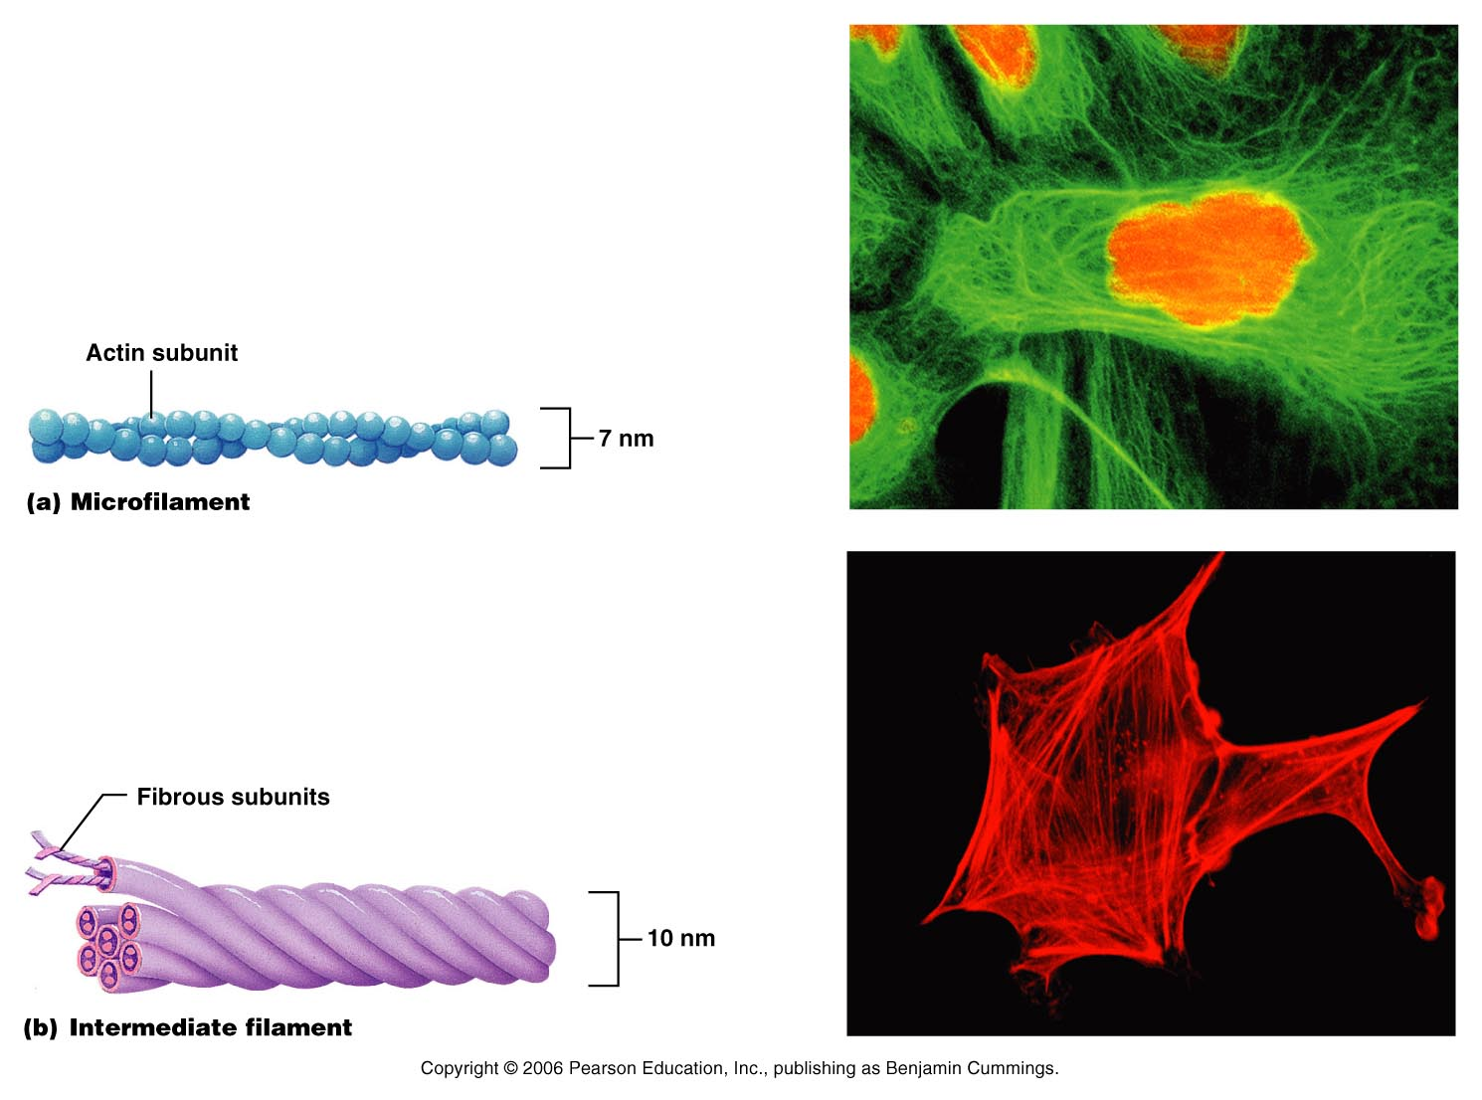
1.2 Cell and its organelles:
Microfilaments and intermediate filaments

Slide 8
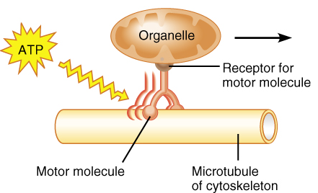
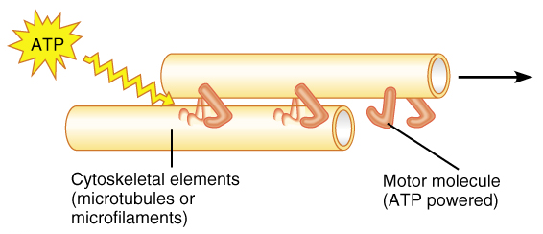
1.2 Cell and its organelles:
Interaction of motor molecules with cytoskeletal elements

Slide 9
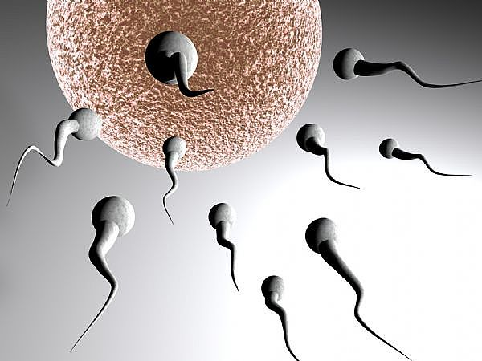
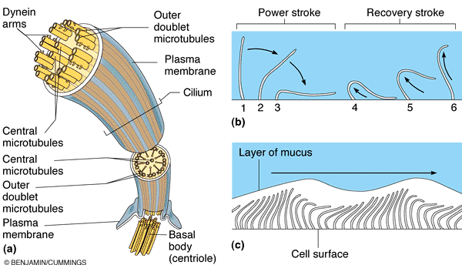

1.2 Cell and its organelles:
Microfilaments and intermediate filaments
Centrioles: basal bodies; 9 triplets of microtubules - source of microtubules; formation of mitotic spindle, core of cilia, flagella
Cilia: eg: respiratory tract - propel mucus laden with dust & bacteria up & away from lungs
Flagellum: exists ONLY in sperm - MT organelle which moves sperm
Cilia propel substances across cell surface while flagellum propels the cell!

Slide 10
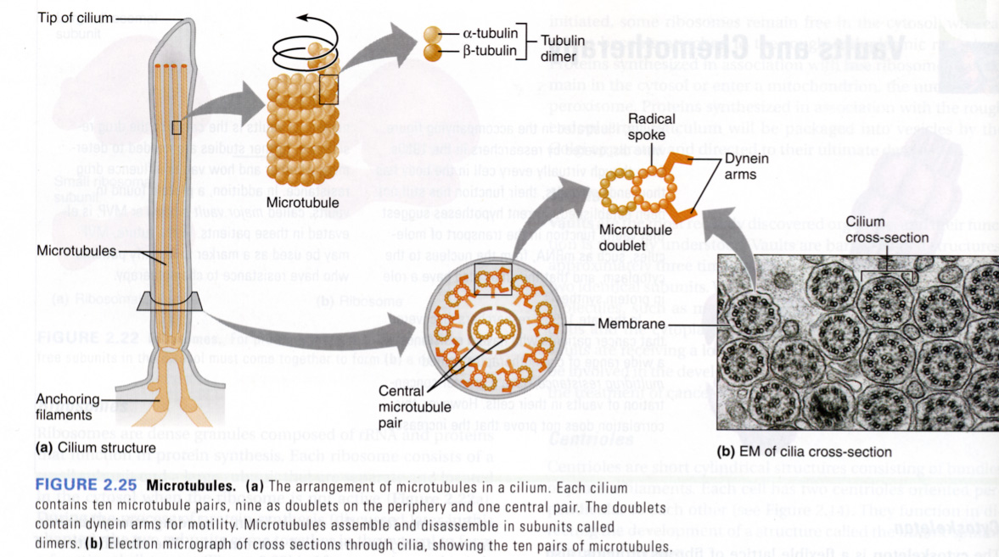
1.2 Cell and its organelles:
Microtubules
Stanfield and Germann,
Principles of Human Physiology,
2009

Slide 11
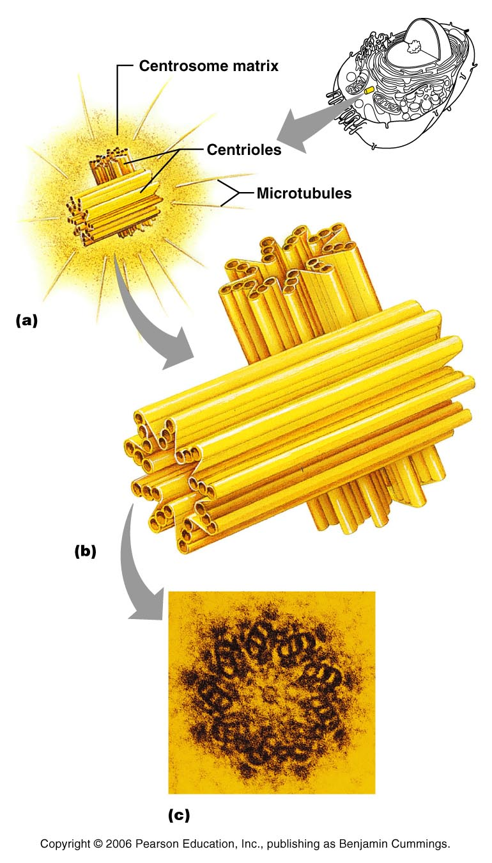
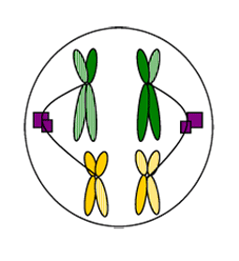
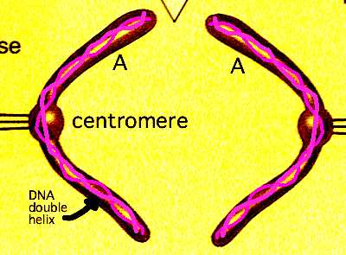
1.2 Cell and its organelles: Non-membraneous organelles - Centrosomes and Centrioles
Centrosome  acts as microtubule organizing center
Granule-like looking matrix  generates microtubules
Centrioles  organize mitotic spindle, role in cytokinesis; form basis for cilia and flagella
Microtubules are anchored
at one end to centrosome

Slide 12
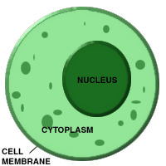
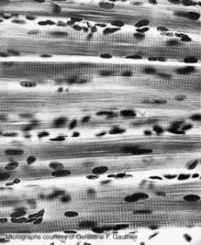
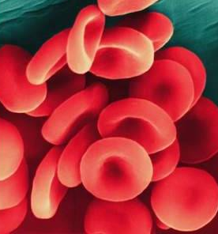
1.2 Cell and its organelles:
The nucleus
The nucleus – cell’s largest organelle;
control center (“headquarters”)  contains the genetic material responsible for transmitting genetic information and providing the instructions for protein synthesis
Most human cells have one nucleus
Some cells are multinucleate (e.g.,
skeletal muscle)
Mature red blood cells  anucleate
(no nucleus; cannot reproduce)

Slide 13
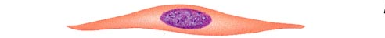
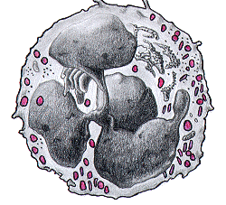
1.2 Cell and its organelles:
The nucleus
Shape of the nuclei may vary, usually conforms to the shape of the cell
Some nuclei have lobes

Slide 14
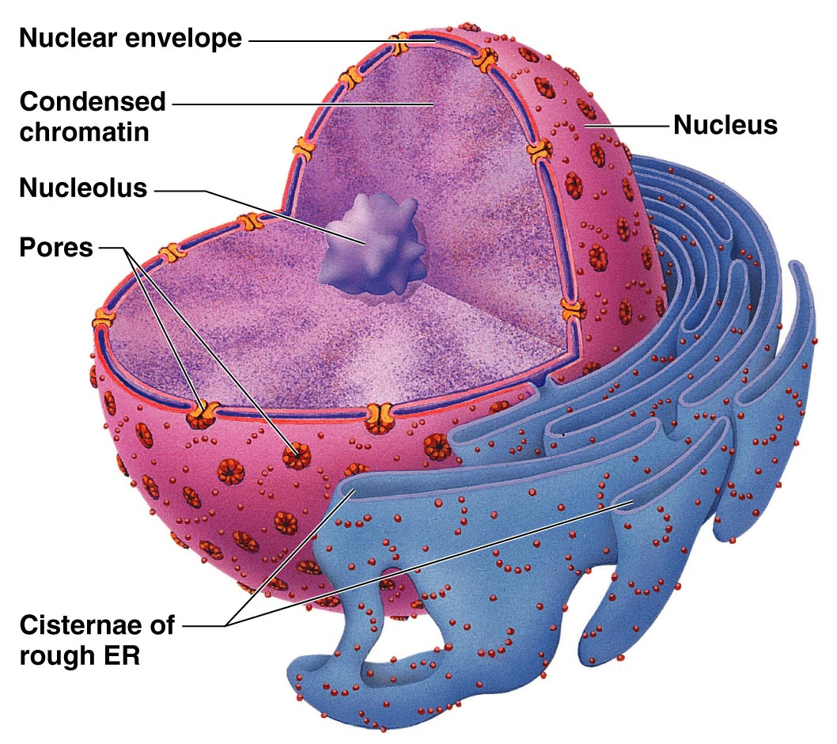
1.2 Cell and its organelles:
The nucleus - structure
Main structures:
The nuclear envelope:
selectively permeable double
membrane with large pores
Nucleoplasm: jellylike fluid in which
other nuclear structures are suspended
Nucleolus or nucleoli:
Spherical structures composed of RNA
and protein; nucleoar organizer regions 
DNA with instruction for ribosomal RNA synthesis
Chromatin :
Threads of 30% DNA combined with 60% histone proteins and 10% RNA ; the fundamental units- nucleosomes

Slide 15
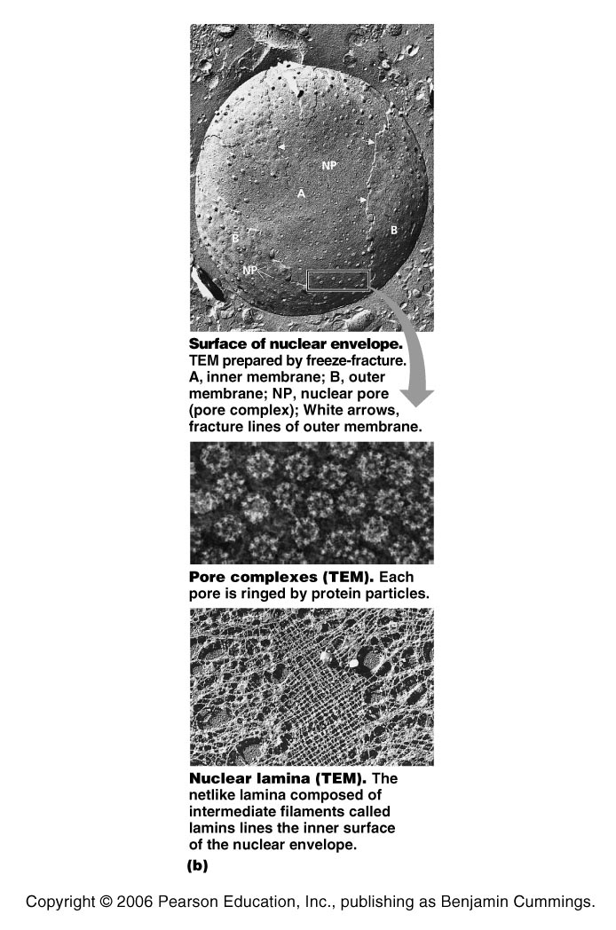
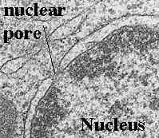
1.2 Cell and its organelles:
The nuclear envelope

Slide 16
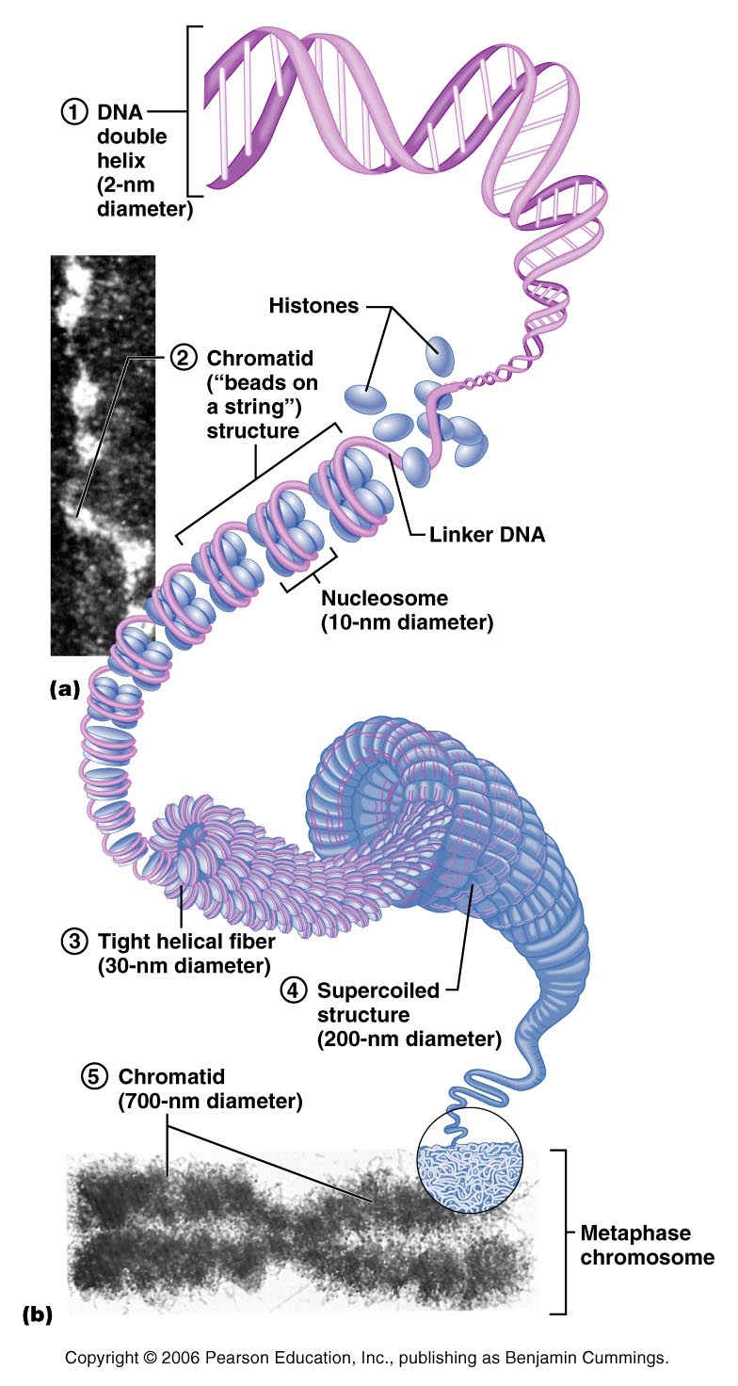
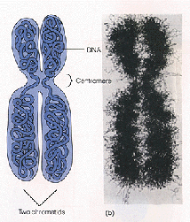
1.2 Cell and its organelles:
The nucleus – chromatin and chromosomes
In not dividing cells  threads of DNA combined with histone proteins
In preparation for cell division  chromatin threads coil to form
2 identical chromatids = chromosomes

Slide 17
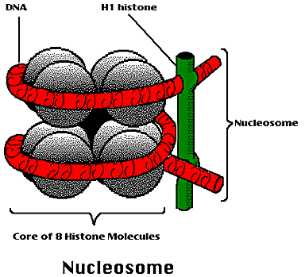
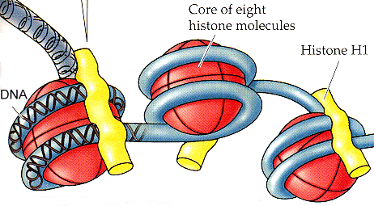
1.2 Cell and its organelles:
The nucleus - nucleosomes
Nucleosomes consist of flattened, disk-shaped clusters of 8 histone proteins connected like beds on DNA molecule
Nucleosomes provide a physical means of packing DNA and play an important role in gene regulation
Two each of H2A, H2B, H3 & H4 per nucleosome
H1 associated with linker DNA

Slide 18
1.2 Cell and its organelles:
The nucleus - function
Nuclear envelope – separates the nucleoplasm from the cytoplasm; regulates passage of the substances to and from the nucleus
Nucleous/nuclei - site(s) of ribosome assembly
Chromatin – DNA  site of genetic information

Slide 19
1.2 Cell and its organelles:
The cell cycle
Cell cycle - Series of changes a cell goes through from the time it is formed until it reproduces itself
Interphase: growth & normal functions; DNA replication begins toward end of it
Mitosis: division of genetic material between 2 daughter cells; includes cytokinesis (division of cytoplasm)

Slide 20
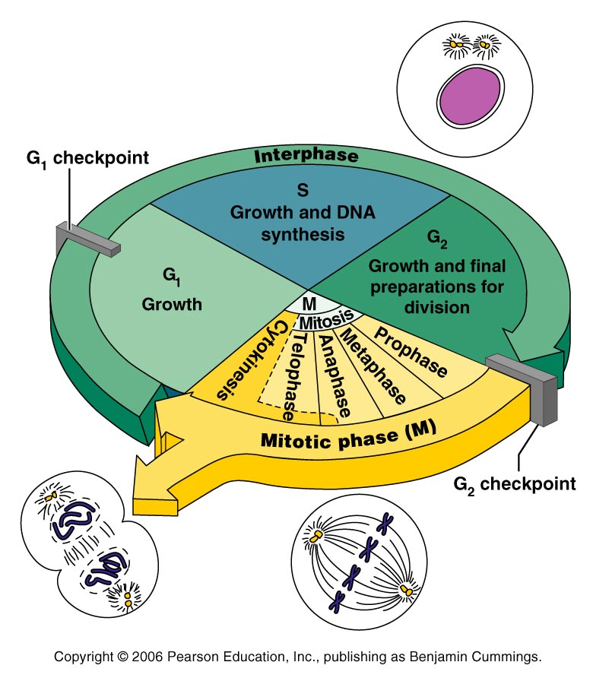
1.2 Cell and its organelles:
The cell cycle
Interphase:
G₁ – cell growth
S – growth and DNA synthesis
G₂ – growth and synthesis of materials needed for cell division
Mitosis:
M – mitosis  division of genetic material

Slide 21
Quick questions
Describe the basic structure of plasma membrane
Describe the basic functions of each of the organelles
Describe the three types of filaments of the cytoskeleton and their functions
Describe two pathological conditions related to decreased number of some of the organelles or their enzymes

