Slide 1
Engineering Economics
ECO 1192
Lecture 5: Financial & Management Accounting
Claude Théoret
University of Ottawa

Slide 2
Recommended Reading
Fraser et al.* chapter 6
  Newnan et al. chapter 18
  Park chapter 13

Slide 3
Lecture Focus
Accounting
  financial
  management
Performance Measurement
  the balance sheet
  the income statement
  the statement of changes in financial position
Analysis of financial statements
  financial ratios

Slide 4
Financial Accounting
Recording and organizing business financial data
  revenues and expenses and
  levels (resources and claims on resources at a given time)
Used for budgeting, cash management, and management of long-term debt
  By external users (investors, creditors) to make rational choices about a business
Includes the preparation of:
    Balance sheets
    Income statements
    Changes in financial position

Slide 5
Management Accounting
Analysis of the costs and benefits of business activities
  provides managers with information for decision-making
Engineers are increasingly involved in business decision-making
  need both financial and management accounting

Slide 6
Performance Measurement
Flow of money in a firm is like the flow of water in a pipe or electricity in a wire
  water pressure and voltage are “across variables” measured at a point in time (a snapshot)
  water and electrical flow are measured as “through variables” over time (a second; week; etc)
Income statement
  a “through variable”
  measures the flow of income and expenses during a specific period of time
Balance sheet
  an “across variable” or “stock” variable
  Measures assets, liabilities and net worth at a point in time (i.e., a snapshot)

Slide 7
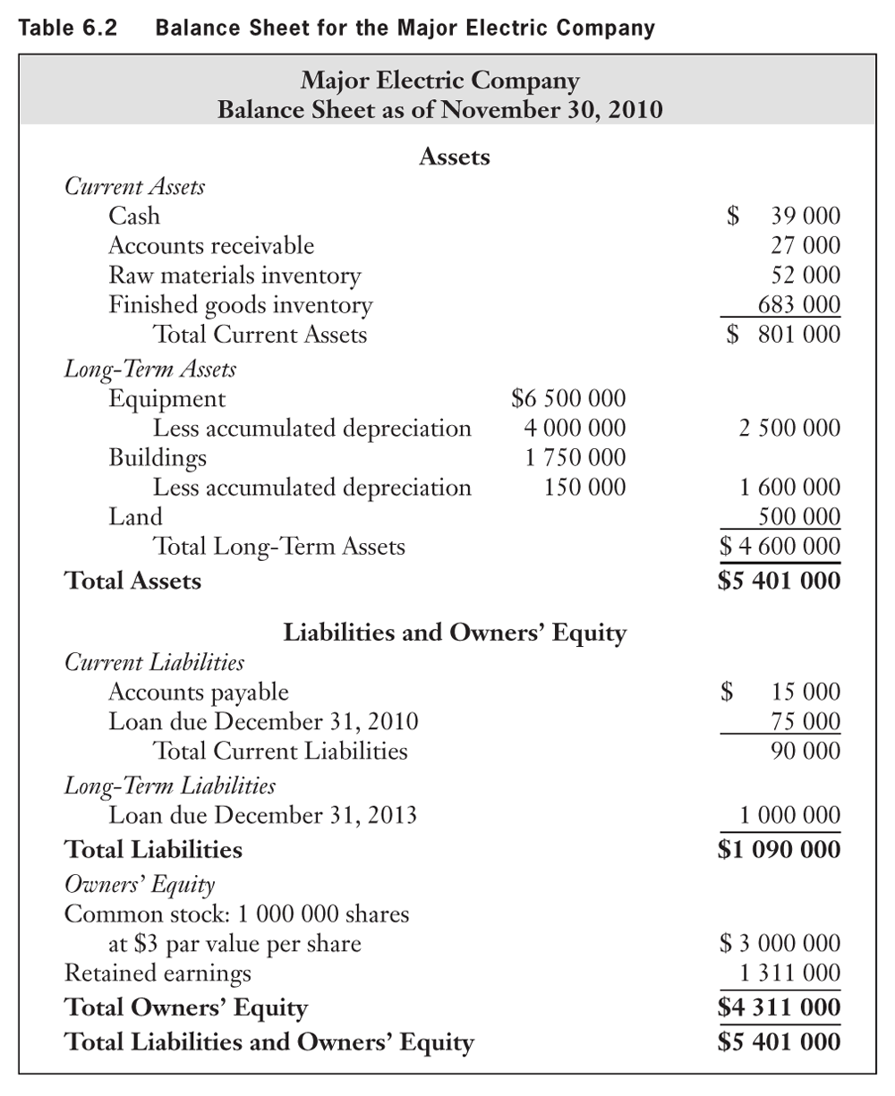
Example: Balance Sheet for the Major Electric Company

Slide 8
Balance Sheet: Typical Long-Term Assets
(Assets = Resources owned)
LONG-TERM ASSETS
Gross Equipment (Purchase price)
Less total depreciation since purchased
= Net Equipment (Purchase price minus total depreciation)
Gross Buildings (Purchase price)
Less total depreciation since purchased
= Net Buildings
Land Note: Land is NOT depreciable.
B. TOTAL LONG-TERM ASSETS
C. TOTAL ASSETS (A+B)

Slide 9
Balance Sheet: Typical Liabilities
(Liabilities = Resources owed = debt)
CURRENT LIABILITIES
Accounts Payable ($ owed suppliers)
Loan due in 6 months (short-term loan from bank)
D. TOTAL CURRENT LIABILITIES
LONG-TERM LIABILITIES
Loan due in 2 years (medium- to long-term loan from bank)
E. TOTAL LONG-TERM LIABILITIES
F. TOTAL LIABILITIES (D+E)

Slide 10
Balance Sheet: Owner Equity
(Resources owned by stakeholders)
OWNER EQUITY
Common and other capital stock
Retained Earnings
G. TOTAL OWNER EQUITY
H. TOTAL LIABILITIES AND EQUITY (F+G)

Slide 11
Balance Sheet: Assets
XYZ Company Balance Sheet at December 31, 2010 | Thousands $
Current Assets
Accounts receivable | 30,000
Cash | 4,200
Inventories | 36,000
Prepaid expenses (due in 3 months) | 6,000
Total Current Assets | 76,200
Long Term Assets
Long term bond investments | 9,000
Land | 6,000
Gross plant and equipment | 37,000
Less: Accumulated depreciation on plant and equipment | -22,000
Net plant and equipment | 15,000
Total Long Term Assets | 30,000
TOTAL ASSETS | 106,200

Slide 12
Balance Sheet: Liabilities
XYZ Company Balance Sheet at December 31, 2010 | Thousands $
Current Liabilities
Accounts payable | 20,000
Accrued wages | 8,000
Income taxes payable in 6 months | 8,000
Working capital Loan | 4,000
Property taxes payable in 6 months | 6,200
Total Current Liabilities | 46,200
Long Term Liabilities
Mortgage on building (5-year) | 40,000
Total Long term liabilities | 40,000
TOTAL LIABILITIES | 86,200

Slide 13
Balance Sheet: Equity
XYZ Company Balance Sheet at December 31, 2010 | Thousands $
Common shares | 10,000
Retained Earnings | 10,000
Total Owner Equity | 20,000
TOTAL LIABILITIES & OWNERS’ EQUITY | 106,200

Slide 14
Income & Expense Statements
Summarizes business revenues and expenses over a specified accounting period
Operating revenues
  less Operating costs
= Income or profit before taxes
  less Income Taxes
= Net Profit (Profit after taxes)

Slide 15
Income & Expense Statements
Operating revenues
  sales of goods and services
  investment income such as interest and dividends generated by investments in bonds, shares ….)
Operating Expenses
  Salaries and wages, interest paid on loans, income taxes ….
  Purchases of goods and services
  Depreciation (wear and tear) of capital assets

Slide 16
EXAMPLE
INCOME & EXPENSE STATEMENT
Speedy Electric Company
Income Statement
Calendar year 2001
Revenues
  Sales
  + Investment Income (interest, dividends …)
= Total Revenues
Expenses
  Cost of goods sold
  + Selling costs
  + Administrative expenses
  + Interest paid on loan
= Total Expenses
Profit before income taxes
- Income taxes (at t%)
= Net Income or Net Profit After Taxes

Slide 17
Changes in Financial Position During a Specific Period of Time (Source and Application of Funds)
Indicates how much cash was
  generated from regular business operations and by other sources during a specific period.
  used for investments as well as for other non-operating disbursements.

Slide 18
Statement of Changes in Financial Position
(e.g. from December 31, 2009 to December 31, 2010)
Sources of cash
Cash from operations
Net profit after taxes
+ depreciation charges (no corresponding cash flow)
- increase (+ if decrease) in materials inventory
- increase (+ if decrease) in finished goods inventory
+ cash from financing activities (loans)
= Total Sources of Cash (A)

Slide 19
Statement of Changes in Financial Position
(e.g. from December 31, 2009 to December 31, 2010)
Cash Applications (Uses)
Purchases of plant, machinery and equipment
+ Dividends paid to shareholders
= Total Applications of Cash (B)
Increase (decrease) in cash = (A - B)

Slide 20
Investments in working capital
Most projects require some investment in non-depreciable assets to support day-to-day operations ➔ working capital
  Cash, accounts receivable, and inventory
Working capital
  A business investment (not unlike the initial investment (P)
  Ties up funds that cannot generate investment income ➔ constitutes a cost of doing business
The size and composition of working capital will vary by project size and type.

Slide 21
Net Income and Cash Flow Approaches
 | Years
 | 0 | 1 | 2 | 3
1. Income After Taxes (From Income and Expense Statement) |  | X | X | X
2. Capital Cost Allowance (CCA) (does not generate a cash flow) |  | X | X | X
Investment Activities
Initial investment | X
Salvage value |  |  |  | X
Tax Effects on Disposal |  |  |  | X
Working Capital | X |  |  | X
= Net Cash Flow | X | X | X | X

Slide 22
Financial Ratio Analysis
The analysis of a firm’s financial data can provide answers to questions such as:
  Can the firm meet its short-term commitments?
  Do assets generate sufficient profits?
  How dependent is the firm on creditors?
Financial ratios
  derived from financial statements
  their calculation is usually easy but their interpretation may be more difficult.
A good interpretation of financial ratios normally requires comparisons with industry standards (thresholds) and with the firm’s previous year ratios (trend analysis).

Slide 23
Financial Ratios (for this course)
Liquidity (2 ratios)
Leverage or debt-management
Effectiveness (asset-management) (2 ratios)

Slide 24
Liquidity Ratios
A measure of a firm’s ability to meet unforeseen cash flow fluctuations.
  the larger the liquidity ratio, the more likely a firm can meet unforeseen cash flow fluctuations
Liquidity ratios
1. Current ratio (or working capital ratio)
  = current assets ÷ current liabilities
2. Acid-test ratio (or quick ratio)
= quick assets ÷ current liabilities
Quick assets = cash + accounts receivable + notes receivable
+ short term investments in marketable securities (excludes
inventory and prepaid expenses).

Slide 25
Leverage or debt-management ratio
The extent to which a firm relies on debt Bank loans, bonds ..) The higher the ratio the lower the risks.
Equity Ratio | = total owner equity÷ total assets

Slide 26
Effectiveness (asset-management) ratios: Inventory Turnover Ratio
The efficiency with which a firm uses its resources to manage its inventories
  higher ratio ➔ higher efficiency (better management of inventory)
  Inventory Turnover Ratio = Total Sales/Inventory
Concerns with this ratio:
  Sales are generated over a period of time while inventories are measured at a point in time; better to use an average inventory concept.
  Sales refer to market prices while costs are based on historical prices
  This ratio overstates the true turnover of inventories during a year.

Slide 27
Effectiveness or asset-management ratios: Return-on-total-assets or net profit ratio
Measures the productivity of assets to
generate profits.
Profitability ratio
= profits after taxes ÷ total assets

Slide 28
Cautionary Notes on Financial Ratios
Financial statements are frequently approximations ➔ financial ratios must be interpreted accordingly
May be difficult to find a perfect industry fit for a specific firm
  could result in poor industry comparisons and erroneous conclusions
Seasonality and economic cycles or fluctuations (the cycle can affect firms differently) could cause significant fluctuations in financial data and, as result, incorrect ratios and comparisons.

Slide 29
Other Financial Ratios
Short-term solvency – the firm’s ability to meet its short-term obligations.
Activity – the firm’s ability to control its investment in assets.
Financial Leverage – the extent to which a firm relies on debt financing.
Profitability – the extent to which a firm is profitable.
Value – the value of the firm
Not Required For This Course

Slide 30
1. Short-Term Solvency
Current Ratio | Current Assets/Current Liabilities
2. Quick Ratio | Quick Assets/Current Liabilities

Slide 31
2. Activity
1. Total Asset Turnover | Total Operating Revenues/Average Total Assets Where average assets = (Assets on Jan 1 + Assets on Dec31)/2
2.a Receivables Turnover | Total Operating Revenues/Average Receivables
2.b Average Collection Period | Days in Inventory/Receivables Turnover
3.a Inventory Turnover | Cost of Goods Sold/Average Turnover
3.b Days in Inventory | Days in Period/Inventory Turnover
Not Required For This Course

Slide 32
3.. Financial Leverage
1.a Debt Ratio | Total Debt/Total Assets
1.b Debt Equity Ratio | Total Debt/Total Equity
1.c Equity Multiplier | Total Assets/Total Equity
2. Interest Coverage | Earnings Before Interest and Taxes/ Interest Expense
Not Required For This Course

Slide 33
4. Profitability
1.a Net Profit Margin (ROA) | Net Income/Total Operating revenues where [ROA = Profit Margin x Asset Turnover]
1.b Gross Profit Margin | Earnings Before Interest and Taxes/Total Operating Revenues
2.a Net Return on Assets | Net Income/Average Total Assets
2.b Gross Return on Assets | Earnings Before Interest and Taxes/Average Total Assets
3. Return on Equity (ROE) | Net Income/Average Shareholders’ Equity [ROE = Profit Margin x Asset Turnover x Equity Multiplier]
4. Payout ratio | Cash Dividends/Net Income
5. Retention Ratio | Retained Earnings/Net Income where Retained earnings = Net Income - Dividends
Not Required For This Course

Slide 34
5. Market-Value Ratios
Not Required For This Course

Slide 35
Problem 1
ABC Company’s income statement and balance sheet entries for calendar year 2007 are shown in Table 1
Assumption
  The cut-off period for short-term assets and liabilities for this course is one year
    a bank loan that must be repaid in 6 months
    purchases of goods by the firm that must be paid within 90 days.

Slide 36
Problem 1: Table 1
Selected Balance Sheet and Income Statement Items for ABC Company Limited (2007) | Thousand $
1. Accounts Payable | 7,500
2. Accounts Receivable | 15,000
3. Accrued wages | 2,850
4. Cumulative depreciation on plant and equipment | 15,450
5. Cash | 2,100
6. Common shares | 150
7. Contributed capital | 3,000
8. Cost of goods sold | 57,000
9. Income Taxes for 2007 (deferred 6 months) | 2,250
10. Depreciation expense in 2007 | 750
11. Long-Term Financing (Bonds) | 4,350
12. Long-Term Bond Purchases by ABC | 4,500
13. General operating expense | 8,100

Slide 37
Problem 1: Table 1
Selected Balance Sheet and Income Statement Items for ABC Company Limited (2007) | Thousand $
14. Gross plant and equipment | 18,450
15. Income taxes payable in 1 year | 2,250
16. Interest Expense | 1,500
17. Inventories end of 2007 | 18,000
18. Land | 3,000
19. Mortgage on building and equipment (5-year) | 9,450
20. Net Sales in 2007 | 76,500
21. Prepaid Expenses in 2007 | 450
22. Retained Earnings | 12,300
23. Selling Expenses in 2007 | 4,650
24. Treasury Bills (3-month) owned by ABC | 450
25. Working Capital Loan | 4,650

Slide 38
Selected Balance Sheet and Income Statement Items for ABC Company Limited (2007) | Thousand $
1. Accounts Payable | 7,500
2. Accounts Receivable | 15,000
3. Accrued wages | 2,850
4. Cumulative depreciation on plant and equipment | 15,450
5. Cash | 2,100
6. Common shares | 150
7. Contributed capital | 3,000
8. Cost of goods sold | 57,000
9. Income Taxes for 2007 (deferred 6 months) | 2,250
10. Depreciation expense in 2007 | 750
11. Long-Term Financing (Bonds) | 4,350
12. Long-Term Bond Purchases by ABC | 4,500
13. General operating expense | 8,100
14. Gross plant and equipment | 18,450
15. Income taxes payable in 1 year | 2,250
16. Interest Expense | 1,500
17. Inventories end of 2007 | 18,000
18. Land | 3,000
19. Mortgage on building and equipment (5-year) | 9,450
20. Net Sales in 2007 | 76,500
21. Prepaid Expenses in 2007 | 450
22. Retained Earnings | 12,300
23. Selling Expenses in 2007 | 4,650
24. Treasury Bills (3-month) owned by ABC | 450
25. Working Capital Loan | 4,650

Slide 39
Balance Sheet
Complete ABC’s Balance Sheet at December 31, 2007 from the information in Table 1.

Slide 40
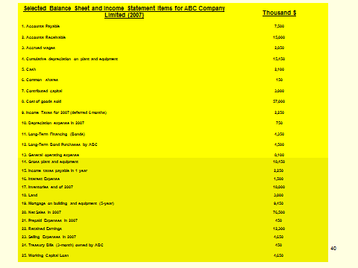
ABC Company BALANCE SHEET (December 31, 2007)
ASSETS (Thousand $)
Current Assets
Accounts receivable (2); (2) is the Table reference | 15,000
Cash (5) | 2,100
Treasury Bills (24) | 450
Inventories (17) | 18,000
Prepaid expenses (due in 3 months) (21) | 450
Total Current Assets | 36,000
Long Term Assets
Long term bond investments by ABC (12) | 4,500
Land (18) | 3,000
Gross plant and equipment (14) | 18,450
Less: Accumulated depreciation on plant and equipment (4) | 15,450
Net plant and equipment (14) minus (4) | 3,000
Total Long Term Assets | 10,500
TOTAL ASSETS | 46,500

Slide 41
ABC Company BALANCE SHEET (December 31, 2007)
LIABILITIES (Thousand $)
Current Liabilities
Accounts payable (1) | 7,500
Accrued wages (3) | 2,850
Taxes Payable Within 6 months | 2,250
Working capital loan (25) | 4,650
Total Current Liabilities | 17,250
Long Term Liabilities
Long-Term Financing (Bonds) (11) | 4,350
Mortgage on building (10-year) (19) | 9,450
Total Long term Liabilities | 16,050
TOTAL LIABILITIES | 31,050
OWNER EQUITY
Common shares (6) | 150
Contributed capital (7) | 3,000
Retained Earnings (22) | 12,300
Total Owner Equity | 15,450
TOTAL LIABILITIES & OWNER EQUITY | 46,500

Slide 42
Income Statement
Complete ABC’s Income Statement for calendar year 2007 (from the information in Table 1).

Slide 43
Income and Expense Statement for ABC Company from Calendar Year 2007 | Thousand $
REVENUES
Net Sales (20) | 76,500
(-) Cost of Goods Sold (8) | 57,000
OPERATING EXPENSES
Depreciation expense (10) | 750
+ General operating expense (13) | 8,100
+ Selling expenses (23) | 4,650
+ Interest expense (16) | 1,500
TOTAL EXPENSES | 15,000
INCOME BEFORE TAXES | 4,500
Income Taxes (40% of Income before taxes) | 1,800
PROFIT AFTER TAXES (Net Income) | 2,700

Slide 44
Complete ABC’s Income Statement for Calendar Year 2007

Slide 45
Income and Expense Statement for ABC Company from Calendar Year 2007 | Thousand $
REVENUES
Net Sales (20) | 76,500
(-) Cost of Goods Sold (8) | 57,000
OPERATING EXPENSES
Depreciation expense (10) | 750
+ General operating expense (13) | 8,100
+ Selling expenses (23) | 4,650
+ Interest expense (16) | 1,500
TOTAL EXPENSES | 15,000
INCOME BEFORE TAXES | 4,500
Income Taxes (40% of Income before taxes) | 1,800
PROFIT AFTER TAXES (Net Income) | 2,700

Slide 46
Change in ABC’s Financial Position in 2007
Cash from operations
+ Net profit after taxes: $2,700
+ depreciation charges: $750
- increase in materials inventory: $250
+ decrease in finished goods inventory: $100
+ cash from financing activities (loans): $1,000
Total Source of Cash in 2007 = $4,600

Slide 47
Change in ABC’s Financial Position in 2007
Cash Application (use)
Purchases of equipment: $2,000
+ Dividends paid to shareholders: $500
Total Uses of Cash in 2007 = $2,500
Net increase in cash in 2007 (from 2006)
= $4,600 - $2,500 = $2,100

Slide 48
Industry Sector & ABC’s Financial Ratios
Complete the Table below
Industry Norms and Financial Ratios For ABC Company
Ratio | Industry Norms | ABC Ratios | ABC Meets Industry Norm? Yes/No
Current ratio | 2.5 | ? | Yes/No
Acid-test ratio | 1.75 | ? | Yes/No
Equity Ratio | 0.6 | ? | Yes/No
Inventory-turnover ratio | 2.2 | ? | Yes/No
Return-on-total-assets ratio | 0.08 (8%) | ? | Yes/No

Slide 49
ABC’s Financial Ratios
1. Current Ratio | = Current assets ÷ Current liabilities = 36 000 ÷ 17 250 = 2.09
2. Acid-test Ratio | = Quick assets ÷ Current liabilities = (36 000 – 18 000 – 450) ÷ 17 250 = 1.02
3. Equity Ratio | = owner equity/{total liabilities and equity} = 15 450 ÷ 46 500 = 0.33 or 33%

Slide 50
ABC’s Financial Ratios
4. Inventory turnover ratio | = Sales ÷ Inventory = 76 500 ÷ 18 000 = 4.25
5. Return-on-total-assets or net profit ratio (profitability ratio) | = Profits after taxes ÷ Total assets = 2 700 ÷ 46 500 = 0.058 or 5.8%

Slide 51
Financial Ratios
Ratio | Ratio characteristic
Current ratio | The better the more it exceeds unity (1).
Acid-test ratio | The better the more it exceeds unity (1).
Equity Ratio (%) | The closer to 100% the better.
Inventory-turnover ratio | The bigger the better.
Return-on-total-assets ratio (%) | The bigger the better.

Slide 52
ABC’s Financial Ratios
Industry Sector & ABC’s Financial Ratios
Ratio | Industry Norms | ABC Ratios (2007) | ABC Meets Industry Norm? Yes/No
1. Current ratio | 2.5 | 2.4 | No
2. Acid-test ratio | 1.75 | 1.17 | No
3. Equity Ratio (%) | 60 | 33 | No
4. Inventory-turnover ratio | 2.2 | 4.25 | Yes
5. Return-on-total-assets ratio (%) | 8 | 6 | No

Slide 53
ABC’s Trend Analysis
Ratio | 2007 | 2006 | 2005
Current | 2.4 | 1.9 | 1.6
Acid-test | 1.17 | 0.9 | 0.75
Equity (%) | 33% | 40% | 55%
Inventory-turnover | 4.25 | 7 | 12
Return-on-assets (%) | 6 | 8 | 10
?
?
?
?
Increasing reliance on debt capital
?
?
Assets tied up for longer periods of time
Decreasing return on resources

Slide 54
ABC’s Trend Analysis
Positive Trends
  ABC’s current and acid-test ratios.
Negative Trends
  Share of equity capital, inventory-turnover and return-on-assets ratios
  Omens of potential problems.

Slide 55
Your Turn
A friend recommended that you purchase “Petit Ourson Ltd” shares.
You have the 2006 and 2007 financial statements for the company and the standards for this industry.
Carry out a financial ratio analysis of the company.
Are there any trends apparent in your analysis?
(Fashioned after Fraser et al. Engineering Economics, Pearson, 2009)

Slide 56
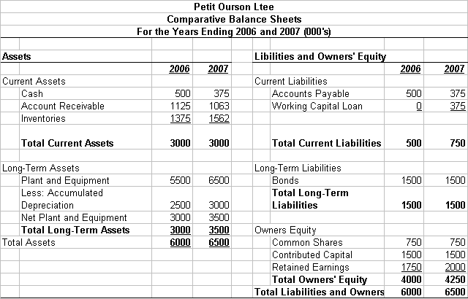
Your Turn cont’d

Slide 57
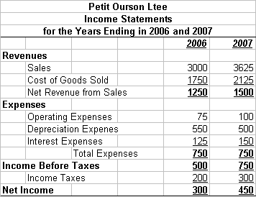
Your Turn cont’d

Slide 58
Your Turn cont’d
Ratios for 2006
Current ratio | Current assets ÷ Current liabilities | 3000 ÷ 500 | 6.00
Acid-test ratio | Quick assets ÷ Current liabilities | 1625 ÷ 500 | 3.25
Equity ratio | Total equity ÷ Total assets | 4000 ÷ 6000 | 0.667
Inventory turnover ratio | Sales ÷ inventories | 3000 ÷1375 | 2.182
Return on assets ratio | Net income ÷ Total assets | 300 ÷ 6000 | 0.05 or 5%

Slide 59
Your Turn cont’d
Ratios for 2007
Current ratio | Current assets ÷ Current liabilities | =
Acid-test ratio | Quick assets ÷ Current liabilities | =
Equity ratio | Total equity ÷ Total assets | =
Inventory turnover ratio | Sales ÷ inventories | =
Return on assets ratio | Net income ÷ Total assets | =

Slide 60
Next Week:
First mid-term exam (7-8:30 pm)
Lecture 6: Cost-Benefit Analysis (CBA)

Slide 61
Engineering Economics
ECO 1192
Lecture 5: Financial & Management Accounting
Claude Théoret
University of Ottawa

