Slide 1
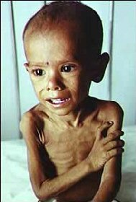

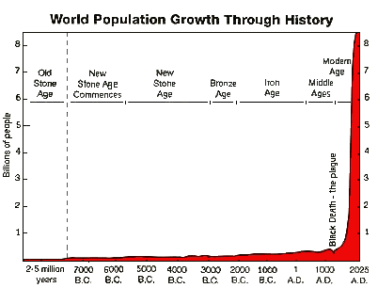
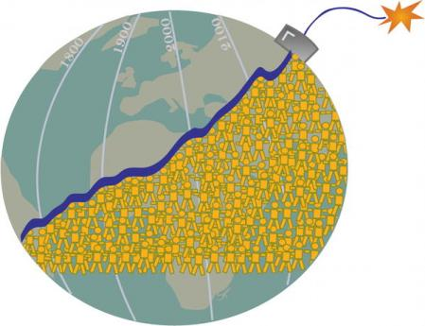
OCT-30: The Population Bomb
Are there any environmental limits to human civilization?

Slide 2

Survival Week:
One objective of this assignment was to give modern Canadians a feel for what sustainable living is like; how onerous did you find the experiment?
Do you think it is possible to live sustainably in modern Canadian society?
What behaviours or lifestyle changes made the biggest impact in terms of meeting your sustainability goal?
Using a journal or calculator helps an individual to track the ecological costs of our mode of living. How could we incorporate this calculation into our larger social structures; the economy and civilization?
Congrats hero, you are off the island!

Slide 3
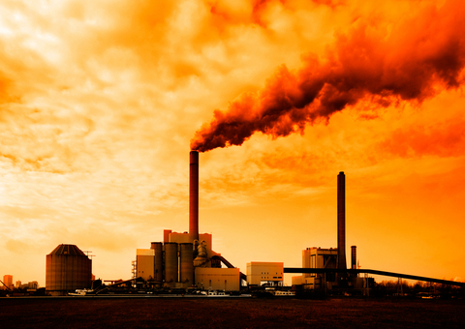
Hero Essay
Climate Change is a surprisingly ignored threat; a planetary emergency that appears a dead political issue.
McKibben presents climate change in real terms so that ordinary people can translate a complex science into the sphere of their life.
Climate change is not a long term nuisance, but already exerts a strong impact on the world economy, agriculture, weather, and has great bearing on our civilization’s future.
Climate change is already impacting the microsphere of your life, the things your care about, and determining the shape of your future, whether you acknowledge this or not.
Our focus is going to shift to concrete environmental problems and solutions. Keep this in mind for the second essay.

Slide 4
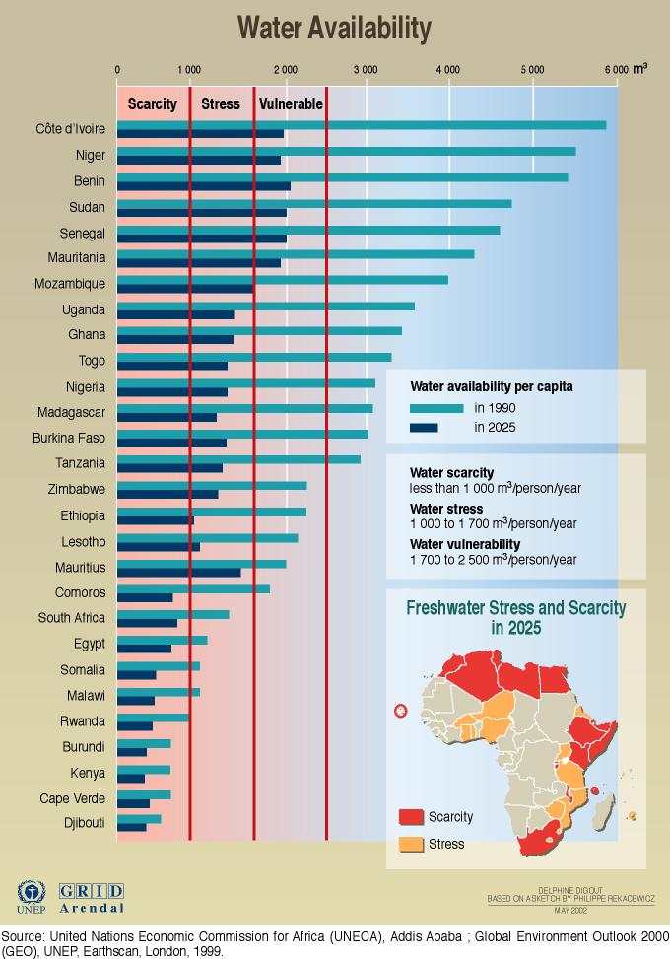
Lecture Objective:
A balanced investigation of the links between human population and environmental degradation, featuring historical demography, urban history, and ecology to objectively assess carrying capacity, limits to economic growth, water scarcity, and food security.

Slide 5

State of the Question:
1992 UCS Warning to Humanity: “The earth is finite. Its ability to absorb wastes and destructive effluent is finite. Its ability to provide food and energy is finite. Its ability to provide for growing numbers of people is finite. And we are fast approaching many of the earth's limits. Current economic practices which damage the environment, in both developed and underdeveloped nations, cannot be continued without the risk that vital global systems will be damaged beyond repair.”
1994 Cairo UN Conferences: Benchmarks, Women’s Education, Child Mortality, and Family Planning

Slide 6
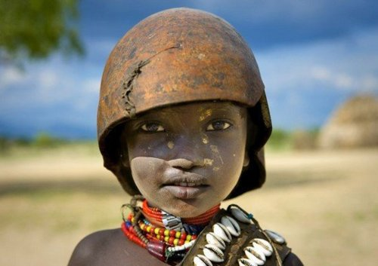
Preliminary Questions:
Is the world really ‘overpopulated?’
What adverse environmental consequences result from human population?

Slide 7
Lecture Outline
I. Planetary Demography: Fact and Figures
II. Malthus, Ehrlich and the Population Bomb
III. The Club of Rome and Limits to Growth
IV. Mexico and the Green Revolution
V. Blue Gold: Water Scarcity and Conflict
VI. Obesity in Wake of Global Famine
VII. Food Inflation in Age of Limits and Scarcity
READINGS: PCR Chapter 12, Feast and Famine, Mexico birth of Green Revolution,
AV: Bananas, Blue Gold, Corporation Bechtel, World Population,

Slide 8
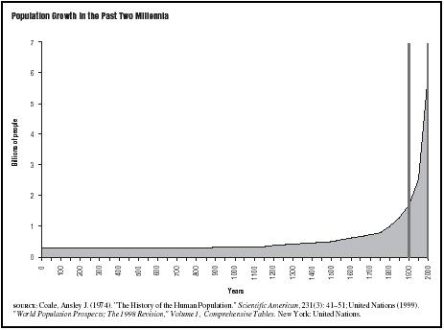
I. Historical Demography (2:00)
From a planetary perspective The human species has been a stunning success. Our numbers are a reflection of our triumph in the survival of the fittest battle. We have through our technology been able to dramatically increase our numbers, but from an evolutionary frame our success is both very dramatic and very recent. Human population has exploded over the twentieth century after a dramatic uptick following the Industrial Revolution.

Slide 9
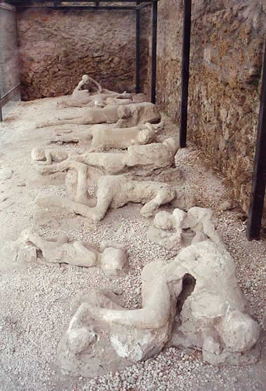
Population and Pressure Events
The human population, like that of other species, has been punctuated by several episodes that caused mass mortality; climate change, natural disasters, world wars, ecological collapse, and infectious diseases. Except for climate change at the dawn of man that pushed our numbers to perhaps 30,000, these pressure events were localize and did not impact the overall global demographic trends towards expansion. Despite serious local degradation that pushed down local carrying capacity, exhausting half of the carbon in the Earth’s top soil since the Neo-Lithic Revolution, the human species has been able to increase by expanding to new areas and developing new crops and technologies that raise our population threshold.
Pompeii; 90% mortality in 15 KM radius.

Slide 10
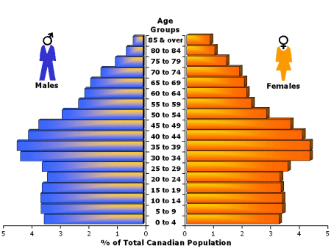
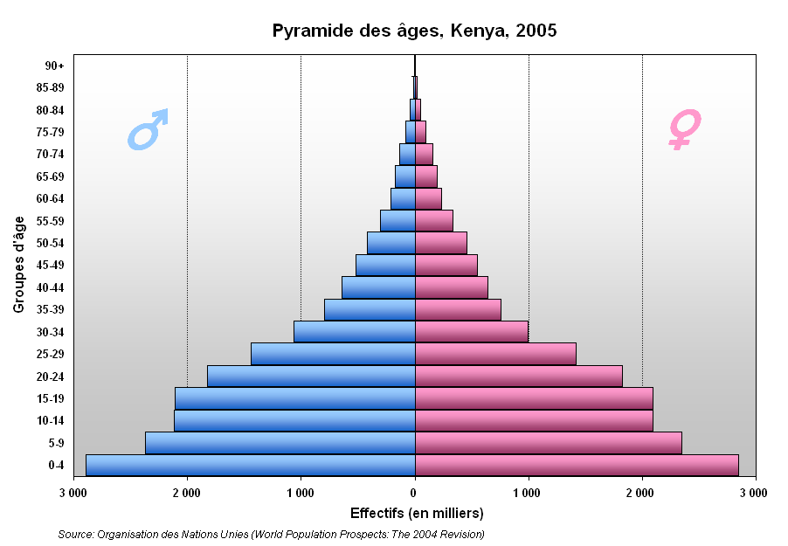
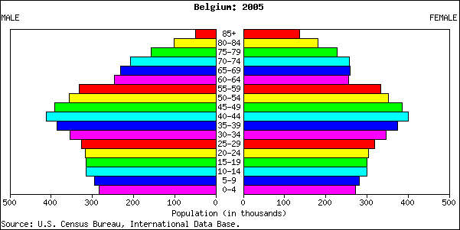
Population Growth Factors
Canada
Kenya Belgium
Population pyramids provide a graphic image of statics that help us to understand at a glance the evolution of the human population in various states on Earth.
Net population growth is a combination of the natality or birth rate, longevity, and the mortality rate.

Slide 11
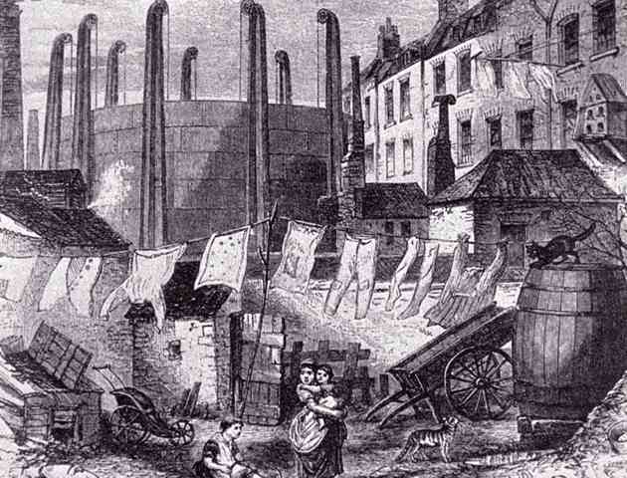
The West and the Industrial Revolution 1780-1920
The Industrial Revolution provoked a population explosion beyond past limits in Western Europe. Despite social commentators like Charles Dickens, and the notable pollution in industrial slums, demographic information reveals a steady increase in industrial Britain’s population. The largest factor spurring population growth was a sharp decline in the mortality rate, first under the impulse of public health initiatives, and second under greater food production generated in colonies. As a result the Western World’s share of the world population reached its peak around 1900.
Industrial Slum

Slide 12
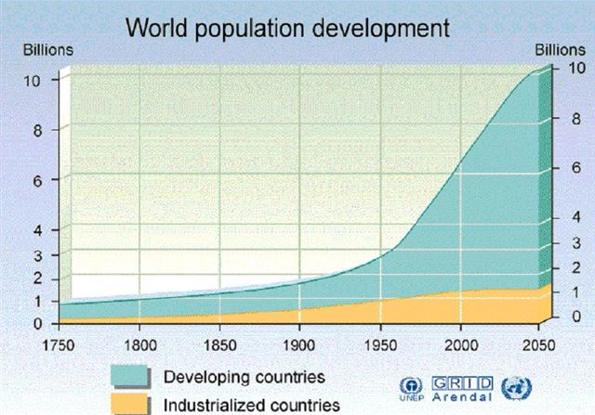
Western World and Developing World
Postwar (1945) population growth has been primarily powered by advances in the developing world. The key catalyst was not a rise in the birth rates, but a sharp drop in the mortality rates given the introduction of Western medicines, antibiotics, and more effective treatment of infectious diseases; malaria, small pox, polio, and others. Although global birth rates have decreased since 1970 world population growth has accelerated. How do you explain this?

Slide 13
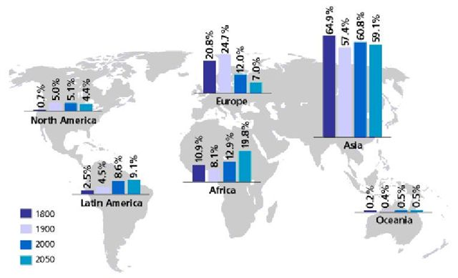
Population Density
Global population numbers can obscure substantial continental and local differences. Today global population density is quite unequal. The majority of the world’s population is clustered in South Asia, particularly China and India, the East Coast of North America, and Northwestern Europe. The Americas, Australia, and Africa are less densely populated. Obviously, the pressure population exerts on the environment is not uniform, given that a global system of enables the importing of food and resources from peripheral areas.
Based on this map, which continent is the most and which is the least ‘overpopulated’?

Slide 14
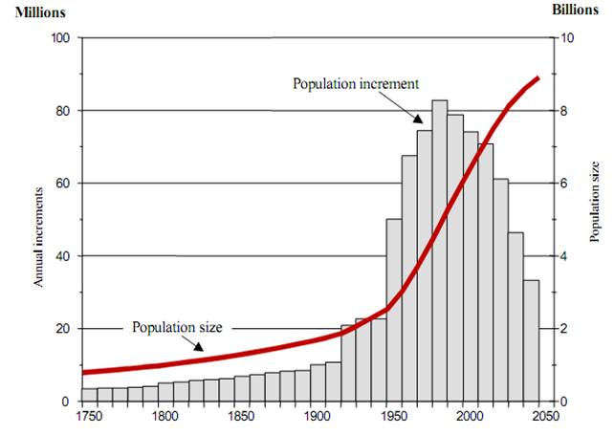
Urbanization and World Population
Population growth in the developing world mirrors, in general, the pattern of growth experienced in the Western World during the process of industrialization, with a sharply rising population for three generations, followed by a leveling off as birth rates drop to a replacement level.
Catch Up Effect: Many argue that population growth in the developing world is no big deal because the ‘explosion’ is a natural by product of the historical process of industrialization and that as people move to cities the national population will level off.
Leveling Off: Currently the global population growth rate is decelerating, but population growth will continue to increase until the end of the 21st century barring a drastic event.

Slide 15
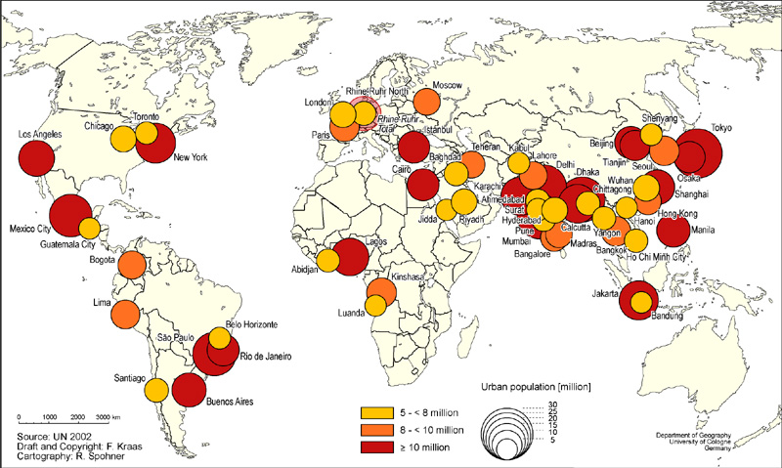
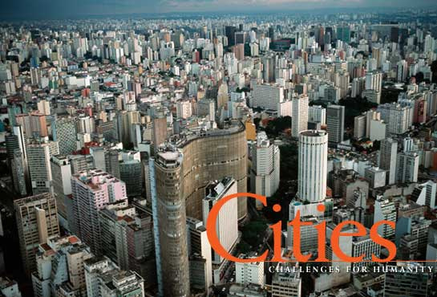
Mega-Cities in the Developing World
In many developing countries, population growth has been centered in the largest metropolitan areas, in particular the national capital. Throughout the developing world rural migration from 1970-1980s precipitated the formation of ‘mega-cities’ formally those with populations of five million. Megacities are representative of a development process in which rural development stimulated rural migration to large metropolitan areas. Mega cities grew spontaneously with little planning and many new shanty town suburbs do not have access to sewer and fresh water, sometimes even electricity.

Slide 16
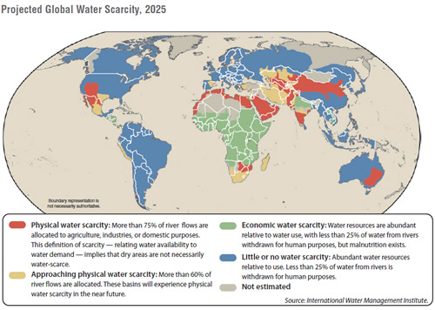
Postwar Population Explosion: Regional Trends and Perspectives
*Most of the postwar population growth took place in Asia, particularly South East Asia and China, because while the growth rate was not as high as in other world regions, the area already had a high population density.
*Postwar Africa experienced the highest rate of growth, and while growth rates remained high, the population density in sub-Saharan Africa was relatively low to begin with, while generally speaking the environment, soils, and resources are sufficient to enable these states to feed themselves.
*Population growth in the Middle East is the most dangerous, not only because of explosive growth rates, but because these populations are highly vulnerable in the future given their lack of agriculture and fresh water resources.
In Latin America modest population growth rates have steadily increased the population, which can in larger measure be supported by local resources, but most of the population growth has taken place in cities which struggle to provide basic services for the underclass.
The water limit to development and human population.

Slide 17
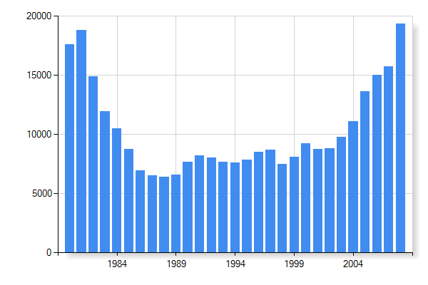
Population and GDP
In general, population adds to the GDP given that every unit of labor will increase national output.
In countries with low economic growth or limited resources, population growth will actually make the state poorer on a relative or per capita basis.
Population growth in the Middle East and Sub-Saharan Africa has made these regions poorer than they were in 1960 during the ‘developmental decade.’
Asia has generally fared better with family planning than Africa and the Middle East, but there are lots of national exceptions.
Saudi Arabia’s GDP has increased in recent years with the rising price of oil, but over the last thirty years its GDP/per capita has lost ground because population growth has outstripped economic growth.

Slide 18
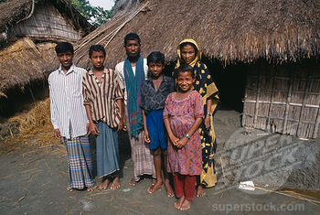

Fecundity and Culture
In the developing world, the decision to have children is a complex decision that factors in economic realities with cultural heritage. Many people in the developing world have no old age security systems, so children are essentially their retirement plan. In addition, birth rates are higher in the countryside, where farm families often depend on the labor of children to survive. Typically, urban living creates economic conditions that discourage large families, but in many cultures children still have a significance and the state’s involvement in family planning and birth control is highly variable.

Slide 19
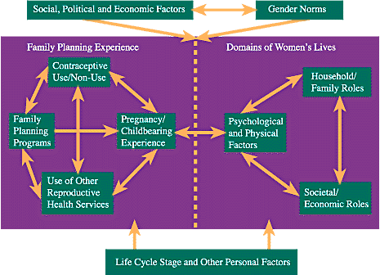
Family Planning in the Developing World
The success of family planning policies across the developing world is highly variable, reflecting cross cultural differences in terms of how children are viewed, as well as divergent commitment among national governments to support such policies. Many African states lack the resources to support family planning initiatives and foreign aid has fallen 300% short of UN targets.
Globally, the key is affordability and accessibility of birth control.
But family planning will take more than a Trojan Revolution, deeply embedded cultural assumptions and social structures will need to be changed.

Slide 20
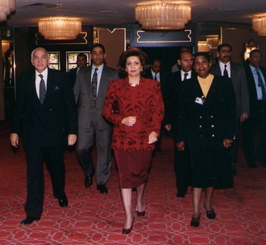
International Population Management Efforts
1994 Cairo Conference
1. Provide universal education:
2. Reduction of infant mortality
3. Reduce maternal mortality
4. Access to family planning
There have been several UN Conferences that have looked at population from variant angles. Since the 1970s family planning and population issues, however, have commanded less international attention and support.

Slide 21
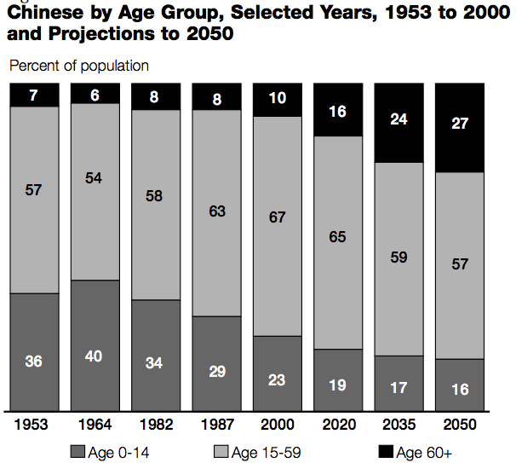
China’s One Child Policy
In China during the 1960s the poverty of the populace and widespread starvation as result of Mao’s disastrous Great Leap Forward, resulted in a draconian 1978 one-child policy, where the iron grip of the Communist Party was deployed to enforce a family planning policy to prevent China’s population from outstripping available resources. Although there are exceptions, 36% of the population is subject to this policy and deviants are punished in a number of ways.

Slide 22
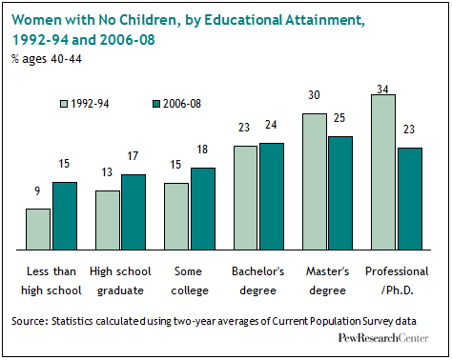
Women’s Education and Birth Rate
Population specialists have identified female education and occupational opportunities for women as key variables that contribute to smaller families. Many traditional societies are patriarchal, which means that the decision to have children and work opportunities outside the family may be influenced by husbands, fathers, and male figures.

Slide 23
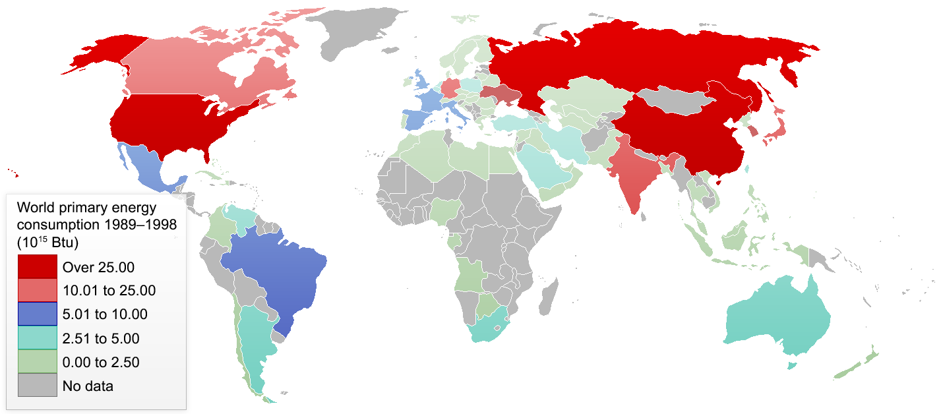
Population and Environment
People cause diverse environmental pressures. Human settlement, farms and cities, take over natural habitat. Cities draw resources, water, food, and energy from neighboring areas. Industrial society releases pollutants into the air, water, and land. Roughly speaking, the ecological impact of population must be multiplied by that state’s level of consumption because the carbon footprint for example of the average Kenyan is significantly less than that of the Middle Class Canadian.

Slide 24
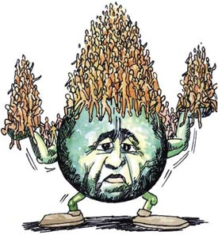
Carrying Capacity and Global Population
‘Carrying Capacity’ suggests that there exists a discrete number of humans that the Earth can support. Given the twentieth century explosion in human population and a dramatic increase in our standard of living, many observers are worried that the Earth has become ‘overpopulated. In fact the Earth’s carrying capacity would be difficult to determine, given various limits in terms of water, resources, and land.
Have we overpopulated? How would we determine this?

Slide 25
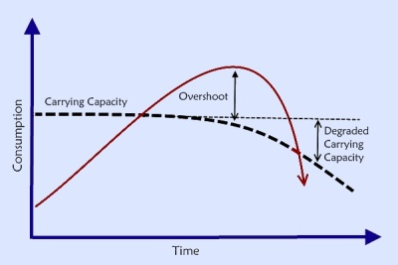
The Ecological Perspective
Carrying capacity is a concept used by wildlife biologists to describe ecosystem health and its ability to sustain biodiversity and biomass. According to this general model, there is a maximum threshold for how much biomass an ecosystem can support. A species may overshoot temporarily this support level, but the resulting ecosystem degradation establishes a permanently lower ‘new normal’ carrying capacity.

Slide 26
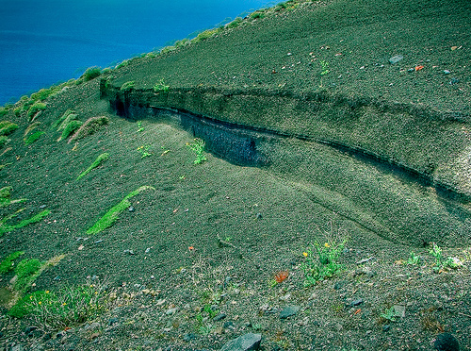
Local Ecological Collapse
As noted earlier in the semester, history is filled with examples of human populations that have degraded the local environment and resource base. Greece, Lebanon, and Greenland are all examples of local environments that have been degraded which can support less biomass than previously, although even there the human population has increased because technology has enabled us to raise the carrying capacity. We have seen many events of local population collapse in past history when civilizations were linked to a particular environment, the question is whether humanity now possessing a global environment could face a population collapse on a world scale?
The Romans cut down the cedars in Lebanon and the Ancient Greeks eroded away their topsoil.

Slide 27
Conclusions and Reflections
The industrial revolution stimulated a dramatic uptick in world population, with geometric explosion powered mostly by a decreasing mortality rate and increasing longevity.
Since 1945 most of the population growth has taken place in the developing world.
The world’s population density is very uneven, and while Africa’s population is growing rapidly, but Asia is the most densely inhabited, and the Middle East’s population growth is most dangerous in terms of resource exhaustion.
There are multiple ecological effects of population and they are not easy to calculate or measure. Human carrying capacity is not static number because our technology enables us to transform the population supported, but there is also an ultimate resource and environmental limit on human population, while history shows that human degradation does lower the productivity of land and the number of people that can be supported.

Slide 28
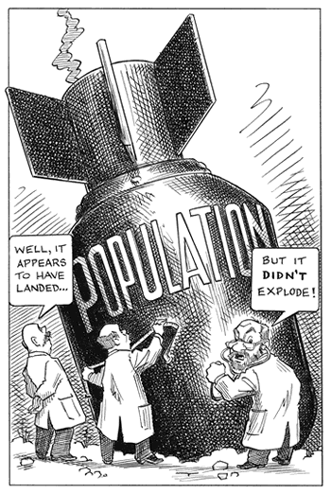
II. Malthus, Ehrlich, and the Population Bomb
Bomb is a very suggestive metaphor. What does it imply relative to human population?

Slide 29
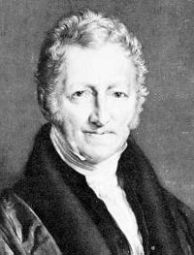
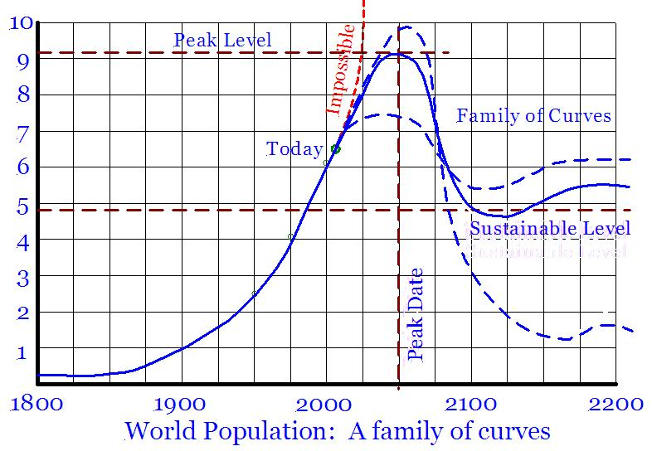
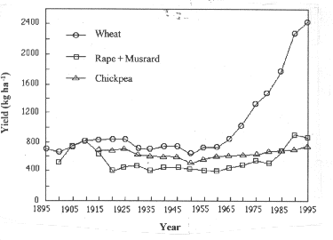
Malthusian Math
Parson Malthus
Arithmetic versus geometric growth
Misery of countryside
Smaller farm pastures
Agricultural Revolution
Agricultural Revolution

Slide 30

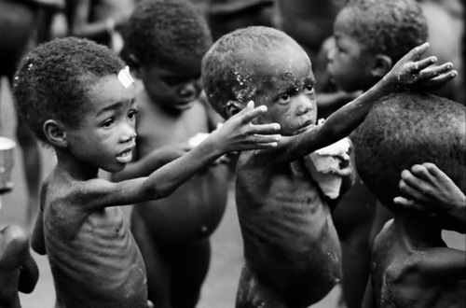
Ehrlich’s ‘Bomb’
In the late 1960s many sounded the alarm and pointed to starvation in East Africa as evidence of ‘overpopulation’. Paul Ehrlich’s 1968 Population Bomb was widely read an important staple of the Environmental Decade and how people viewed environmental issues at that time. Since 1970, however, the Earth’s human population has nearly doubled. This raises skepticism about Ehrlich argument, while a more rigorous analysis of famines in East Africa has revealed that they were not the product of overpopulation in a strict sense, since there was food to feed these people, but they had little money and aid had difficulty reaching them in a civil war environment.

Slide 31
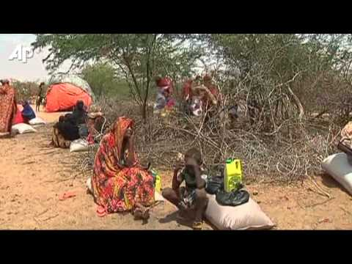
African and Indian Famines of 1970s
“Rising meat consumption also played its role. A Soviet Union determined to outpace American levels of meat-eating had to import enormous quantities of grain to support that measure, which drove up world prices, leading to shortages. Famine spread across the southern hemisphere, from West Africa to Bangladesh.”
-Otter
Market forces, rather than environmental forces were a principal driver of famines of the 1970s

Slide 32
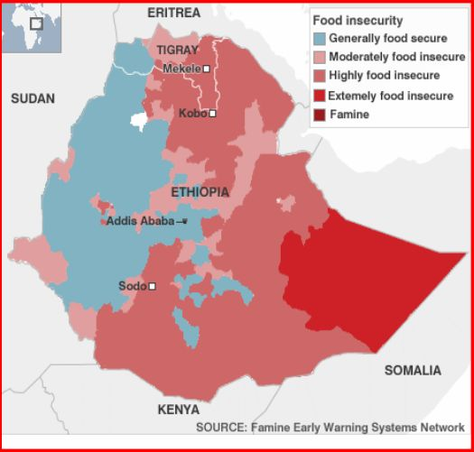
Famine in Ethiopia 1983-1985 (25:00)
400,000 Deaths
Dry Cycle 1961-1985
Global Dimming
Deforestation and Ecosystem Degradation
Failed State, Civil War, and Social Strife

Slide 33

In 1969 the world’s best and brightest scientists, statesmen, and development experts gathered in Rome in 1971 and concluded that the world system was not sustainable. Were they catastrophists that underestimated human ingenuity or was their logic sound even if most of their dramatic predictions did not materialize in the intervening time?
Meadows
III. The Club of Rome and Limits to Growth

Slide 34


Limits to Growth?
In 1968, Italian playboy and maverick industrialist summoned the world’s best and brightest to his villa in Rome. Their assignment: solve the world’s problems.
a. Aurelio Peccei (1968)
b. The Club of Rome (1969)
c. Limits to Growth (1971)
Peccei

Slide 35
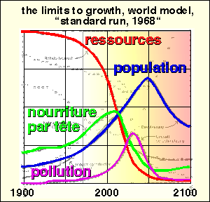
Meadows’ Computer Models
The credentials of the club’s members and its at the time unique invocation of computer technology gave the Limits to Growth model the perception of scientific legitimacy.
The basic dynamic in Limits to Growth

Slide 36
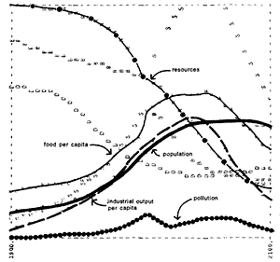
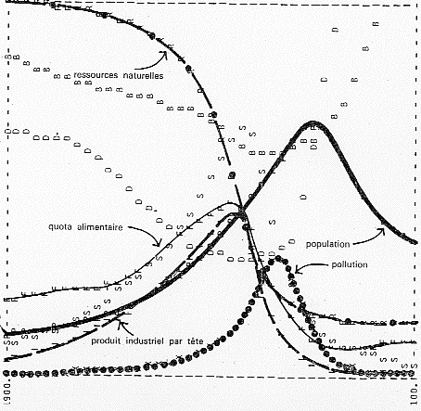
In all there were over 12 models making different assumptions about the future, but whether one doubled the amount of arable land or natural resources, the result was always a crash. . .

Slide 37
The Club’s Conclusions
i. Irresolvable Contradiction: Infinite growth and Finite resources.
ii. Crash inevitable: without reducing consumption and creating an equilibrium by 1977
iii. Technology cannot save us: Human technology can increase the Earth’s capacity, but not alter the fundamental limits of the Earth

Slide 38
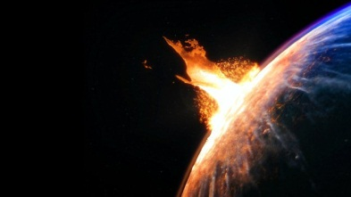
Discussion: Evaluating the Limits to Growth Thesis
What are the World’s limits according to the COR model? Are these an accurate reflection of the limits upon human civilization?
Meadows argued that without sustainability in 1977, the world would suffer a catastrophe. It is 2012 and we have not seen this. Was Meadows “wrong” or has he yet to be proven “right”?

Slide 39

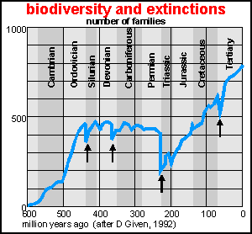
New Thinking on Limits to Growth
The rate of species extinction is harrowing and perhaps unprecedented.
Resource limits less important than ecological limits
Climate Change and Biodiversity
Demography and Consumption:
Human Population and Habitat Loss:
Developing World and Footprint:

Slide 40
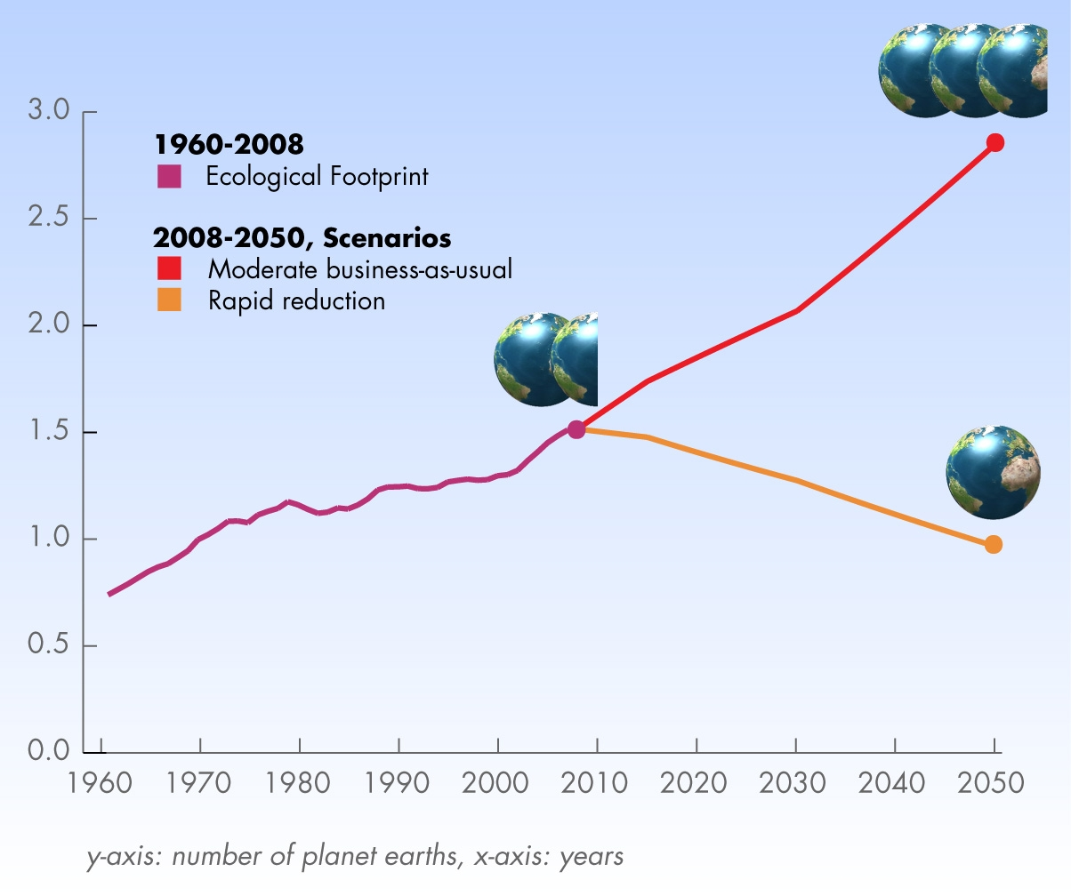
Ecological Assessments
The Global Footprint Network illuminates the current dilemma. We are at at a 40% overshoot. As a society we can chose to reduce our consumption to par, but if we do nothing we will reach 180% overshoot by 2050, roughly when you are set to retire.
1999 David Pimentel Study: Global carrying capacity 2 billion
GFN: 40 % current overshoot

Slide 41
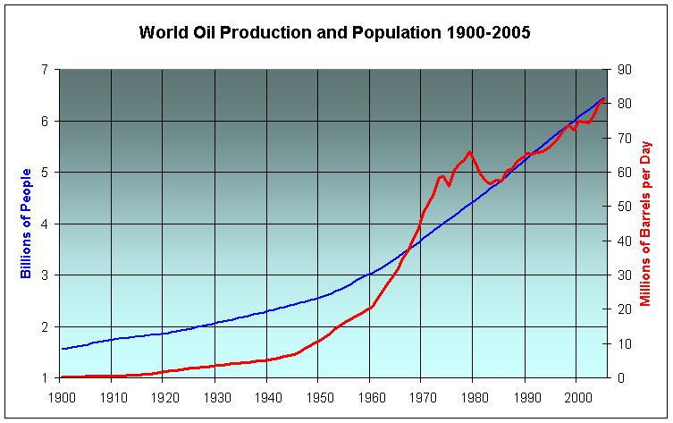
Oil and Population
Oil is the lifeblood of modern civilization, powering its post-fordist global system of production, generating much of our electricity, and underwriting our agricultural system. Note the interesting symmetry between oil production and population.

Slide 42
Detailed Analysis
Resource Exhaustion: One flaw in the limits to growth theory is that growth is linked to closely to natural resources, but in the post-industrial economy much of the growth has come in terms of the service sector and intellectual property.
Carrying Capacity: This is not a scientific concept, but a ‘rough gauge’ about the number of humans the Earth can support. Clearly, carrying capacity is not a discrete number, but rather a variable dependent not only on the total global population, but their standard of living, their level of technology, and the efficiency of their society.
Extinction and Biodiversity: Most environmentalists believe that ecosystems rather than natural resources provide the primary limit to human population growth. Species extinction and habit loss makes human’s very vulnerable to ecosystem collapse because we lack the capacity to adapt to change.
Industrial Agriculture, Peak Oil, and Climate Change: Most of the recent population boom has been precipitated by the twentieth century roll out of an agro-industrial system, but this system is dependent on cheap oil and a stable climate, two preconditions not likely to remain constant during the twenty first century.

Slide 43
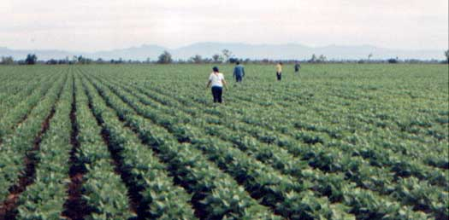
IV. Mexico and the Green Revolution
When the world last faced a major food crisis, Western science sprung into action, exporting Western agronomical advances to the developing world. What were the consequences of this Green Revolution?

Slide 44
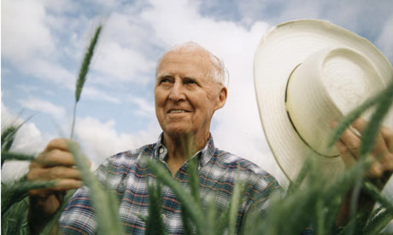
Borlaug
Father of the Green Revolution
Agronomy: The application of agricultural science to improve crop yields.
  Saved 1 billion people from starvation
  1970 Nobel Peace Prize

Slide 45
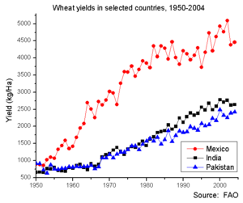
History of GR in Mexico
1944 Cooperative Wheat Research Production Program
Hybrids for Superior Performance
  High Yield
  Dwarf
  Disease Resistant; Rust
Nitrogen Fertilizer to compensate for poor soil
Northern and Southern Wheat Varieties
Two growing Seasons
Post World War II Irrigation Projects
From a yield perspective, which was its singular goal, the Green Revolution in Mexico was an unmitigated triumph.

Slide 46
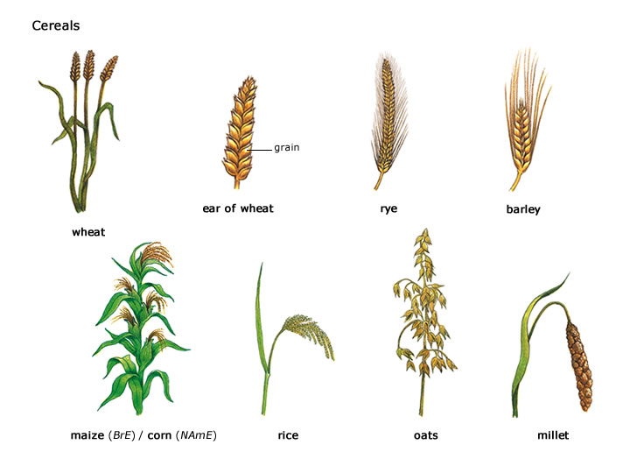
Agronomical Revolution
Cultivars
Crossbreeding
1963 Wheat Harvest 600% 1944 level
Mexico as Wheat Exporter
“Mexican agriculture was used as a model by the Rockefeller Foundation, the U.S. Agency for International Development (AID), the World Bank, and other agencies, to promote Green Revolution technology packages around the world “-Sonnefeld

Slide 47
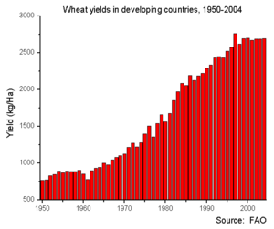
Global Green Revolution
Technocratic approach to cope with growing population
Epicenters: Mexico 1950s and India late 1960s
Saved 1 billion people from starvation
Cash Crops: Cotton, Maize
Environmental Consequences: severe water salinization, desertification, deforestation, and pesticide abuse.
Social Consequences: The technocratic approach favored large, rich farmers able to afford the capital intensive infrastructure. Subsistence farmers lost out in the process and many were evicted to join ranks of urban under class.
Global Market and Food Security: The agronomical model is predicated at maximizing production, but does not take into account ecological limits or the needs of beneficiaries.

Slide 48
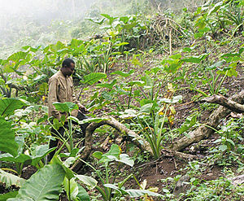
Food Crops and Cash Crops
In a capitalist system the incentive to produce is dictated by price. Farmers are encouraged to specialize, leverage their comparative advantage, on those cash crops that yield them the greatest profit for them individually. One phenomenon present in the modern Agro-Industrial economy is that much of the world’s best land is being cultivated for cash crops rather than low margins staple food crops that could feed the hungry. In fact the Green Revolution on a global scale precipitated a transfer of land from small subsistence farmers to larger farmers with the capital to effectively compete in the global market.
Finance: machinery, hybrids, fertilizers, and pesticides.
Reliance on Irrigation: Yield characteristics
Loss of Draught Resistance:
Loss of Food Security

Slide 49
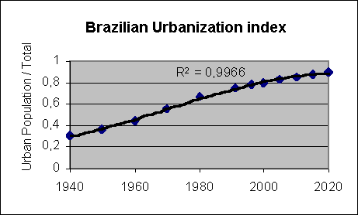
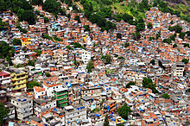
GR Urbanization
One of the unintended consequences of the Green Revolution was creating conditions that favored larger corporate farms in India and Mexico, with smaller subsistence farmers forced from their land and ancestral villages by debt and compelled to migrate as low skill workers to urban centers in search for work. One legacy of the green revolution and its off shoots was urbanization and the social and environmental problems of mega-cities.
Favela Sao Paolo

Slide 50

Green Revolution and Carrying Capacity
Although the Green Revolution bought the world 30-40 years to find a solution to its population problem, the agronomical revolution has peaked. Globally yields are declining, the limits to expanding the technology have been reached, and the GMO results so far do not amount to another revolution.
Borlaugh also maintained that the Green Revolution would buy the world 30 years, but that it would not solve the global food crisis.

Slide 51

The GMO Revolution?
Given that population will continue to expand while global food production has peaked, the world is in desperate need of a new ‘Green Revolution.’ The obvious place to look is genetic engineering, in particular the science of genomics is allowing us to endow food crops with favorable characteristics: draught resistance, higher yields, natural pesticides. But to date innovation has not been sufficient to make up for declining yields and rising costs afflicting the Modern Agro-Industrial system.
As we will note later in the semester, there are significant unknowns and health risks affiliated with genetically modified crops.

Slide 52

Climate Change Factor
Climate Change is by definition a complex phenomenon, increasing human carbon dioxide leads to shifts in weather systems across the globe. Changes in patterns of rainfall, the length of growing seasons, and soil quality are difficult to quantify or relate to particular disaster events. Draught resistance crops are clearly in high demand in the current environment.

Slide 53


V. Blue Gold : Water Scarcity and Conflict
You do not hear much about fresh water scarcity in richly endowed Canada, but water is one critical limit on modern agriculture and therefore human population.
2009 World Economic Forum: In fewer than 20 years the world will face severe water shortages so severe that “global food production could crater.”

Slide 54


Irrigation and Agriculture
3% of Earth’s water is fresh water
.3% potentially usable
Significant Scarcity in Developing World
  Dryland Africa
  Northern India and Southwestern China
Climate Change
Draining of Aquifers
  Imperial Valley
Ban Ki-moon warns: "A shortage of water resources could spell increased conflicts in the future. Population growth will make the problem worse. So will climate change. As the global economy grows, so will its thirst. Many more conflicts lie just over the horizon."

Slide 55


Water Conflict: West Bank
It is impossible to understand conflicts like the Palestinian question without investigating the water angle. Water holds the key not only to economic future of this arid region, but for supporting a rapidly expanding increasingly urban population.
Water is life, and given shortages people will do anything to procure it. War for water is not only logical, it is inevitable in an era of increasing scarcity.

Slide 56


Global Water Scarcity
Water scarcity is already a pressing environmental, economic, and social problem in many heavily populated areas of the world, but its radius of impact will increase to subtropical areas with climate change.
Current 2050

Slide 57

Water and Modern Agriculture
In 2050 there will be ¼ of the water per capita as there was in 1950.
The modern agricultural system is predicated upon applying high inputs of fossil fuels, capital, and water. Without irrigation, the system does not function.

Slide 58
Conclusions and Reflections
Since the human population is fed by a global agro-industrial system, critically examining it provides the best index into global carrying capacity.
The modern agricultural system has been built to maximize yield through intensive capital inputs, but many of these inputs are limited or non-renewable resources like water and oil.
After the glut of the 1990s we are entering an era where demand and food supply are close together creating an era of food inflation and disaster related temporary shortages.
Climate change is the principal unknown variable moving forward. We know it will impact agriculture, it already is, but the question is to what extent will it undermine global yields and can this be offset by technological advances?

Slide 59

VI. Obesity in Wake of Global Famine
In the capitalist market system is that food is distributed not according to need, but according to price. In a global food market, some are gorging themselves into an obesity epidemic that makes diabetes the main health threat that compromises the fiscal integrity of states. On the other hand, poor people starve as cropland is diverted to more lucrative protein and fossil fuel production.
The Big Mac conquers China; throughout the developing world the Western diet is on the rise.

Slide 60



Obesity on Naura
Throughout the world, indigenous people serve as a canary in the coal mine, showing the effects of the modern diet has on the human body adapted to survive in a difficult environment. Through natural selection and past episodes of starvation, indigenous people often have a low metabolism and when introduced to the quarter pounder their bodies have reacted.
“The "neoliberal" food regime. . . promotes a "global diet" (high in sugars and fats) increasingly at odds with older national or cultural culinary traditions. Countries as diverse as Japan, Iran and the Democratic Republic of Congo consume vastly more wheat products than they did in 1945.”
-Otter.

Slide 61


Hunger in Age of Plenty
1 billion people globally are malnourished and 1.6 billion people are obese, technically 30% overweight or more. What does this say about modern society?

Slide 62

Ecological Stress
Development and Rising Living Standards
Aspirational Diets and Protein
Ecological Efficiency
“The growth of non-western economies like China almost invariably generates a shift to a more "western" style diet, which involves rising meat consumption, which in turn necessitates diverting vast quantities of cereals from humans to cattle. This is a high-status but inefficient way to consume protein and calories.”
=Chris Otter

Slide 63

VII. Food Inflation in Age of Limits and Scarcity
After reaching historical lows, food prices have started to tick up, a reflection of increased demand and a flattening supply. Why is this s not a temporary blip?

Slide 64

China and India Factor
Rising food prices in Canada over the last decade can be mostly attributed to one trend: India and China have evolved from food exporters to net consumers. This global competition has sparked a rise in commodity prices generally, but in inelastic food in particular.

Slide 65

Inflection Point
Food inflation is a universal concern because we live in a global market system, but with food distributed according to price, the developing world has more capacity to weather rising prices and compete for scarce resources. Much of the developing world stands at the precipice, dependent also on a global market system, but without the financial resources to pay for a necessity for life. The Arab Spring had several causes, but food inflation was one significant and universal catalyst. This should be no surprise, historical the price of bread has often been a catalyst for revolution because food is a basic need for every human being.

Slide 66

Potential Responses
The Havana Solution:
Dutch Greenhouse System:
Vegetarian Diet:
Sustainable Farming Practices:
GMO Revolution:
Plant Paradise: The Dutch Greenhouse system allows for high yields despite limited land. The system already supplies Canadians with vegetables outside of their regular growing seasons.

Slide 67


Your Food Future?
How will rising food prices impact the average Canadian?

Slide 68
Key Terms:
Geometric Growth, Population Bomb, Agronomy, Green Revolution, Borlaug, Carrying Capacity, Club of Rome, Limits to Growth, Mega Cities.

Slide 69
Review Questions
1. What were the origins and trigger for the twentieth century spike in human population?
2. Where has population growth been concentrated since 1945?
3. How does population impact the economy and a state’s standard of living?
4. Why is population growth in Africa and the Middle East more of a concern despite relatively low population density?
5. Why is family planning difficult to implement in the developing world?
6. Why is it difficult to determine the carrying capacity of the Earth?

Slide 70
Review Questions
Who was the Club of Rome and what did they attempt to accomplish?
What were the conclusions of the Club of Rome, captured in the Limits to Growth thesis?
Why did Meadows prediction of an inevitable catastrophe not occur?
How have ecologists reworked the Limits of Growth model to put more emphasis on environmental security?
What were the basic constituent elements of the Green Revolution in Mexico?
In what ways was the Green Revolution in Mexico a success?

Slide 71
Review Questions
What were some of the adverse social and environmental consequences of the Green Revolution in Mexico?
How is agronomy a technocratic approach to the challenge of human population and how might this not be an ideal solution to feeding the Earth over the long term?
How is water the critical ingredient in the Modern Agro-Industrial system?
How can a planet where the surface is 60% water have a shortage?
How is food inflation related to changes in the developing world?
How does climate change threaten food security and supply?
In what ways could the system of agriculture be transformed to make it more sustainable.

