Slide 1
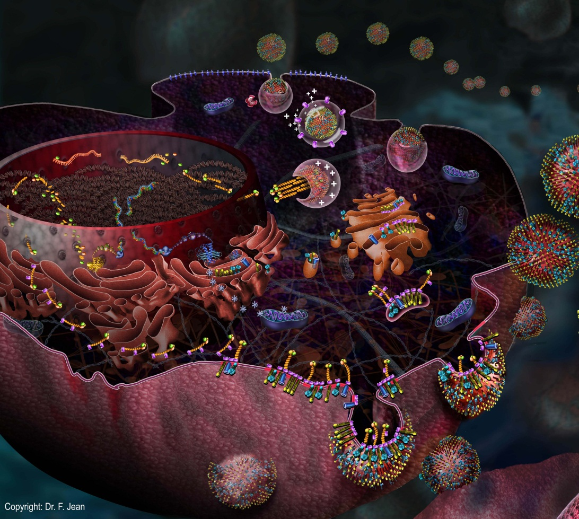
Week 3 - Biology 112

Slide 2

Multiple Choice (M/C) Database
Create your login and password- see instructions on CONNECT.
Prior to Midterm 1 for 1% of your grade
  submit 1 multiple choice question (by Fri, Jan 25, midnight)
  answer 2 questions from other students (by Mon, Jan 28, midnight).
  See deadlines on CONNECT.
  Sign up for a PeerWise workshop on Connect!

Slide 3
Replicating thing criteria:
Generate a container Membranes (wall)
Gather raw material
Gather or make parts Proteins
Gather and transform energy
Have a set of instructions DNA
Pass instructions to replicas Proteins and DNA
Mechanism to read the instructions RNA and proteins
Notes:
3
This list will be posted on VISTA at the end of the week so they don’t need to copy it down. We will use it over and over in organizing the class.

Slide 4
First, let’s talk about “stability”
Stability and change are related. Something is stable if it does not change.
Stability arises if there is no potential for change.
A chemical change has the potential to occur only if it leads to an increase in stability of the chemical system.

Slide 5
Stability
Two kinds of stability
Enthalpic
Stability associated with chemical bonds (all types)
Entropic
Stability associated with molecular motion (eg. types of motion and their intensities)
Entropy is NOT about (dis)order or chaos

Slide 6
High and Low Stability
 | High | Low
Enthalpic Stability (Bonding) | Strongly bonded | Weakly bonded
Entropic Stability (Motional Freedom) | Motionally free | Motionally constrained

Slide 7
Changes (differences) in Stability
Mathematically, the total difference in stability (ΔG) between 2 states of a chemical system is given by:
Difference in enthalpic (bonding) stability
Total difference in stability
ΔG = ΔH + (-TΔS)
Difference in entropic (motional freedom) stability

Slide 8
Changes in Stability
 | Increases | Decreases
Enthalpic Stability (Bonding) | Bonding strength increases | Bonding strength decreases
Entropic Stability (Motional Freedom) | More freedom to move | Less freedom to move

Slide 9
Changes in Stability
Sign conventions
 | Increases | Decreases
Overall Stability | ΔG < 0 | ΔG > 0
Enthalpic stability (Bonding) | ΔH < 0 | ΔH > 0
Entropic stability (Motional Freedom) | TΔS > 0 | TΔS < 0

Slide 10
ΔG as a criterion for “spontaneity”
A chemical change has the potential to occur only if it leads to an increase in stability of the chemical system.
High
Stability
Low
Yes
State X
State Y
No
Potential to occur?

Slide 11
Chemical process (eg. reaction) with the potential occur is called spontaneous = favourable = permissible (ΔG < 0)
Chemical process (eg. reaction) with no potential occur is called nonspontaneous = unfavourable = prohibited (ΔG > 0)
Important
Spontaneous ≠ fast! Spontaneous process can occur very quickly to very slowly depending on the process.

Slide 12
Stability
We will be using the concept of stability a lot in this course, so take some time to become familiar with it.
Note that stability is closely linked to the concept of Free Energy, which will be discussed later in the course.

Slide 13
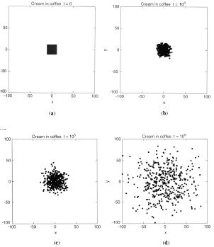
Let’s Talk Diffusion
Two properties are at work:
The molecules are moving (kinetic energy).
The system will spontaneously tend towards more arrangements (more motional freedom), which is more stable.
http://chemistry.illinoisstate.edu/standard/che38056/lecture_notes/380.56chapter13-S06.pdf
Notes:
We’re all familiar from common experience with diffusion. This is a computer simulation of diffusion where dots move randomly from their starting position. Smells from the stove, spreading of a drop of cream in the coffee cup. Two things cause this. First molecules are moving because of kinetic energy. Secondly there is increasing entropy-why they move to fill the space evenly. A useful way to think about increasing entropy is increasing randomness.
As you may remember the second law of thermodynamics says entropy always increases. Anything that reduces entropy requires energy . In the absence of that energy input any “system” group of molecules will maximize the entropy (randomness)

Slide 14


Consider a repeat of the diffusion experiment. Which of the following will affect the rate each particle diffuses?
1. The mass of the diffusing particle.
2. The size of the space the particle is diffusing through.
3. The number of molecules that are in the middle initially.
4. The temperature of the system.
5. The characteristics of the space the particle is diffusing through.
All 5 characteristics
Only 2 and 4
Only 1, 3 and 5
Only 1, 4 and 5
Only 2, 3 and 4
Notes:
So the answer is D
Since are talking about rate for each particle, it’s mass matters (goes slower, if everything else is constant), the temperature of the system matters (determines the kinetic energy in the particle), the characterisitcs of the space matters. The other two don’t.

Slide 15
Add a drop of water soluble dye to the water layer
water
non-aqueous
(oil)
Diffusion happens
What’s the barrier?
Notes:
Since the dye is not soluble in the oil, it never enters that layer so it stops its diffusion into it.
The molecules in the cell : amino acids/nucleotides, proteins, DNA are water soluble.
The oil layer could be dichlormethane which is denser than water.
In the cell,the barrier that keeps them from floating way by diffusion is a hydrophobic layer that is in the cytoplasmic membrane. So this is a primary function of the cytoplasmic membrane and it’s a big part of why life is cellular. Things that the cell wants to keep, like ATP, amino acids, bases, sugars, will not go through the cytoplasmic membranes very fast.

Slide 16
Solubility depends on the ability to form intermolecular interactions between the solute and the solvent.
The water soluble dye stays in the water because it is interacting strongly with water molecules (stronger interactions, therefore more stable).
Water is a molecule with polar bonds and so will easily interact with other molecules that are charged or have polar groups.
H
δ⁺
δ⁻
O
H
δ⁺
Electrons pulled towards O

Slide 17
Electronegativity
The tendency of an atom to attract a pair of bonding electrons.
High O > N > S = C ~ H = P Low
Notes:
Atom with high electronegativity pull eledctrons from ones with lower electronegativity. If the difference is big enough, then the atome with high electronegativity becomes a little negative and the other one becomes a little positive-there is a “dipole” established. Use paper for this. Notes were ambiguous about a C-S bond. It’s probably not polar. Answer is C Electronegativity is the property used to describe the ability of an atom to attract electrons. Oxygen is highly electronegative. If something that is highly electronegative (eg. Oxygen) is bonded to something that isn’t (eg. H), it is more likely to cause unequal sharing of electrons resulting in a POLAR covalent bond. Equal sharing of electrons results in non polar covalent bond.

Slide 18
Which types of bonds are probably polar?
C-H
O-H
C=O
P=O
N-H
S-H
1, 3, 5
2, 4, 6
C. 2, 3, 4, 5
D. 3, 5, 6
E. 2, 3
Notes:
Atom with high electronegativity pull eledctrons from ones with lower electronegativity. If the difference is big enough, then the atome with high electronegativity becomes a little negative and the other one becomes a little positive-there is a “dipole” established. Use paper for this. Notes were ambiguous about a C-S bond. It’s probably not polar. Answer is C

Slide 19
Permanent dipole-induced dipole interaction
Induced dipole-induced dipole interaction
Notes:
H bonds are considerable stronger than induced dipole bond, but the induced dipole bonds to hold molecules together. In the induced dipole induced dipole bonds (called van der Waals forces in some places) are significant in holding proteins in their shape. But these are only a minor component of holding membranes together.
Dipole means separation of charges.

Slide 20
In the aqueous environment of the cell, the bond energies (amount of energy required to break the bond or intermolecular interaction) decrease in the following order. This is an indication of bond or interaction strength.
Strongest Covalent bonds (polar and non-polar)
Ionic bonds (fully charged ion-fully charged ion)
Ion–permanent dipole interactions
Permanent dipole–permanent dipole interactions
(e.g. H-bond)
Permanent dipole–induced dipole interactions
Weak Induced dipole–induced dipole interactions
Notes:
It’s good to keep these in mind for the next set of lectures when we’ll be talking about structures and the forces that hold them together. Biological molecules have 3 dimensional shapes and the non-covalent forces (and the hydrophobic effect) are particllay resposible for holding them in these shapes.

Slide 21
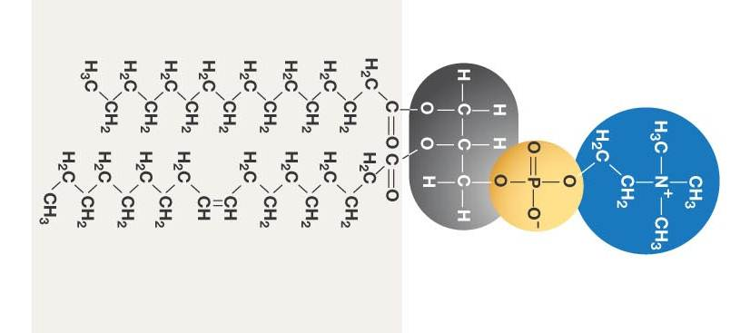
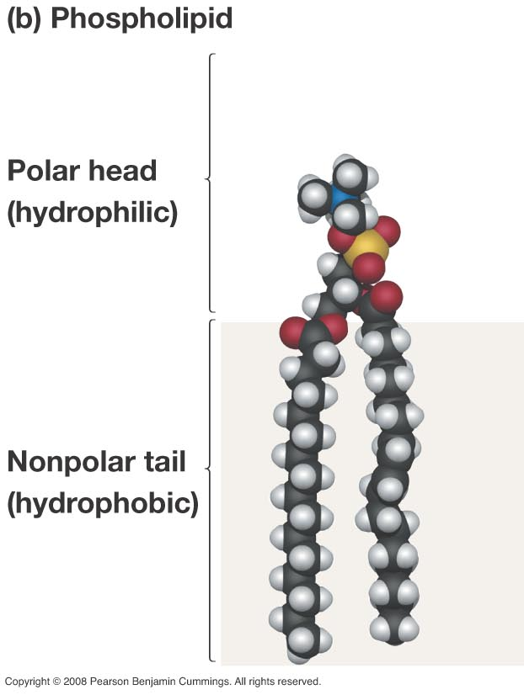
Cytoplasmic membranes are made from molecules called phospholipids
choline
fatty acids
phosphate
Molecules can have polar and non-polar groups.
In cases where the regions are separated and distinct, the molecules are called amphipathic
Fig 6.4b Biological Sciences
Notes:
Point here is to introduce the differences in the parts of the molecule.

Slide 22
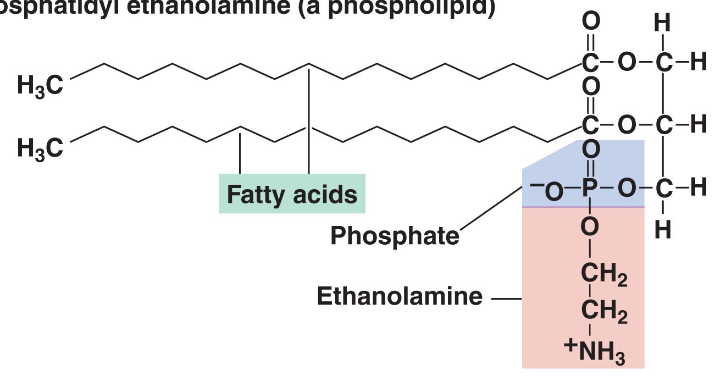
Phospholipids are Amphipathic Molecules
H
H
H
H
H
H
H
H
H
H
H
H
H
H
C
C
C
C
C
C
C
C
C
C
C
C
C
C
H
H
H
H
H
H
H
H
H
H
H
H
H
H
H
H
H
H
H
H
H
H
H
H
H
H
H
H
C
C
C
C
C
C
C
C
C
C
C
C
C
C
H
H
H
H
H
H
H
H
H
H
H
H
H
H
@ Pearson
Non-polar tail
Polar Head
Fig 3.7c Brock “Biology of Microorganisms”
Notes:
22
Fig 3.7 Brock 12th ed and added H groups
Point here is to introduce the differences in the parts of the molecule.

Slide 23


Imagine the phospholipid shown below is placed in water. Which of the circled atoms/groups would form hydrogen bonds with water molecules?
2
1
H
H
H
H
H
H
H
H
H
C
H
C
H
C
H
C
H
C
C
C
H
H
C
H
C
H
C
H
C
H
C
H
C
H
C
H
H
H
H
H
H
H
H
H
H
H
H
H
H
H
H
C
H
C
H
C
H
C
H
C
C
C
H
H
C
H
C
H
C
H
C
H
C
H
C
H
C
1 and 2
2 and 3
1 and 3
Only 3
All three
H
H
H
H
H
H
H
3
Fig 3.7c Brock “Biology of Microorganisms”
Notes:
B. 2 and 3. 1 can form permanent dipole/ induced dipole, but these will be much weaker than hydrogen bonds

Slide 24
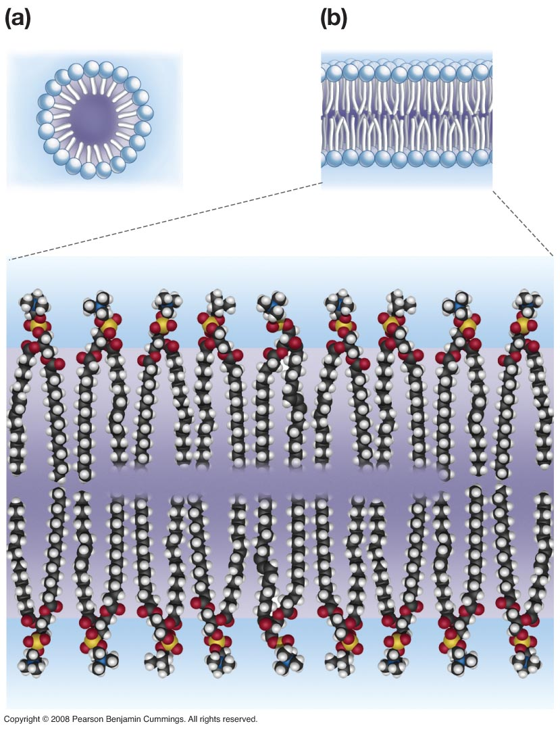
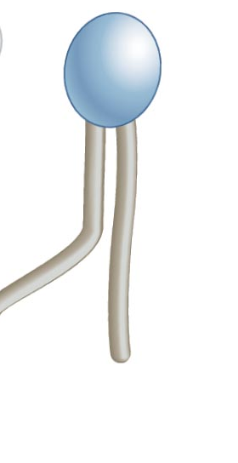
Phospholipid
Phospholipids form bilayers that are non-polar in the middle.
Left: Fig 6.9 Biological sciences
Right: Fig 6.5 Biological sciences
Notes:
24
We’ll talk about why these bilayers form next time. They create a layer that watersoluble molecules- ones that form bonds with water are not soluble in. This is like that water/oil layers from earlier. So water soluble molecules most of the ones in the cell don’t penentrate the layers.

Slide 25
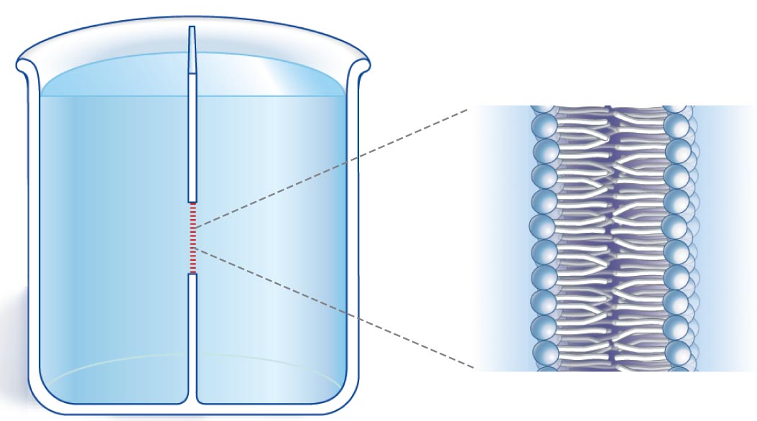
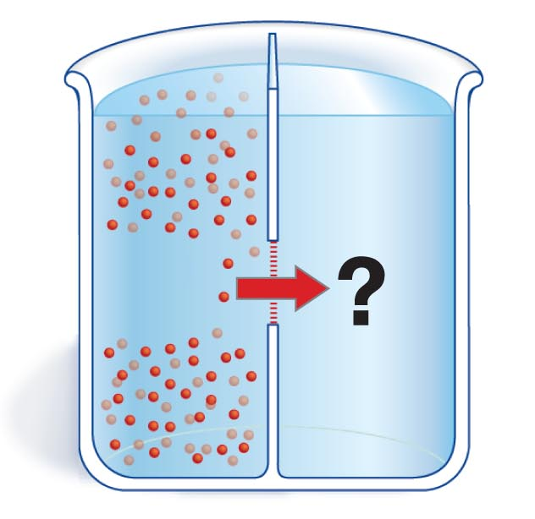
What sort of barrier is a this bilayer?
We can use a dual-chamber container separated by a membrane to test the permeability of a membrane to different molecules.
Fig 6.7b and Fig 7.6c Biological Sciences
Notes:
Here the way to do an experiment to see what goes through a bilaer and what doesn’t. This is from freeman

Slide 26
Permeability for the
phospholipid bilayer of a membrane.
None very slow slow fast very fast
Cl⁻ (36)
H₂O (18)
Na⁺ (23)
Glycerol (92)
PO₄⁻³ (95)
Glucose (180)
Toluene (92)
ATP
Large molecules: proteins, DNA, RNA
Notes:
Number beside is molecular mass.
Note that water goes through fast. Other things are slow to none. Notes have description of charged molecules being larger than they seem by molecular weight because they organize water or other ions around them (Charge sphere).

Slide 27


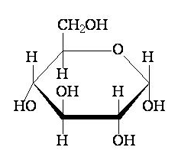
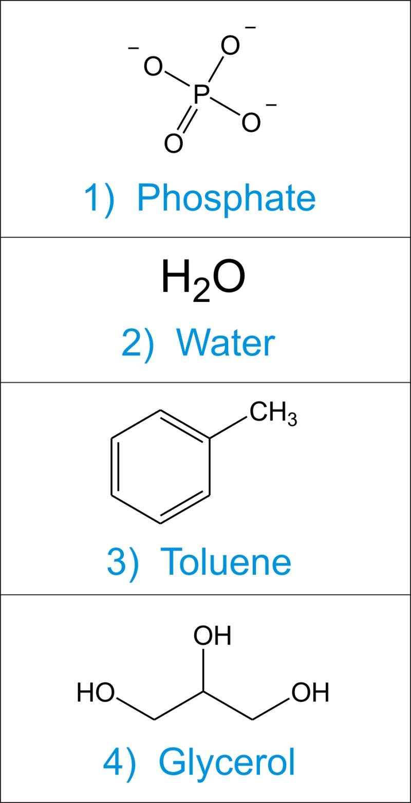
Glucose Phosphate Toluene Glycerol
Compare the molecules shown above with respect to membrane permeability. Which comparison would best yield information about the effect of chemical size alone on lipid bilayer permeation?
A. glucose and phosphate
B. toluene and glycerol
C. phosphate and a chloride ion (Cl⁻)
D. glucose and glycerol
Notes:
Answer = D

Slide 28
Glucose Phosphate Toluene Glycerol
Which comparison would best yield information about the effect of charge on lipid bilayer permeation?
A. toluene and a sodium ion (Na+)
B. glucose and a chloride ion (Cl-)
C. glycerol and phosphate
D. toluene and phosphate
Notes:
Answer = C
Both molecular mass of phosphate and glycerol = approx 92

Slide 29
Glucose Phosphate Toluene Glycerol
Which comparison would best yield information about the effect of polar/nonpolar content on lipid bilayer permeation?
A. toluene and phosphate
B. toluene and glycerol
C. glucose and toluene
D. glucose and Na+
Notes:
Answer = B

Slide 30
What would be the order of molecules shown to the right in terms of permeability across a phospholipid bilayer?
List from the slowest molecule on the left to the fastest molecule on the right.
  3 < 1 < 4 < 2
  1 < 2 < 4 < 3
  2 < 1 < 3 < 4
  4 < 1 < 2 < 3
  1 < 4 < 3 < 2
Notes:
Answer would be E phosphate is the slowest look at next slide for picture

Slide 31
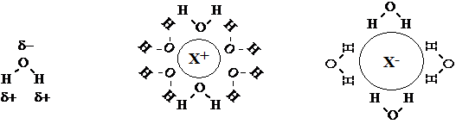
Charged Molecules
A hydration shell surrounding a charged molecule (X⁺ or X⁻).
Charged molecules, regardless of their size, do NOT readily permeate lipid bilayers because they are surrounded by a shell of water molecules (called a “hydration shell”).
Notes:
Ions are more stable in solution where they form hydrogen bonds with water than they are in the interior of membranes, which is electrically neutral.

Slide 32
Week 3 - Biology 112

Slide 33
None very slow slow fast very fast
Cl⁻ (36)
H₂O (18)
Na⁺ (23)
Glycerol (92)
PO₄⁻³ (95)
Glucose (180)
Toluene (92)
ATP
Large molecules: proteins, DNA, RNA
The molecules that can rapidly pass through the phospholipid bilayer are uncharged, non polar and relatively small.
Water appears to break this rule. Discuss.
Notes:
Answer would be A. Water Note that water goes through fast. Other things are slow to none. Notes have description of charged molecules being larger than they seem by molecular weight because they organize water or other ions around them (Charge sphere). Water seems to be anomolous.

Slide 34
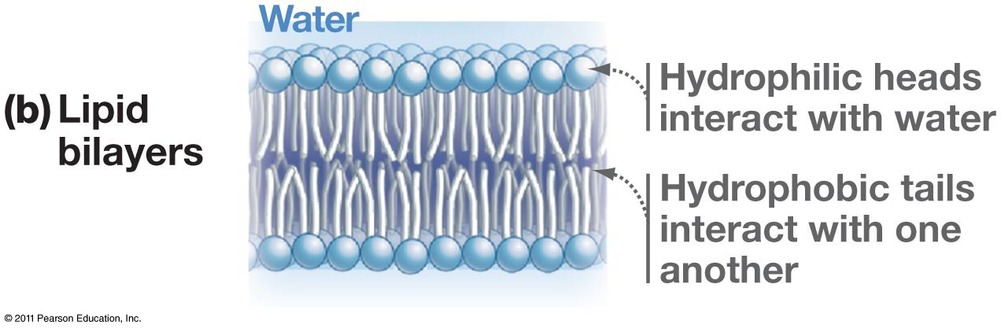
How do phospholipids form membrane bilayers?
Fig 6.7b Biological Sciences

Slide 35
Water makes strong polar interactions.
As a result it forms hydrogen bonds with other polar molecules, including itself. A water molecule surrounded by four other water molecules can make hydrogen bonds in multiple ways. The position of the water molecule is not fixed.
δ-
δ+
δ+
Notes:
To understand how a membrane forms, we need to think about entropy again. Do this on paper overhead Note that in the diagram on the right the light blue triangles are there to show the 3-D orentation and ARE NOT bonds.

Slide 36
δ-
δ+
δ+
How many ways can the central water make H–bonds to two of its four neighbours?
    3
    4
    6
    8
    16
3
2
4
1
Notes:
The answer is C. One orientation is shown. There are 6 , 2 for each sides of the tetrahedron

Slide 37
Notes:
The six orientations.

Slide 38
3
2
Suppose we replace the water indicated with an arrow with a non–polar molecule that the water can’t make H–bonds with.
Now, how many arrangements are there where the central water makes two H–bonds?
    2
    3
    4
    6
    8
4
1
3
CH₄, methane
4
1
Notes:
Answer would be B. There are 3. Lower than 6

Slide 39
Notes:
The six orientations minus the three that can no longer be formed.

Slide 40
After removing one of the surrounding water molecules and replacing it with a methane molecule, how has the entropy (motional freedom) of the central molecule changed?
It increased
It decreased
It is unchanged
Can’t tell from the information
Notes:
The answer is B So randomness of the water is reduced and the entropy goes down.

Slide 41

Hydrophobic, non polar molecule
water molecules
+
In a mixture of water and hydrophobic molecules, the hydrophobic molecules “clump” together. Why?

Slide 42
Hydrophobic, non polar molecule
water molecules
+
This maximizes the entropy (motional freedom) of the water and therefore contributes to the stability of the system.
The clumping of the hydrophobic molecules is known as the hydrophobic effect. What drives the process is maximizing the entropy of the system.

Slide 43
The hydrophobic effect
The term hydrophobic effect is simply a name for the observation that burying nonpolar groups away from water increases system stability.
Nature uses this phenomenon to help build and a stabilize biological structures
eg.
Lipid bilayers
Folded polypeptides
Quaternary structure of proteins

Slide 44
If purified phospholipids are mixed with water and allowed to come to a stable arrangement, which of the following would form?
random arrangement
in solution
single layer spheres
C) bilayer sheets
in solution
D) single layer sheets in solution
E) hollow bilayer
spheres
Notes:
Answer is E--

Slide 45
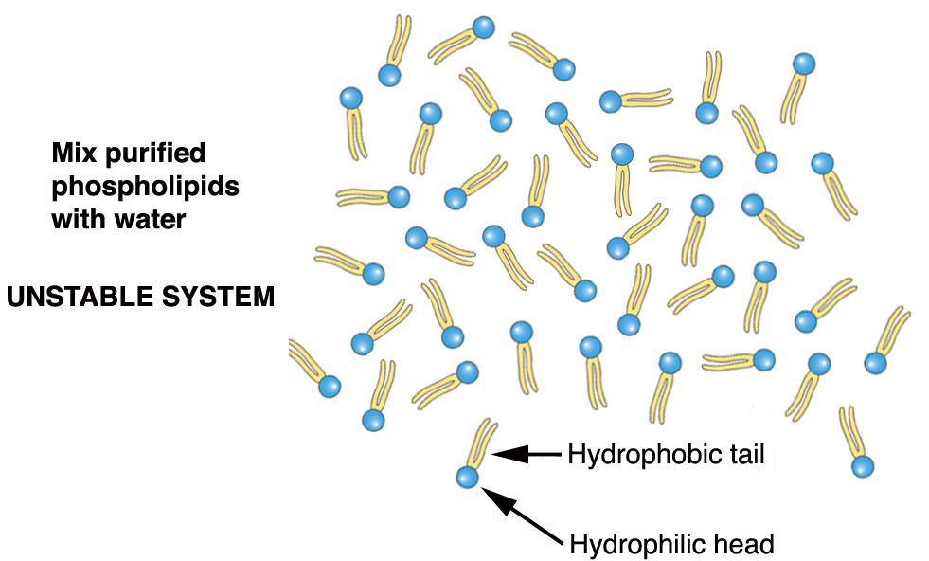
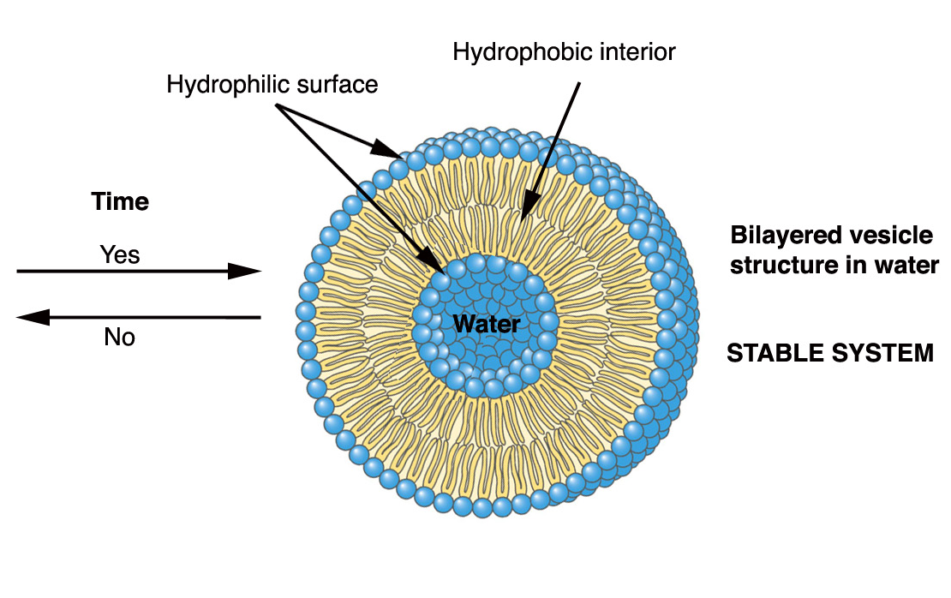
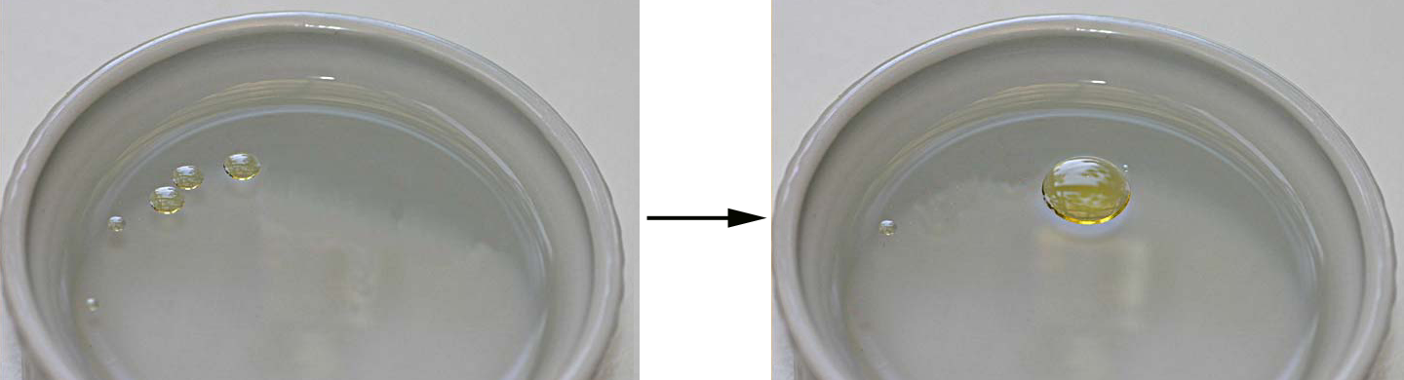
Lipid bilayer asssembly: a macroscopic analogy
Which state is more stable, i.e. which state has the least potential for change?
Notes:
The one on the right is more stable – and the more stable has least potential for change.

Slide 46
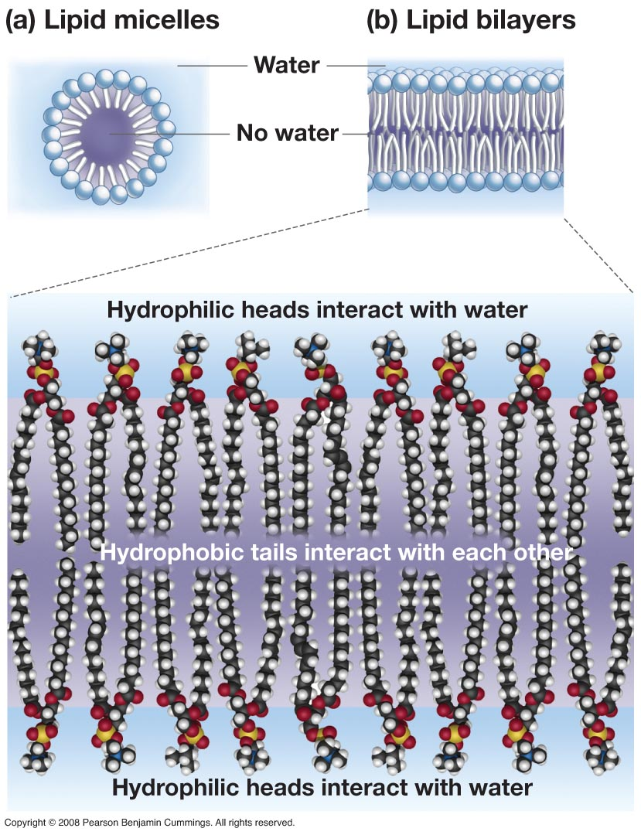

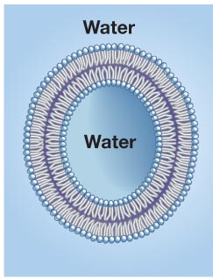
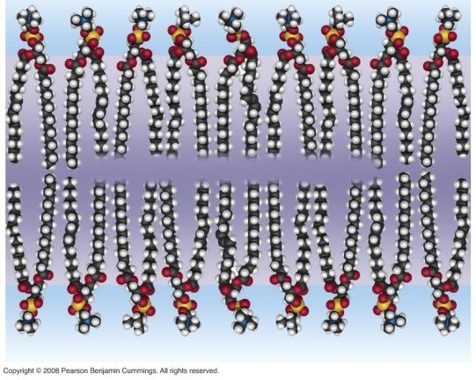
Bilayers and Micelles Form Spontaneously
OR
This would be the expected process
single-tailed lipids are wedge-shaped
no aqueous cavity
Fig 6.5 and 6.7 Biological Sciences
Notes:
46
Note the similarity to the strcture of a cell.

Slide 47
Permeability for the
phospholipid bilayer of a membrane.
None very slow slow fast very fast
Cl⁻ (36)
H₂O (18)
Na⁺ (23)
Glycerol (92)
PO₄⁻³ (95)
Glucose (180)
Toluene (92)
ATP
Large molecules: proteins, DNA, RNA
Notes:
47
Note that water goes through fast. Other things are slow to none. Notes have description of charged molecules being larger than they seem by molecular weight because they organize water or other ions around them (Charge sphere).

Slide 48
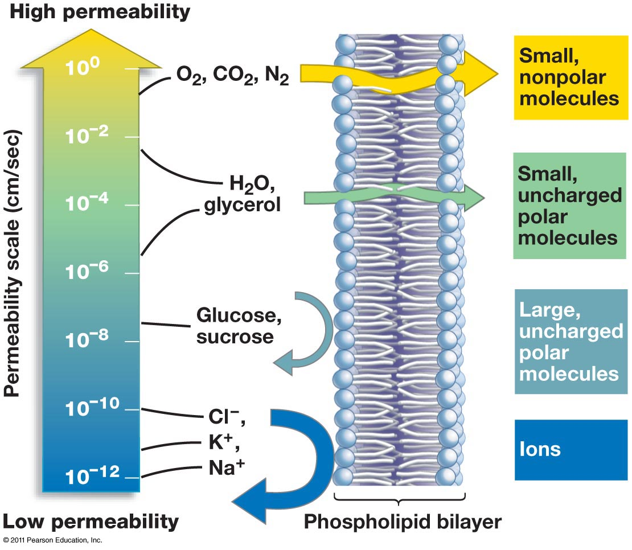
Fig 6.8 Biological Sciences

Slide 49
How does the cell get nutrients?

Slide 50
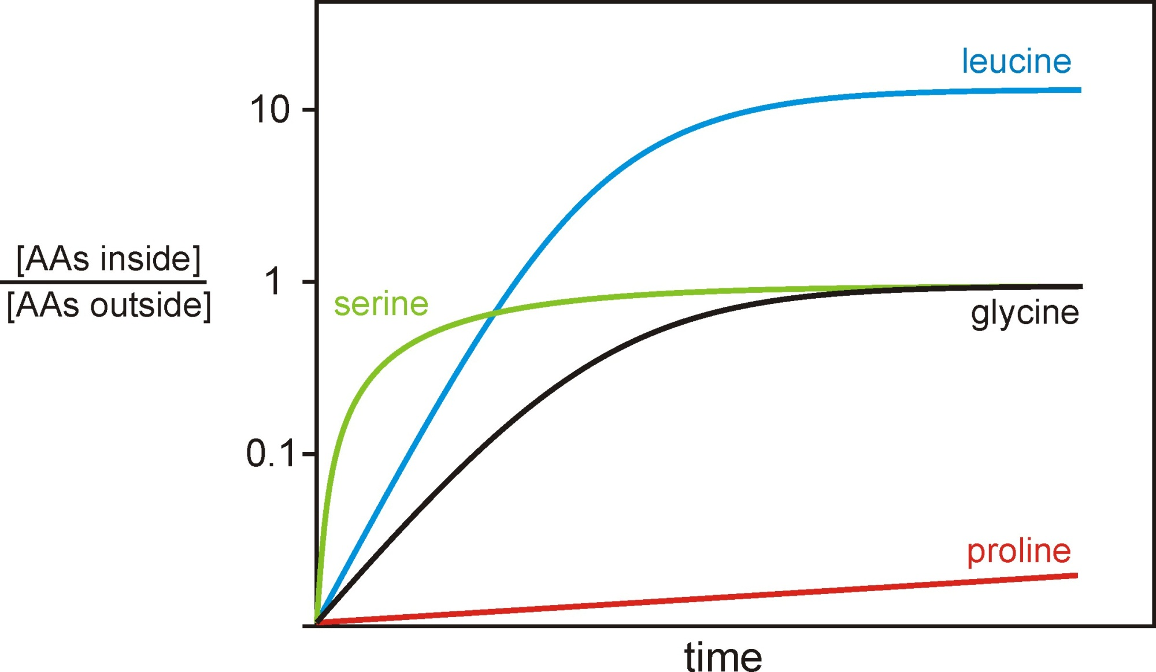
Recall the clicker questions from the rodent invention activity.
What we are looking at is different forms of membrane transport.

Slide 51
Week 3 - Biology 112

Slide 52
Which of the following are defining features of facilitated diffusion?
The molecules can only move in one direction.
The process requires a membrane protein.
Molecules move with their concentration gradient.
1 and 2
2 and 3
1 and 3
All of them
Notes:
Answer is B

Slide 53
Which of the following are defining features of active transport?
The cell must expend energy (usually ATP).
The process requires a membrane protein.
Molecules always move against their concentration gradient.
1 and 2
2 and 3
1 and 3
All of them
Notes:
Answer is A.
If an active transport protein requires ATP or energy in order to change its conformation during transport, the energy will be required even if the molecules are moving down their gradient, and therefore 3 is not a true feature of active transport.

Slide 54
Getting things across the membrane: Transport
Passive (simple)
diffusion
Facilitated
diffusion
Active Transport
outside
inside
Higher concentration
inside
(cell expends energy)
Lower concentration inside
Notes:
54
Faclitated diffusion uses the concentration gradient, but the solute passes through a cellular protein pore of some kind.
Active transport uses energy to transport the solute so that the concentation inside is higher than the concentration outside

Slide 55
Materials can move across the cell membrane in different ways.
1. Passive transport does not require an input of energy.
  Forms of passive transport are (a) simple diffusion and (b) facilitated diffusion
2. Active transport requires energy to move substances across the membrane.

Slide 56
1.(a) Simple Passive Diffusion
Small molecules and ions in solution are called solutes, have thermal energy, and are in constant, random motion.
  The movement of solute molecules through the phospholipid bilayer from a region of high solute concentration to low solute concentration is called diffusion.
  Diffusion is a form of passive transport.
outside
inside

Slide 57
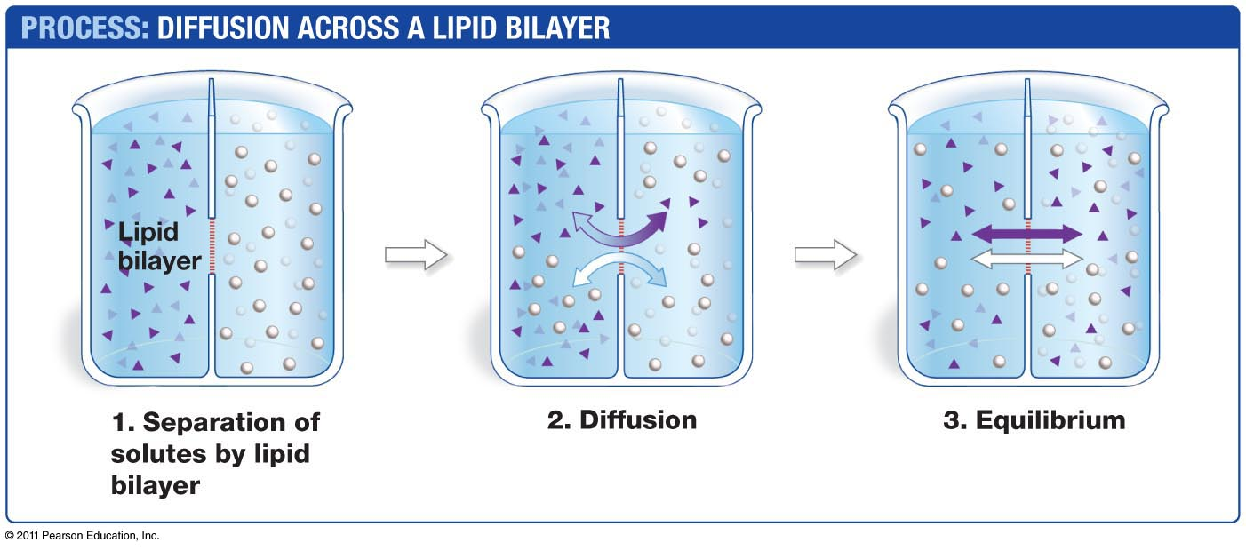
A difference in solute concentrations creates a
concentration gradient.
Molecules and ions move randomly when a concentration gradient exists, but there is a net movement from high-concentration regions to low-concentration regions.
Diffusion along a concentration gradient increases entropy and is thus spontaneous.
Fig 6.14 Biological Sciences

Slide 58
Equilibrium is established once the molecules or ions are randomly distributed throughout a solution
Molecules are still moving randomly but there is no more net movement
Fig 6.14 Biological Sciences

Slide 59
1(b). Facilitated Diffusion via Carrier Proteins
Some carrier proteins, or permeases increase the permeability of the cytoplasmic membrane and do not require the input of energy hence “facilitating”diffusion.
Facilitated diffusion by permeases occurs only down a concentration gradient.
outside
inside

Slide 60
Facilitated diffusion occurs via:
(I) Protein channels:
  Ion channels are specialized membrane proteins which circumvent the plasma membrane’s impermeability to small, charged compounds
  Additional proteins that will not be discussed in this course:
  Porins are water filled membrane proteins in the outer membrane of Gram negative bacteria.
  Aquaporins are proteins channels that allow water molecules to move across the membrane.
(II) Carrier proteins called permeases

Slide 61
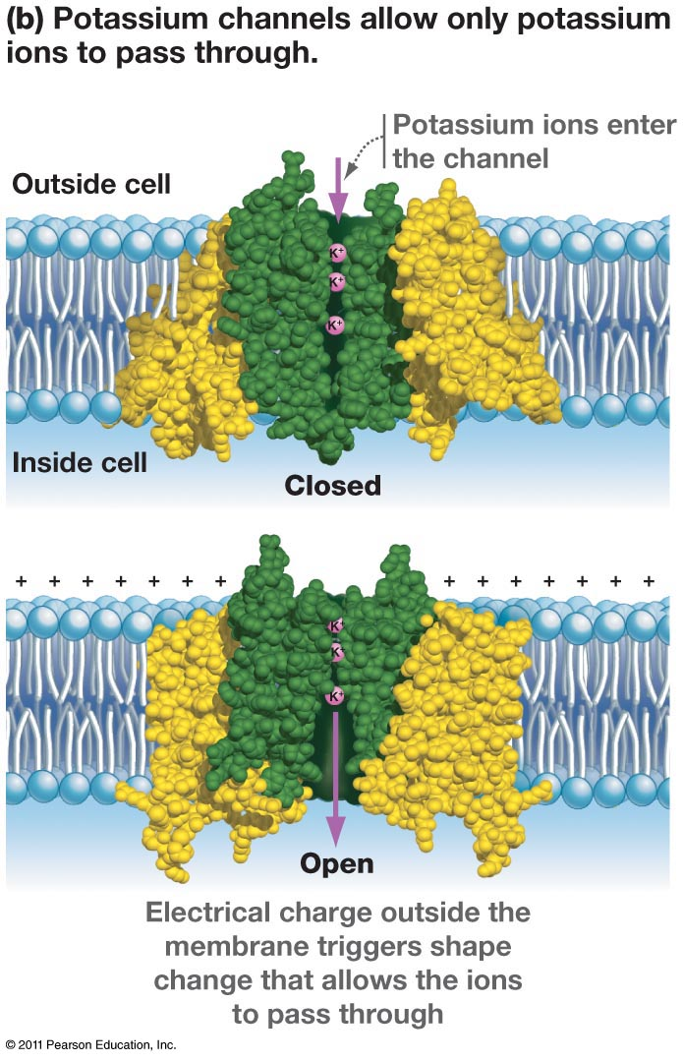
Facilitated Diffusion via Ion Channels
When ions build up on one side of a plasma membrane, they establish both a concentration gradient and a charge gradient, collectively called the electrochemical gradient.
The ions diffuse through channels down their electrochemical gradients.
This passive transport decreases the charge and concentration differences between the cell’s exterior and interior.
Fig 6.25b Biological Sciences

Slide 62
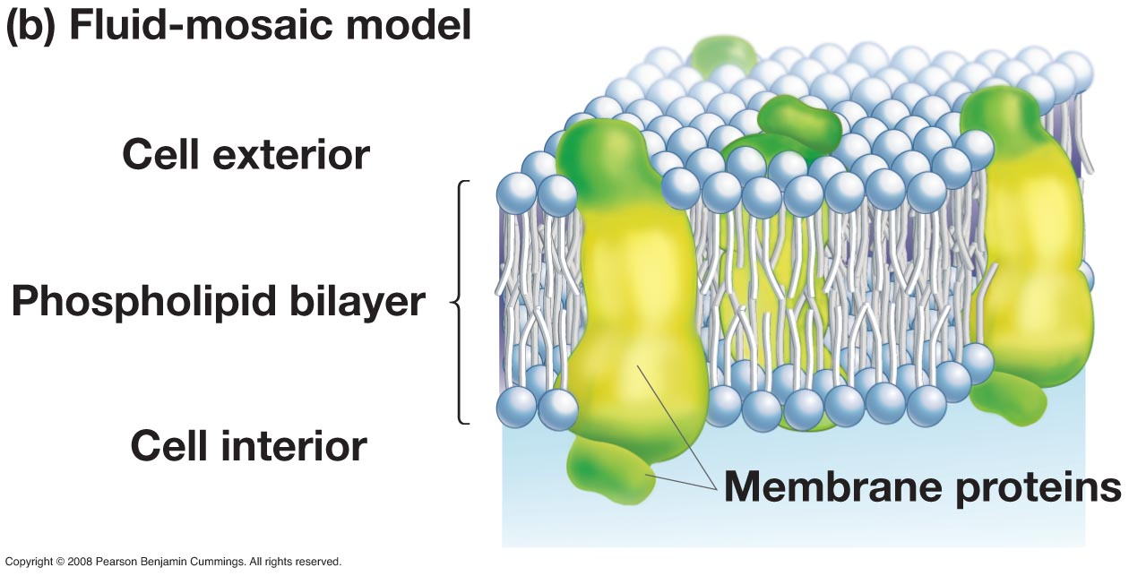
Carrier proteins (permeases) positioned in the membrane allow transport of some molecules the bilayer, alone, will not allow through.
Fig 6.18b Biological Sciences
Notes:
62

Slide 63
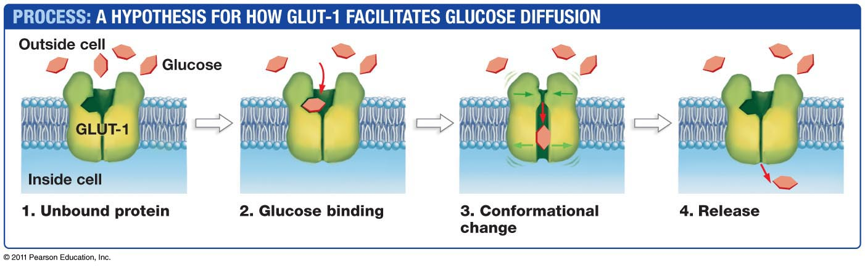
Glucose is a building block for important macromolecules and a major energy source, but lipid bilayers in eukaryotic cells such as erythrocytes are only moderately permeable to glucose.
The eukaryotic glucose permease called GLUT-1 increases membrane permeability to glucose.
Fig 6.27 Biological Sciences

Slide 64
2. Active Transport
Cells can transport molecules or ions against an concentration gradient. This process requires energy in the form of ATP and is called active transport.
Pumps are membrane proteins that provide active transport of molecules across the membrane
outside
inside

Slide 65
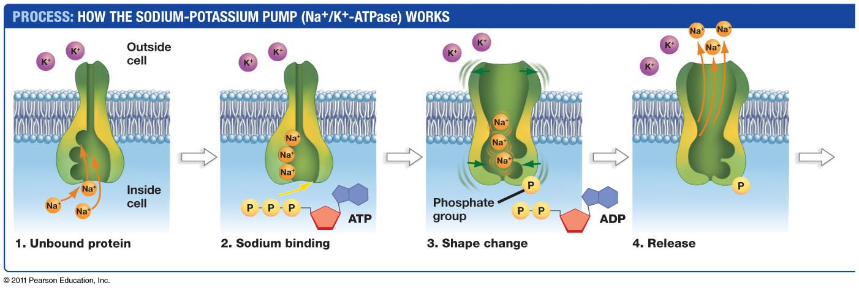
  The sodium-potassium pump, Na⁺/K⁺-ATPase, uses ATP to transport Na⁺ and K⁺ against their concentration gradients (1-4).
Fig 6.28 Biological Sciences

Slide 66
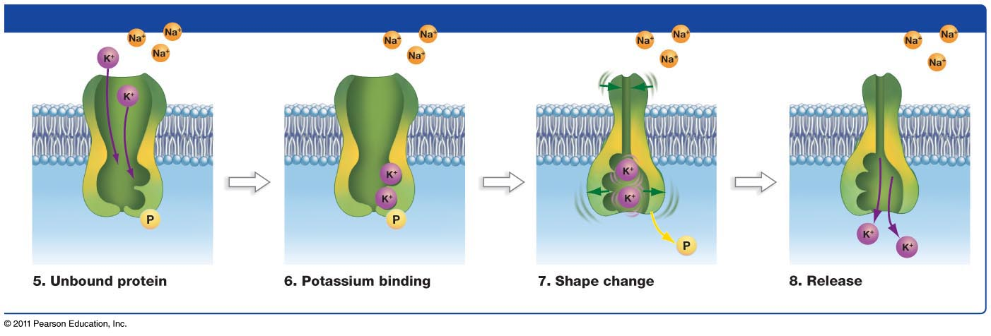
  The sodium-potassium pump, Na⁺/K⁺-ATPase, uses ATP to transport Na⁺ and K⁺ against their concentration gradients (5-8).
Freeman 6.28
Fig 6.28 Biological Sciences

Slide 67


100
10
1
D
Glucose inside
Glucose outside
C
B
A
Concentration of glucose
A student measured the uptake of glucose into 4 different cell types. He used 5 different concentrations of glucose, and measured the ratio of glucose inside/glucose outside after 10 min for each cell type. He got the 4 graphs shown. Which cell type is using facilitated diffusion for glucose uptake?
A
B
C
D
E None of them.
Notes:
Answer would be B. The basic reason is that the ratio is 1 for all concentrations tested. A would represent no uptake. C and D the ratio gets above 1 so there is a higher concentration inside than outside.

Slide 68
Experimental set up for measuring uptake of molecules
This is a filter that traps the bacteria
To start the experiment add radioactive molecule (leucine) to cells.
Take samples of the cells at increasing times.
Filter: Cells are trapped on filter. The leucine transported into the cells is trapped with the cells on the filter.
Leucine that is free goes into flask with the culture medium.
Vacuum

Slide 69
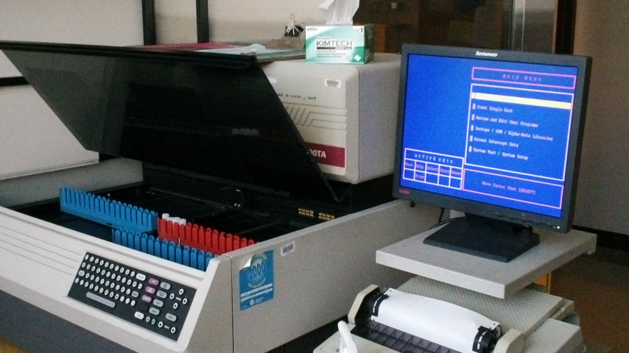
Experimental set up for measuring uptake of molecules
Filter placed in a vial
The radioactivity inside the bacteria on the filters is measured in a “scintillation counter”
Radioactive leucine
on filters
Time after adding leucine

Slide 70
1
Radioactive solute
on filters
A
B
C
Time after adding solute
Trend line 1 shows the uptake of a solute into a bacterial cell by active transport
Which of the other three trend lines (A, B or C) might represent the uptake if ATP synthesis is inhibited before measuring the uptake.
Choose D if none of them is possible.
Notes:
70
Answer would be C

Slide 71
Radioactive leucine
on filters
Time after adding leucine
Is it possible to tell whether Leucine is being taken up by active transport?
Yes, the rate of uptake is very fast
Yes, the level of uptake would be lower if uptake was by facilitated diffusion
No, the graph doesn’t show whether the rate slows with time or not
No, the graph doesn’t show whether energy is needed or not
Notes:
71
Answer would be D.

Slide 72
Summary of Membrane Transport
There are three mechanisms of membrane transport:
  1.(a) Diffusion
  1.(b) Facilitated diffusion
  2. Active transport
Diffusion and facilitated diffusion are forms of passive transport and thus move materials down their concentration gradient and do not require an input of energy.
Active transport requires energy provided by the cell (as ATP or an electrochemical gradient) and allows the cells to transport materials against their concentration gradient.
Notes:
Electrochemical gradient can also be used to provide energy to cell (“secondary active transport”)

Slide 73
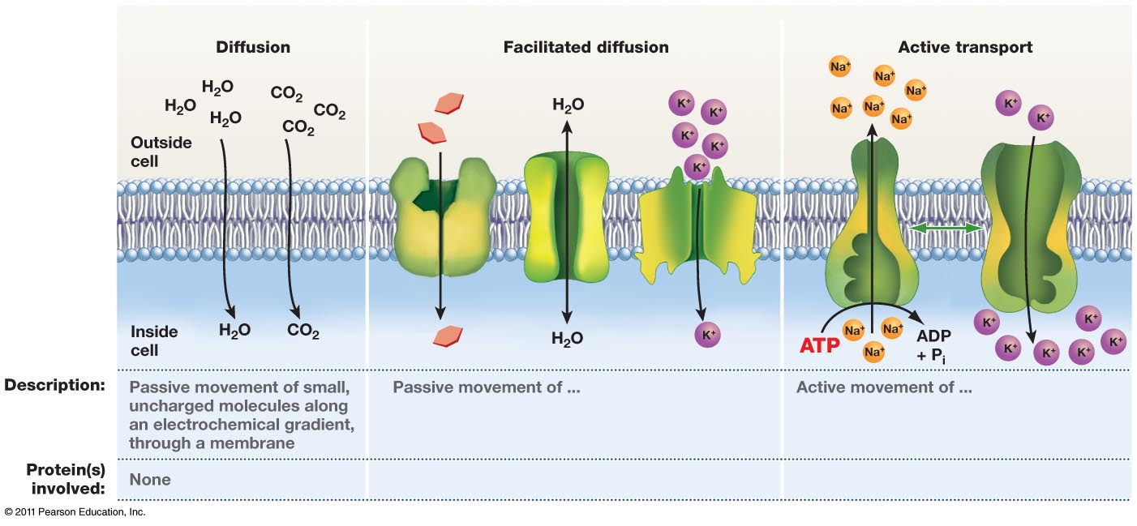
Fig 6.29 Biological Sciences

Slide 75
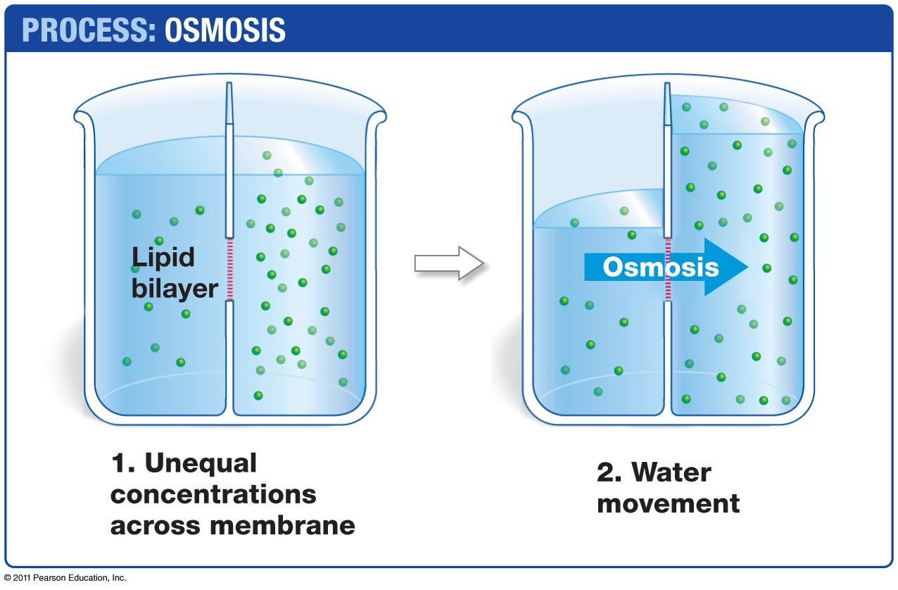
Osmosis
Water moves quickly across lipid bilayers. The movement of water is a special case of diffusion called osmosis.
Water moves from regions of low solute concentration to regions of high solute concentration.This movement dilutes the higher concentration, thus equalizing the concentration on both sides of the bilayer.
Fig 6.15 Biological Sciences

Slide 76
Why can’t the cytoplasmic membrane resist osmotic pressure?
The cytoplasmic membrane has too many types of molecules in it.
The interactions holding the phospholipids together are very weak.
Lipid molecules change shape when subjected to pressure.
High pressure makes water more soluble in lipid.
High pressure makes lipids more soluble in water.
Notes:
76
The answer is B.

Slide 77
For cells living in ‘natural water’ (lakes, oceans), the concentration of water is lower concentration inside the cell than it is outside the cell. The diffusion of water across the cell membrane results in “osmotic pressure”.
The cell membrane might be able to expand a little. But then it will burst.
To combat osmotic pressure, Bacteria use a ‘net’ to surround the cytoplasm, and in some cases another barrier.
Notes:
77

Slide 78
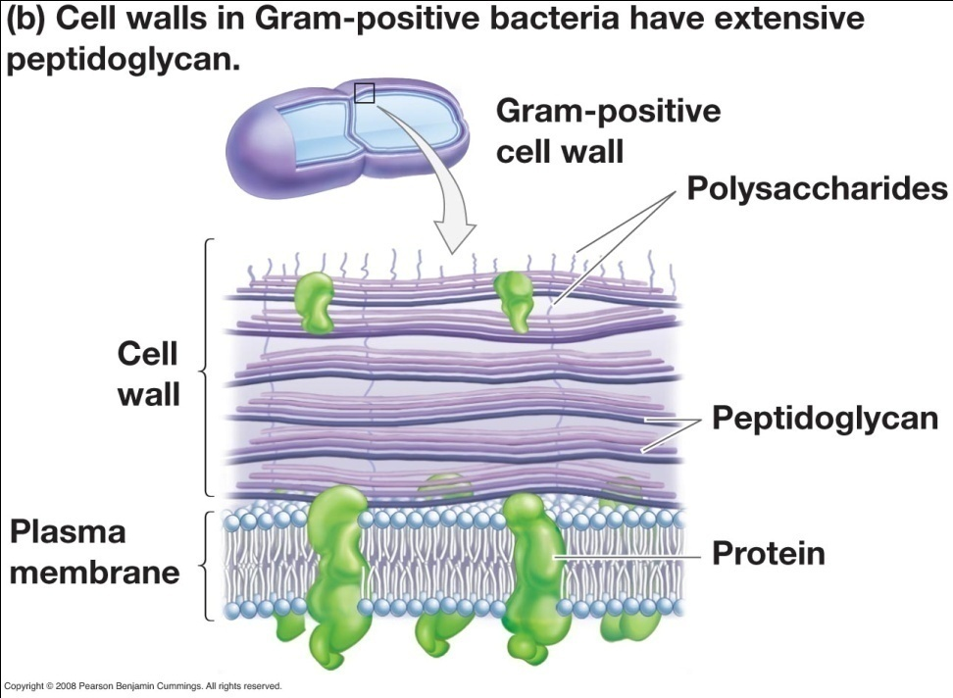
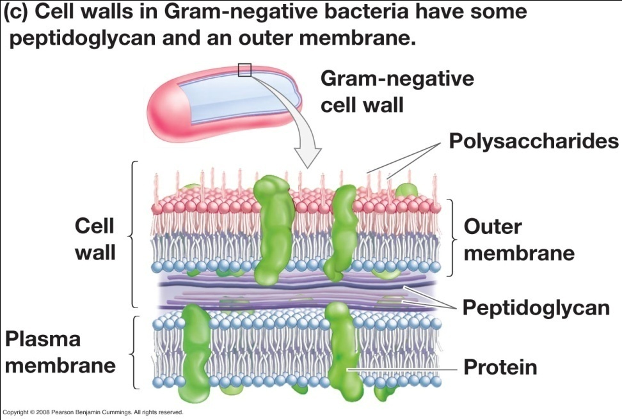
Two Basic Types of Bacterial Cells
Gram-positive bacteria
Gram-negative bacteria
Fig 28.14b and Fig 28.14c Biological Sciences
Notes:
Peptidoglycan counteracts osmotic pressure

Slide 79
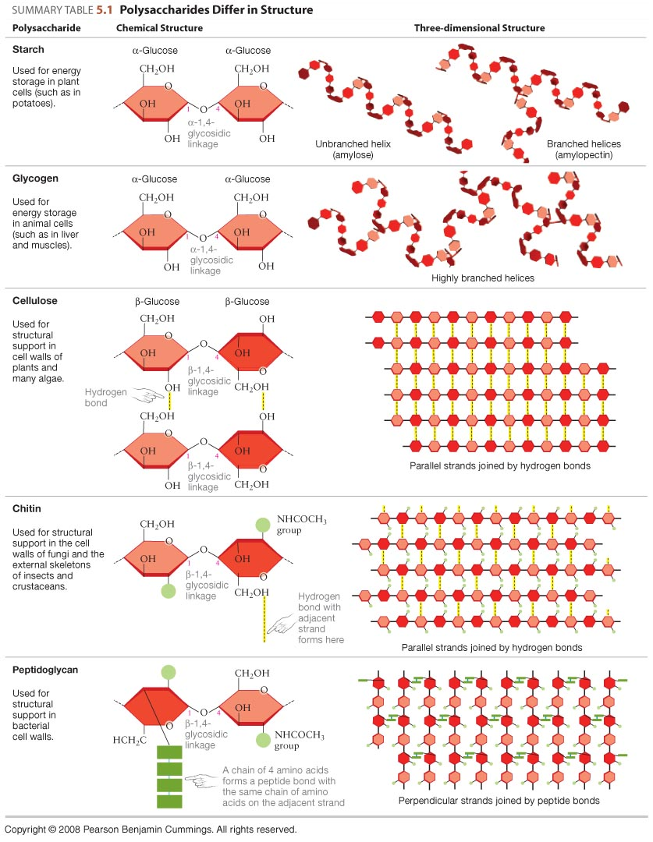
The Bacterial Net: Peptidoglycan
Table 5.1 Biological Sciences
Notes:
79

Slide 80
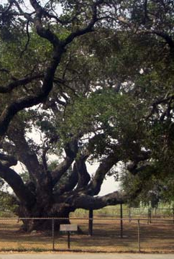
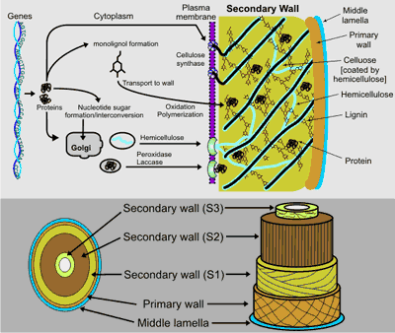
Plant cell walls
Left: http://tinka.net/category/texas/page/28/
Right: http://www.ccrc.uga.edu/~mao/intro/ouline.htm
Notes:
80
Plants have specis adaaptations of cell walls ..The have very thick walls making ver strong structures. Try holding the text book with an outstreched arm-the extrapolate to the structure holding that lower branch.

Slide 81
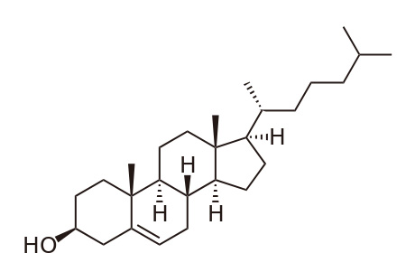
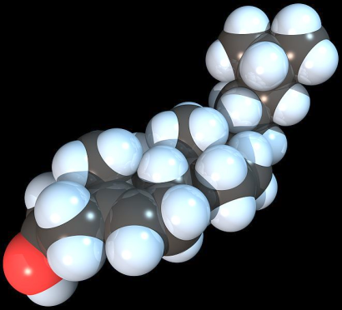
Other Eukaryotic membranes have several types of phospholipids. They are not the same on the inside and outside! Also, cholesterol stabilizes the membrane making it less permeable to water.
Structure of cholesterol
Phosphatidylcholine
Phosphatidylserine
Sphingomyelin
Phosphatidylethanolamine
Top: http://en.wikipedia.org/wiki/File:Cholesterol.svg
Bottom: http://en.wikipedia.org/wiki/File:Cholesterol_Spacefill.jpeg (author: RedAndr)
Notes:
81

Slide 82
Many eukaryotes do not have cell walls, but live in aqueous environments.
How might these cells deal with osmotic pressure?
Exist in an isotonic environment
Have a membrane containing aquaporins or use other methods to transport water.
Notes:
The reason cells like amoeba can live in fresh water without cell walls is that their membranes are not permeable to water so they don’t have such high osmotic pressure. The use things like regulated aquaporins and pinocytosis (uptake of liquids with dissolved solutes) to get water inside and exocytosis to get water out.
82

