Slide 1
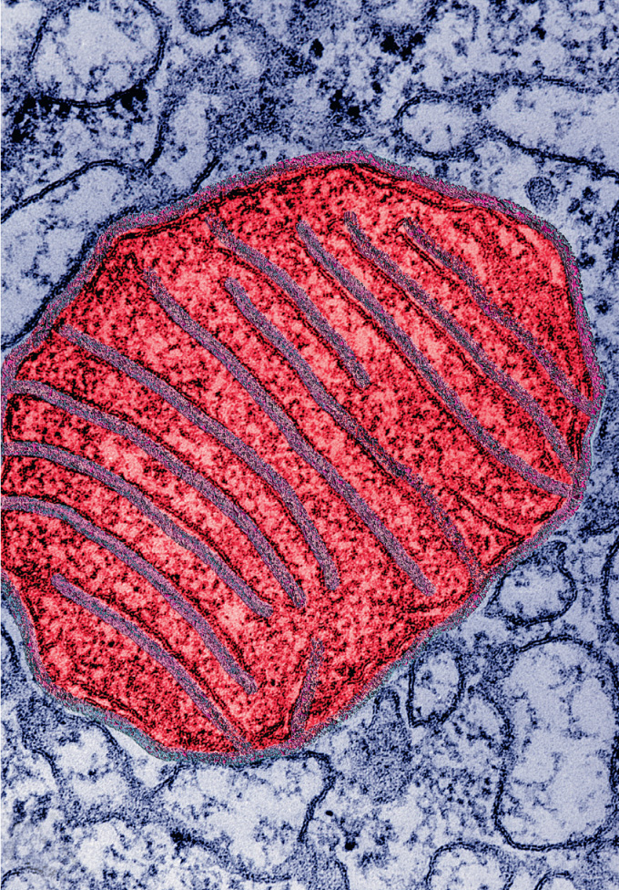
Topic 3 – Cellular energetics
Reading
  Chapter 4.3
  Chapter 6
Objectives
  Energy flow and why cells need energy
  The energy currency of the cell - ATP
  Glycolysis and fermentation
  The mitochondrion as the energy powerhouse of the cell
  Pyruvate oxidation and the citric acid cycle
  Oxidative phosphorylation
    Electron transport
    Chemiosmosis powers ATP synthesis
Ch. 6, p 115

Slide 2
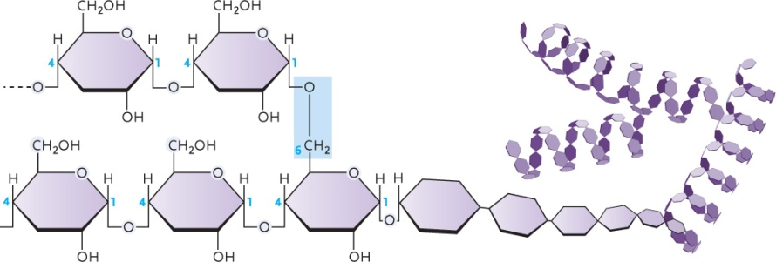
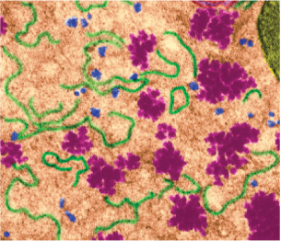
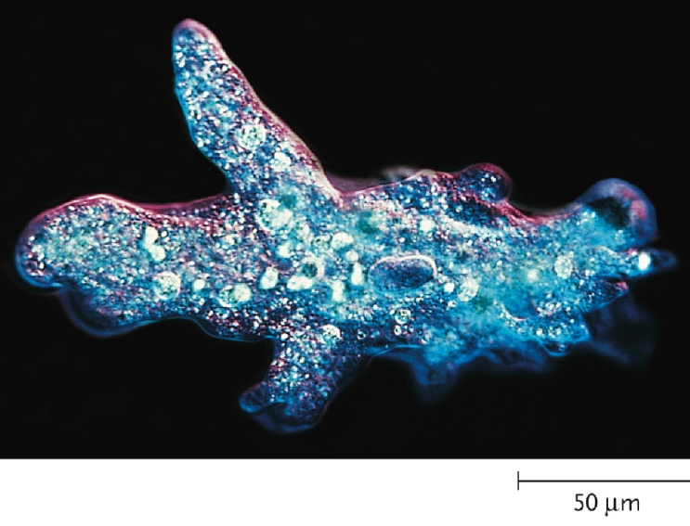
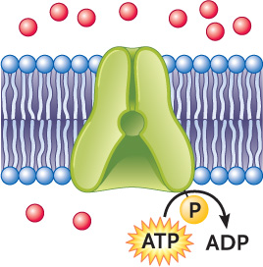
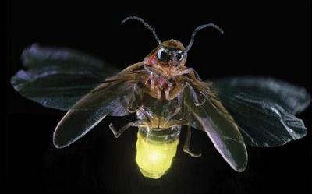
Energy flow and the importance of energy
Purple pages, F27
How do we define energy?
Capacity to do work ie physical/chemical changes in cell
Why do cells need energy?
  Biosynthesis
  Mechanical work
    e.g. Movement in cell, cell movement
  Concentration work
    e.g. Active transport
  Electrical work
    Transport of ions with generation of membrane potential
  Generation of heat
  Generation of bioluminescence
Fig. 22.6
Fig. 5.17
Fig. 36.1

Slide 3
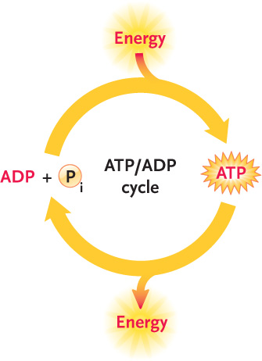
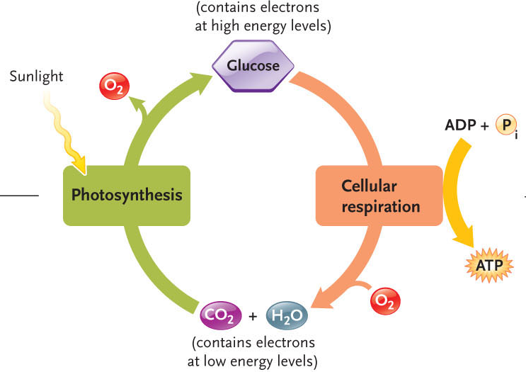
Energy flow through the biosphere
  Photosynthesis – transformation of light energy into chemical energy. Light energy reduces inorganic carbons and make it organic by creating carbohydrates. The energy is stored and then it can be used in:
  Cellular respiration – conversion of chemical energy from carbohydrates/lipids/proteins to ATP (catabolic pathways of metabolism)
Fig. 6.1
Fig. 4.12

Slide 4
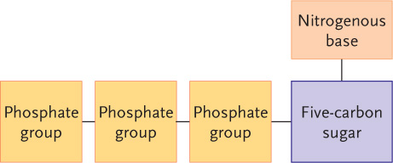
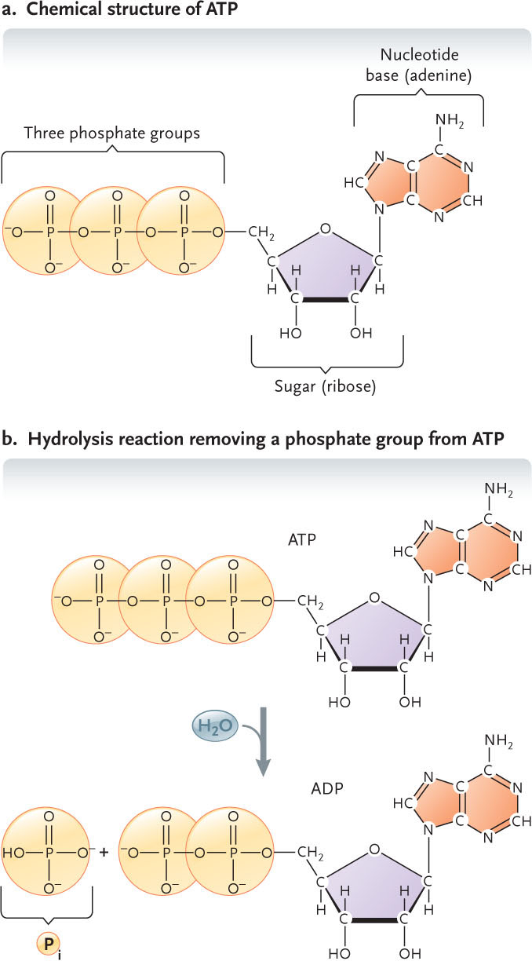
ATP is the energy currency of the cell
  Nucleotides play several roles
  ATP is made up of 3 things:
  5C sugar which is a pentose (in this case it is ribose)
  Attached to 1st carbon is a Nitrogenous base (adenine)
  Up to 3 stringed phosphate groups attached on the 5th carbon
  Combination of sugar and base = nucleoside = adenosine if the base is adenine. Can add 1, 2 or 3 phosphate group to get a nucleotide.
Purines: adenine, guanine
Pyrimidines: cytosine, thymine, uracil
Ribose
Deoxyribose
Adenosine (nucleoside)
Adenosine monophosphate (AMP)
Adenosine diphosphate (ADP)
Adenosine triphosphate (ATP)
Fig. 4.10

Slide 5
Fig. 4.12
  Hydrolysis of ATP releases energy
    Charge repulsion
    Increased entropy
    Resonance stabilization
  ATP couples energy-yielding processes to energy-requiring processes
The reasoning for why ATP releases energy:
The phosphate group carries a negative charge that means nucleotide carries the negative charge. To form ATP, u have to bring together 2 negatively charged molecules (they repel) therefore u need energy to overcome the repulsion. When u hydrolyse ATP, that energy is then released once more.
Can see it when u go from an order state – tiny molecule, less ordered – 2 molecules that can move. Energy is released from this.
The phosphate group on its own is more stable as a molecule than phosphate groups that are bounded to each other. Lowest energetic group is there since the electrons can distribute themselves more when not bounded to another phosphate. Referred to as RESONANCE STABILIZATION.
ATP
Pi = HPO₄⁻
ADP
H₂O
Fig. 4.10

Slide 6
Test your knowledge...
  ATP...
  a) Consists of the nucleoside adenine with three phosphate groups linked to the 5’ carbon of the sugar.
  -cant be adenine since it’s a base so the nucleoside is adenicine
  b) Is a ribose sugar covalently coupled via its 1’ carbon to the nitrogenous base adenine and its 5’ carbon to two phosphate groups.
  - 2 phosphate not 3
  c) Is a high energy nucleotide capable of transferring energy through the loss of a phosphate group to power cellular reactions.
  - YES
  d) Is a purine nucleotide found in DNA.
  - Its RNA not DNA since its not dATP
  e) All of the above are true of ATP.
  Explain your answer.
  C – the answer :D

Slide 7
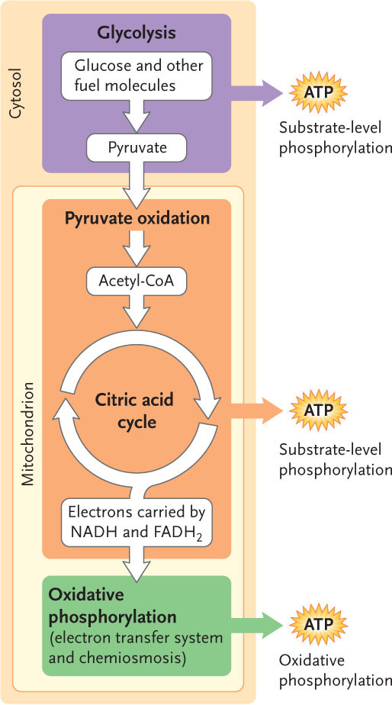
Glycolysis and fermentation
Cellular respiration
  Glycolysis (CYTOPLASM)– glyco (sugar) lysis (breaking)
    ATP production by substrate-level phosphorylation
    Reduction of NAD^{+ (LEO THE LION SAYS GER)}
    (nicotinamide adenine dinucleotide)
    - Stores the energy in NADH, serves as an electron carrier
  Pyruvate (3C molecules) oxidation and the
  citric acid cycle
    ATP production by substrate-level phosphorylation
    Reduction of NAD⁺ and FAD
    (flavin adenine dinucleotide) to form NADH and FADH2
    Pyruvate then enters the mitochondrion and oxidized to acetal coenzyme A which enters the citric acid cycle which is a series of rxns that generate some ATP but produces more NADH and FADH2
  Oxidative phosphorylation
    NADH and FADH₂ oxidation ( harvesting the E out of them)
    Energy used to make a proton gradient to drive ATP production in a process called the chemiosmotic model of ATP synthesis.
Fig. 6.7

Slide 8
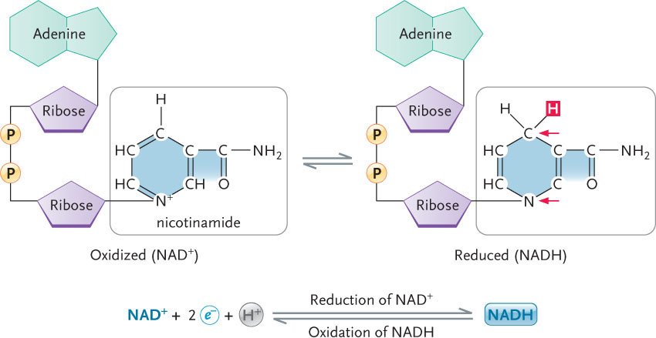
Glycolysis and fermentation
Cellular respiration
  Glycolysis
    ATP production by substrate-level phosphorylation
    Reduction of NAD⁺
    (nicotinamide adenine dinucleotide)
  Pyruvate oxidation and the
  citric acid cycle
    ATP production by substrate-level phosphorylation
    Reduction of NAD⁺ and FAD
    (flavin adenine dinucleotide)
  Oxidative phosphorylation
    NADH and FADH₂ oxidation
    Electron transport drives ATP production by chemiosmosis
Reduction
(requires energy)
NAD⁺ + 2e⁻ + H⁺
NADH
Oxidation
(releases energy)
Fig. 6.7

Slide 9
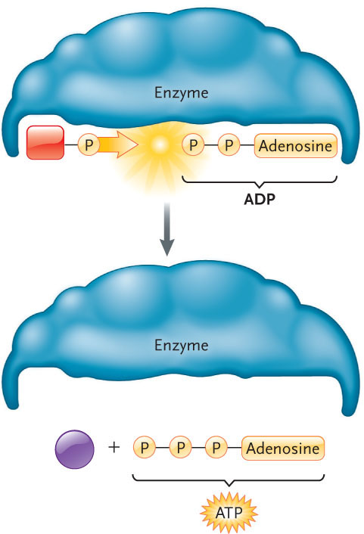
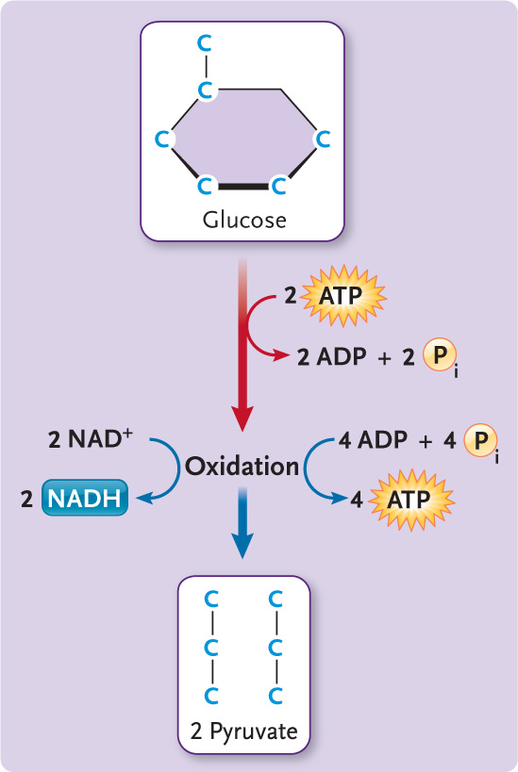
Glycolysis
  Glucose catabolized to pyruvate yielding ATP and NADH
  10 enzyme-catalyzed reactions where you can see:
    Phosphorylation and cleavage
    - Glucose makes 2 pyruvate (they are phosphorolated) by burning 2 ATPs (here u get the phosphate groups from ATP)
    Oxidation yielding ATP and NADH
    - Pyruvates are then phosphorylated again by an inorganic molecule (from cytoplasm). The phosphorylated pyruvates get oxidised which allows NAD+ to reduce to NADH and makes 2 ATP. This ATP is made from substrate level phosphorylation. NET GAIN = 2 NADH
    Pyruvate formation with ATP generation
    - A second set of substrate level phosphorylation causes the pyruvate to lose its Pi and end up with 2 pyruvate molecules and a net gain of 2 atp and 2 NADH total.
Fig. 6.11
2
ADP
2
ATP
Pi
Pi
2
ADP
2
ATP
2
ATP
2
ADP
Pi
Pi
2
Pi
2
NAD⁺
2
NADH
2 Pyruvate
Glucose
2 Glyceraldehyde-
3-phosphate
2 3-Phospho-
glycerate
Glucose + 2NAD⁺ + 2ADP + 2Pi
2 pyruvate + 2NADH + 2ATP + 2H⁺

Slide 10
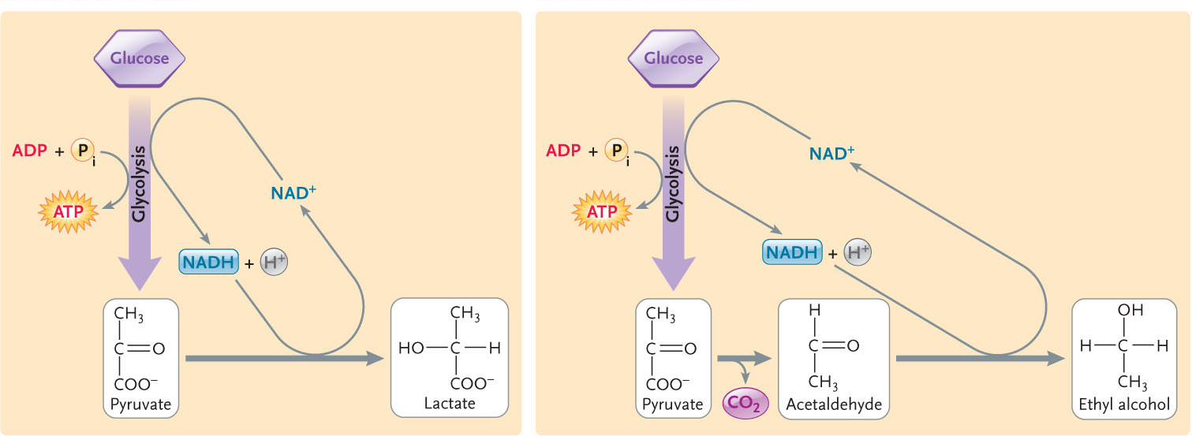
  Fate of pyruvate depends on O₂ availability
    Note regeneration of NAD⁺ in absence of O₂
Pyruvate
oxidation
Citric acid
cycle
Oxidative
phosphorylation
O₂
Glycolysis
Glucose
2 pyruvate
Lactate
(e.g. skeletal muscle)
Fermentation
Ethanol
(e.g. S. cerevisiae, anoxic goldfish)
Fig. 6.23
Lactate
dehydrogenase
Alcohol
dehydrogenase
Notes:
If oxygen is present, the pyruvate enters the mitochondria, ozidises, goes through cyclic cycle and so on.
If oxygen isnt present 1 of 2 fermentation process occurs
Lactate fermentation
Pyruvate molecule accepts molecules from nadh and becomes a lactate molecule (3 carbon lactate by gaining electrons from nadh)
In our skeletal muscles (weight lifting or sprinting and so on)
2) Alcoholic fermentation
Loses carbon to co2 that gives 2 carbon molecule that forms ethanol
Yeast does it, goldfish do it too
Purpose is to regenerate NAD+
Presence of oxygen, pyruvate will enter mitochondrion.

Slide 11
Pause to reflect...
  Fermentation involves the regeneration of NAD⁺ that was reduced during glycolysis. Why is the regeneration of NAD⁺ significant?
  Purpose: only way to get atp is glycolysis, and u need NAD+ in order to keep the glycolysis pathway going.

Slide 12
The mitochondrion – the cell’s powerhouse
Structure-function relationships
  Outer membrane contains porins
  Inner membrane
    Permeability barrier
    Highly folded
    75% protein (pyruvate transporter, electron transport chain, ATP synthase)
  Matrix contains enzymes of pyruvate oxidation, citric acid cycle
Prokaryotic origins
Fig. 6.7

Slide 13
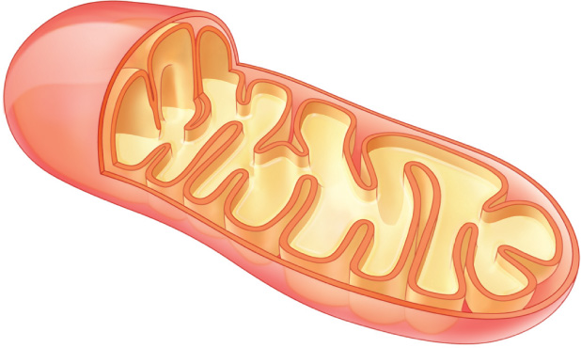
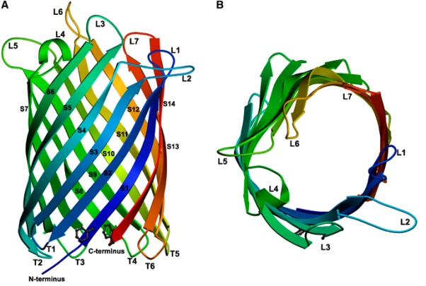
The mitochondrion – the cell’s powerhouse
Structure-function relationships
  Outer membrane contains porins
  Inner membrane contains folds called cristae (single: crista)
    Permeability barrier
    75% protein (pyruvate transporter, electron transport chain, ATP synthase)
  Matrix contains enzymes of pyruvate oxidation, citric acid cycle
Prokaryotic origins
Fig. 6.8
Outer membrane
Inner membrane
Cristae
Matrix
Intermembrane
space
Yildiz et al. 2006 EMBO 25, 3702-3713

Slide 14
Folds are called cristae (single – crista)
5x more S.A in innermembrane than outer.
Inner is where membrane bound proteins required for ATP synthesis and electron transfer are found.
Folding in mb provide S.A. for these proteins.
The inner mb is protein rich because of this.
Innermembrane divides the mitochondria into 2 compartments. Inside both is the mitochondrial matrix – dna, ribosomes and soluble enzymes are house here for pyruvate oxidation and citric acid cycle.
Between the 2 membranes is the intermembrane space which is the space (particular in crista folds) where u see a proton gradient. Proton gradient between interm.b. space and the matrix. The outer mitochondrial mb is much more permeable than inner mitochondrial mb. This is so since it contains porins (like channels except they are large and non selective) They are like a barrel like structure that is non selective and as long as molecule can fit, it can go through. Applies to pyruvate molecules, water, ions etc.
To get to matrix, need a pyruvate transporter. Porins are found in a shit load of bacteria (endocytosis theory proof again)

Slide 15
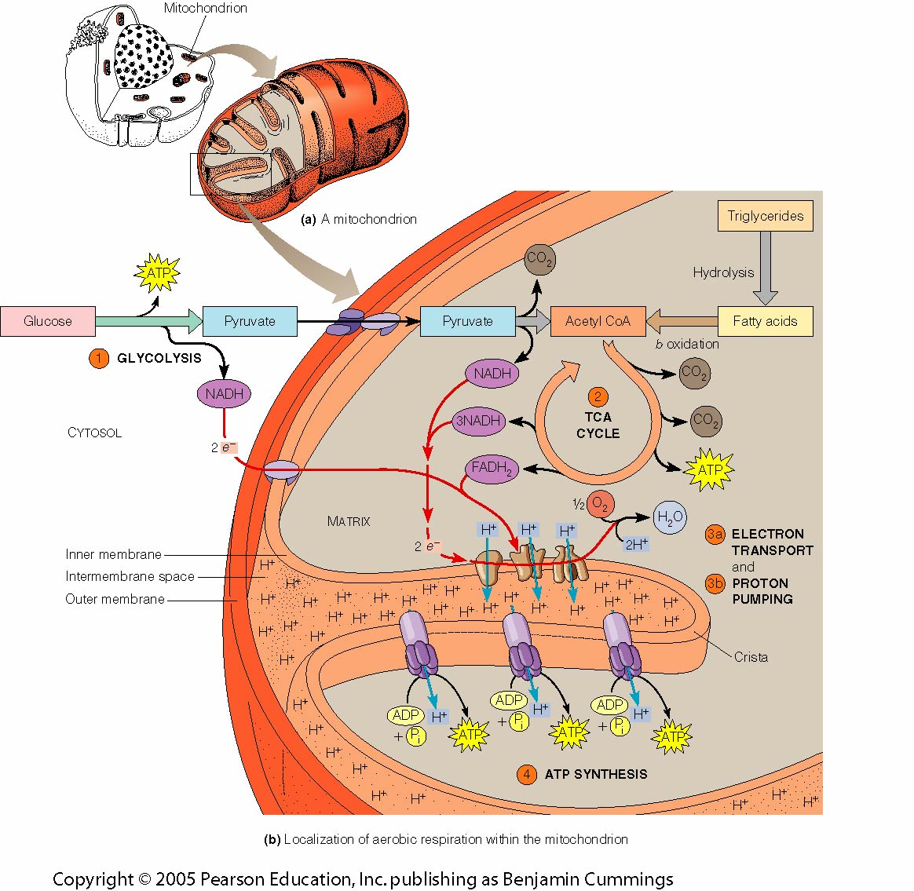
Fig. 10-1 Becker et al. 2009

Slide 16
Consolidate your knowledge
  Discuss structure-function relationships at the mitochondrion.
The cristae – increase S.A. in a mb for more ATP production
Look at mitochondria in active itssue ie muscle cells, see more ATP production and more cristae
Inner mb is less permeable across proton gradient allows a proton gradient to be established to drive ATP production.
Matrix contain ribosomes and genetic information that allows it to make its own proteins.
Contains enzyms for pyruvate oxidation and the citrate cycle
Contains nadh and fadh2

Slide 17
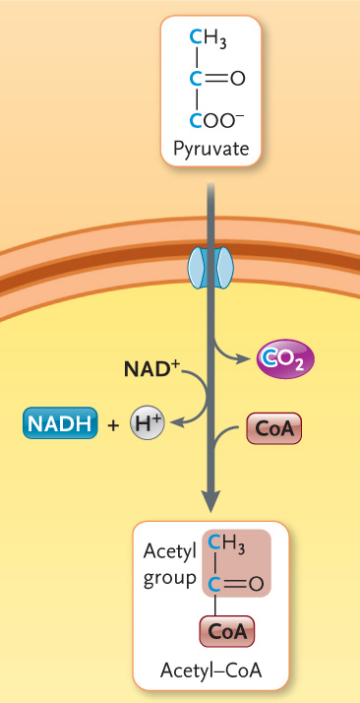
Pyruvate oxidation
  Oxidative decarboxylation of pyruvate
The citric acid cycle
  8 enzyme-catalyzed reactions
  Liberation of energy from remaining
  C-H bonds
  2 C enter cycle (as acetyl-CoA)
  Two decarboxylation steps
    Loss of 2 CO₂
  Four oxidation steps
    reduction of 3 NAD⁺ and FAD
    FAD = flavin adenine dinucleotide
Acetyl-CoA + 3NAD⁺ + FAD + ADP + Pi
2CO₂ + 3NADH + FADH₂ + ATP + CoA
Fig. 6.12

Slide 18
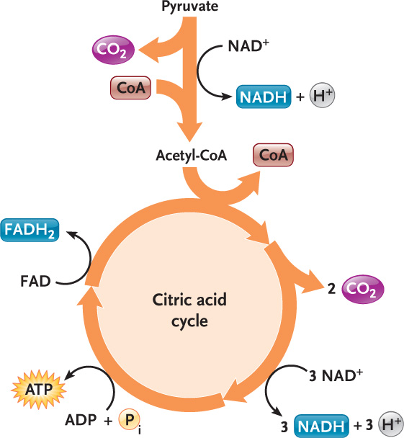
Pyruvate oxidation
  Oxidative decarboxylation of pyruvate
The citric acid cycle
  8 enzyme-catalyzed reactions
  Liberation of energy from remaining
  C-H bonds
  2 C enter cycle (as acetyl-CoA)
  Two decarboxylation steps
    Loss of 2 CO₂
  Four oxidation steps
    reduction of 3 NAD⁺ and FAD
    FAD = flavin adenine dinucleotide
Acetyl-CoA + 3NAD⁺ + FAD + ADP + Pi
2CO₂ + 3NADH + FADH₂ + ATP + CoA
Fig. 6.13

Slide 19
Cellular respiration so far…
  Glycolysis
    2 ATP
    2 NADH
  Pyruvate oxidation and the
  citric acid cycle
    2 ATP
    8 NADH + 2 FADH₂
  Oxidative phosphorylation → conversion of energy from NADH, FADH₂ to ATP
Fig. 6.7

Slide 20
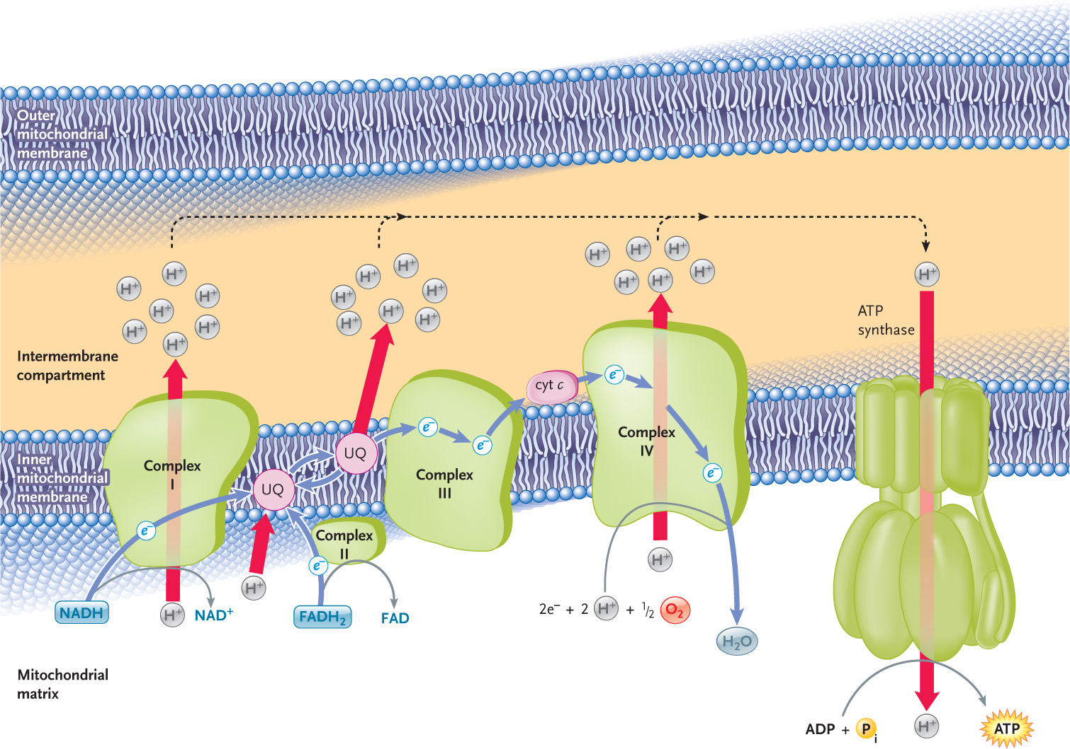
Oxidative phosphorylation
  Reoxidation of coenzymes by transfer of e⁻ to O₂
    Affinity for e⁻ increases along electron transport chain
  Creation of proton gradient that drives ATP synthase
Fig. 6.15

Slide 21
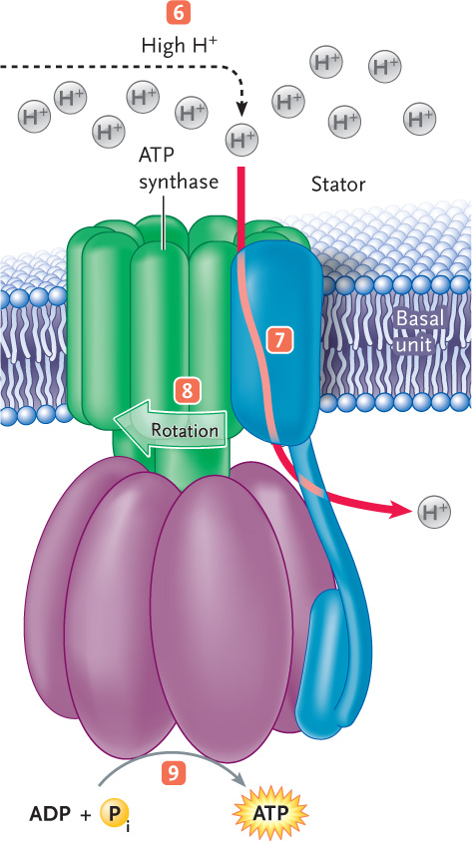
  ATP synthase
    Proton channel
    Molecular rotary motor
    NADH → ~10 H⁺ → ~3 ATP
    FADH₂ → ~2 ATP
10 NADH + 10 H⁺ + 5 O₂ + 30 ADP + 30 Pi
10 NAD⁺ + 10 H₂O + 30 ATP
2 FADH₂ + O₂ + 4 ADP + 4 Pi
2 FAD + 2 H₂O + 4 ATP
Substrate-level
phosphorylation
Oxidative
phosphorylation
4 ATP + 34 ATP = 38 ATP
(36 ATP in eukaryotes)
Efficiency ~40-50%
Fig. 6.17

Slide 22
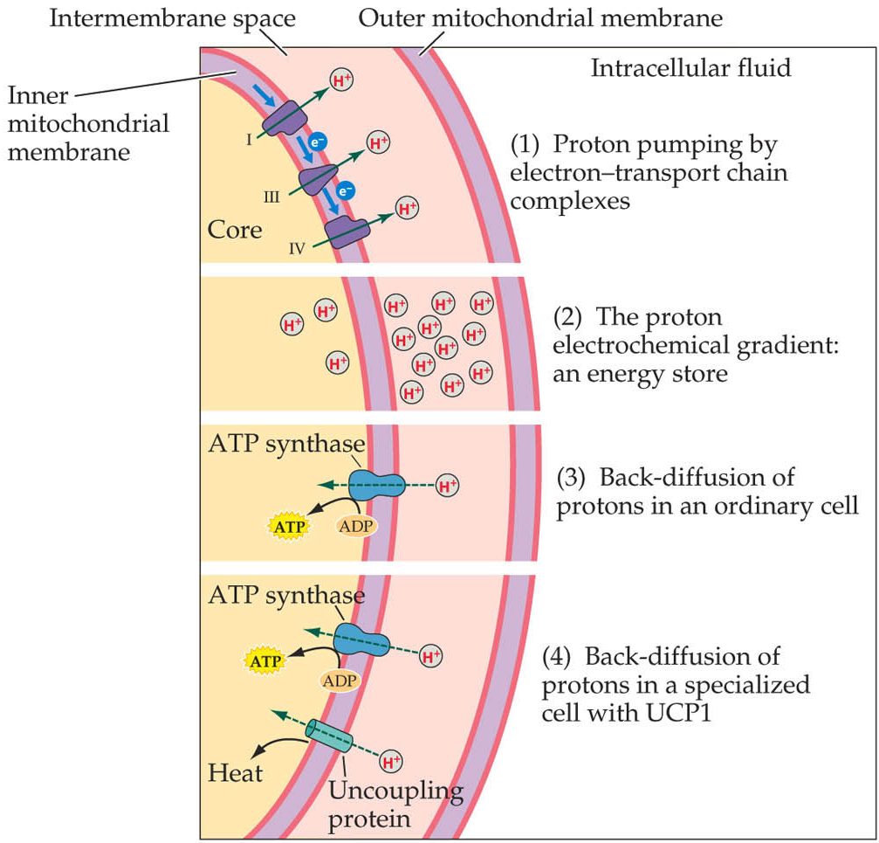
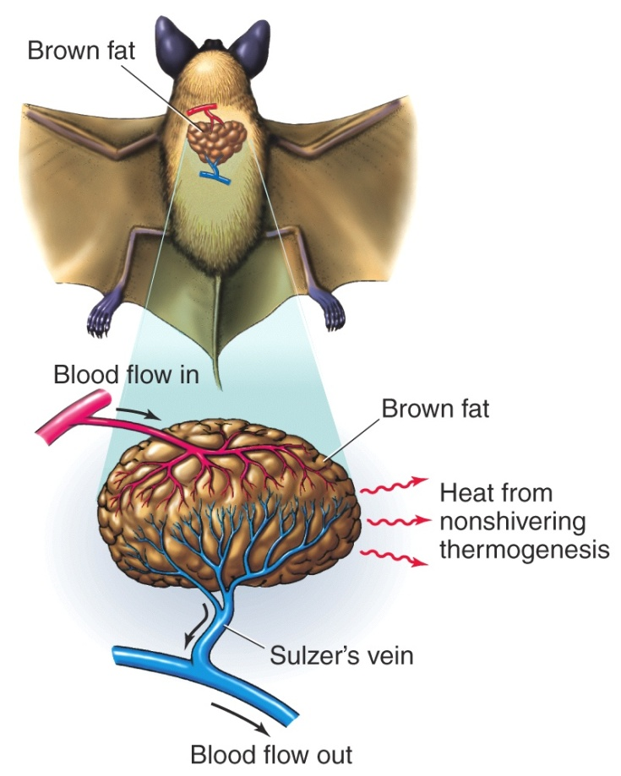
  Proton leak
    Uncoupling protein (UCP1)
    Heat generation by nonshivering thermogenesis in brown adipose tissue
Fig. 17-22, Randall et al. 2002
Box 6.1, Hill et al. 2004

Slide 23
Test your understanding...
  What experimental evidence could be gathered to support the chemiosmotic model of ATP synthesis?

Slide 24
Regulation of cellular respiration
Serves to match ATP supply to ATP demands of cell
  Negative feedback
  Allosteric regulation of enzyme activity
    Inhibitors
    Activators
  Glycolysis, pyruvate oxidation & citric acid cycle
  Oxidative phosphorylation regulated by the availability of ADP
Hibernation and torpor?
Glucose
+
-
ATP
Glycolysis
(cytosol)
AMP
Pyruvate
Pyruvate
oxidation
(mitochondrial
matrix)
NAD⁺
+
NADH
AMP
-
ATP
CoA
Acetyl-CoA
Citrate
Citric acid
cycle
(mitochondrial
matrix)
+
-
ADP
NADH
NADH, FADH₂
(cristae
membranes)
+
ADP
Oxidative
phosphorylation
ATP
See Fig. 6.21

Slide 25
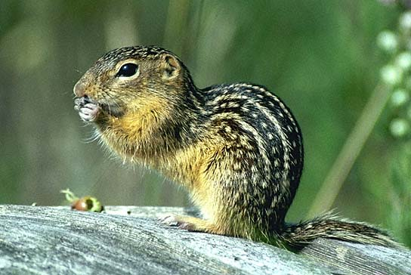
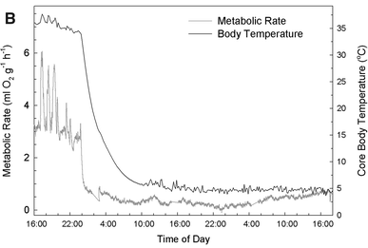
Hibernation and torpor
  Metabolic rate and body temperature lowered to conserve energy
    MR < 5% of active animal
    Tb = 5°C
  Does active metabolic suppression contribute to hibernation & torpor?
  Isolated mitochondria from liver of torpid vs active animals
    Mitochondrial respiration reduced
    by up to 88%
  Ground squirrels choose PUFA-rich foods prior to hibernation.
    Low PUFA → higher Tb and MR,
    shorter torpor
    Excess PUFA → shallower,
    shorter torpor
http://newsforsquirrels.blogspot.ca
Staples & Brown 2008 J Comp Physiol B178, 811-827

Slide 26
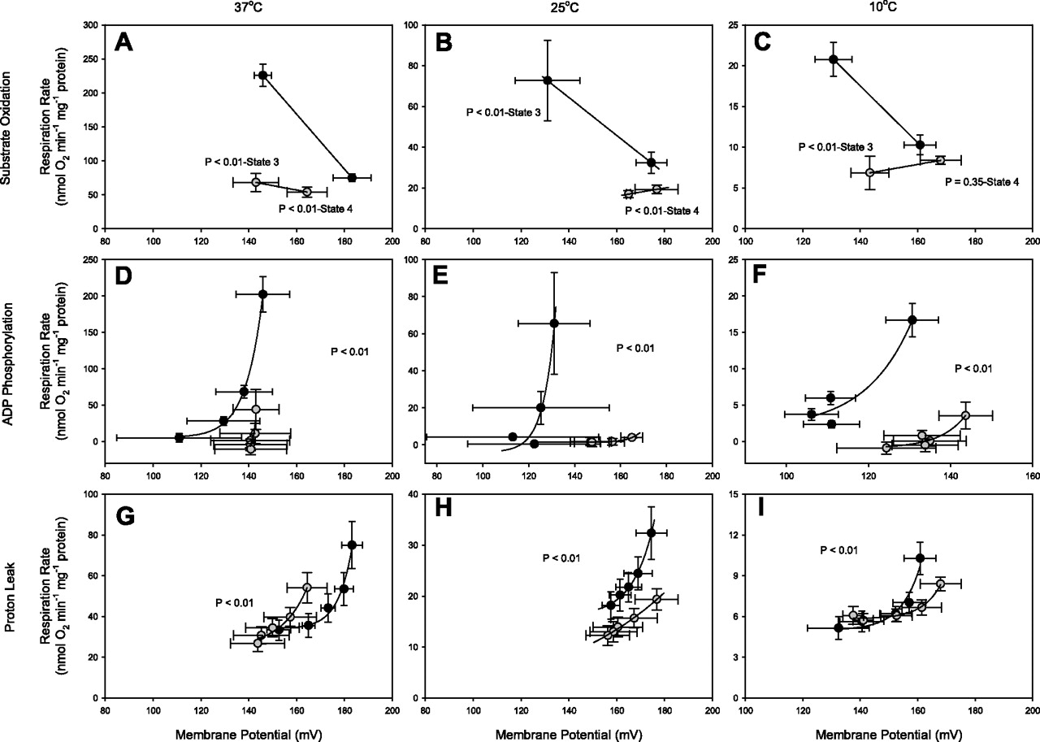
Hibernation and torpor
  Metabolic rate and body temperature lowered to conserve energy
    MR < 5% of active animal
    Tb = 5°C
  Does active metabolic suppression contribute to hibernation & torpor?
  Isolated mitochondria from liver of torpid vs active animals
    Mitochondrial respiration reduced
    by up to 88%
  Ground squirrels choose PUFA-rich foods prior to hibernation.
    Low PUFA → higher Tb and MR,
    shorter torpor
    Excess PUFA → shallower,
    shorter torpor
active
torpid
Brown et al. 2012 AJP 302, R15-R28

Slide 27
Pause to reflect...
  Suppression of mitochondrial respiration contributes to lowering of metabolic costs during hibernation and torpor. How else could cellular energy costs be reduced?

Slide 28
Can you meet these objectives?
By the end of this lecture you will be able to...
  Describe the cellular processes for which energy is required
  Describe the structure of ATP and explain how it acts as the cell’s energy currency
  Describe the steps in cellular respiration, noting where each takes place and tallying the ATP yield from each step
  Distinguish between substrate-level phosphorylation and oxidative phosphorylation
  Explain the role of fermentation
  Link the structure of the mitochondrion to its function as the energy powerhouse of the cell
  Explain the chemiosmotic model of ATP synthesis
  Describe the regulation of cellular respiration

