Slide 1
Drugs 101
BPS 1101

Slide 2
Assigned Readings
Each mid term and the exam will include questions dealing with assigned readings
  Mid Term 1 Reading 1
  Mid Term 2 Reading 2
  Final Exam Reading 3
Available from the course website

Slide 3

Finding information
Great source of info
Be careful
  Anyone can post anything on the web
  Check more than one site
Drug company web sites
Notes:
Look up info yourself first
Internet gives a good starting point – always dig deeper as internet info is often “filtered”
Other suggested site: WHO, NIH, compendium of _____, university sites .edu
3

Slide 4
The web can be good or bad

Slide 5
Most reliable information on web
Pharmaceutical company websites
  Regulated
Government websites
  Health Canada
  FDA
University websites
Scientific journals

Slide 6
Life expectancy (2009)
Notes:
We live in a unique time and place
current life expectancy higher than at any other time in history
6

Slide 7
Life expectancy through history
Approx 30 to 35 years for most of recorded history
  Last 6,000 years
Approx 30 to 35 years through the stone age
  500,000 to 6000 years ago
82 years in 2009 (Canada)
  Most Improvements over the last 150 years
Notes:
Life span is an educated guess – written records and archaeology
important to remember that only “important” people make it into historical records, life expectancy is mostly the “ordinary” people
Most improvements in life span have happened over last 150 years
7

Slide 8
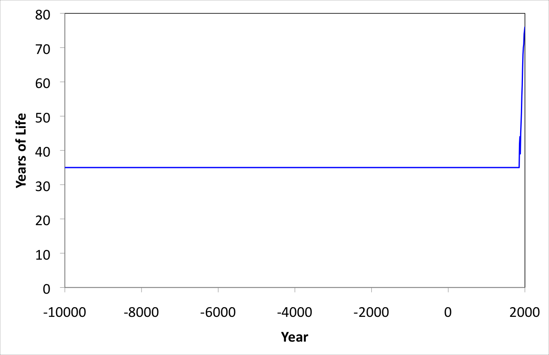







Life expectancy through history
Notes:
Variations smoothed out as records are not precise
number of 35 years is an estimate made by combining data from various sources
numbers may vary depending on source used
range is more appropriate
8

Slide 9
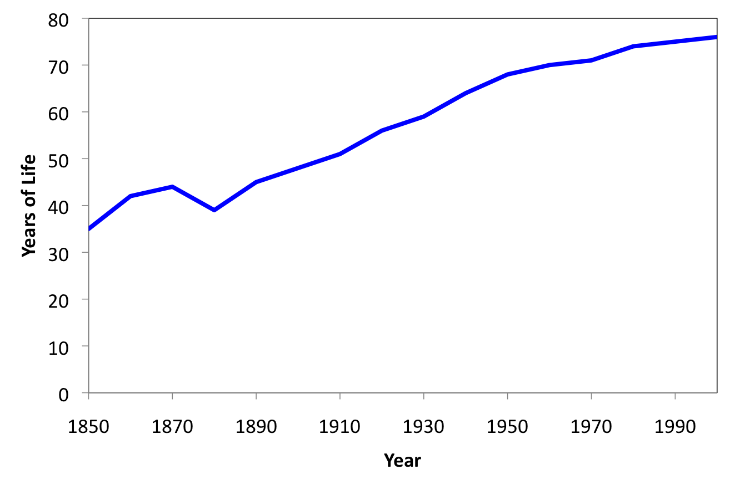
Life expectancy last 150 years
Notes:
Data for united states
150 years ago, life expectancy was same as that of the stone age
- special time in history to be living now
9

Slide 10
Life expectancy then and now
2004
  82 years
Main causes of death
  Heart disease
  Cancer
  Stroke
  Lower respiratory infection
  Traffic accidents
  Diabetes
1900
  44 years
Main causes of death
  Pneumonia
  Tuberculosis
  Influenza
(this lasted until 1950’s)
Notes:
Data for Canada
life expectancy has doubled in last 100 years
changes also in quality of life
causes of death have shifted from infectious disease to “wear and tear”
historically people lived entire lives in an unhealthy state
constantly sick (parasites)
this condition still exists in many developing countries
10

Slide 11
Disease affects quality of life

Slide 13
Chronic infections

Slide 14
Malnutrition was common
Notes:
James Lind – surgeon in royal navy
Treatise on the scurvy
14

Slide 15
Main reasons for improved health
Improved sanitation
Clean drinking water
Refrigeration
Vaccination
Antibiotics

Slide 16
Improved sanitation
Notes:
16

Slide 17
Safe water supply

Slide 18
Major improvement was chorination

Slide 19
Food spoilage was common before refrigeration

Slide 20
Greatest achievement in medicine
Immunization (vaccination)
Very successful for viral diseases
Smallpox
  Eliminated in 1977
  Only exists in labs and biological weapons
  Gene sequence online

Slide 21
Polio eradicated from North America 1991
Currently less that 1000 cases world-wide
  10 or 11 countries
  Major eradication barrier is politics

Slide 22
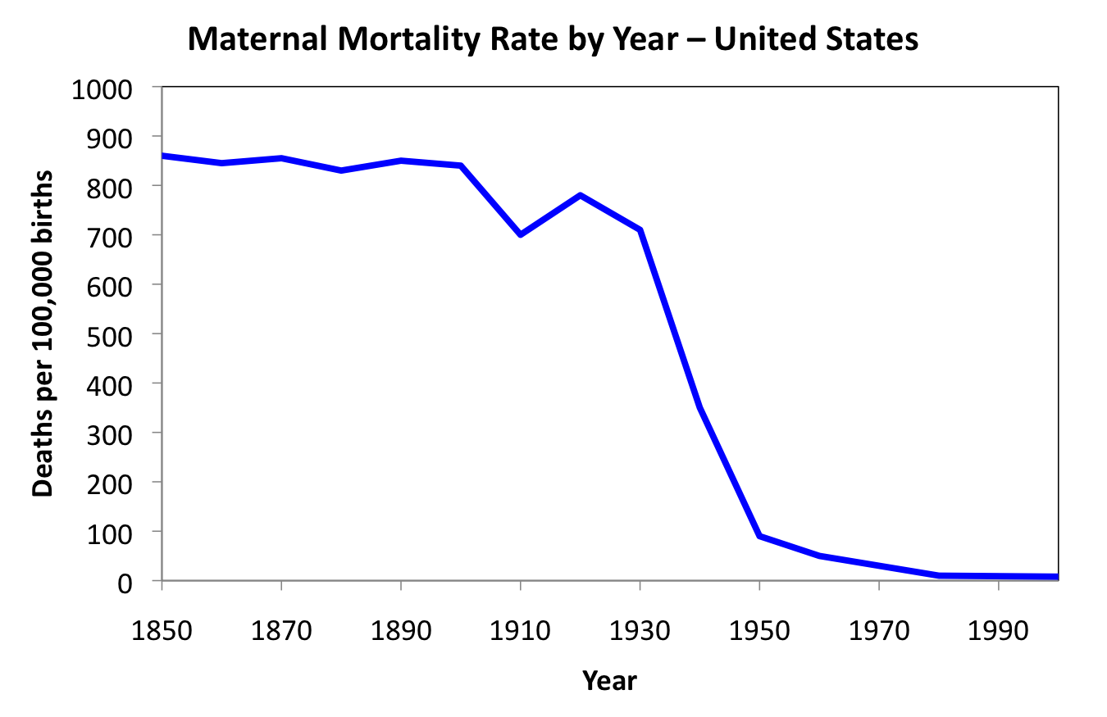
Penicillin reduced maternal mortality

Slide 23
North American drug market (2009)
Prescription drugs
  $ 300 billion
Over-the-counter (OTC) drugs
  $25 billion

Slide 24
World drug markets

Slide 25
Types of Medical Treatment
Surgical
  Removal of affected body part (traditional)
  Modification of affected body part (modern)
Medicinal
  Use of chemical compounds to treat disease

Slide 26
Plants as sources of drugs

Slide 27

Early drugs were poisons
Drugs
  Produce desired (beneficial) biological effect
Poisons
  Produce undesired (harmful) biological effect
  Poison Drug
  pharmakon

Slide 28
Sola dosis facit veneum
Poison – kill
Potion – cure
Only the dose makes the poison

Slide 29
Dosages
Normally we assume
  low doses produce beneficial effects (drug)
  high doses produce harmful effects (poison)

Slide 30
Dosages
Sometimes
  low doses produce harmful effects (poison)
  higher doses produce beneficial effects (drug)

Slide 31
Only the dose makes the poison

Slide 32
How were drugs discovered?
Observation and experiment
  People observed the effect of the drug
  Strong poisons given in low dose
Philosophy
  Cure arrived at by reasoning
  Method requires good information
    GIGO
  Healing often connected with superstition, magic, religion

Slide 33
Drugs from observation and experiment
Strong poisons
  Easily identified
  Low dose makes it into a drug
Weak poisons
  Large quantity for effect

Slide 34
Hippocrates 460-370 BC
Father of medicine
  Promoted experimental methods
  Rejected superstition and religion from healing

Slide 35
Identification of opium for pain
Opium (extracted from poppy seeds)
  Narcotic painkiller
  Sedative
Toxic in high doses
Drug in low doses

Slide 36
Identification of cocaine as a stimulant
Observation
  extracted from coca leaves
    Topical painkiller
    Stimulant

Slide 37
Quinine as a malaria treatment

Slide 38
Problems with observation
Human brain searches for patterns
  Even when they are not there
Anecdotal evidence unreliable
  Drug and effect may be coincidence
Once “evidence” is available, hard to contradict
  Many harmful remedies retained because of this
  Parent’s cold remedies

Slide 39
Anecdotal evidence often misleading

Slide 40
Anecdotal evidence relies on chance
Medication and cure may not be connected
Poison and harm may not be connected

Slide 41
Problems with herbal remedies
Poor control over dose
  Plants produce variable amounts of active ingredient

Slide 42
Problems with herbal remedies
Variations in preparation and administration

Slide 43
Problems with herbal remedies
No instructions
  Information passed verbally
  Imprecise
  Poor reproducibility

Slide 44
Philosophy to identify cures
Cure arrived at by reasoning
Method requires good information
  GIGO
  Garbage in garbage out
Healing often connected with superstition, magic, religion
Notes:
>they made it up
>incorrect info > incorrect result

Slide 45
Hippocrates develops doctrine of humors
Universe is made of 4 elements
  Earth
  Air
  Fire
  Water

Slide 46
Hippocrates develops doctrine of humors
Body is made of 4 humors
  Blood
  Phlegm
  Yellow bile
  Black bile
Universe is made of 4 elements
  Earth
  Air
  Fire
  Water
Notes:
>tried to relate element to humors
>earth-dry-black bile
>air-cold-blood
>fire-hot-phlegm
>water-wet-yellow bile

Slide 47
Doctrine of humors
4 humors are normally in balance
Too much or not enough of a humor causes disease
Cure by re-balancing the humors
  Diagnose using the properties of the humors
Fever associated with hot and dry
  Cure using cold and wet
Notes:
>add or remove humors (balancing with the humor properties)

Slide 48
Bloodletting and the doctrine of humors
Re-balance blood humor
Notes:
>cut different parts of the body
>amount of blood
>different types of knifes/shape of cut
>bloodletting often killed the patient (George Washington)

Slide 49
Doctrine of humors was crap
Based on incorrect idea
  Made it up
Treatments developed using it were harmful and painful
  Bloodletting
  Purges
  Fasting
  Special foods
Notes:
>not beneficial
>dominated medical science for over 2000 years

Slide 50
Doctrine of Signatures
Jakob Bohme, shoemaker and philosopher (1575-1624)
  God left clues to tell us how to use
  things
  Disease and cure were linked
  This approach is/was used by almost
  all cultures
Notes:
>give a name to the procedure
>earth exists for our purpose
>look for the signature in something

Slide 51
Walnuts look like brains
Eating walnuts is good for brain health
Notes:
>Boneset stems grow through the leaves -good for bones
>sharks don't get cancer – sharks have cartilages instead of bones (used for cancer treatment) sharks do get cancer...

Slide 52
Parsley and fresh breath
Fresh breath – Parsley
Parsley – Green
Green – Chlorophyll
Chlorophyll – Fresh breath

Slide 53
Mandrake roots look like people
Mandrake roots used for many medicinal and magical purposes
  Primary use was a cure for demonic possession
Notes:
Protect against screaming
>ensures magic is preserved (dog pulls it out)

Slide 54
Rhino horn is a phallic symbol
Powdered rhino horn used in Chinese medicine as an aphrodisiac
Notes:
>made out of the same thing as your nail
Mercury is a heavy liquid
-people drink mercury as a purgative

Slide 55
Doctrine of signatures
Most remedies developed this way were harmful
At best were harmless
  Denied the patient proper treatment
Lack of rationality or evidence
  Based on appearance or location
  Required imagination to see connections

Slide 56
Some problems require surgery

Slide 58
Amputation without anesthetic

Slide 59
Sir Humphry Davy discovers nitrous oxide
Notes:
>150 years ago
>would put you in a state where you felt no pain
>laughing gas
>intoxicates you

Slide 60
William T.G. Morton and ether 1846
Notes:
>significant improvement
>patient would not remember the surgery

Slide 61
Anesthetics make modern surgery possible

Slide 62
Less than 30 % survived surgical treatment
Notes:
>developed infection
>no sanitation

Slide 63
Joseph Lister uses phenol as antiseptic
Notes:
>bacteria causing infection
>still thought disease was cause by humors, so they didnt believe him

Slide 64
Carbolic acid sprayer
Notes:
>disinfectant
>chemical structure for phenol
>toxic effects of phenol on doctors

Slide 65
Washing and glove use was safer
Notes:
1860-1870
>antisepsis brought to Canada by Thomas Roddick 1877
>carbolic smoke ball for home use
>listerine becomes household product
>listerine for dandruff
>listerine no longer contains phenol

Slide 66
Listerine no longer contains phenol
Notes:
>same family of chemical properties

Slide 67
Problems with drugs in the 1800’s
No regulation
  Industrialization created big markets
  Lots of opportunity for fraud
All these problems had/have always existed, but there was a dramatic increase in the 19th century
Notes:
>could poison an entire country

Slide 68
Science and fraud
The emergence of science made people trust claims
  “scientifically proven”
  “patented”
The emergence of science made it easier to identify fraud
  Before science, there was no way to know

Slide 69
Science and fraud
1862 – first analysis of sugar/alcohol manipulation in wine
1873 – first analysis of morphine content in opium
1874 – first experiments on the effects of pesticides on humans

Slide 70
Experiments on humans
Common until world war II

Slide 71
Rise of patent medicine late 1800’s
Notes:
>using scientific ideas to creates bogus products
>patented
>heroin, morphine, alcohol made they feel “better”
>kickapoo indian oil cures all with alcohol, claims to cure a whole bunch of things
>all drugs produce side effects
>great radium spring water

Slide 72
William J.A. Bailey makes Radithor
Notes:
>radiation kills cancer
>twisted scientific idea
>cancer to morons
>Eben M. Byers was a believer (jaw had to be removed and other parts of his skull)
>medicine from death's laboratory

Slide 73
Board of Food and Drug Inspection
Formed in 1907
  Labeling only
  No regulation of therapeutic claims
  No safety testing

Slide 74
Massengill sells sulfanilamide exilir
Notes:
>regulations were not strict enough
>massengill huge pharmaceutical company
>cannibus, morphine, chlorophorm
>sold sulfanilamide (antibiotic) as a power
>first antibiotic
>used for strepthroat
>formilation, stuff to add to drugs to make them taste better
>massengill sells sulfanilamide

Slide 75
Message to the AMA
“please wire collect by Western Union suggestion for an antidote”
Notes:
>keep selling the drug and people started dying

Slide 76
Labeling forced drug off the market
  Legal definition of elixir is a substance dissolved in ethanol

Slide 77
Government inspectors track down drug
Recovered 234 of 240 gallons that were sold
107 dead
260 permanently disabled

Slide 78
Dr. Samual Evans Massengill
"My chemists and I deeply regret the fatal results, but there was no error in the manufacture of the product. We have been supplying a legitimate professional demand and not once could have foreseen the unlooked-for results. I do not feel that there was any responsibility on our part."

Slide 79
Food and Drug Administration (FDA) created
  Ensure the safety of drugs
  Animal testing was now required (safety only)
  Clinical trials were done to follow safety in humans
  Directions for proper use were required on the label

Slide 80
Thalidomide
Developed as a sedative – 1957
  Very few side effects
By 1962, thalidomide recognized as a teratogen
  Phocomelia
  Never marketed in the U.S.
    Teratogenicity was discovered before
    FDA approval was given
Notes:
Teratogen- condition that causes birth defects
Phocomelia- born with no arms or legs (seal)

Slide 81
Teratogen causes birth defects
From Greek word “teratos” for “monster”
Thalidomide was tested in rats
  Rats do not often give birth to deformed pups
  In humans, problems with
  a fetus result in
  miscarriage, stillbirth or
  birth defects

Slide 82
Modern safety standards
  Safety testing done in at least 2 species
  At least one must be a primate
  Must show that the drug is bioavailable
    Gets into body
  Must use relevant doses

Slide 83
Genetic engineering changes drug discovery
Replaces many animal experiments

Slide 84
Genetically engineered drugs
Safest source of human protein
Notes:
>safer

Slide 85
Drug discovery today
Each new drugs costs more than $800,000,000 to develop
From idea to market requires 8 years
High risk
  High profit

Slide 86
Sources of drugs today
Biologic 14%
Vaccine 4%
Natural Product 5%
Semi-Synthetic 23%
Synthetic 54%

Slide 87
High failure rate for new drugs
Less than 1 in 10 drugs survive clinical trials and reach market
More than 10,000 compounds are tested to find each new drug
Process requires 8 to 12 years
Each new drug costs $800,000,000 to bring to market

