Slide 1
ADM1100~W1
Chapter 1
.I.B.M.~.T.S.M.
JFA
Thanks to the much appreciate collaboration of
Prof. Matt Archibald and Prof. David Delcorde
W’2013

Slide 2
Today’s Agenda
Chapter 1:
  Managers and Managing;
  The Rational Decision-Making Process;
  The Behavioural Aspects of Decision Making
  The Importance of Strategic Management;
  The Levels of Strategies;
  Corporate Culture;
  Tips of the week: In Class
Be prepared for the W2 and W3
  Chapter 2:
    Three critical challenge ~Pages 48+49
    What is management? ~Pages 50+51
    Managerial Roles by Mintzberg ~Pages 67 to 70
    Tips of the week: In Class
Chapter 3: Entrepreneurship, Small business and New venture creation
Notes:
It’s normal to have 47 questions after the first lecture. Please, ask me your questions in class, by email (see Outline) or by appointment. I wish you a great semester!
JFA

Slide 3

Managers and Managing
Managing the Business Enterprise
Idea of the management process:
  Management is the process of Planning, Organizing, Leading and Controlling an enterprise’s financial, physical, human and information Resources to achieve the organization’s Goals of supplying various Products and Services.
Notes:
Question could be:
Describe the 4 basic function that constitution the management process?
Learn this by heart

Slide 4

Part II
Managers and Managing
Managing the Business Enterprise
Idea of the management process:
  Management Efficiency means achieving the greatest level of output with a given amount of input (doing things right);
  Management Effectiveness means achieving the organizational goals that have been set (doing the right things);
  True or False: A manager who focuses on being effective will likely also be efficient, but a manager who focuses on being efficient may or may not be effective
Notes:
Dizzy Tips!!!!

Slide 5
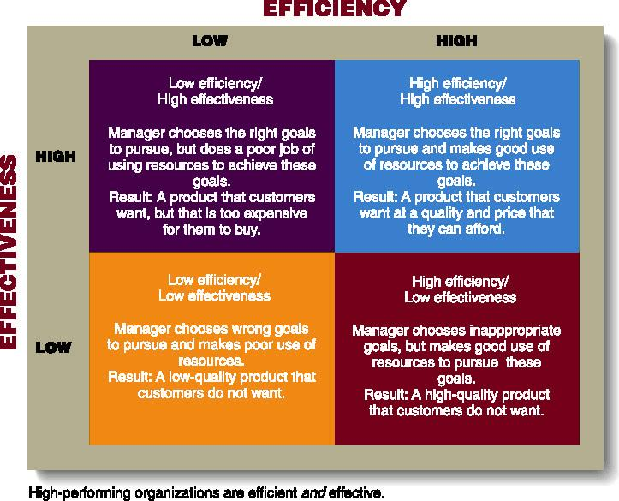
Efficiency, Effectiveness, and Performance in Organizations

Slide 6
Part II
Managers and Managing
Managing the Business Enterprise
The functions that are necessary in the management process:
  All managers plan, organize, direct and control day-to-day operations;
  PODC are interrelated;
  Planning is the process of determining the firm’s goal and developing a strategy for achieving them;
  See the five basic steps on page 17 (Textbook).
Notes:
Page17 in text book

Slide 7
Part II
Managers and Managing
Managing the Business Enterprise
Planning:
  Step 1: Goals are established for the organization;
  Step 2: Managers identify whether a gap exists between the company’s desire and actual position.
  Step 3: Managers develop plans to achieve the desired goal (Goal=Result desired/ Plans=How these goals are to be achieved)

Slide 8
Part II
Managers and Managing
Managing the Business Enterprise
Planning:
  Step 4: Thinking is converted into action. Therefore, the plans that been decided upon are implemented.
  Step 5: The effectiveness of the plan is assessed.
    Means actual results are compared with planned performance.
    Plans may then have to be modified and a different goal may have to set.

Slide 9
Part II
Managers and Managing
Managing the Business Enterprise
Planning (A Hierarchy of Plans):
  Strategic plans: Set by top management
    Reflect decisions about resource allocations, company priorities, and the steps needed to meet strategic goals
  Tactical plans: Set by middle management
    Shorter-range plans concerned with implementing specific aspects of the company’s strategic plans.
    They typically involve upper and middle management.
  Operational plans: Developed by middle management and lower-level managers that set short-term targets for daily, weekly, or monthly performances.

Slide 10
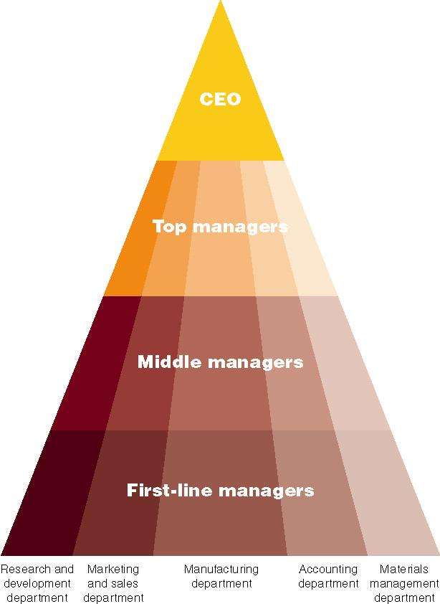
Management Hierarchy

Slide 11
Part II
Managers and Managing
Managing the Business Enterprise
The functions that are necessary in the management process:
  Organizing involves mobilizing the resources that are required to complete a particular task;
  In organizing, managers create the structure of working relationships between organizational members that best allows them to work together and achieve goals
  Managers will also lay out lines of authority and responsibility for members.

Slide 12
Part II
Managers and Managing
Managing the Business Enterprise
The functions that are necessary in the management process:
  Leading involves the interactions between managers and their subordinates as they both work to meet the firm’s objectives.
    Leading goes beyond merely giving orders.
    Leaders attempt to GUIDE and MOTIVATE employees to work in the best interests of the organizing.
  The outcome of the leading function is a high level of Motivation and Commitment from employees to the organization;

Slide 13
Part II
Managers and Managing
Managing the Business Enterprise
The functions that are necessary in the management process:
  Controlling is the process of monitoring a firm’s performance to make sure that it is meeting its goals.
    Control can also show where performance is better than expected and thus can serve as a basis for providing rewards or reducing cost.
    Managers will monitor individuals, departments, and the organization to determine if desired performance has been reached.
    Managers will also take action to increase performance as required.
    The outcome of the controlling function is the accurate measurement of performance and regulation of efficiency and effectiveness.

Slide 14

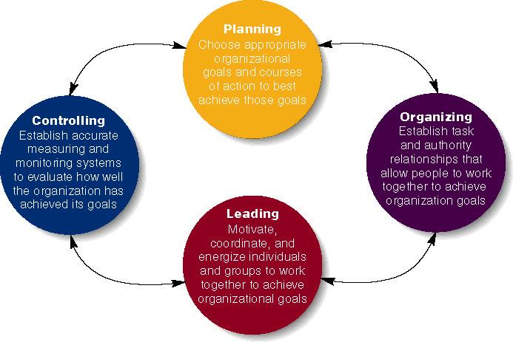
Four Functions of Management
Notes:
DIZZY TIPS!!!!!

Slide 15
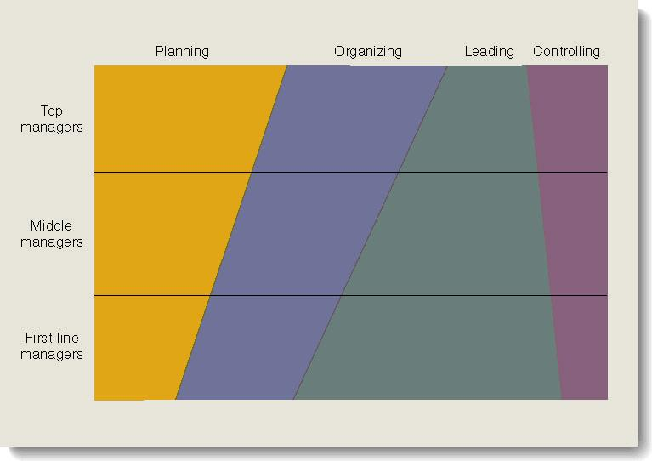
Relative Amount of Time That Managers Spend on the Four Managerial Functions

Slide 16
Part II
Managers and Managing
Managing the Business Enterprise
Types of Managers:
  Top Managers: Those managers responsible for a firm’s overall performance and effectiveness and for developing long-range plans for the company.
  Middle Managers: Those managers responsible for implementing the decision made by top managers.
  First-line Managers: Those managers responsible for supervising the work of employees.

Slide 17
Part II
Managers and Managing
Managing the Business Enterprise
Areas on Management:
  HR Managers: Provide assistance to other managers when they are hiring employees, training them, evaluating their performance, and determining their compensation level.
  Operations Managers: They are responsible for the production systems that create goods and services.
  Information Managers: They are responsible for designing and implementing systems that gather, process, and disseminate information.
    Dramatic increase in both the amount of information available to managers and the ability to manage it have led to the EMERGENCE of this important function.
Notes:
DIZZY TIPS!

Slide 18
Part II
Managers and Managing
Managing the Business Enterprise
Areas on Management:
  Marketing Managers: They are responsible for getting products and services to buyers.
  Financial Managers: Management of a firm’s finances, including its investments and accounting functions, is extremely important to its survival.
Notes:
DIZZY TIPS!!!

Slide 19
Part II
Managers and Managing
Managing the Business Enterprise
The Basic Management Skills:
  Techinal: People develop their technical skills through Education and Experience. Those skills are associated with performing specialized task within a company.
  Human relations: Those skills are very important at all levels, but they are probably most important for middle managers, who must often act as bridges between top managers, first-line managers, and managers from other areas of the organization.
    Effective managers posses communications skills that help them understand others (and to get others to understand and the can go a long way in maintain good relations in a organization.
    Thus, they are skills that enable managers to understand and get along with other people.
Notes:
DIZZY TIPS

Slide 20
Part II
Managers and Managing
Managing the Business Enterprise
The Basic Management Skills:
  Conceptual: A person’s ability to think in the abstract, to diagnose and analyze different situations, and to see beyond the present situation.
    Hey can also help managers analyze the probable outcomes of their deicisons
  Time Management: The productive use that managers make of their time.
    Paperwork, Telephone, Meetings and Email
  Decision-Making: Choosing one alternative from among several options.
    Decision-making skills are the skills in defining problems* and selecting the best courses* of action…
Notes:
DIZZY TIPS

Slide 21
The Rational Decision Making Process
The sparkle : Recognizing that a solution is necessary
The stimulus for a decision maybe either a problem or an opportunity.
Problem decision: A decision that is necessary when actual results do not conform to those expected.
Opportunity decision: Taking new initiatives or doing a current activity more efficiently even no problem exists.

Slide 22
The Rational Decision Making Process
Step 1 : Recognizing and defining the decision situation.
Stimulus +/-
Step 2 : Identifying alternatives
Obvious and creative
The more important the decision, the more alternatives should be generated.
Factors such as legal restrictions, moral and ethical norms and available technology can limit alternatives.

Slide 23
The Rational Decision Making Process
Step 3 :Evaluating alternatives
Feasibility, satisfactoriness and consequences
Step 4 : Selecting the best alternative
Choose the alternative that best fits the managers solution
It is the real crux of decision making
Decision makers should also remember that finding multiple acceptable alternatives maybe possible, so selecting just one alternative and rejecting all others might not be a good decision.

Slide 24
The Rational Decision Making Process
Step 5 : Implementing the chosen alternative
The chosen alternative is implemented into the organizational system
One of the key things that managers must deal with during implementation is employee resistance to change
The reason for such resistance include insecurity, inconvenience and fear of the unknown
Unanticipated consequences are still possible

Slide 25
The Rational Decision Making Process
Step 6 : Following up and evaluating the results.
The decision making process requires managers to :
1- Evaluate the effectiveness of their decision
2- Make sure that the chosen alternative has served its original purpose.
3- Adopt an alternative that had previously been discarded
4- Recognize that the situation was not correctly defined to begin with and start the process all over again

Slide 26
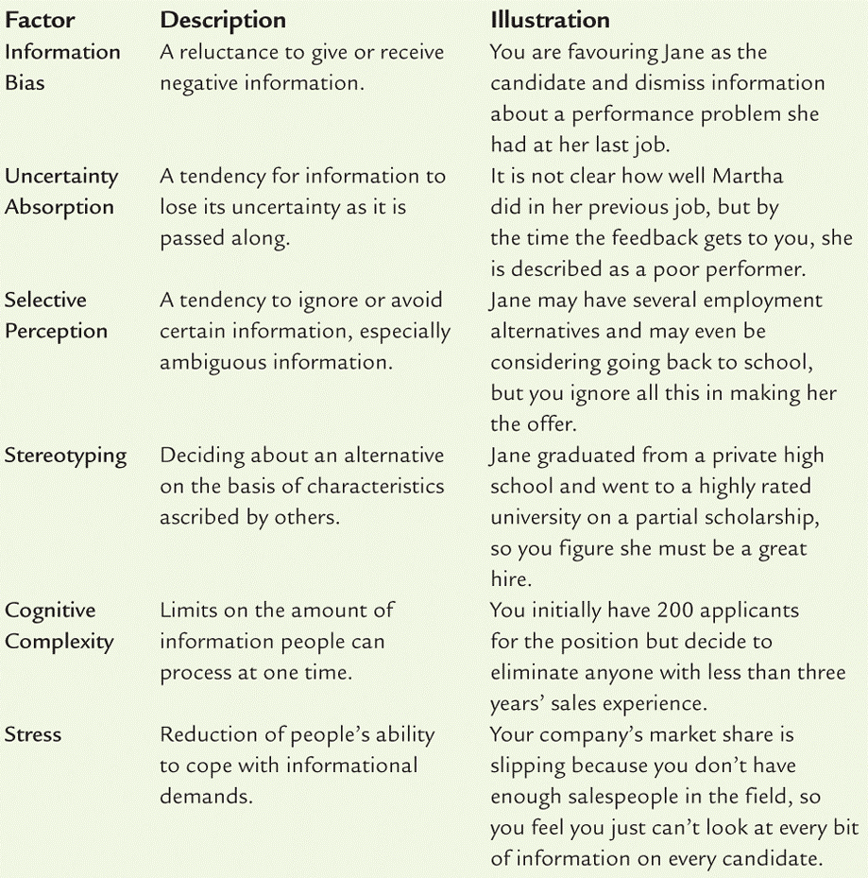
Factors that inhibit accurate problem identification and analysis
Notes:
Factors are important for the exam!!

Slide 27
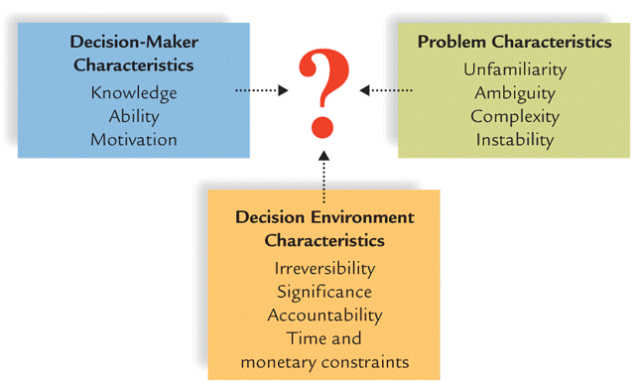
Influences on the
Decision-Making Process
Notes:
DIZZY TIPS!!!!!!

Slide 28
ADM1100~W2
.I.B.M.~.T.S.M.
JFA
Thanks to the much appreciate collaboration of
Prof. Matt Archibald and Prof. David Delcorde
W’2013

Slide 29
The Behavioural Aspects of Decision Making
Non- logical and emotional factors often influence managerial decision making.
1. Organizational politics: The actions that people take as they try to get what they want (Organisational power and Personal power)
2. Intuition: An “inner sense” or “hunch” usually based on years of experience and practice in making decisions in similar situations.

Slide 30
The Behavioural Aspects of Decision Making
3. Escalation of commitment: When a manager makes a decision and then remains committed to its implementation in spite of clear evidence that it was a bad decision.
4. Risk Propensity: How much a manager is willing to gamble when making decisions. (Take risk?)

Slide 31

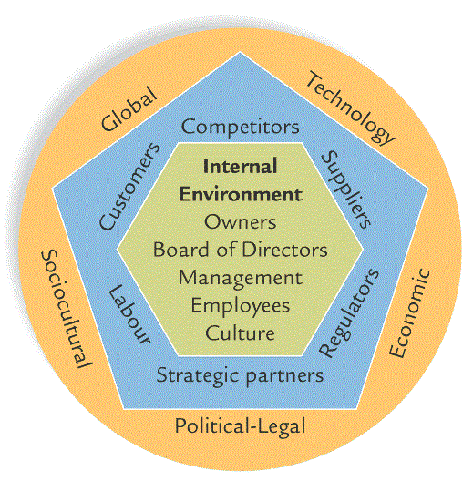
The Strategic Management
What is Strategic Management? The process of aligning the organization with its external environment.
External Environment :
Notes:
Blue shape is task environment.

Slide 32
The Strategic Goals
The starting point in effective management is setting strategic goals…
Strategic Management Goals are the overall objectives that a business wants to achieve.
  What it intends to do is the 1st step of an organization.
  Maybe the organization needs a strategy to achieve its goals…
Strategy: is the broad set of organizational plans for implementing the decisions made for achieving organizational goals.
  See “The purposes of goal setting” on page 29 (Textbook) and complete the next slide by briefly explaining each of those purposes.

Slide 33
The Strategic Management
The four main purposes in organizational goal setting
…Provides direction, guidance, and motivation for all managers.
…Helps firms allocates resources.
…Helps to define corporate culture.
…Helps managers assess performance.

Slide 34
The Strategic Management
Kind of Goals
The Mission Statement: An organization’s statement of how it will achieve its purpose in the environment in which it conducts its business.
  Regardless of a company’s purpose and mission, every firm needs to set long-term (5y or more into the future), intermediate (1 to 5y) and short-term goals (less than one year).

Slide 35
The Strategic Management
The SMART Goals
Specific
Measurable
Achievable
Relevant
Time-framed

Slide 36
The Strategic Management
Steps 1, 2 and 3
The Strategy formulation involves three basic steps:
  Setting strategic (smart) goals:
    What are the kinds of goals?
  Analyzing the organization and its environment:
    See SWOT
  Matching the organization and its environment.
  SWOT analysis is the identification and analysis of organizational STRENGTHS AND WEAKNESSES and environmental OPPORTUNITIES AND THREATS as part of strategy formulation.

Slide 37
The Strategic Management
Steps 1, two and 3
The Strategy formulation involves three basic steps:
  Setting strategic (smart) goals:
    What are the kinds of goals?
  Analyzing the organization and its environment:
    See SWOT
  Matching the organization and its environment.
  This is the heart of strategy formulation;
  (...) Matching environmental THREATS and OPPORTUNITIES with corporate STRENGTHS and WEAKNESSES;
  This process may determine whether a firm typically takes risks or behaves more conservatively.
Notes:
Possible question:
What are the SMART goals?

Slide 38
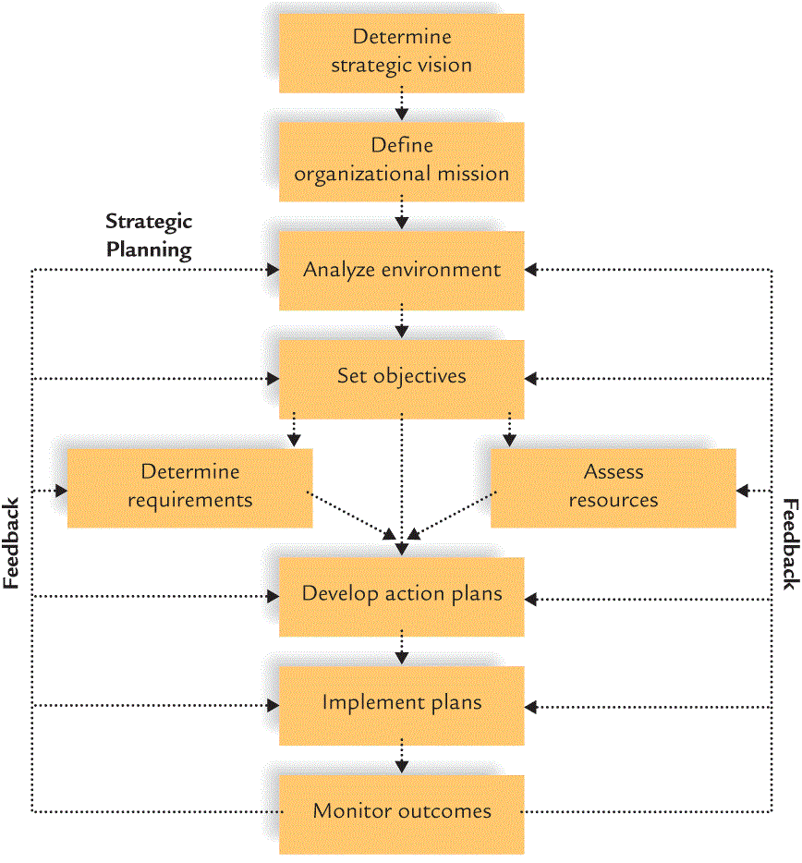
Strategic Management Process

Slide 39
Levels of Strategies
What is a Corporate-level strategy:
  Identifies the various businesses that a company will be in and how these businesses will relate to each other.
What is a Business-level strategy:
  Identifies the ways a business will compete in its chosen line of products and/or services.
What is a Functional strategy:
  Identify the basic courses of action that each department in the firm will pursue so that it contributes to the attainment of the business’s overall goals.

Slide 40
Levels of Strategies
A Corporate-level strategy could be:
  A Concentration strategy which involves focussing the company on one product or product line.
  A Growth strategy All of which focus on internal activities that will result in growth (Market penetration, product development and geographic expansion)
  A Integration strategy which focus on external activities that will result in growth(Horizontal and Vertical integration) or Competitors vs. Inputs and/or Channels.
Notes:
Concentration: Specific Product line, Tiffany and Company (Jewels), Apple Inc
Growth: Tim Hortons Market penetration
Inegration:Wal-Mart with McDonald’s

Slide 41
Levels of Strategies
A Corporate-level strategy could be:
  A Diversification strategy, which means expanding into related or unrelated products or markets segments.
    Related diversification… means adding new, but related, products or services to an existing business.
    Conglomerate diversification… means diversifying into products or markets that are not related to the firm’s present business.
  A Investment Reduction strategy means reducing the company’s investment in one or more of its lines of business.
    Retrenchment… which means the reduction of activity or operations.
    Divestment… involves selling or liquidating one or more of a firm’s business.

Slide 42
Levels of Strategies
Business-level (competitive)strategies are:
  Cost leadership strategy which means becoming the low-cost leader in an industry.
  Differentiation strategy occurs when a firm tries to be unique in its industry along some dimension that is valued by buyer.
  Focus strategy means selecting a market segment and serving the customers in that market niche better than competitors.

Slide 43
Levels of Strategies
A Functional strategies are:
  When the Business-level Strategies are translated into supporting functional strategies (see Areas on management, chapter 1).
  A functional strategy is the basic course of action that each department (Areas) follows so that the business accomplishes its overall goals.

Slide 44
The Corporate Culture
A Corporate Culture is essential. This is the personality or the identity of a company:
  A corporate Culture represents the shared experiences, stories, beliefs, norms and ethical stance that characterize an organization (def.)
  A strong Corporate Culture guides everyone to work toward the same goals and helps newcomers learn accepted behaviours.
  The Corporate Culture is shaped by four forces which are fundamental:

Slide 45
The Corporate Culture
The Corporate Culture is shaped by four forces which are fundamental :
  The values held by top management help set the tone of the organization and influence its business goals and strategies;
  The firm’s history also helps shape its culture;
  Stories and legends are also important;
  A strong behavioural norms help define an sustain corporate cultures.

Slide 46
The Corporate Culture
Communicating the culture :
  Managers themselves must have a clear understanding of culture;
  They must transmit the culture to others in the organization, specially to the newcomers;
  A clear and meaningful statement of the organization’s mission is also a valuable communication tool;
  Managers can maintain the culture by rewarding and promoting those who understand it and work toward maintaining it.

