Slide 1
Slides with extra images to study for the midterm exam
See also the study guide on Buxton for references on images in your textbook

Slide 2
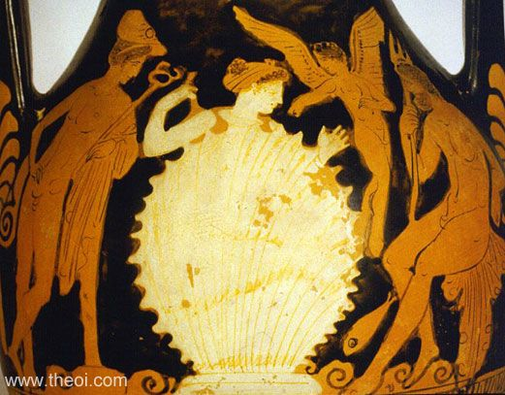
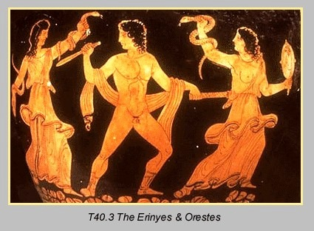
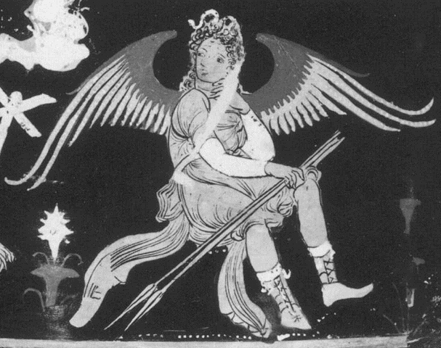
The birth of Aphrodite
See also Buxton, p. 46
Orestes, (Agamemnon's son, who murdered his mother) is haunted by the Erinyes (the Furies)
A fury

Slide 3
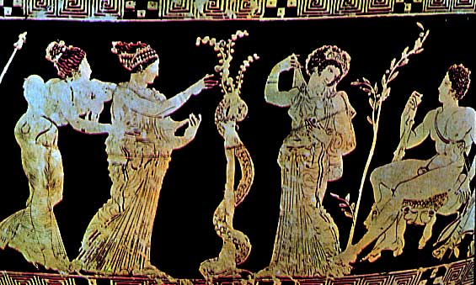
The Hesperides, are according to Hesiod, daughters of the Night. They guard- along with a snake- the sacred tree of life and immortality. One of Herakle’s labours was to steal the golden apples of that tree.

Slide 4
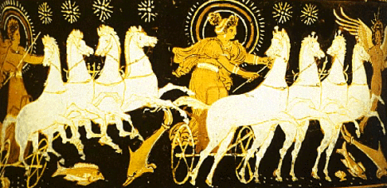
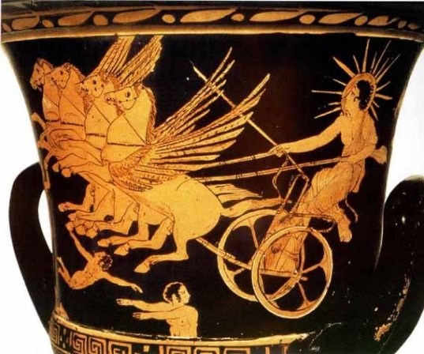
From Left to Right:
Helios (sun),
Eos (dawn)
and morning star
Helios

Slide 5
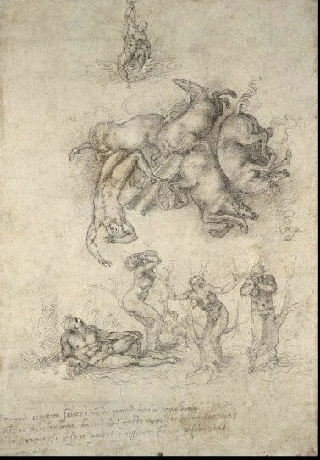
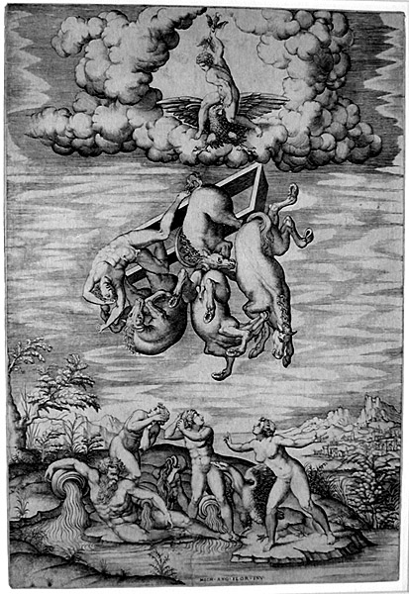
Michelangelo Buonarotti, The Fall of Phaethon, a drawing
Italy, 1533

Slide 6
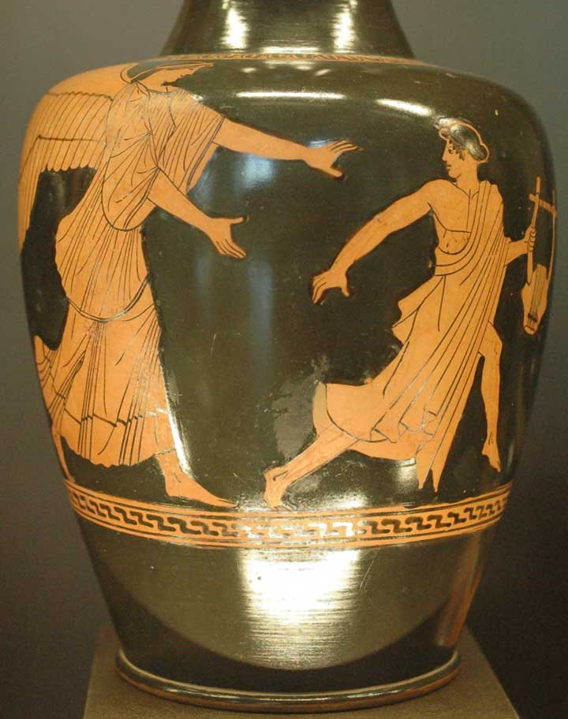
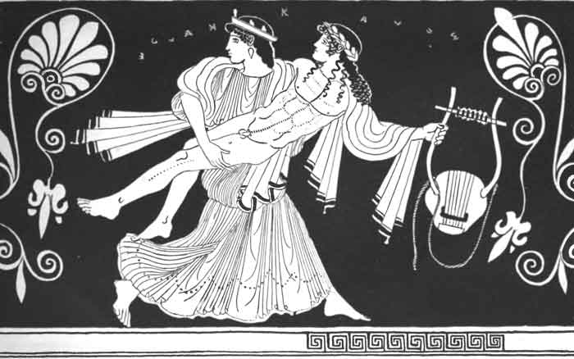
Eos, (Dawn) and the myth of Tithonos
Eos abducting Tithonos

Slide 7
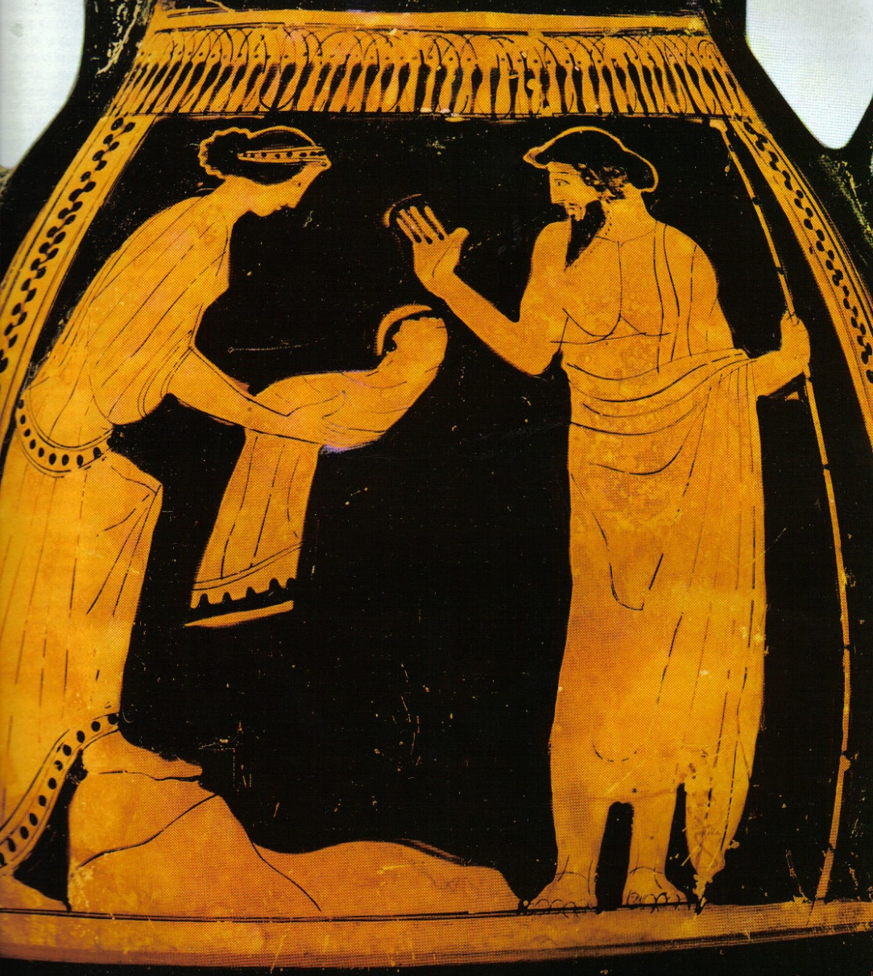
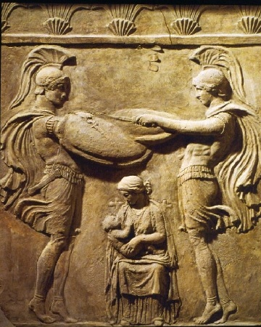
The Nymph Amaltheia nurses baby Zeus, while the Curetes (Kouretes) bang their swords on their shields to cover the cries of Zeus
Rheia tricks Kronos by presenting a rock bundled as a baby

Slide 8
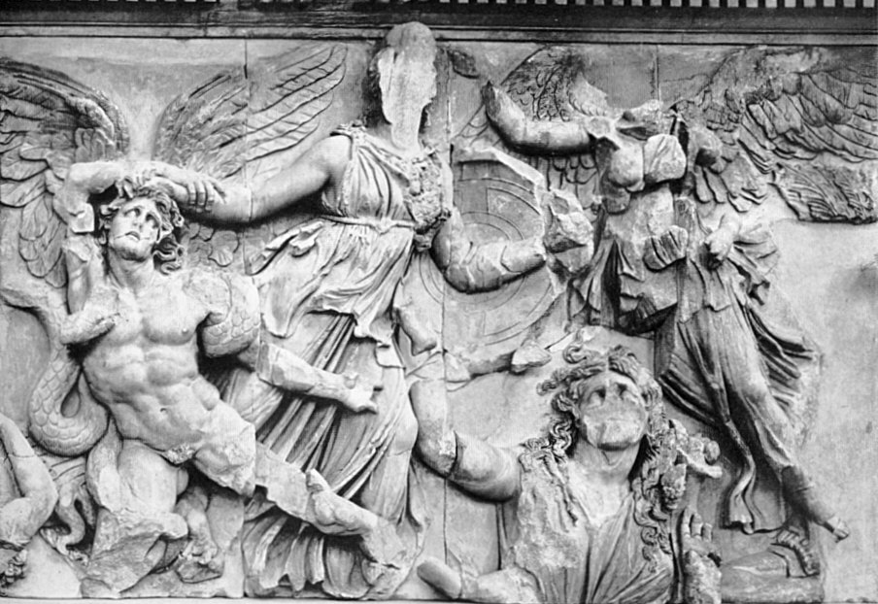
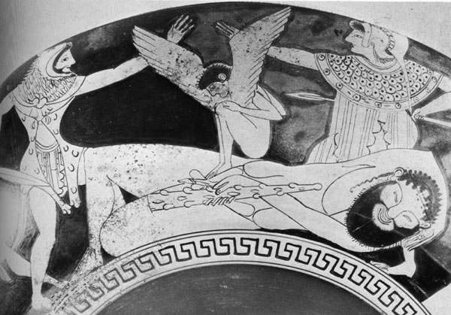
The Battle of the giants
Athena grabbing a Giant, Gaia emerging from the bottom right
See also Buxton, p. 3-4,21, 29
The Battle of the Giants
Herakles is about to attack one of the Giants, while Athena encourages him)

Slide 9
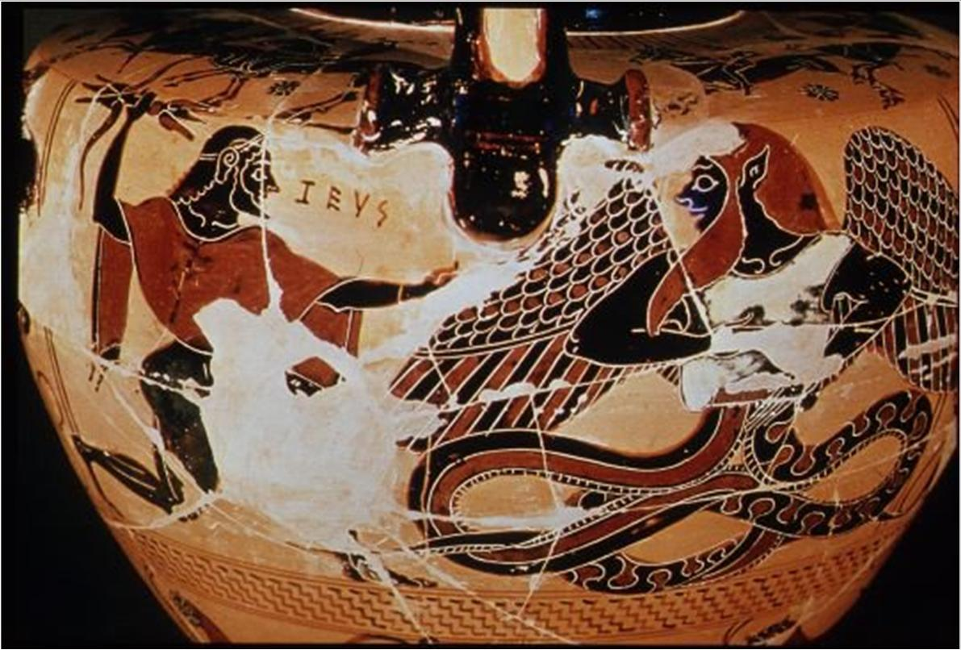
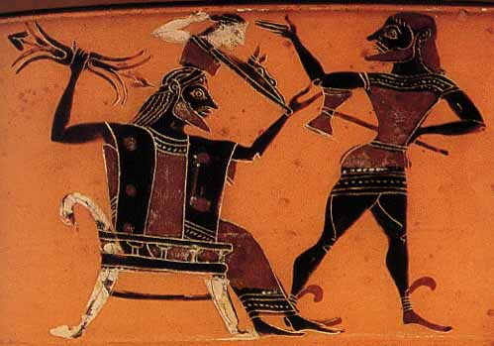
Zeus against Typhoeus
The birth of Athena from the head of Zeus. Hephaistos is holding the axe
See also Buxton, p.49

Slide 10
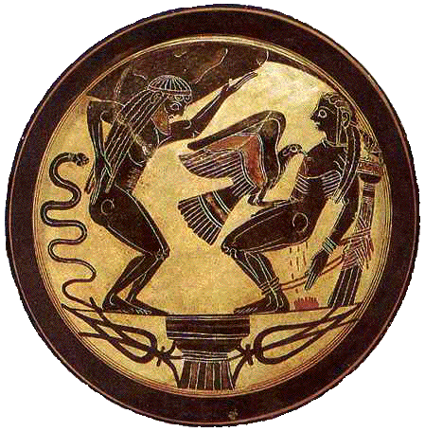
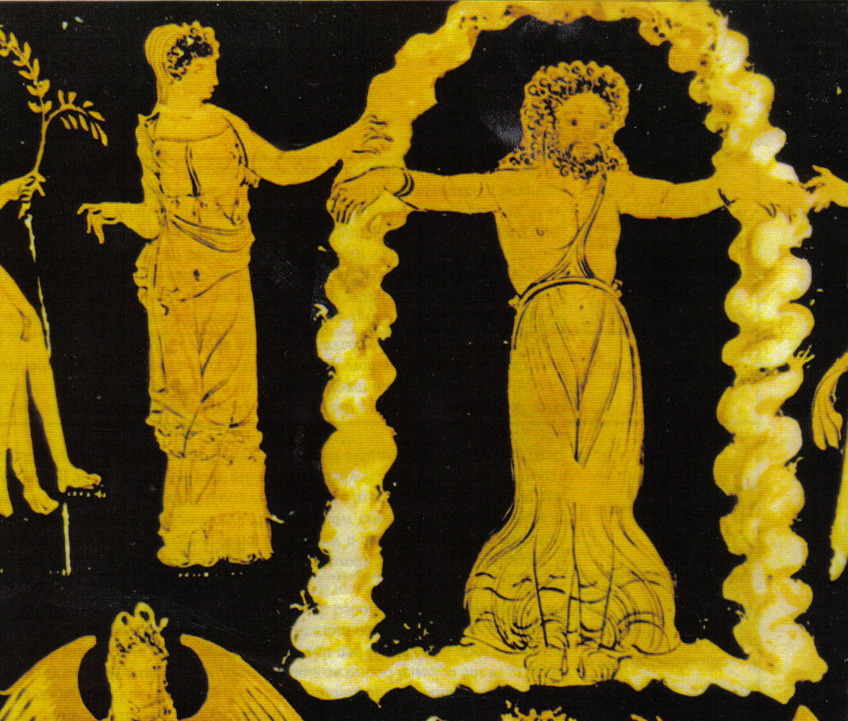
Atlas and Prometheus.
The 2 sons of Iapetos are tormented: Atlas carrying the sky, Prometheus chained while the eagle eats his liver.
See also Buxton, p.56
Prometheus Bound

Slide 11
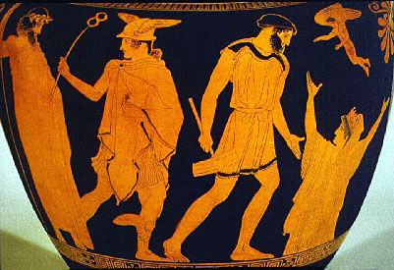
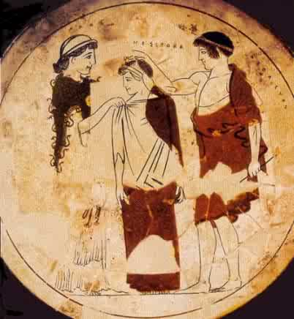
Then Zeus sent the gift to Epimetheus
The creation of Pandora
Eros
Prometheus
Pandora
Hermes
Epimetheus, or Hephaeistos
Zeus
Athena
See also Buxton, p. 56-57 (Pandora with various deities)

Slide 12
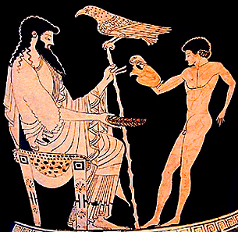
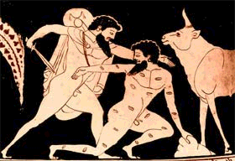
Ganymedes, the nectar- pourer of Zeus
Hermes killing the 100 eyed Argos, Hera’s guardian, while Io, in a cow form, is watching

Slide 13
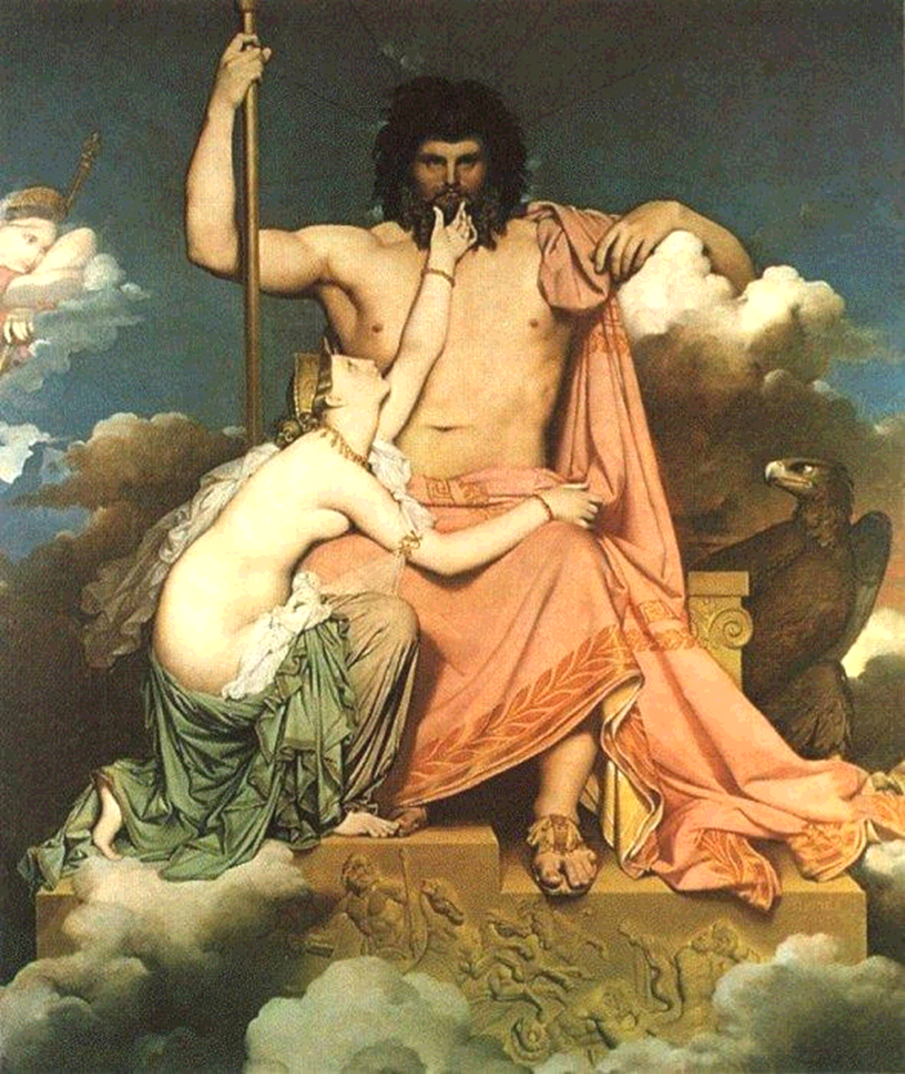
Hera in the Iliad
Book 1: conflict with Zeus over Thetis’ secret visit and request
Thetis in the supplication position, ask Zeus to honor Achilles
Zeus finds himself in a tight situation

